Slide 1
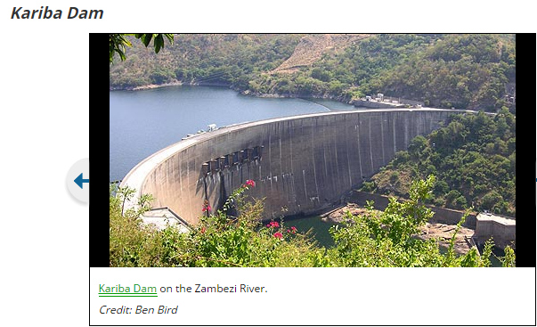
Fluid Mechanics CEE 3311
LECTURE 4
Forces on curved surfaces
L. Handia

Slide 2
Forces on curved surfaces
We do not use a direct method of integration to find the force due to the hydrostatic pressure on a curved surface.
Rather, a free body diagram that contains the curved surface and the liquids directly above or below the curved surface is identified.
Such a free-body diagram contains only plane surfaces upon which unknown fluid forces act; these unknown forces can be found as in the preceeding lecture.

Slide 3
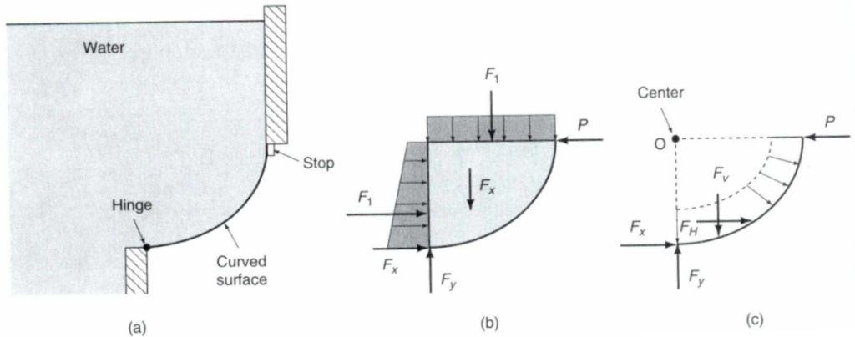
Example
Let us determine the force (P) of the curved gate on the stop.
Fig 4.1 Forces on a curved surface: a) curved surface b) free-body diagram of water and gate c) free-body diagram of gate only

Slide 4
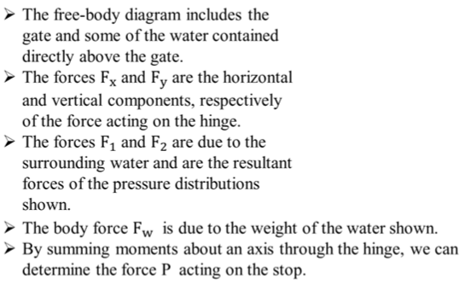
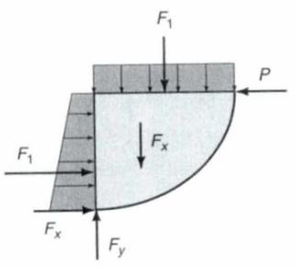
Method 1
F₂
F_{w}
Fig 4.2 Free-body diagram of water and gate

Slide 5
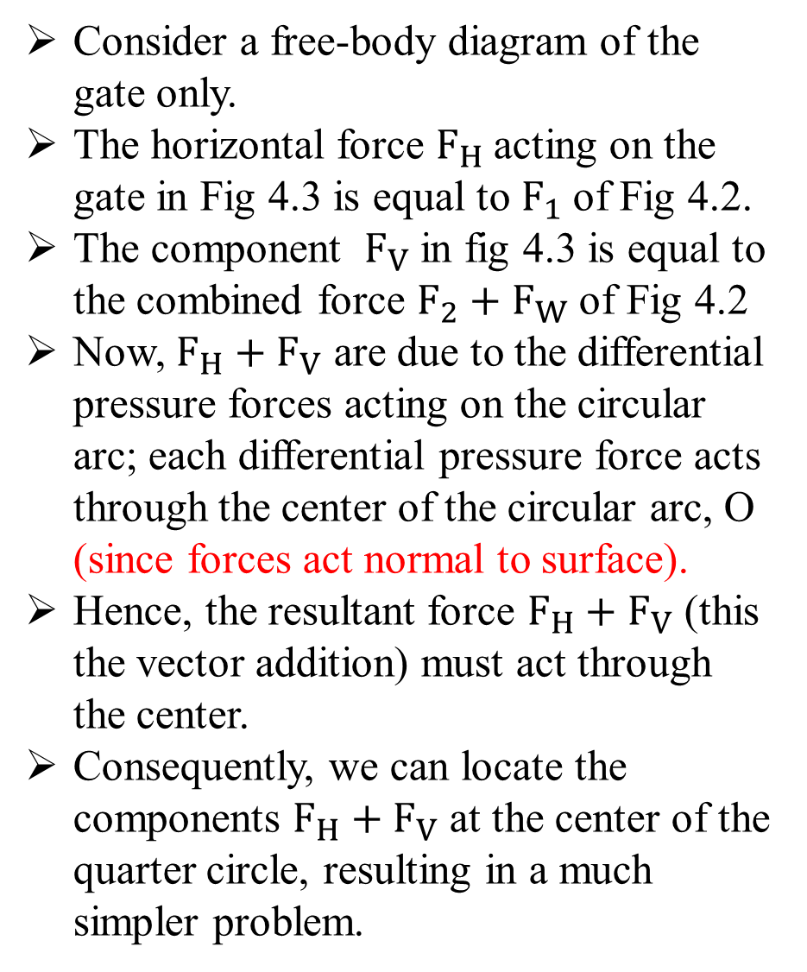
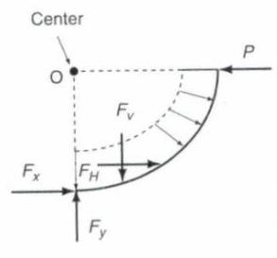
Method 2
Fig 4.3 Free-body diagram of gate only
F₂
F_{w}
Fig 4.2 Free-body diagram of water and gate
F_{V}
F_{H}

Slide 6
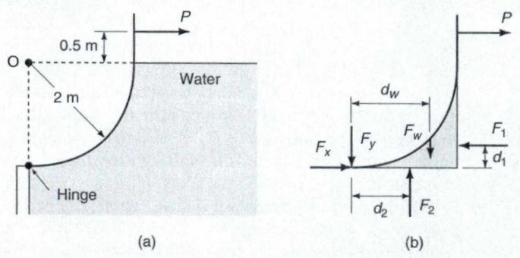
Example 1
Calculate the force P necessary to hold the 4m-wide gate in the position shown in Fig 4.4 (a). Neglect the weight of the gate.
Fig 4.4 Example

Slide 7
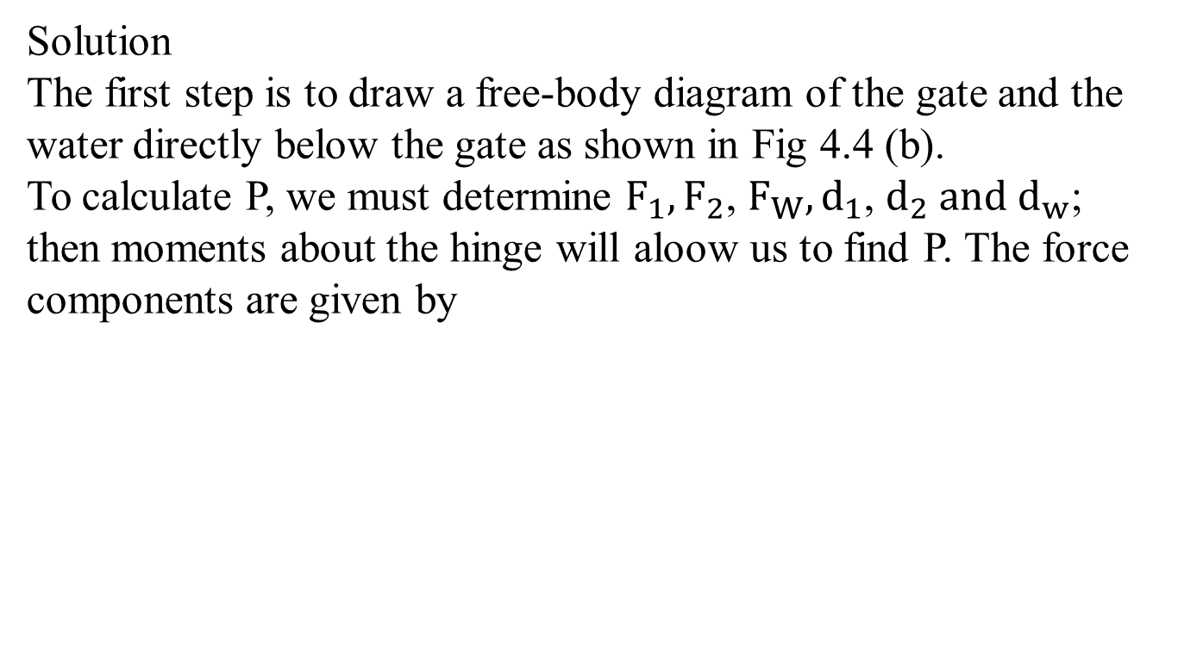
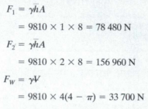

Method 1

Slide 8
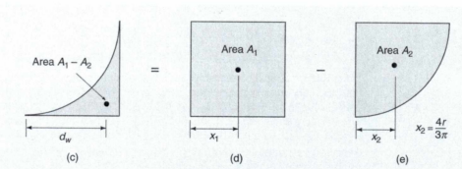
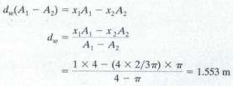
The distance d_{w} is the distance to the centroid of the volume. It can be determined by considering the area as the difference of a square and a quarter circle as shown in Fig 4.4 c-e.
Moments of area yield
Fig 4.4 Example

Slide 9
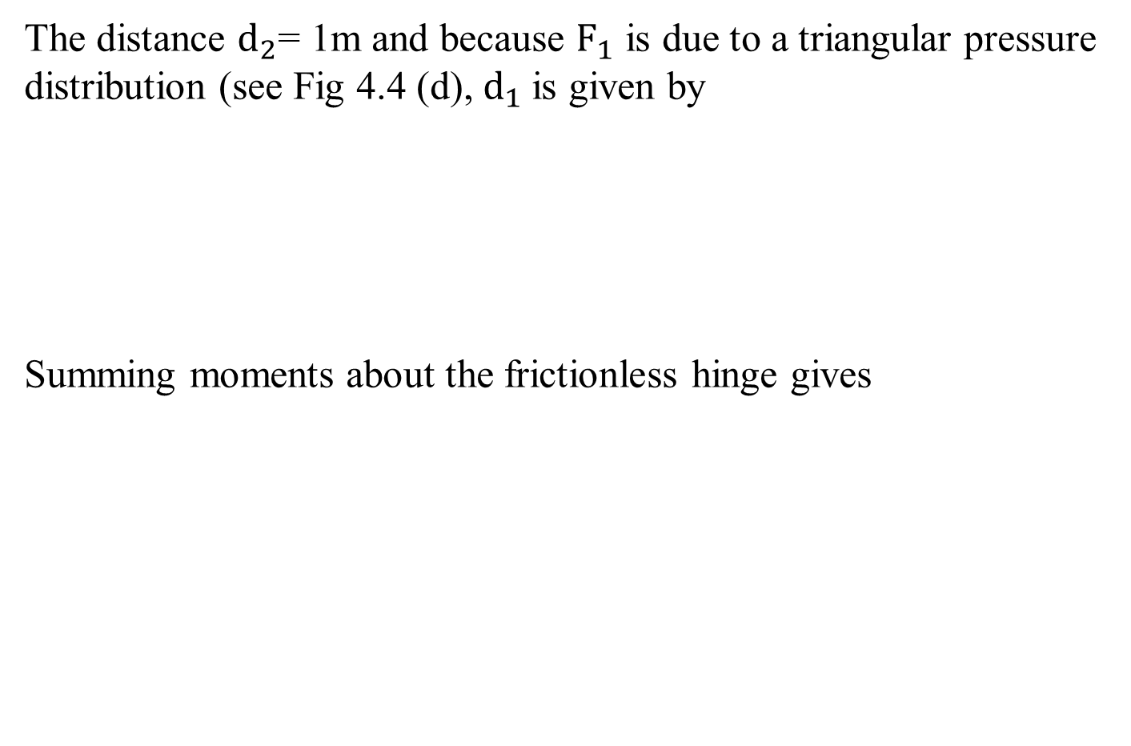




Slide 10
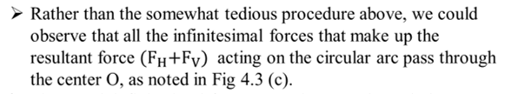
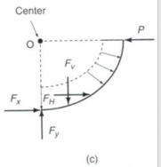
Method 2

Slide 11
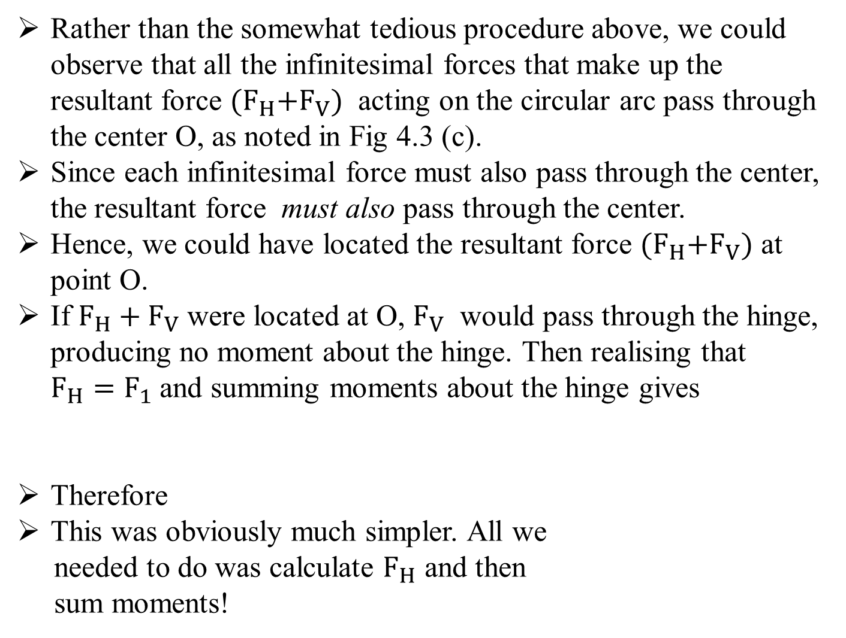
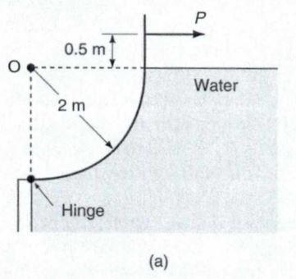

F_{V}
F_{H}

Slide 12
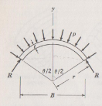
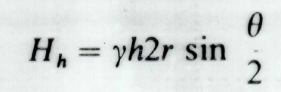
Example 2:Arch dam
Method 1
Normal plane area where hydrostatic force is acting is
Method 2
H_{h}
H_{side}
H_{side}
R
R
Free body diagram

