Slide 1
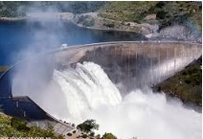
Fluid Mechanics CEE 3311
LECTURE 13
Conservation of momentum
Applications of the momentum equation
L. Handia

Slide 2
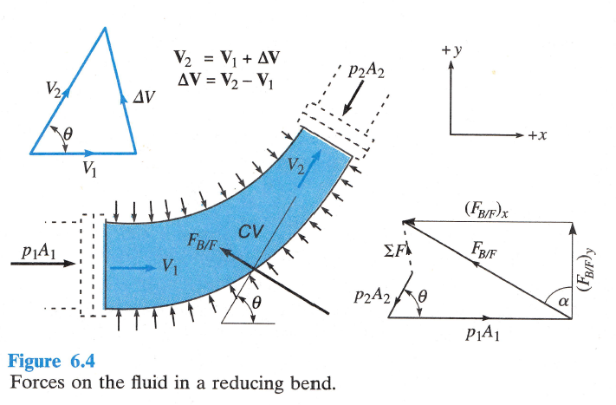
A1: Force exerted on pressure conduits
The momentum equation can be used to compute the force exerted on pressure conduits such as reducers and bends
(F_{BF})_{x} and (F_{BF})_{y} are the components of the force which the bend exerts on the fluid.
The usual convention is to consider the direction in which the flow is occurring as the positive direction.
The force of the fluid on the bend is, of course, equal and opposite to that of the bend on the fluid.

Slide 3


A1: Force exerted on pressure conduits
Momentum equation can be simplified considerably if a device has entrances and exits across which the flow may be assumed to be uniform and if the flow is steady.
Assuming the flow in the
horizontal plane so that the
weight can be neglected,
applying the momentum equation
by summing up forces acting on
the fluid in the x direction, and
equating them to the change in fluid momentum in the x direction gives i.e., $\sum{F_{x}}=\frac{d(mv_{x})}{dt}=ρQ\left(∆v\right)$
$$\sum{F_{x}=−{\left(F_{BF}\right)}_{x}+}P_{1}A_{1}−P_{2}A_{2}cosθ$$
$$\frac{d(mv_{x})}{dt}=ρQ\left(∆v\right)=ρ_{ }v_{1}\left(−A_{1}v_{1}\right)+ρ_{ }v_{2}cosθ\left(A_{2}v_{2}\right)$$

Slide 4


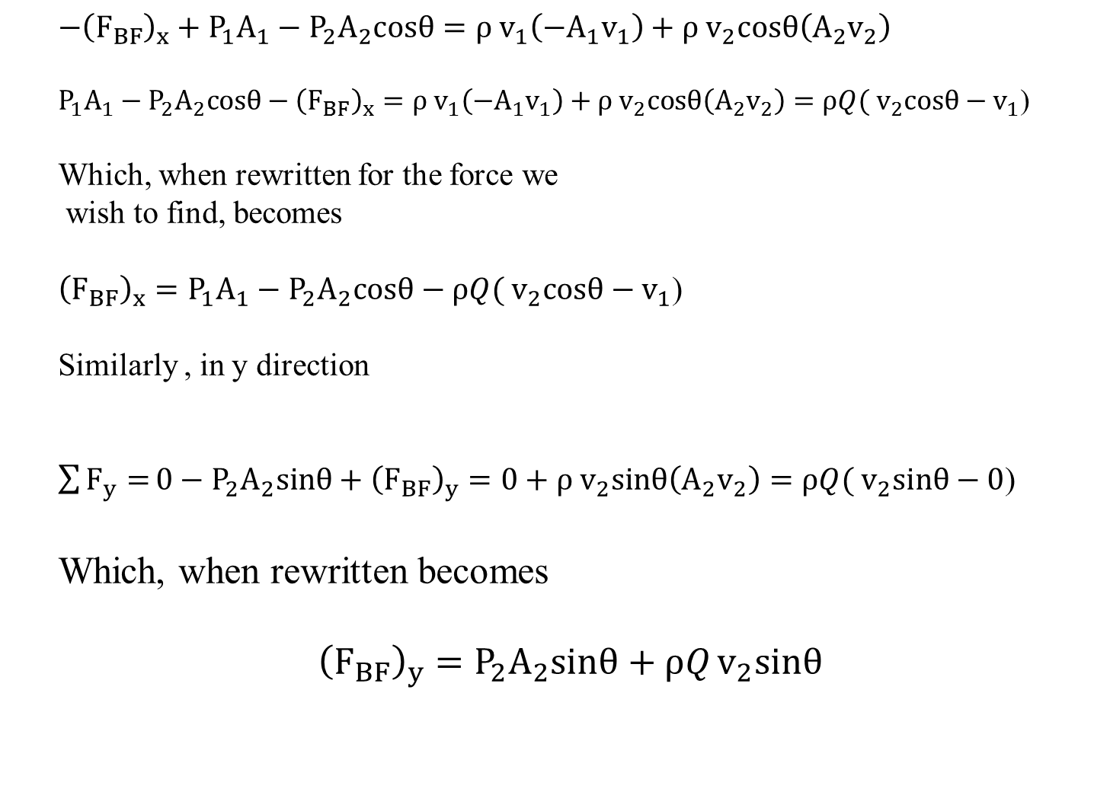
A1: Force exerted on pressure conduits
$$−{\left(F_{BF}\right)}_{x}+P_{1}A_{1}−P_{2}A_{2}cosθ=ρ_{ }v_{1}\left(−A_{1}v_{1}\right)+ρ_{ }v_{2}cosθ\left(A_{2}v_{2}\right)$$
$P_{1}A_{1}−P_{2}A_{2}cosθ−{\left(F_{BF}\right)}_{x}=ρ_{ }v_{1}\left(−A_{1}v_{1}\right)+ρ_{ }v_{2}cosθ\left(A_{2}v_{2}\right)={ρQ(}_{ }v_{2}cosθ−v_{1}$)
Which, when rewritten for the force we
wish to find, becomes
$${\left(F_{BF}\right)}_{x}=P_{1}A_{1}−P_{2}A_{2}cosθ−{ρQ(}_{ }v_{2}cosθ−v_{1}\text{)}$$
Similarly , in y direction
$\sum{F_{y}=}0−P_{2}A_{2}sinθ+{\left(F_{BF}\right)}_{y}=0+ρ_{ }v_{2}sinθ\left(A_{2}v_{2}\right)={ρQ(}_{ }v_{2}sinθ−0$)
Which, when rewritten becomes
$${\left(F_{BF}\right)}_{y}=P_{2}A_{2}sinθ+{ρQ}_{ }v_{2}sinθ$$
14.16
14.17
14.18
14.19
14.20

Slide 5
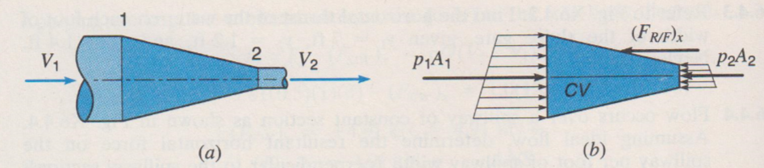
A2: Force exerted on reducer
Analysis is similar to that of a bend

Slide 6
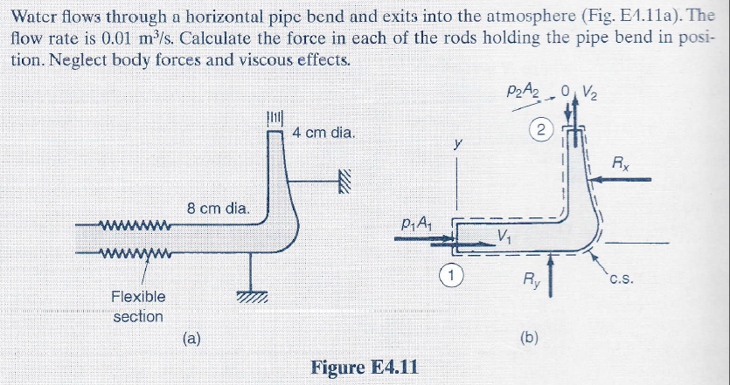
A: Force exerted on a bend
Example

Slide 7
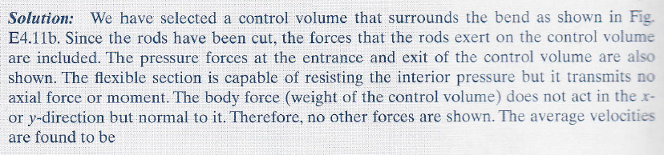
A: Force exerted on a bend
Example

Slide 8
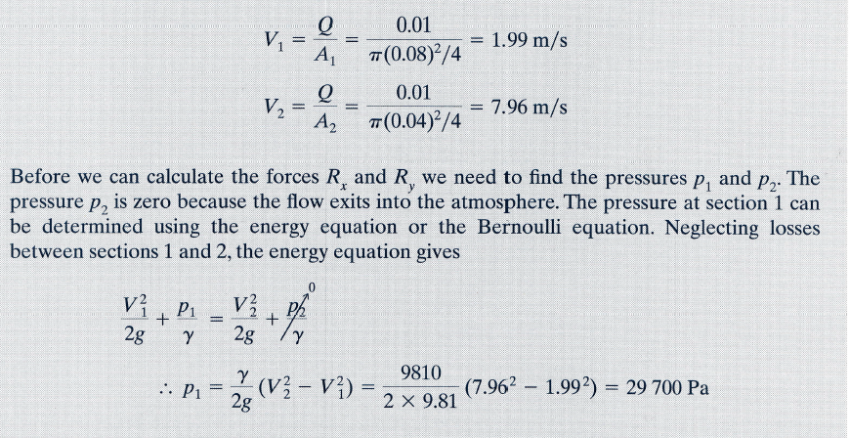
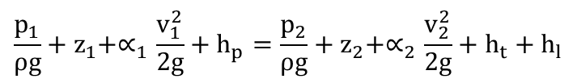
Forces on a bend
Example
$$\frac{p_{1}}{ρg}+z_{1}+∝_{1}\frac{v_{1}^{2}}{2g}+h_{p}=\frac{p_{2}}{ρg}+z_{2}+∝_{2}\frac{v_{2}^{2}}{2g}+h_{t}+h_{l}$$

Slide 9
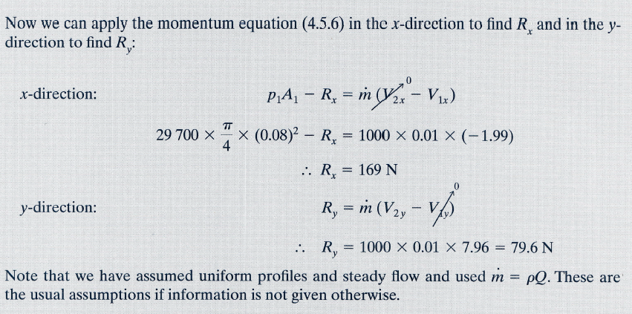
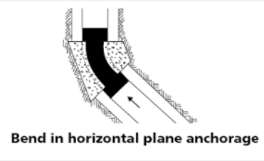


A: Force exerted on a bend
Example
$$−{\left(F_{BF}\right)}_{x}+P_{1}A_{1}−P_{2}A_{2}cosθ=ρ_{ }v_{1}\left(−A_{1}v_{1}\right)+ρ_{ }v_{2}cosθ\left(A_{2}v_{2}\right)$$
14.16
$$\sum{F_{x}}=\frac{d(mv_{x})}{dt}=ρQ\left(∆v\right)$$
$${\left(F_{BF}\right)}_{x}=P_{1}A_{1}−P_{2}A_{2}cosθ−{ρQ(}_{ }v_{2}cosθ−v_{1}\text{)}$$
14.18
Better to use this equation or 14.16 than 14.18
0
$$R_{y}−P_{2}A_{2}$$
x

Slide 10
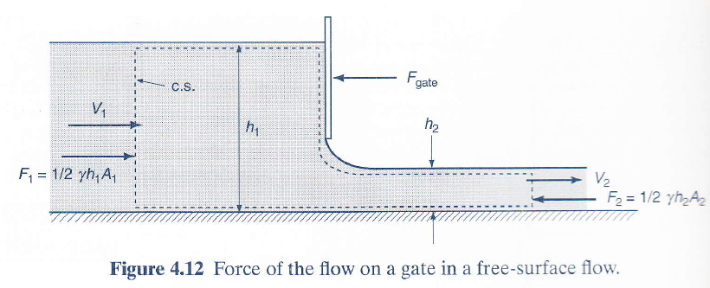

B: Forces on gates
An example of free surface flow in a rectangular channel is shown below.
If we want to determine the force of the gate on the flow, the following expression can be derived from the momentum equation
$$\sum{F_{x}=}F_{1}−F_{2}−F_{gate}=ρ_{ }v_{1}\left(−A_{1}v_{1}\right)+ρ_{ }v_{2}\left(A_{2}v_{2}\right)$$
$={ρQ(}_{ }v_{2}−v_{1}\text{)}$
14.20

Slide 11

B: Forces on gates
$$\sum{F_{x}=}F_{1}−F_{2}−F_{gate}=ρ_{ }v_{1}\left(−A_{1}v_{1}\right)+ρ_{ }v_{2}\left(A_{2}v_{2}\right)$$
$={ρQ(}_{ }v_{2}−v_{1}\text{)}$
$$F_{1}−F_{2}−F_{gate}={ρQ(}_{ }v_{2}−v_{1}\text{)}$$
$$F_{gate}=F_{1}−F_{2}−{ρQ(}_{ }v_{2}−v_{1}\text{)}$$
14.21

Slide 12
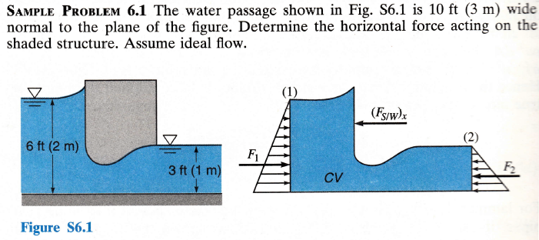
B: Forces on gates
Example

Slide 13

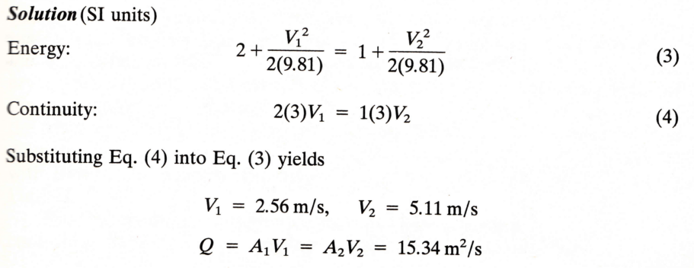
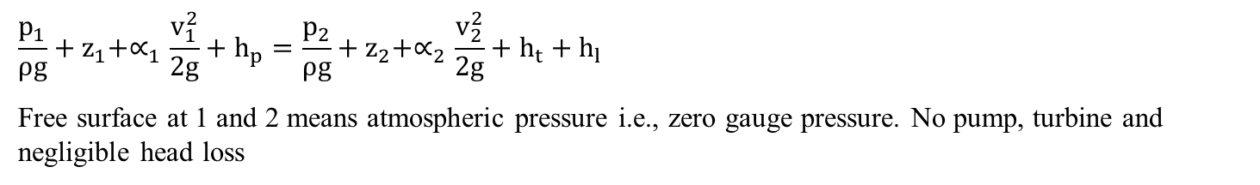
B: Forces on gates
Solution
$$\frac{p_{1}}{ρg}+z_{1}+∝_{1}\frac{v_{1}^{2}}{2g}+h_{p}=\frac{p_{2}}{ρg}+z_{2}+∝_{2}\frac{v_{2}^{2}}{2g}+h_{t}+h_{l}$$
Free surface at 1 and 2 means atmospheric pressure i.e., zero gauge pressure. No pump, turbine and negligible head loss

Slide 14
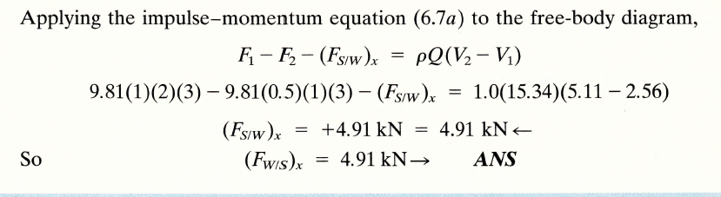

B: Forces on gates
Solution
14.21

Slide 15
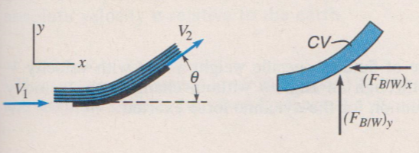
C: Jet deflected by a stationary vane or blade (deflector)
The application of the momentum equation to deflectors forms an integral part of the analysis of many turbo machines such as turbines, pumps and compressors.
We begin by considering a stationary vane or blade under this part C.

Slide 16
C: Jet deflected by a stationary vane or blade (deflector)
The main difference with preceeding sections is that with the vane or blade, the fluid is in contact with the atmosphere; hence the gage pressures in the jet are zero and the PA forces disappear!!!!
Another difference is that in many types of fluid machinery where vanes or blades are used, the velocities are often so high that the neglect of friction may introduce a sizeable error. In such cases, for accurate results, friction should be considered.
This is usually handled by prescribing a reduction in the velocity of the flow between its arrival and departure points on the blade

Slide 17

C: Jet deflected by a stationary vane or blade (deflector)
Hence (F_{BW})_{X} assumed direction is correct since terms in brackets is negative.
If we assume that v₁=v₂ (there is a reduction in the velocity of the flow between its arrival and departure points on the blade, see previous slide).

Slide 18
C: Jet deflected by a stationary vane or blade (deflector)
Applying Eq. 13.6b along the y-axis

Slide 19
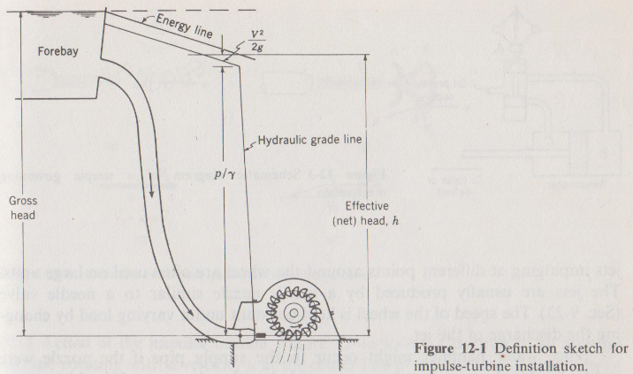
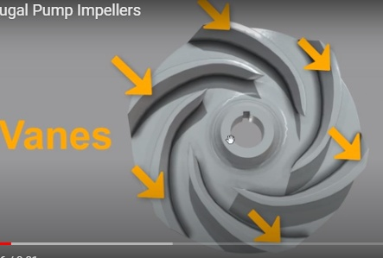
D: Jet deflected by a moving vane or blade
For a moving vane, e.g., a turbine runner or wind vane, the same type of analysis as in the previous section can be carried out, except that it would be convenient to let the cv move with the vane. For that case the flow is steady.
jet
vane

Slide 20
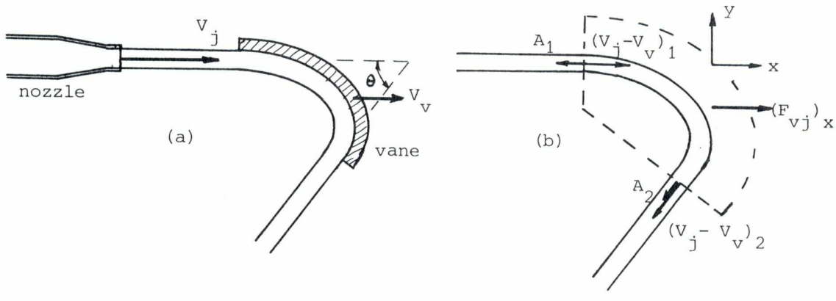
D: Jet deflected by a moving vane or blade
In Fig 14.2a the absolute velocities, i.e. velocities with respect to the earth, are drawn, while Fig 14.2b the relative velocity of the jet, i.e. the velocity of the jet with respect to the moving vane, is represented.
Fig 14.2 Jet deflected by a moving vane

Slide 21
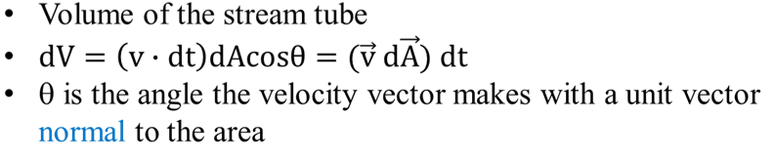
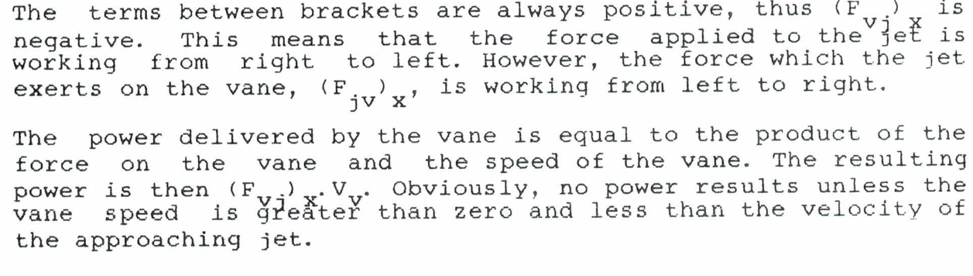

The force applied to the jet by the vane in the x direction is then ($\sum{F_{s}+}\sum{F_{b}}=\frac{d}{dt}\int_{cv}{v ρ dV}+\int_{cs}{v ρ (\vec{v} d\vec{A})}$ )
$$\left(F_{vj}\right)x=0+\int_{cs}{ρ{ v}_{x}(\vec{v} d\vec{A})}=ρ_{ }{(v}_{j}{−v}_{v})1x\left(−A_{}{){(v}_{j}{−v}_{v})}_{1}\right)+ρ_{ }{(v}_{j}{−v}_{v})2x\left(−A_{}{){(v}_{j}{−v}_{v})}_{2}\right)=−ρ_{ }{A{{(v}_{j}{−v}_{v})}^{2} }_{}−ρ_{ }{A{{(v}_{j}{−v}_{v})}^{2} cos θ }_{}$$
13.4
From Lecture 8
If we assume that v₁=v₂
14.5
The terms between brackets are always positive

Slide 22
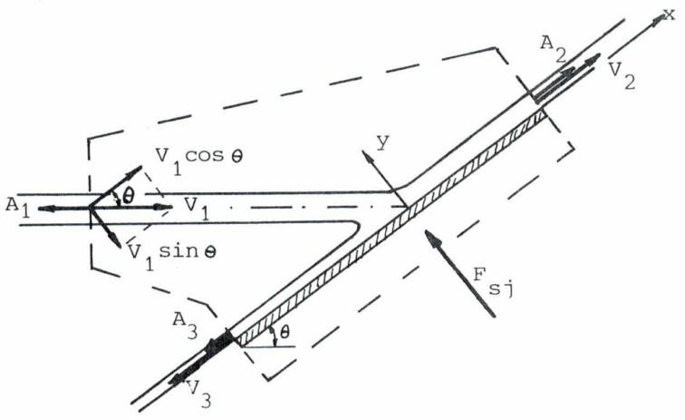
E: Jet striking a surface

Slide 23
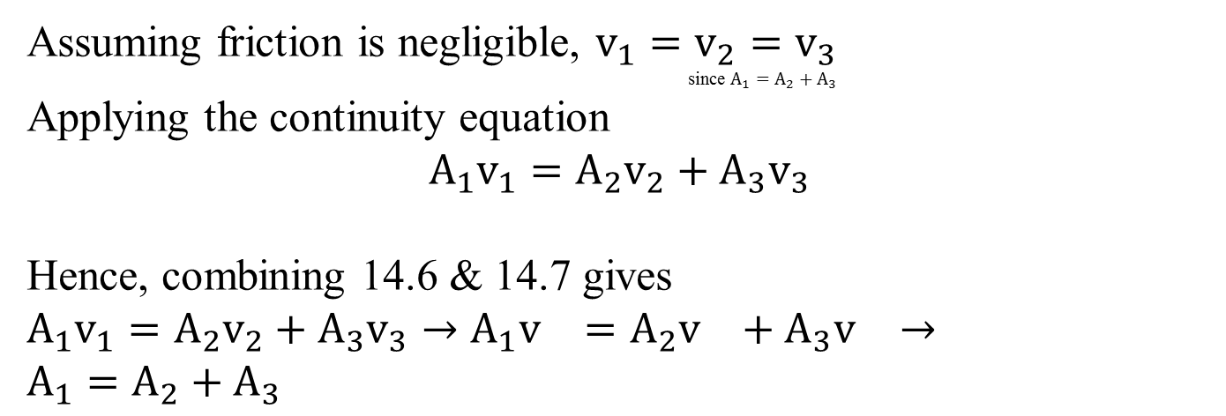
Assuming friction is negligible, $v_{1}=v_{2}=v_{3}$
                since $A_{1}=A_{2}+A_{3}$
Applying the continuity equation
$$A_{1}v_{1}={A_{2}v}_{2}+{A_{3}v}_{3}$$
Hence, combining 14.6 & 14.7 gives
$$A_{1}v_{1}={A_{2}v}_{2}+{A_{3}v}_{3}→A_{1}v_{}={A_{2}v}_{}+{A_{3}v}_{}→$$
$$A_{1}=A_{2}+A_{3}$$
14.6
14.7
14.8

Slide 24
Applying the momentum equation in x-direction
Friction is assumed negligible and therefore there is no friction force. The only force in the figure is F_{sj} which has no component in the x-direction. Therefore, ∑F_{x}=0.
Eq. 14.9 becomes
Since v₁=v₂=v₃=v, divide above Eq by ρv²
13.4
14.9
14.10

Slide 25
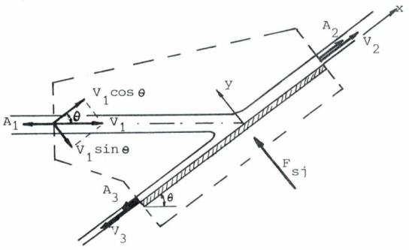

Adding 14.10 and 14.8 yields
$$−A_{1}cosθ+A_{2}−A_{3}=0$$
$$−A_{1} +A_{2}+A_{3}=0$$
$${−A}_{1}(1+cosθ)+{2A}_{2}=0$$
Hence $A_{2}=\frac{1}{2}A_{1}(1+cosθ)$
$$A_{3}=\frac{1}{2}A_{1}(1−cosθ)$$
Eqns 14.11 & 14.12 can also be written in terns of discharges
$$Q_{2}=\frac{1}{2}Q_{1}(1+cosθ)$$
$$Q_{3}=\frac{1}{2}Q_{1}(1−cosθ)$$
14.10
From Eq 14.8
14.11
14.12
14.13
14.14

Slide 26


The momentum eqn in the y-direction
($\sum{F_{s}+}\sum{F_{b}}=\frac{d}{dt}\int_{cv}{v ρ dV}+\int_{cs}{v ρ \left(\vec{v} d\vec{A}\right) }$ )
$${{(F}_{sj})}_{y}=0+{ρ(−v}_{1}sinθ)\left(−A_{1}v_{1}\right)={ρA_{1}{v_{1}}^{2}sinθ }_{}$$
13.4
14.15

Slide 27

Summary
$$\sum{F_{}=}\dot{m}\left(∆v\right)=ρQ\left(∆v\right)$$

