Slide 1
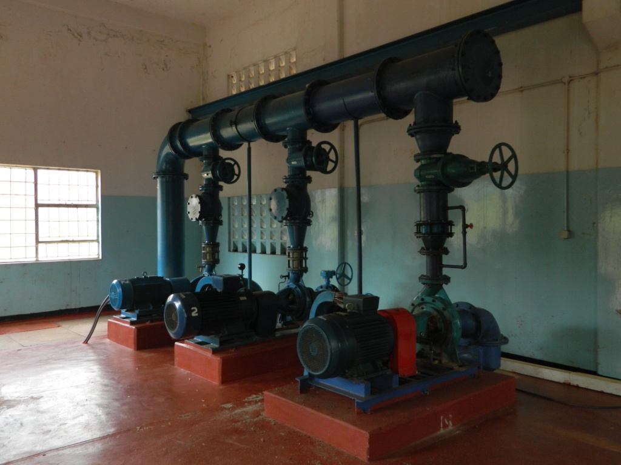
Fluid Mechanics CEE 3311
LECTURE 10
Conservation of energy
Simplified forms of the energy equation
L. Handia

Slide 2
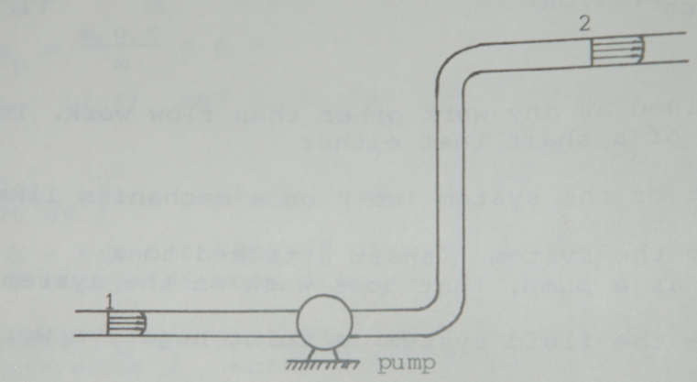
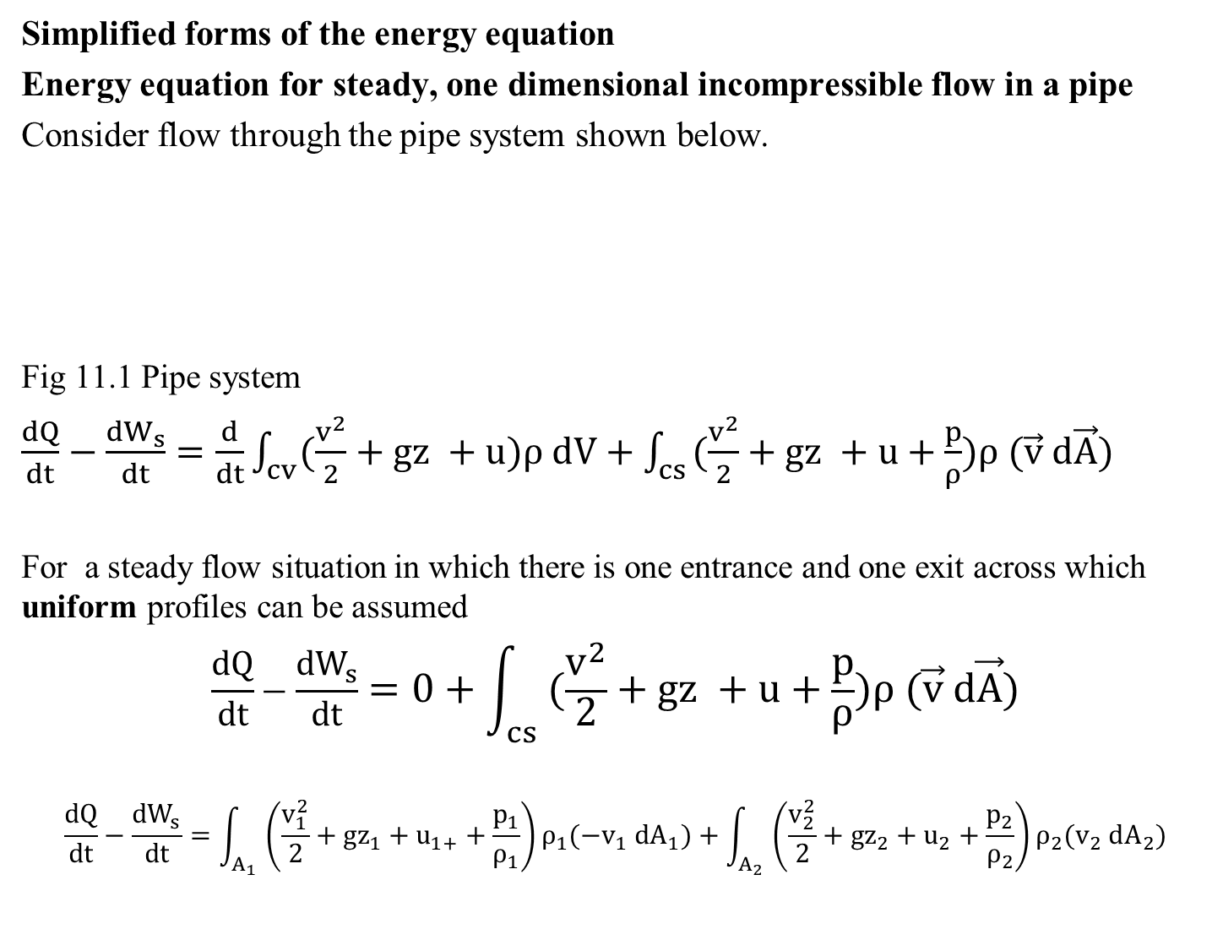
Simplified forms of the energy equation
Energy equation for steady, one dimensional incompressible flow in a pipe
Consider flow through the pipe system shown below.
Fig 11.1 Pipe system
$\frac{dQ}{dt}−\frac{{dW}_{s}}{dt}=\frac{d}{dt}\int_{cv}{(\frac{v^{2}}{2}+gz +u)ρ dV}+\int_{cs}{(\frac{v^{2}}{2}+gz +u+\frac{p}{ρ})ρ (\vec{v} d\vec{A})}$
For a steady flow situation in which there is one entrance and one exit across which uniform profiles can be assumed
$$\frac{dQ}{dt}−\frac{{dW}_{s}}{dt}=0+\int_{cs}{(\frac{v^{2}}{2}+gz +u+\frac{p}{ρ})ρ (\vec{v} d\vec{A})}$$
$$\frac{dQ}{dt}−\frac{{dW}_{s}}{dt}=\int_{A_{1}}{\left(\frac{v_{1}^{2}}{2}+gz_{1}+u_{1+}+\frac{p_{1}}{ρ_{1}}\right)ρ_{1}({−v}_{1} dA_{1})}+\int_{A_{2}}{\left(\frac{v_{2}^{2}}{2}+gz_{2}+u_{2}+\frac{p_{2}}{ρ_{2}}\right)ρ_{2}(v_{2} dA_{2})}$$
11.1
11.2
11.3

Slide 3
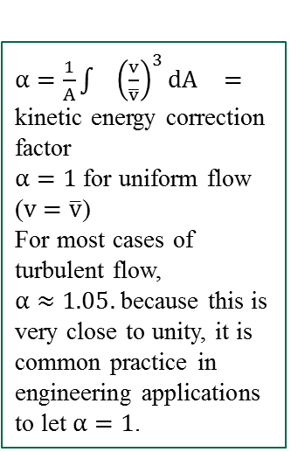
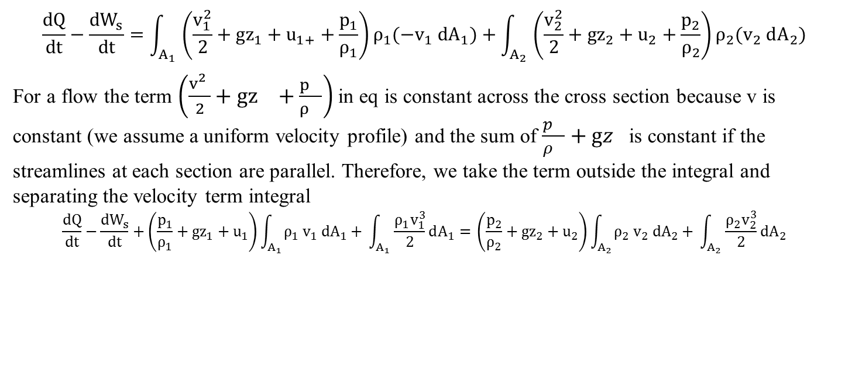
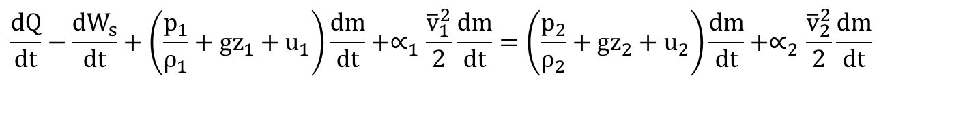
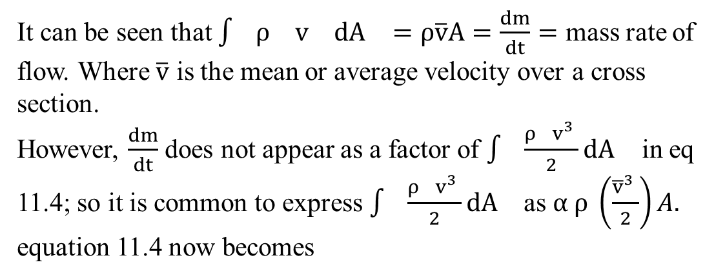
$$\frac{dQ}{dt}−\frac{{dW}_{s}}{dt}=\int_{A_{1}}{\left(\frac{v_{1}^{2}}{2}+gz_{1}+u_{1+}+\frac{p_{1}}{ρ_{1}}\right)ρ_{1}({−v}_{1} dA_{1})}+\int_{A_{2}}{\left(\frac{v_{2}^{2}}{2}+gz_{2}+u_{2}+\frac{p_{2}}{ρ_{2}}\right)ρ_{2}(v_{2} dA_{2})}$$
For a flow the term $\left(\frac{v_{}^{2}}{2}+gz_{}+\frac{p_{}}{ρ_{}}\right)$ in eq is constant across the cross section because v is constant (we assume a uniform velocity profile) and the sum of $\frac{p_{}}{ρ_{}}+gz_{}$is constant if the streamlines at each section are parallel. Therefore, we take the term outside the integral and separating the velocity term integral
$$\frac{dQ}{dt}−\frac{{dW}_{s}}{dt}+\left(\frac{p_{1}}{ρ_{1}}+gz_{1}+u_{1}\right)\int_{A_{1}}{ρ_{1}{ v}_{1} dA_{1}+ }\int_{A_{1}}{\frac{{ρ_{1}v}_{1}^{3}}{2}dA_{1}= }\left(\frac{p_{2}}{ρ_{2}}+gz_{2}+u_{2}\right)\int_{A_{2}}{ρ_{2}{ v}_{2} dA_{2}+ }\int_{A_{2}}{\frac{{ρ_{2}v}_{2}^{3}}{2}dA_{2}}$$
11.3
11.4
See also Lecture 8
$α=\frac{1}{A}\int{{\left(\frac{v}{\overline{v}}\right)}^{3}}dA_{}=$ kinetic energy correction factor
$α=1$ for uniform flow ($v=\overline{v}$)
For most cases of turbulent flow, $α≈1.05.$because this is very close to unity, it is common practice in engineering applications to let $α=1$.
It can be seen that $\int{ρ_{}{ v}_{} dA_{}=ρ\overline{v}A=\frac{dm}{dt}=}$ mass rate of flow. Where $\overline{v}$ is the mean or average velocity over a cross section.
However, $\frac{dm}{dt}$ does not appear as a factor of $\int{\frac{{ρ_{}v}_{}^{3}}{2}dA_{}}$ in eq11.4; so it is common to express $\int{\frac{{ρ_{}v}_{}^{3}}{2}dA_{}}$as $α ρ \left(\frac{{\overline{v}}_{}^{3}}{2}\right)A.$equation 11.4 now becomes
$$\frac{dQ}{dt}−\frac{{dW}_{s}}{dt}+\left(\frac{p_{1}}{ρ_{1}}+gz_{1}+u_{1}\right){\frac{dm}{dt}+∝}_{1}\frac{{\overline{v}}_{1}^{2}}{2}\frac{dm}{dt}=\left(\frac{p_{2}}{ρ_{2}}+gz_{2}+u_{2}\right){\frac{dm}{dt}+∝}_{2}\frac{{\overline{v}}_{2}^{2}}{2}\frac{dm}{dt}$$
11.5

Slide 4


$$\frac{dQ}{dt}−\frac{{dW}_{s}}{dt}+\left(\frac{p_{1}}{ρ_{1}}+gz_{1}+u_{1}\right){\frac{dm}{dt}+∝}_{1}\frac{{\overline{v}}_{1}^{2}}{2}\frac{dm}{dt}=\left(\frac{p_{2}}{ρ_{2}}+gz_{2}+u_{2}\right){\frac{dm}{dt}+∝}_{2}\frac{{\overline{v}}_{2}^{2}}{2}\frac{dm}{dt}$$
$$\frac{dQ}{dt}−\frac{{dW}_{s}}{dt}+\left(\frac{p_{1}}{ρ_{1}}+gz_{1}+u_{1}+∝_{1}\frac{{\overline{v}}_{1}^{2}}{2}\right)\frac{dm}{dt}=\left(\frac{p_{2}}{ρ_{2}}+gz_{2}+u_{2}+∝_{2}\frac{{\overline{v}}_{2}^{2}}{2}\right)\frac{dm}{dt}$$
Dividing by $\frac{dm}{dt}$
$$\frac{1}{\frac{dm}{dt}}\left(\frac{dQ}{dt}−\frac{{dW}_{s}}{dt}\right)+\frac{p_{1}}{ρ_{1}}+gz_{1}+u_{1}+∝_{1}\frac{{\overline{v}}_{1}^{2}}{2}=\frac{p_{2}}{ρ_{2}}+gz_{2}+u_{2}+∝_{2}\frac{{\overline{v}}_{2}^{2}}{2}$$
The shaft work term is usually the result of a turbine or pump in the flow system. It is therefore convenient to represent the shaft work term as
$$W_{s}=W_{t}−W_{p}$$
where $W_{t}=$power delivered by a turbine
$W_{p}=$ power supplied by a pump
Substituting eq 11.8 into eq 11.7 and divided by g results in
$$\frac{\frac{{dW}_{p}}{dt}}{g\frac{dm}{dt}}+\frac{p_{1}}{ρg}+z_{1}+∝_{1}\frac{v_{1}^{2}}{2g}=\frac{\frac{{dW}_{t}}{dt}}{g\frac{dm}{dt}}+\frac{p_{2}}{ρg}+z_{2}+∝_{2}\frac{v_{2}^{2}}{2g}+\left\{\frac{1}{g}\left({ u}_{2}−u_{1}\right)−\frac{\frac{dQ}{dt}}{g\frac{dm}{dt}}\right\}$$
11.6
11.7
11.8
Lecture 9 slide 11
11.9

Slide 5
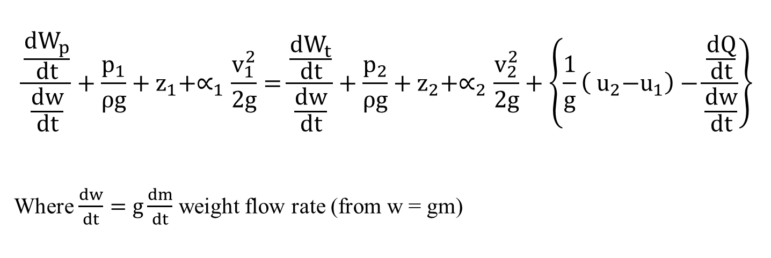
$$\frac{\frac{{dW}_{p}}{dt}}{\frac{dw}{dt}}+\frac{p_{1}}{ρg}+z_{1}+∝_{1}\frac{v_{1}^{2}}{2g}=\frac{\frac{{dW}_{t}}{dt}}{\frac{dw}{dt}}+\frac{p_{2}}{ρg}+z_{2}+∝_{2}\frac{v_{2}^{2}}{2g}+\left\{\frac{1}{g}\left({ u}_{2}−u_{1}\right)−\frac{\frac{dQ}{dt}}{\frac{dw}{dt}}\right\}$$
Where $\frac{dw}{dt}=g\frac{dm}{dt}$ weight flow rate (from w = gm)
11.9

Slide 6
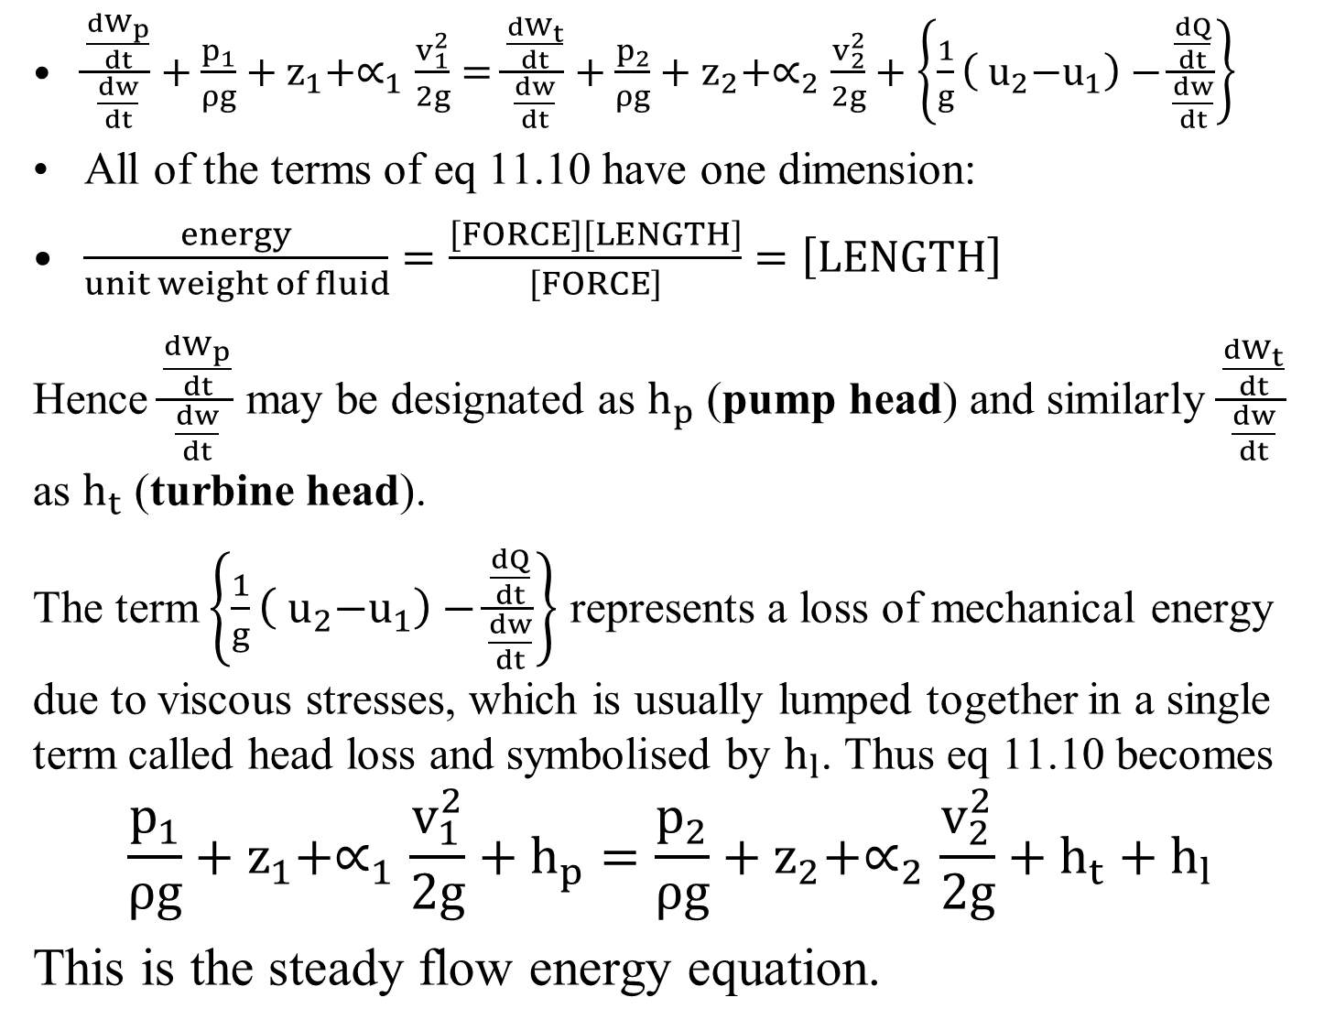
$\frac{\frac{{dW}_{p}}{dt}}{\frac{dw}{dt}}+\frac{p_{1}}{ρg}+z_{1}+∝_{1}\frac{v_{1}^{2}}{2g}=\frac{\frac{{dW}_{t}}{dt}}{\frac{dw}{dt}}+\frac{p_{2}}{ρg}+z_{2}+∝_{2}\frac{v_{2}^{2}}{2g}+\left\{\frac{1}{g}\left({ u}_{2}−u_{1}\right)−\frac{\frac{dQ}{dt}}{\frac{dw}{dt}}\right\}$
All of the terms of eq11.10 have one dimension:
$\frac{energy}{unit weight of fluid}=\frac{\left[FORCE\right]\left[LENGTH\right]}{\left[FORCE\right]}=\left[LENGTH\right]$
Hence $\frac{\frac{{dW}_{p}}{dt}}{\frac{dw}{dt}}$ may be designated as $h_{p}$ (pump head) and similarly $\frac{\frac{{dW}_{t}}{dt}}{\frac{dw}{dt}}$ as $h_{t}$ (turbine head).
The term$\left\{\frac{1}{g}\left({ u}_{2}−u_{1}\right)−\frac{\frac{dQ}{dt}}{\frac{dw}{dt}}\right\}$ represents a loss of mechanical energy due to viscous stresses, which is usually lumped together in a single term called head loss and symbolised by $h_{l}$. Thus eq 11.10 becomes
$$\frac{p_{1}}{ρg}+z_{1}+∝_{1}\frac{v_{1}^{2}}{2g}+h_{p}=\frac{p_{2}}{ρg}+z_{2}+∝_{2}\frac{v_{2}^{2}}{2g}+h_{t}+h_{l}$$
This is the steady flow energy equation.
11.10
11.11

Slide 7
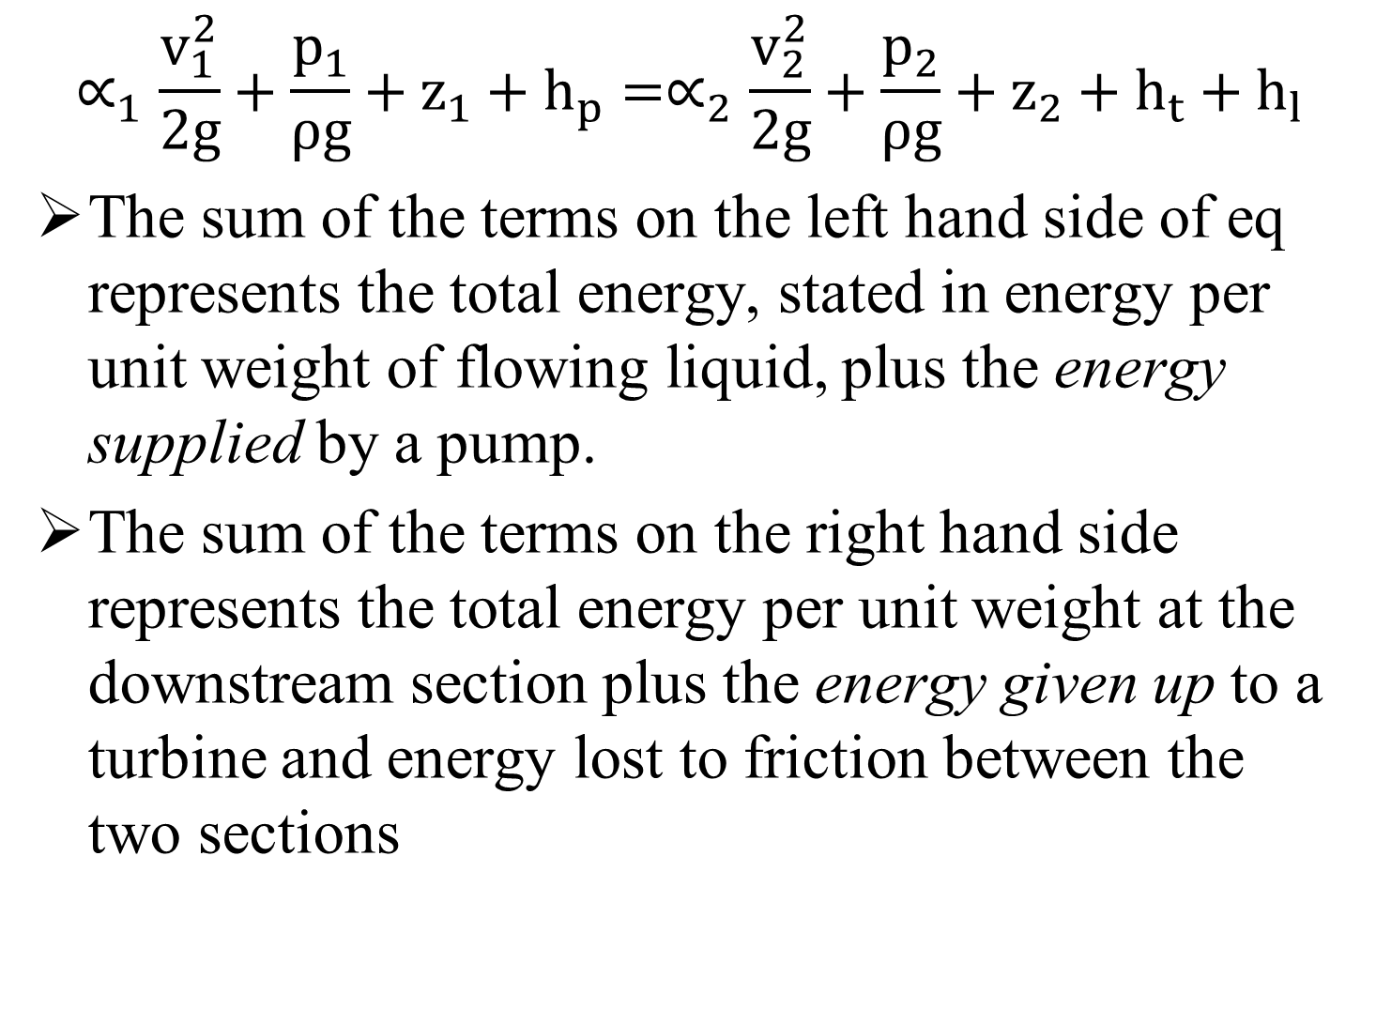
$$∝_{1}\frac{v_{1}^{2}}{2g}+\frac{p_{1}}{ρg}+z_{1}+h_{p}=∝_{2}\frac{v_{2}^{2}}{2g}+\frac{p_{2}}{ρg}+z_{2}+h_{t}+h_{l}$$
The sum of the terms on the left hand side of eq represents the total energy, stated in energy per unit weight of flowing liquid, plus the energy supplied by a pump.
The sum of the terms on the right hand side represents the total energy per unit weight at the downstream section plus the energy given up to a turbine and energy lost to friction between the two sections

Slide 8
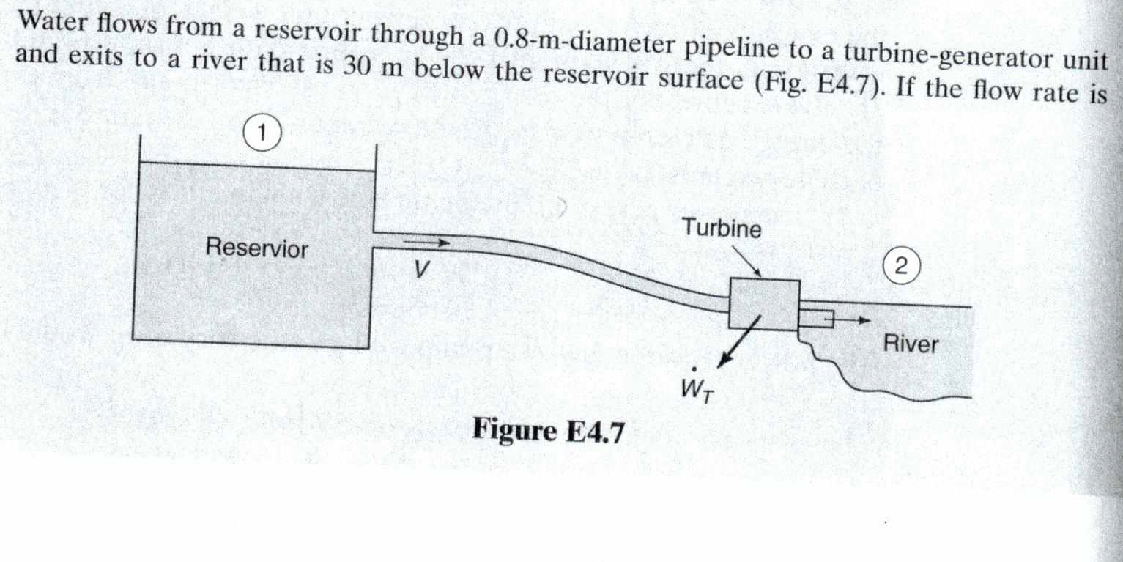

Slide 9
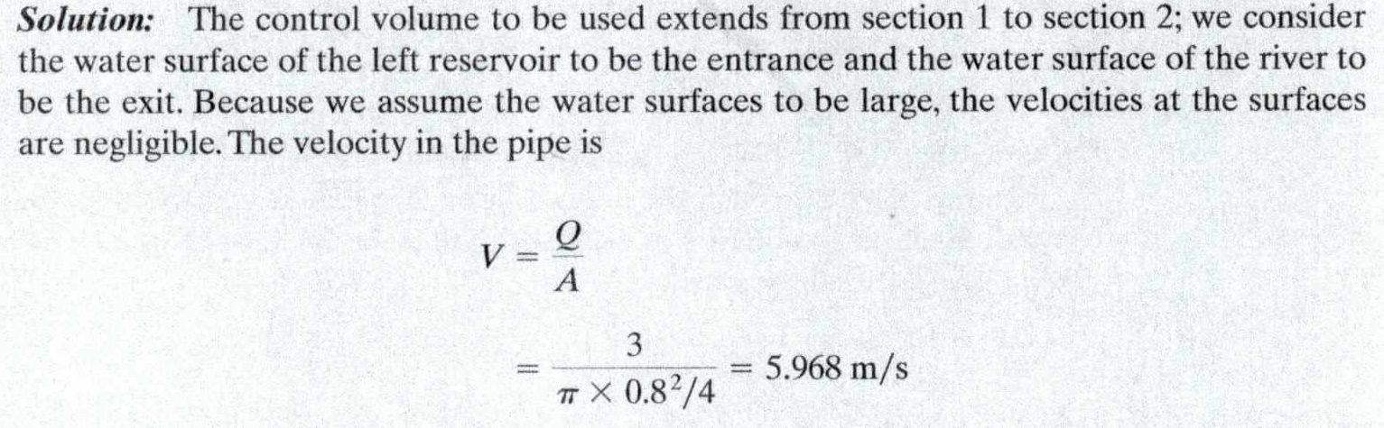
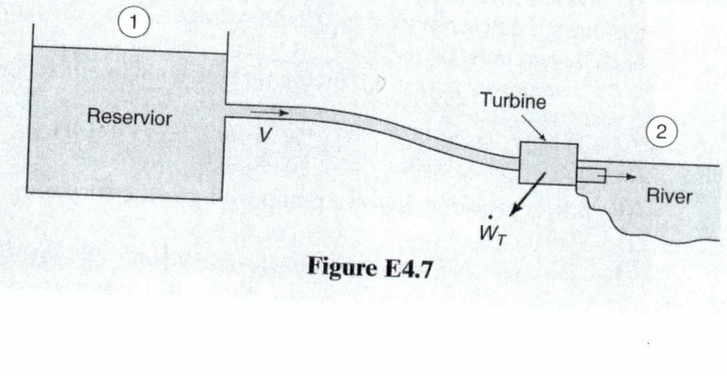
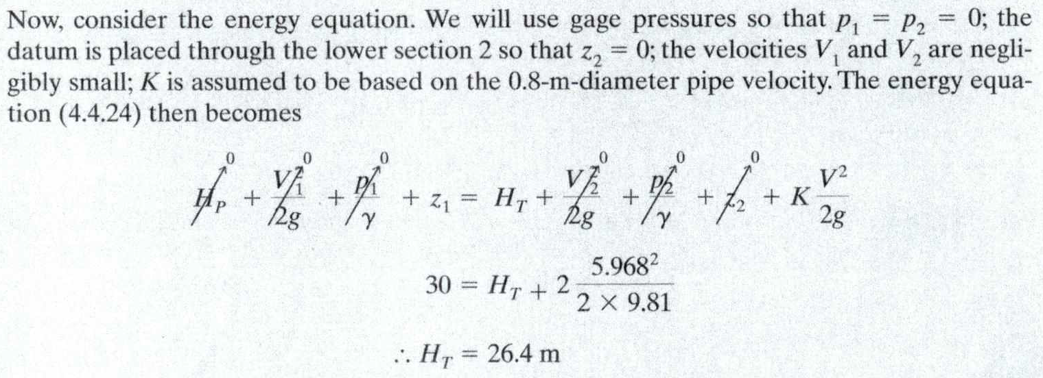

Slide 10
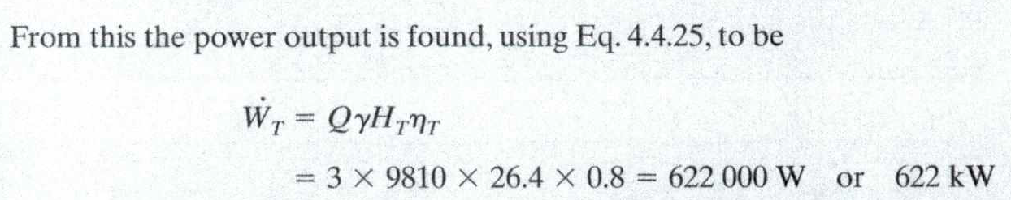
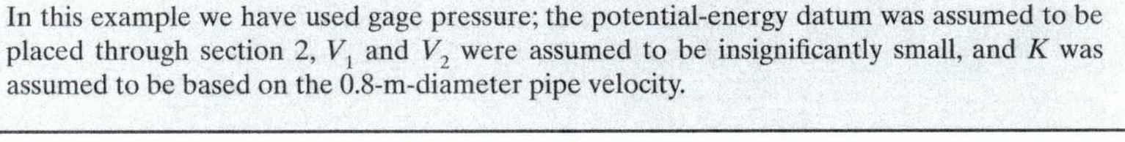

Slide 11

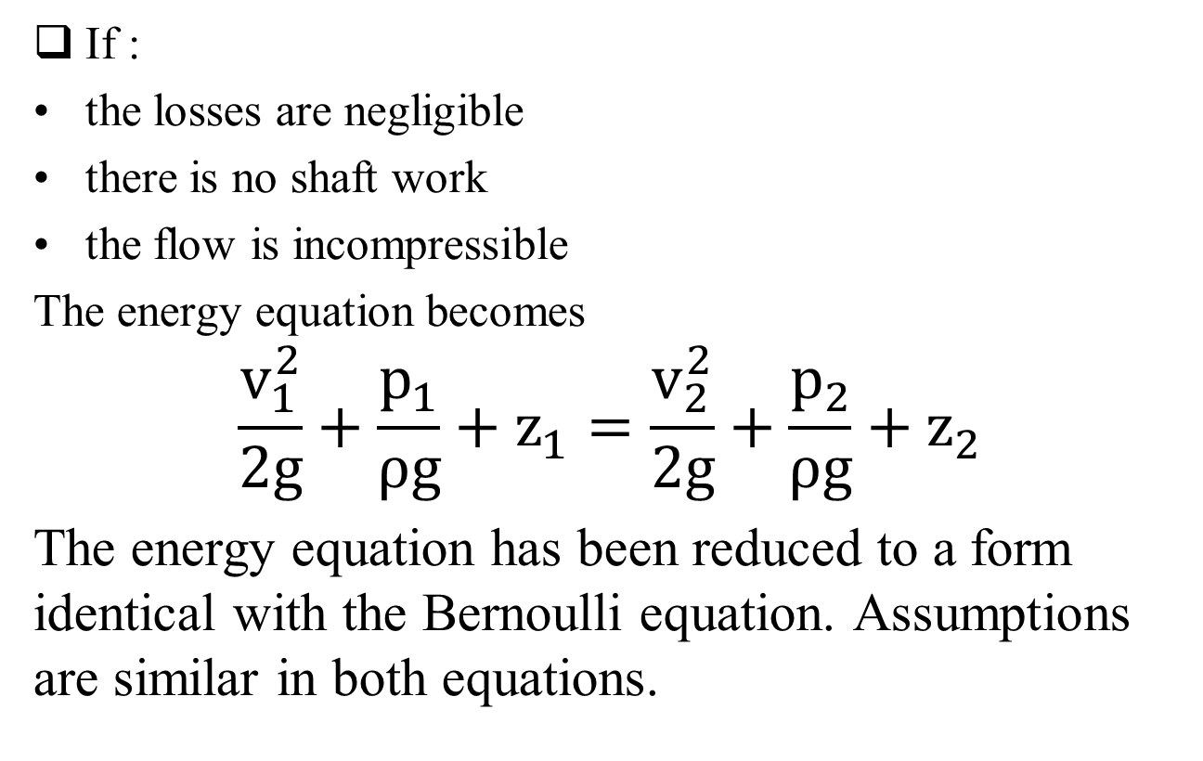
Energy equation for non-viscous steady, one dimensional incompressible flow in a pipe
If :
the losses are negligible
there is no shaft work
the flow is incompressible
The energy equation becomes
$$\frac{v_{1}^{2}}{2g}+\frac{p_{1}}{ρg}+z_{1}=\frac{v_{2}^{2}}{2g}+\frac{p_{2}}{ρg}+z_{2}$$
The energy equation has been reduced to a form identical with the Bernoulli equation. Assumptions are similar in both equations.
11.12

