Slide 1
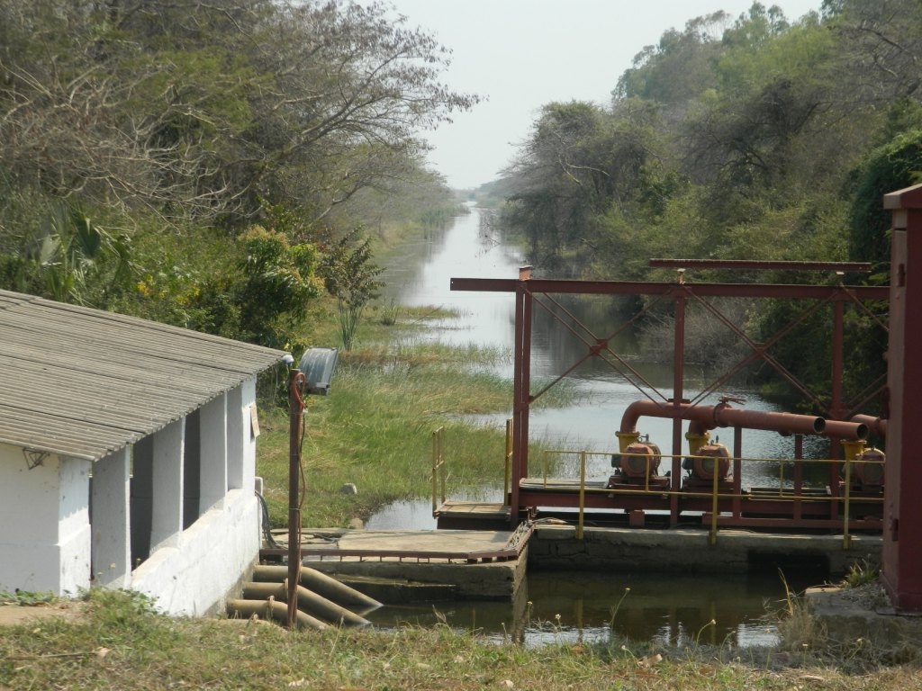
Fluid Mechanics CEE 3311
LECTURE 9
Conservation of energy
L. Handia

Slide 2

The energy equation will be derived starting from the first law of thermodynamics which states that for steady flow, the external work done on any system plus the thermal energy transferred into or out of the system is equal to the change of energy of the system. In other words, for steady flow during time $∆$t
$$∆E=Q−W$$
The total energy E consists of kinetic energy E_{K}, potential energy E_{P} and internal energy E_{u}. Thus the total energy of the system is
$${E=E}_{k}+E_{p}+E_{u}$$
Then continuity equation becomes
10.1
Another definition of the first law of thermodynamics:
It states that the change in the internal energy ΔU of a closed system is equal to the amount of heat Q supplied to the system, minus the amount of work W done by the system on its surroundings.
In thermodynamics, the internal energy of a system is the total energy contained within the system. It is the energy necessary to create or prepare the system in any given state, but does not include the kinetic energy nor the potential energy of the system.
where Q is thermal energy & W is external work done
10.2

Slide 3
The energy equation will be derived starting from the first law of thermodynamics which states that for steady flow, the external work done on any system plus the thermal energy transferred into or out of the system is equal to the change of energy of the system. In other words, for steady flow during time $∆$t
$$∆E=Q−W$$
The total energy E consists of kinetic energy E_{K}, potential energy E_{P} and internal energy E_{u}. Thus the total energy of the system is
$${E=E}_{k}+E_{p}+E_{u}$$
Then continuity equation becomes
In other words
10.1
where Q is thermal energy or heat transferred into a system & W is external work done
10.2

Slide 4
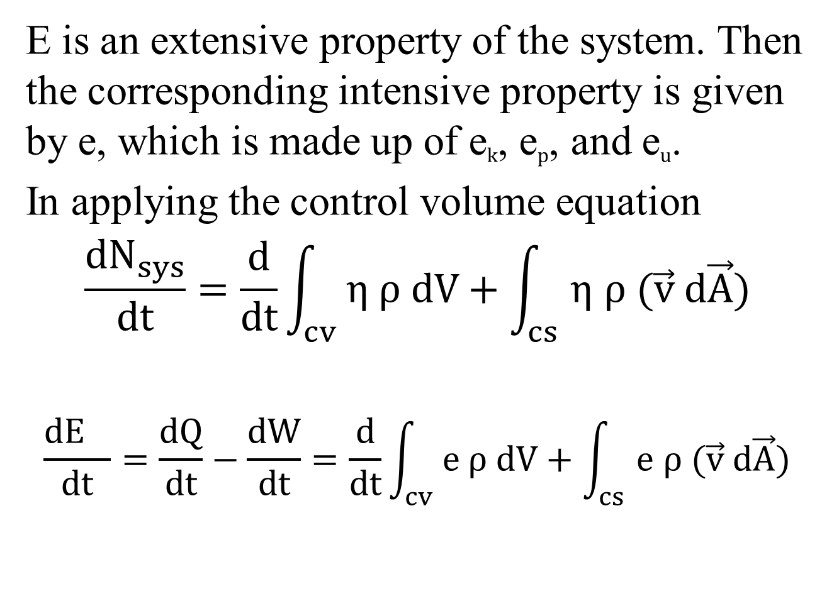
E is an extensive property of the system. Then the corresponding intensive property is given by e, which is made up of e_{k}, e_{p}, and e_{u}.
In applying the control volume equation
$$\frac{{dN}_{sys}}{dt}=\frac{d}{dt}\int_{cv}{η ρ dV}+\int_{cs}{η ρ (\vec{v} d\vec{A})}$$
$$\frac{{dE}_{}}{dt}=\frac{dQ}{dt}−\frac{dW}{dt}=\frac{d}{dt}\int_{cv}{e ρ dV}+\int_{cs}{e ρ (\vec{v} d\vec{A})}$$
u
10.3
10.4

Slide 5
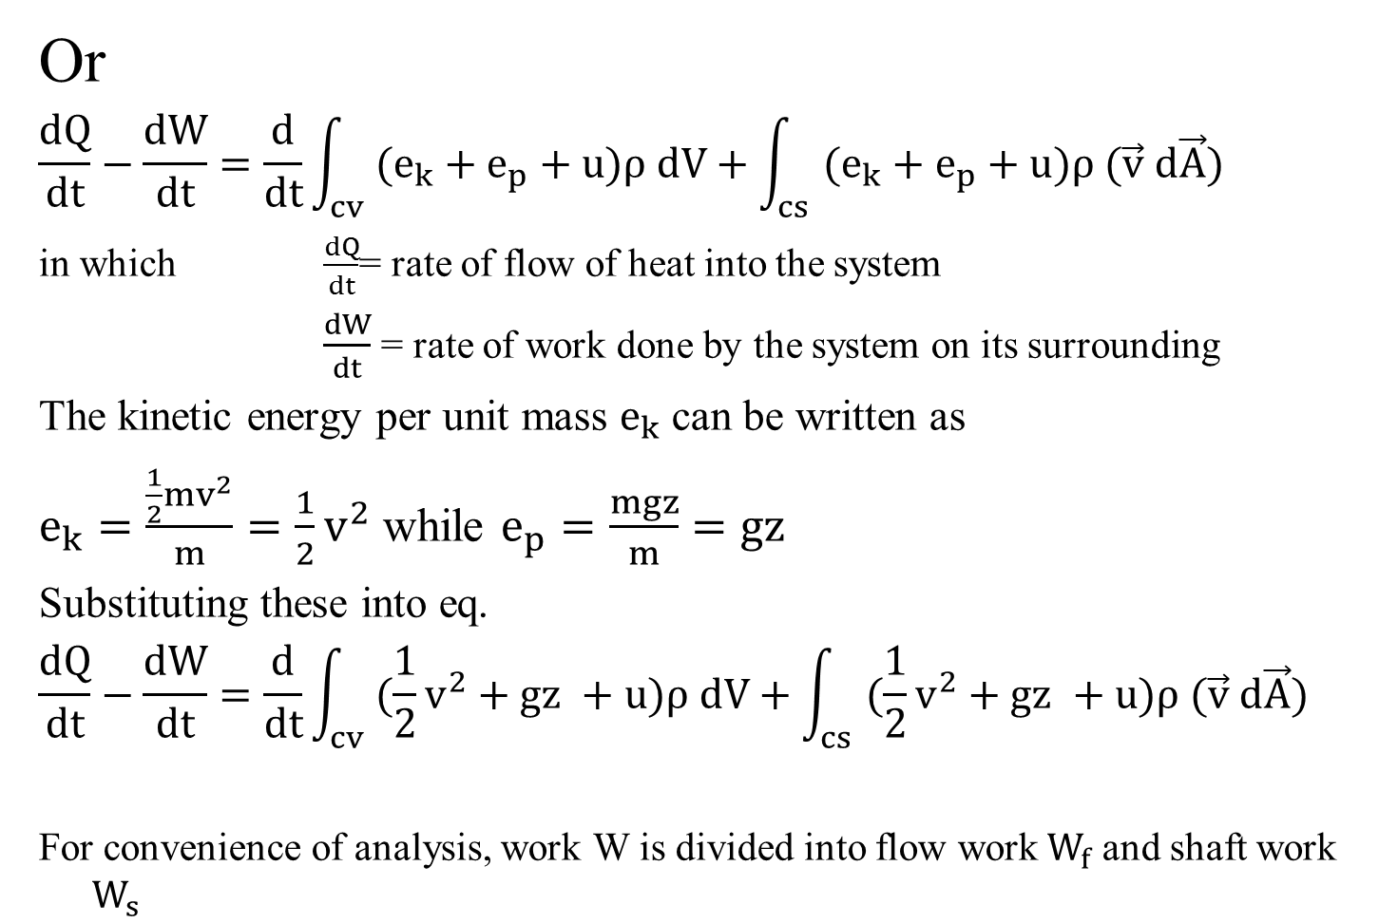
Or
$$\frac{dQ}{dt}−\frac{dW}{dt}=\frac{d}{dt}\int_{cv}{(e_{k}+e_{p}+u)ρ dV}+\int_{cs}{(e_{k}+e_{p}+u)ρ (\vec{v} d\vec{A})}$$
in which $\frac{dQ}{dt}$= rate of flow of heat into the system
$\frac{dW}{dt}$= rate of work done by the system on its surrounding
The kinetic energy per unit mass $e_{k}$ can be written as
$e_{k}=\frac{\frac{1}{2}mv^{2}}{m}=\frac{1}{2}v^{2}$ while $e_{p}=\frac{mgz}{m}=gz$
Substituting these into eq.
$$\frac{dQ}{dt}−\frac{dW}{dt}=\frac{d}{dt}\int_{cv}{(\frac{1}{2}v^{2}+gz +u)ρ dV}+\int_{cs}{(\frac{1}{2}v^{2}+gz +u)ρ (\vec{v} d\vec{A})}$$
For convenience of analysis, work W is divided into flow work$W_{f}$ and shaft work $W_{s}$
10.5
10.6
10.7
10.7

Slide 6
Flow Work
Work is needed to push the fluid into or out of the boundaries of a control volume if mass flow is involved. This work is called the flow work (flow energy). Flow work is necessary for maintaining a continuous flow through a control volume.

Slide 7
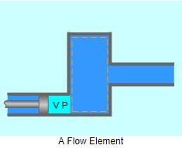
Flow Work
Consider a fluid element of volume V, pressure P, and cross-sectional area A as below.
The flow immediately upstream will force this fluid element to enter the control volume, and it can be regarded as an imaginary piston.

Slide 8
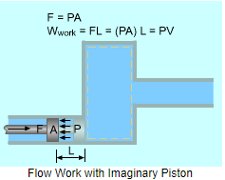
Flow Work
The force applied on the fluid element by the imaginary piston is:
F = PA
The work done due to pushing the entire fluid element across the boundary into the control volume is
W_{flow} = FL = PAL = PV
The work done due to pushing the fluid element out of the control volume is the same as the work needed to push the fluid element into the control volume.

Slide 9
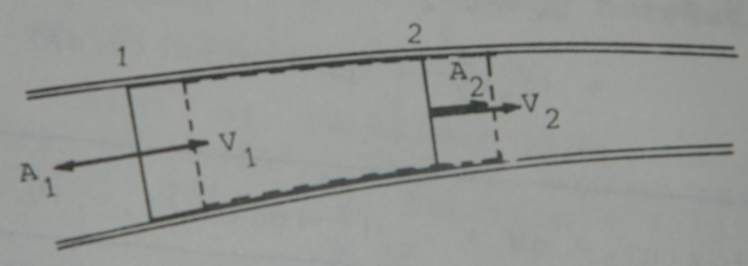
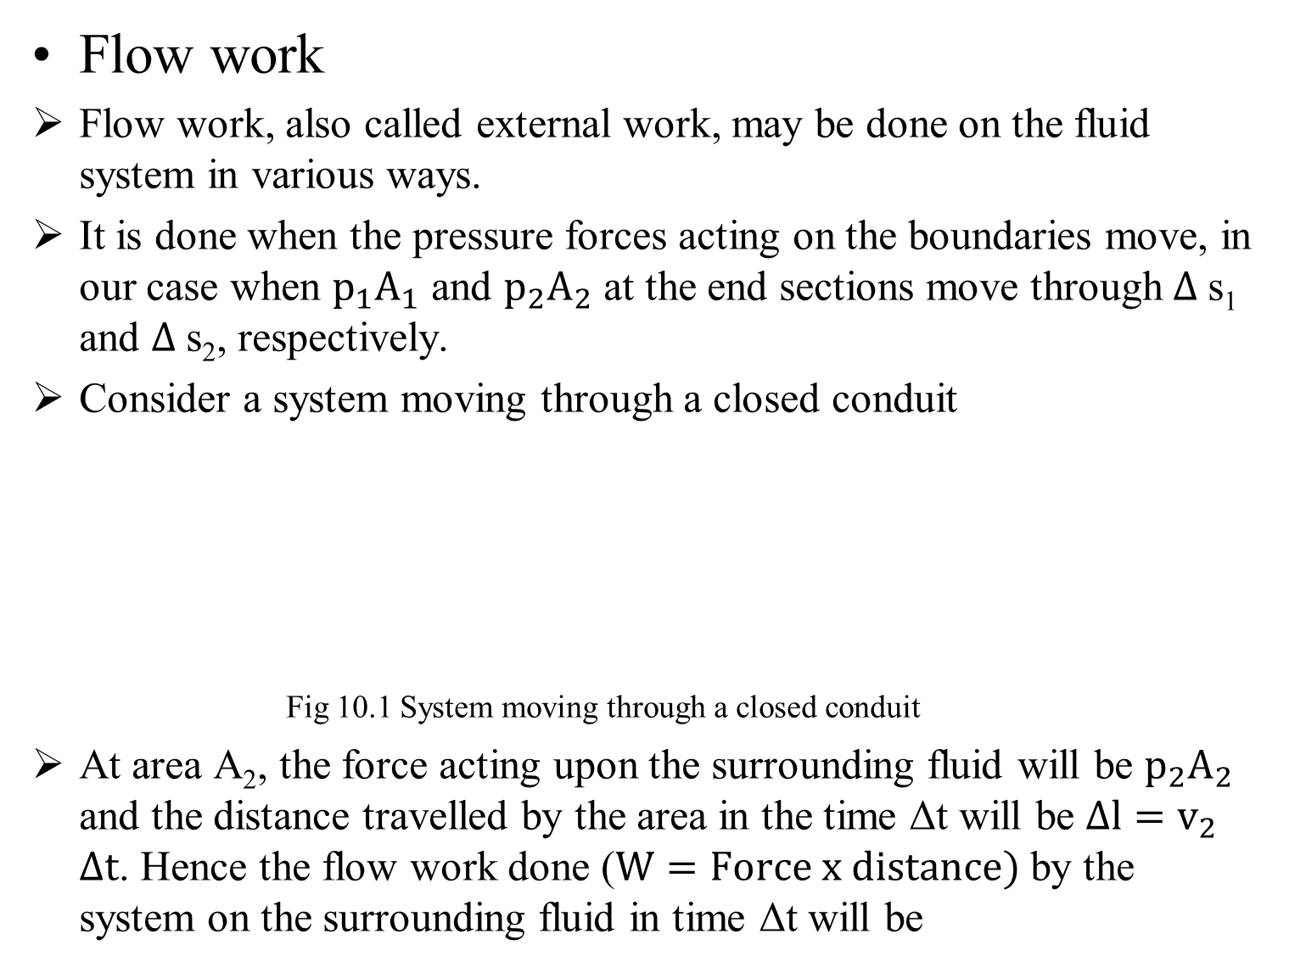


Flow work
Flow work, also called external work, may be done on the fluid system in various ways.
It is done when the pressure forces acting on the boundaries move, in our case when $p_{1}A_{1}$ and $p_{2}A_{2}$ at the end sections move through $∆$s₁and $∆$s₂, respectively.
Consider a system moving through a closed conduit
Fig 10.1 System moving through a closed conduit
At area A₂, the force acting upon the surrounding fluid will be $p_{2}A_{2}$ and the distance travelled by the area in the time Δt will be $∆l=v_{2}$$∆t$. Hence the flow work done ($W=Force x distance)$by the system on the surrounding fluid in time Δt will be
Flow work
Another way of looking at the same flow work is given below:
$∆$s₂
$∆$s₁

Slide 10
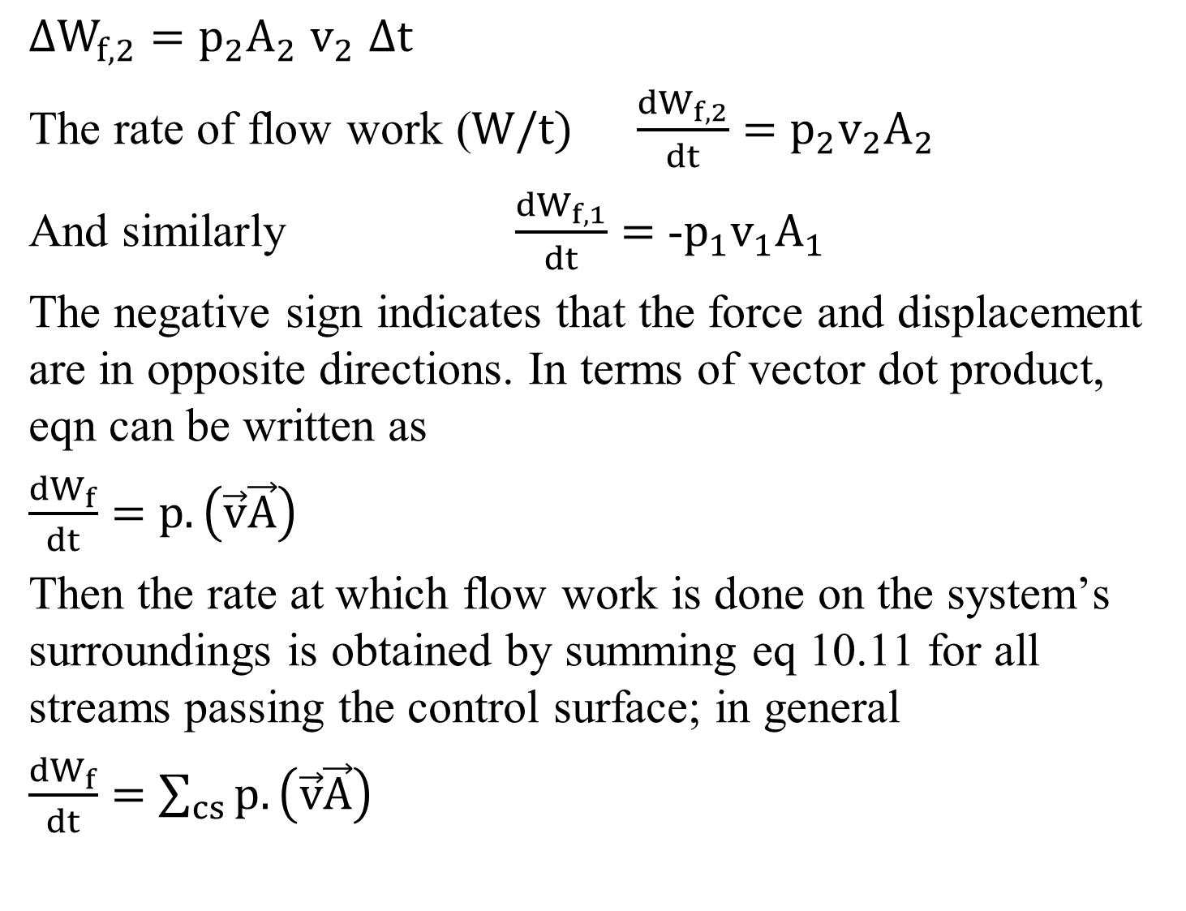
$∆W_{f,2}=$$p_{2}A_{2}$$v_{2}$$∆t$
The rate of flow work ($W/t)$$\frac{{dW}_{f,2}}{dt}=$$p_{2}{v_{2}A}_{2}$
And similarly $\frac{{dW}_{f,1}}{dt}=$-$p_{1}{v_{1}A}_{1}$
The negative sign indicates that the force and displacement are in opposite directions. In terms of vector dot product, eqn can be written as
$\frac{{dW}_{f}}{dt}=$${{p.\left(\vec{v}\vec{A}\right) }_{}}_{}$
Then the rate at which flow work is done on the system’s surroundings is obtained by summing eq 10.11 for all streams passing the control surface; in general
$\frac{{dW}_{f}}{dt}=$${{\sum_{cs}{p.\left(\vec{v}\vec{A}\right)} }_{}}_{}$
10.8
10.9
10.10
10.11
10.12

Slide 11
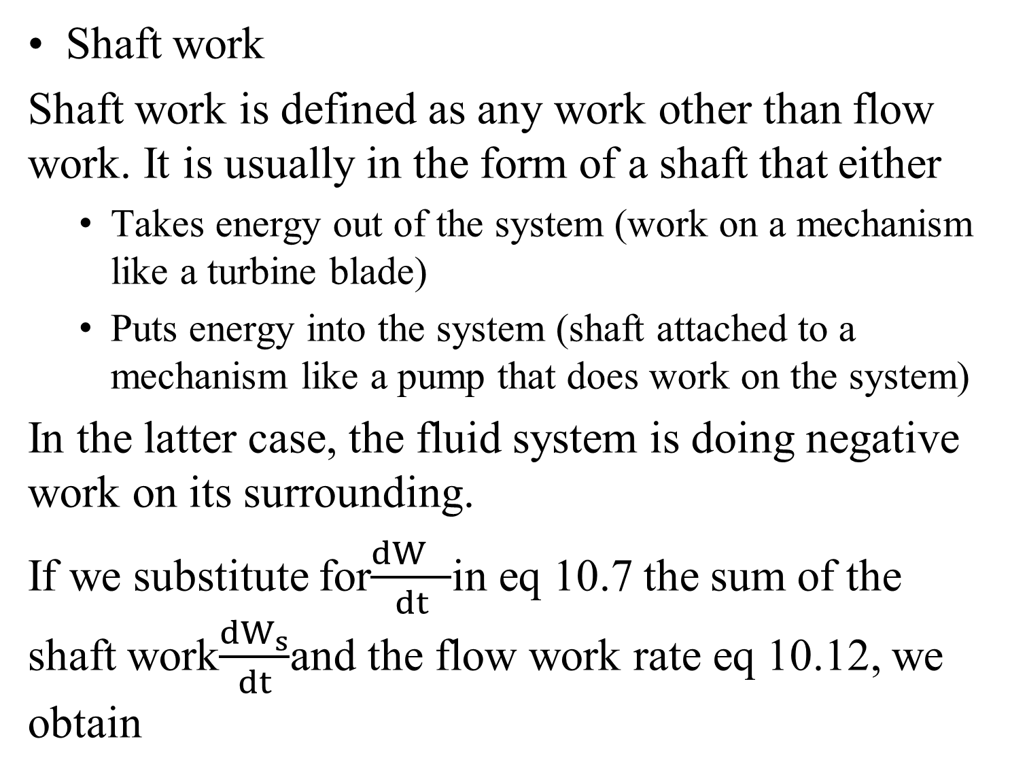
Shaft work
Shaft work
Shaft work is defined as any work other than flow work. It is usually in the form of a shaft that either
  Takes energy out of the system (work on a mechanism like a turbine blade)
  Puts energy into the system (shaft attached to a mechanism like a pump that does work on the system)
In the latter case, the fluid system is doing negative work on its surrounding.
If we substitute for$\frac{{dW}_{}}{dt}$in eq 10.7 the sum of the shaft work$\frac{{dW}_{s}}{dt}$and the flow work rate eq 10.12, we obtain

Slide 12
Rate of change of work dW/dt is the sum of the shaft work dWs/dt and the flow work rate eq. 10.12
If we substitute for dW/dt into Eq. 10.7 we get
Putting Eq 10.12 into above Eq we obtain
Replacing summation by integration and introducing ρ/ρ
or

