Slide 1
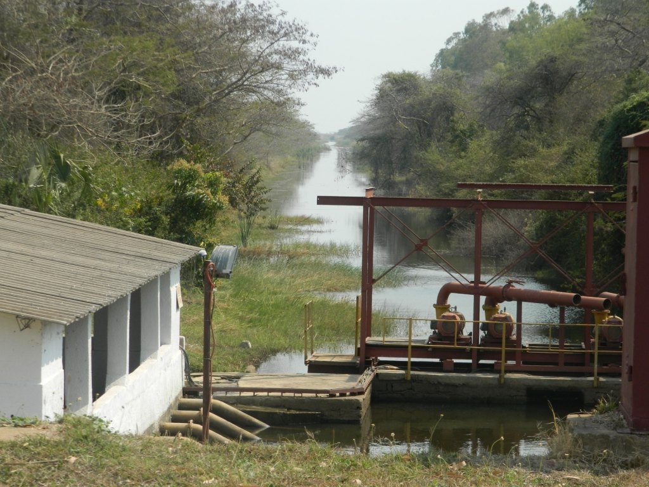
Fluid Mechanics CEE 3311
LECTURE 10
Conservation of energy
L. Handia

Slide 2
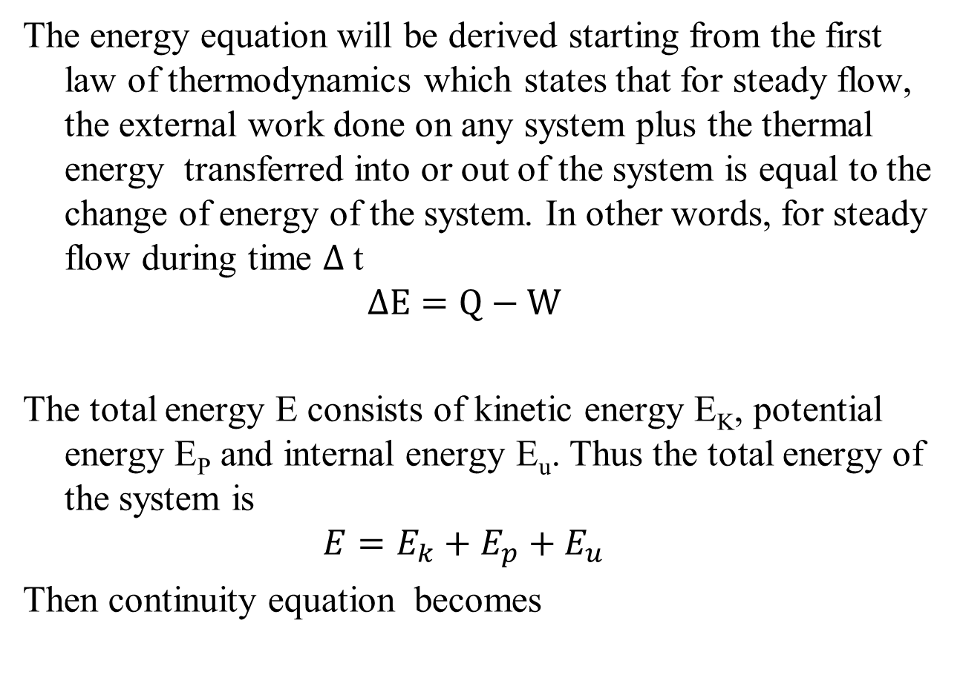
The energy equation will be derived starting from the first law of thermodynamics which states that for steady flow, the external work done on any system plus the thermal energy transferred into or out of the system is equal to the change of energy of the system. In other words, for steady flow during time $∆$t
$$∆E=Q−W$$
The total energy E consists of kinetic energy E_{K}, potential energy E_{P} and internal energy E_{u}. Thus the total energy of the system is
$${E=E}_{k}+E_{p}+E_{u}$$
Then continuity equation becomes
10.1
where Q is thermal energy & W is external work done
10.2

Slide 3
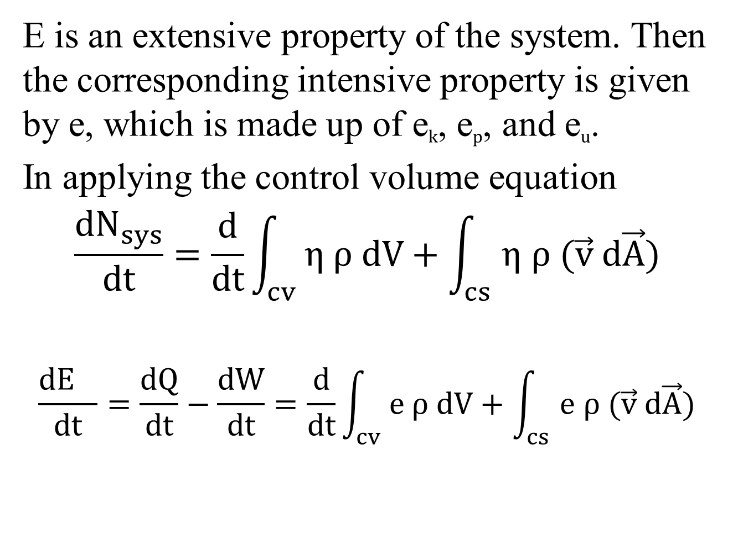
E is an extensive property of the system. Then the corresponding intensive property is given by e, which is made up of e_{k}, e_{p}, and e_{u}.
In applying the control volume equation
$$\frac{{dN}_{sys}}{dt}=\frac{d}{dt}\int_{cv}{η ρ dV}+\int_{cs}{η ρ (\vec{v} d\vec{A})}$$
$$\frac{{dE}_{}}{dt}=\frac{dQ}{dt}−\frac{dW}{dt}=\frac{d}{dt}\int_{cv}{e ρ dV}+\int_{cs}{e ρ (\vec{v} d\vec{A})}$$
u
10.3
10.4

Slide 4
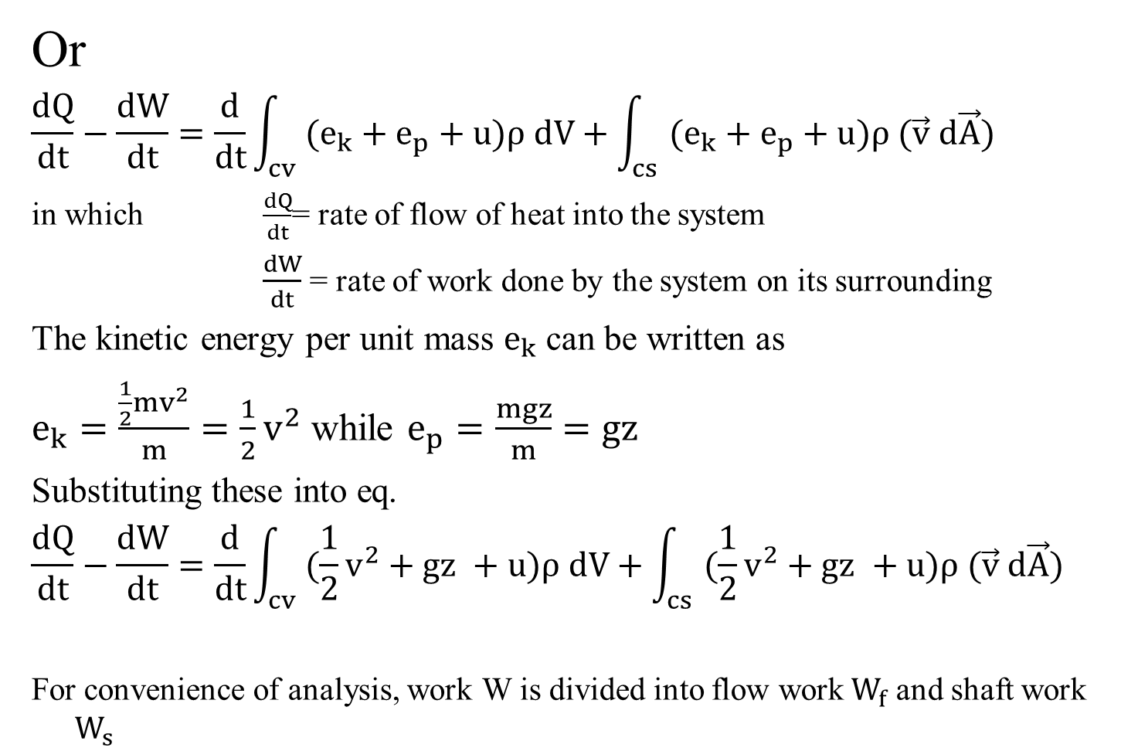
Or
$$\frac{dQ}{dt}−\frac{dW}{dt}=\frac{d}{dt}\int_{cv}{(e_{k}+e_{p}+u)ρ dV}+\int_{cs}{(e_{k}+e_{p}+u)ρ (\vec{v} d\vec{A})}$$
in which $\frac{dQ}{dt}$= rate of flow of heat into the system
$\frac{dW}{dt}$= rate of work done by the system on its surrounding
The kinetic energy per unit mass $e_{k}$ can be written as
$e_{k}=\frac{\frac{1}{2}mv^{2}}{m}=\frac{1}{2}v^{2}$ while $e_{p}=\frac{mgz}{m}=gz$
Substituting these into eq.
$$\frac{dQ}{dt}−\frac{dW}{dt}=\frac{d}{dt}\int_{cv}{(\frac{1}{2}v^{2}+gz +u)ρ dV}+\int_{cs}{(\frac{1}{2}v^{2}+gz +u)ρ (\vec{v} d\vec{A})}$$
For convenience of analysis, work W is divided into flow work$W_{f}$ and shaft work $W_{s}$
10.5
10.6
10.7
10.7

Slide 5
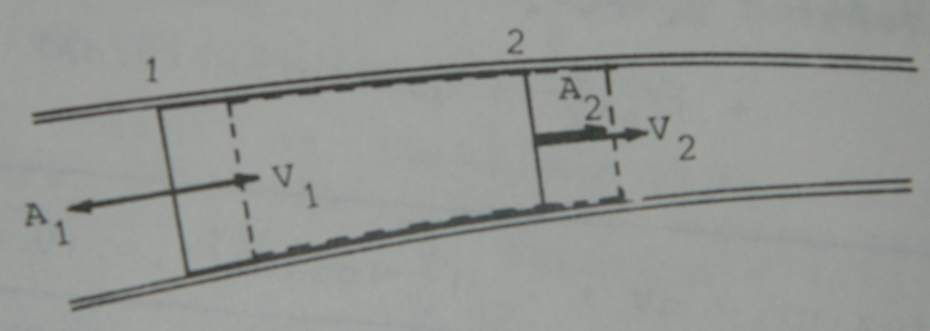
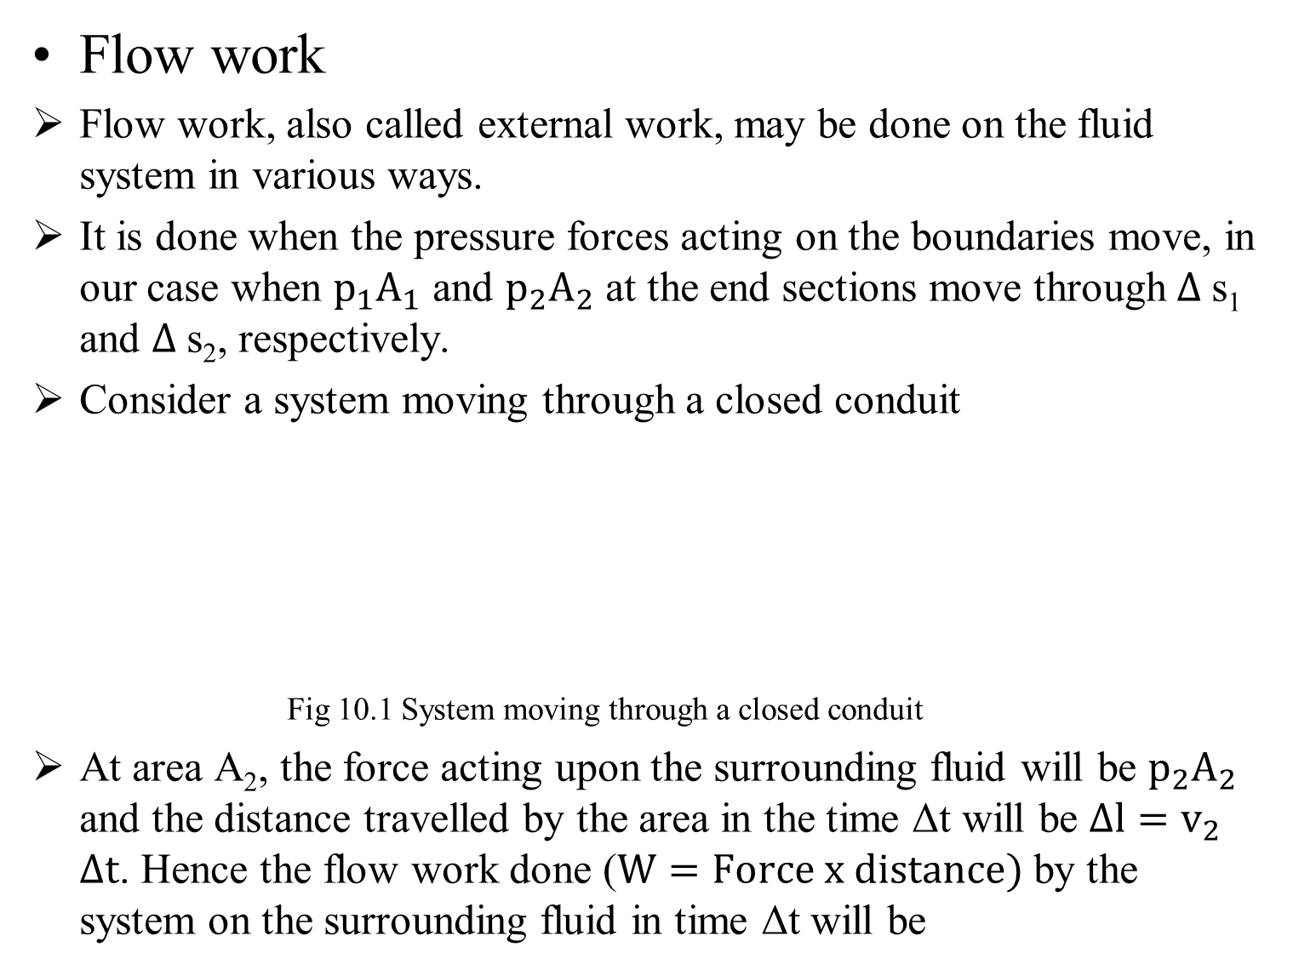


Flow work
Flow work, also called external work, may be done on the fluid system in various ways.
It is done when the pressure forces acting on the boundaries move, in our case when $p_{1}A_{1}$ and $p_{2}A_{2}$ at the end sections move through $∆$s₁and $∆$s₂, respectively.
Consider a system moving through a closed conduit
Fig 10.1 System moving through a closed conduit
At area A₂, the force acting upon the surrounding fluid will be $p_{2}A_{2}$ and the distance travelled by the area in the time Δt will be $∆l=v_{2}$$∆t$. Hence the flow work done ($W=Force x distance)$by the system on the surrounding fluid in time Δt will be
$∆$s₂
$∆$s₁

Slide 6
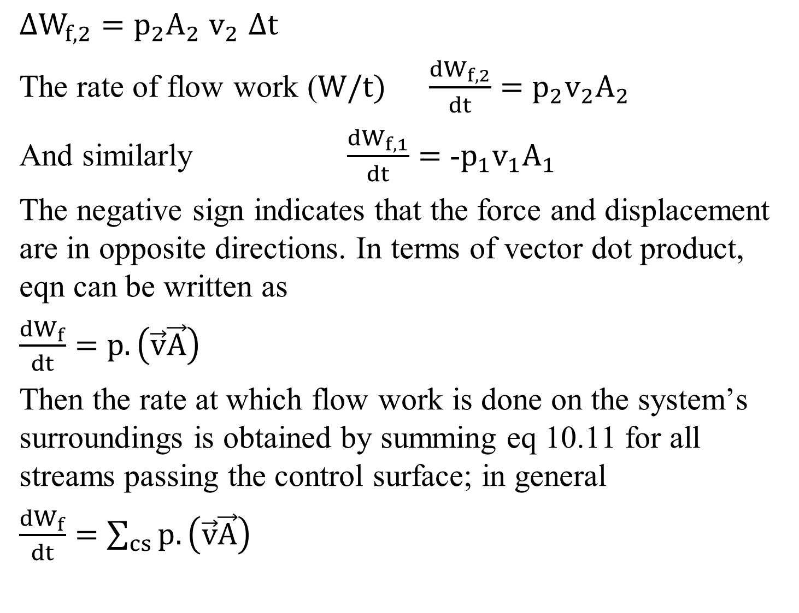
$∆W_{f,2}=$$p_{2}A_{2}$$v_{2}$$∆t$
The rate of flow work ($W/t)$$\frac{{dW}_{f,2}}{dt}=$$p_{2}{v_{2}A}_{2}$
And similarly $\frac{{dW}_{f,1}}{dt}=$-$p_{1}{v_{1}A}_{1}$
The negative sign indicates that the force and displacement are in opposite directions. In terms of vector dot product, eqn can be written as
$\frac{{dW}_{f}}{dt}=$${{p.\left(\vec{v}\vec{A}\right) }_{}}_{}$
Then the rate at which flow work is done on the system’s surroundings is obtained by summing eq 10.11 for all streams passing the control surface; in general
$\frac{{dW}_{f}}{dt}=$${{\sum_{cs}{p.\left(\vec{v}\vec{A}\right)} }_{}}_{}$
10.8
10.9
10.10
10.11
10.12

Slide 7
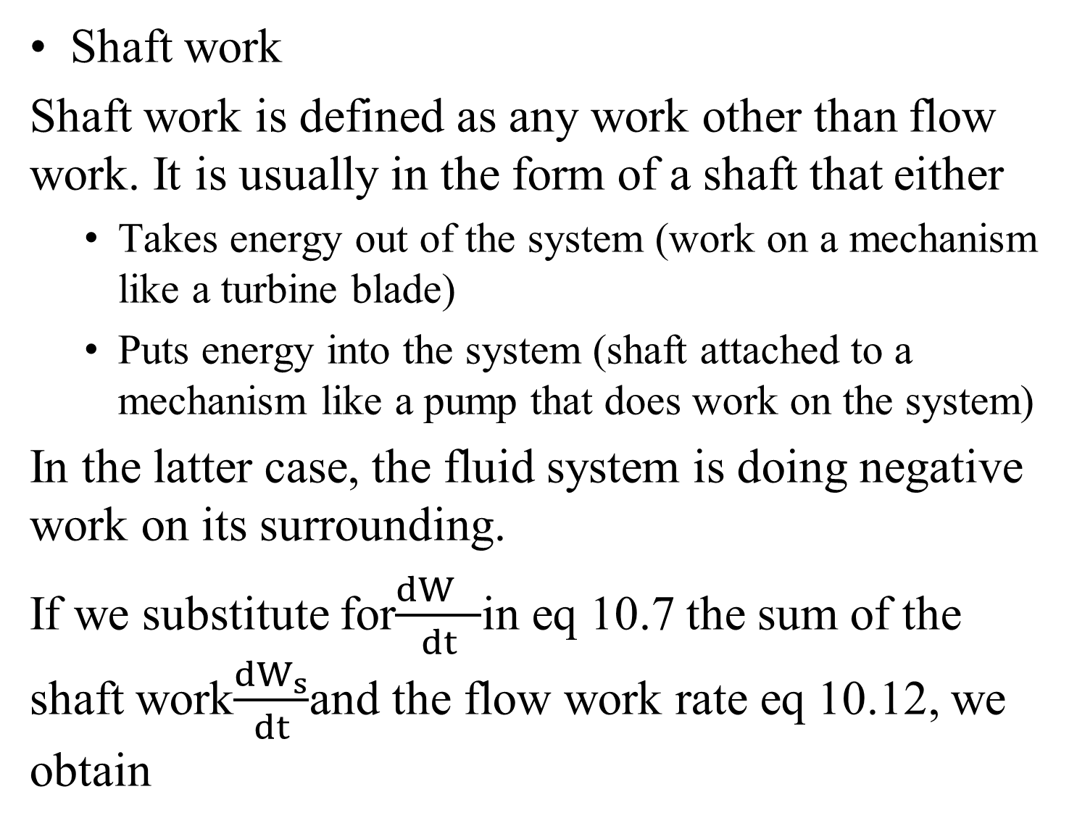
Shaft work
Shaft work is defined as any work other than flow work. It is usually in the form of a shaft that either
  Takes energy out of the system (work on a mechanism like a turbine blade)
  Puts energy into the system (shaft attached to a mechanism like a pump that does work on the system)
In the latter case, the fluid system is doing negative work on its surrounding.
If we substitute for$\frac{{dW}_{}}{dt}$in eq 10.7 the sum of the shaft work$\frac{{dW}_{s}}{dt}$and the flow work rate eq 10.12, we obtain

Slide 8


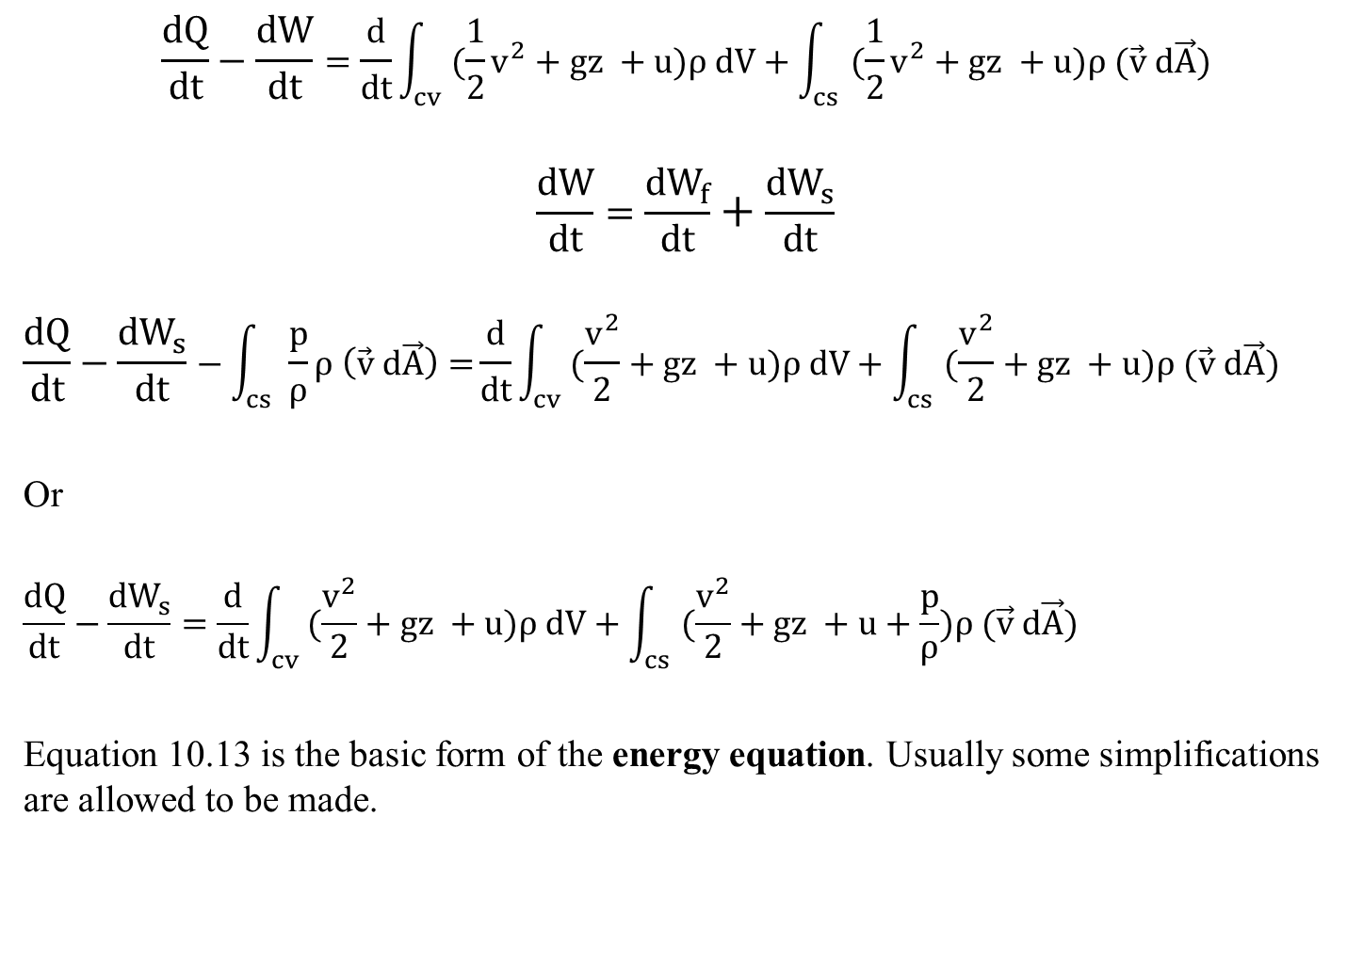
$$\frac{dQ}{dt}−\frac{dW}{dt}=\frac{d}{dt}\int_{cv}{(\frac{1}{2}v^{2}+gz +u)ρ dV}+\int_{cs}{(\frac{1}{2}v^{2}+gz +u)ρ (\vec{v} d\vec{A})}$$
$$\frac{dW}{dt}=\frac{{dW}_{f}}{dt}+\frac{{dW}_{s}}{dt}$$
$$\frac{dQ}{dt}−\frac{{dW}_{s}}{dt}−\int_{cs}{\frac{p}{ρ}ρ \left(\vec{v} d\vec{A}\right)=}\frac{d}{dt}\int_{cv}{(\frac{v^{2}}{2}+gz +u)ρ dV}+\int_{cs}{(\frac{v^{2}}{2}+gz +u)ρ (\vec{v} d\vec{A})}$$
Or
$$\frac{dQ}{dt}−\frac{{dW}_{s}}{dt}=\frac{d}{dt}\int_{cv}{(\frac{v^{2}}{2}+gz +u)ρ dV}+\int_{cs}{(\frac{v^{2}}{2}+gz +u+\frac{p}{ρ})ρ (\vec{v} d\vec{A})}$$
Equation 10.13 is the basic form of the energy equation. Usually some simplifications are allowed to be made.
10.7
10.12
10.13

