Slide 1
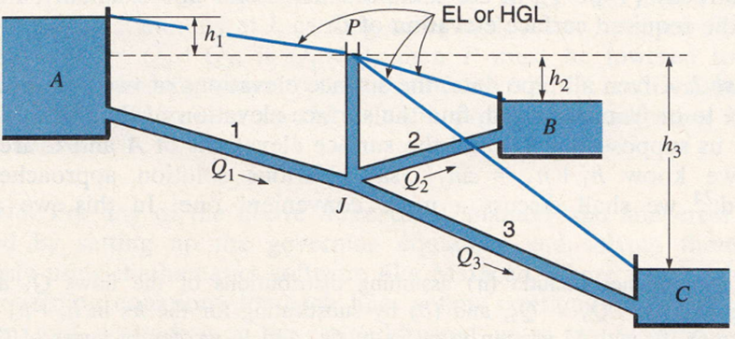
Fluid Mechanics CEE 3311
LECTURE 17
Flow in Pipes
(Internal Flows)
Series, parallel, branching and hardy cross
L. Handia

Slide 2
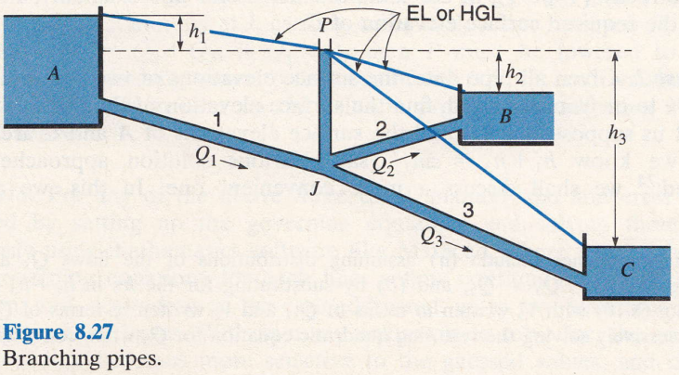

Branching Pipes
For convenience, let us consider three pipes connected to three reservoirs as in Fig. 8.27 and connected together or branching at the common junction point J.
Actually, any of the pipes may be considered to be connected to some other destination than a reservoir by simply replacing the reservoir with a piezometer tube in which the water level is the same as the reservoir surface.
We shall suppose that all the pipes are sufficiently long (large head loss in the pipes) that minor losses and velocity heads may be neglected.

Slide 3
Branching Pipes
We name the pipes and flows and corresponding friction losses as shown in the diagram.
The continuity and energy equations require that the flow entering the junction (J) equal the flow leaving it and that the pressure head at J (which may be represented schematically by the open piezometer tube shown, with water at elevation P) be common to all pipes.

Slide 4
Branching Pipes
There being no pumps, the elevation of P must lie between the surfaces of reservoirs A and C.
If P is level with the surface of reservoir B then h₂ and Q₂ are both zero. If P is above the surface of reservoir B then water must flow into B and Q₁ = Q₂+ Q₃.
If P is below the surface of reservoir B then the flow must be out of B and Q₁ + Q₂ = Q₃.
So for the situation shown in Fig. 8.27 we have the following governing conditions:
  Q₁ = Q₂ + Q₃
  Elevation of P is common to all.
Since h_{L} is zero, there is no flow
The diagram suggests several different problems or cases, three of which will be discussed below using different methods of solution.

Slide 5
Rigorous Solutions
When we know the pipe wall material, we can estimate its e value (from Tables) and we know that the friction factor f varies with the e/D of the pipe and the Reynolds number of the flow.
Because we are not considering minor losses, we can use the equations in the previous lecture 16.
In particular, using only a basic scientific calculator, we can solve pipelines for h_{L} (Type 1 problems), for V or Q (Type 2 problems) and more rarely, we can solve for D (Type 3 problems) using a number of equations (see Lecture 16).
These equations are preferred because they avoid trial and error, which can become quite confusing when combined with other trial-and-error techniques needed to solve for branching flow.
These, and the variety of approaches used to “manually” solve the different types of problems that can occur, are illustrated in the following cases.

Slide 6


Rigorous Solutions
Case 1. Given all pipe data (lengths, diameters, and materials for e values), the surface elevations of two reservoirs, and the flow to or from one of these two, find the surface elevation of the third reservoir.
This problem can be solved directly. Suppose that Q₁ and the elevations of A and B are given.
Then the head loss h_{L} may be determined directly (Type 1), using the moody diagram or Eq. (8.41) to ﬁnd the proper value of f.
Knowing h_{L} ﬁxes P, so h₃ is now easily obtained. Knowing h₂ enables the ﬂow in pipe 2 to be determined directly using the Type 2 equation (8.42).
Condition 1 (continuity at junction J) then determines Q₃, which in turn enables h₃ to be found directly (Type 1), in the same manner as for line 1.
Finally, P and h₃ deﬁne the required surface elevation of C.

Slide 7
Rigorous Solutions
Case 2. Given all pipe data, the surface elevations of two reservoirs, and the ﬂow to or from the third, find the surface elevation of the third reservoir.
Let us suppose that Q₃ and the surface elevations of A and C are given.
Then we know h_{l} + h₃ = ∆h₁₃, say.
Various solution approaches may be used; we shall discuss a more convenient one.
In this, we assume the elevation of P, which yields values for h₁ and h₃, and so Q₁ and Q₃ via Eq. (8.42).
If these do not satisfy the discharge relation at J (∑Q=0)then P must be adjusted until they do.

Slide 8
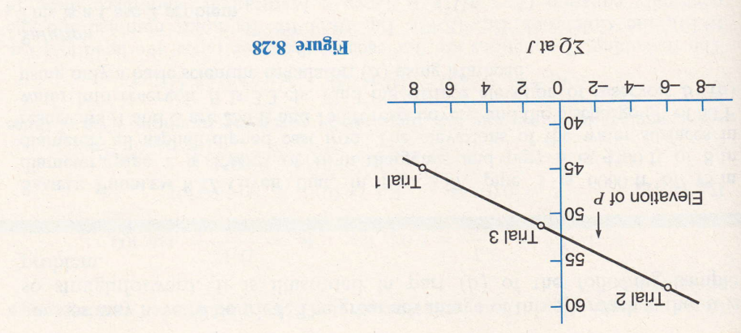
Rigorous Solutions
To help us converge on the correct elevation of P, we can plot the results of each assumption on a graph like Fig. 8.28.
For ∑Q at J, inflows to J are taken as positive and outflows as negative.
Two or three points, with one fairly close to the vertical axis, determine a curve that intersects that axis at the equilibrium level of P, where ∑ Q = 0, as required.
Last, h₂ can be determined from Q₂ and Eqs. (8.41) and (8.10), and the required surface elevation of B found.

Slide 9
Rigorous Solutions
Case 3. Given all pipe lengths and diameters and the elevations of all three reservoirs, ﬁnd the ﬂow in each pipe.
This is the classic three-reservoir problem, and it differs from the foregoing cases in that it is not immediately evident whether the ﬂow is into or out of reservoir B. This direction is readily determined by ﬁrst assuming no ﬂow in pipe 2; that is, the piezometer level P is assumed at the elevation of the surface of B. The head losses h₁ and h₃ then determine the ﬂows Q₁ and Q₃ via Eq. (8.42). If Q₁ >Q₃ then P must be raised to satisfy continuity at J, causing water to ﬂow into reservoir B, and we shall have Q₁ = Q₂+Q₃; if Q₁<Q₃ then P must be lowered to satisfy continuity at J, causing water to ﬂow out of reservoir B, and we shall have Q₁ + Q₂ = Q₃. From here on the solution proceeds by adjusting P as for Case 2 above.

Slide 10
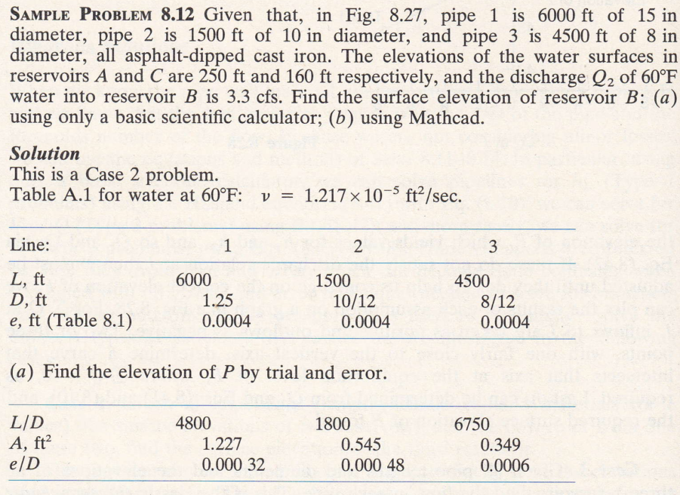
Case 2

Slide 11
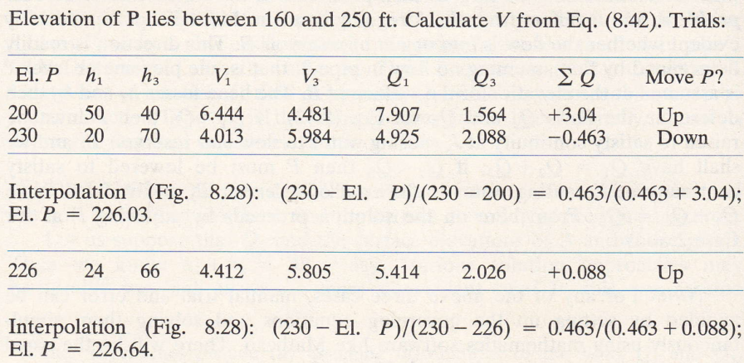


Q_{2=3.3}
When ∑Q is +ve, there is more flow into junction, producing higher h_{L} , therefore reduce Q₁, which reduces V₁ since A₁ is constant (Q=AV). Reduced V₁ results in reduced h_{L}, .Hence P has to move up so that h_{L} = h₁ is reduced as El. A is fixed
7.907-3.3-1.564
h₁ reduces from 50 to 20, V to 4.013, Q to 4.925 while the opposite happens to pipe 3

Slide 12
Q_{2=3.3}
0.463+0
Slope between Trial 2 and El P is the same as between Trial 2 and Trial 1 i.e,
Slope 1 = slope 2

Slide 13
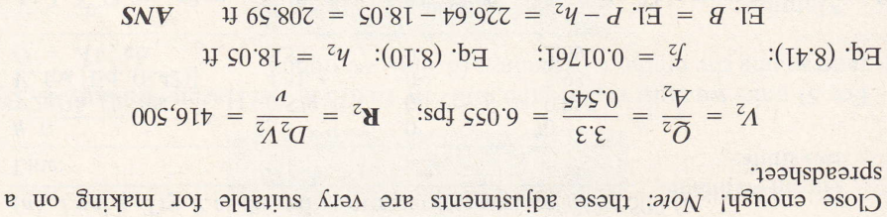

Slide 14

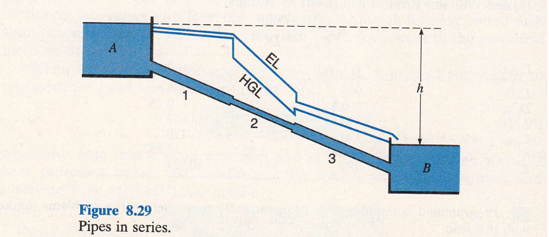
Pipes in series
If the pipe is made up of sections of different diameters, as shown in Fig. 8.29, the continuity and energy equations establish the following two simple relations that must be satisﬁed:

Slide 15
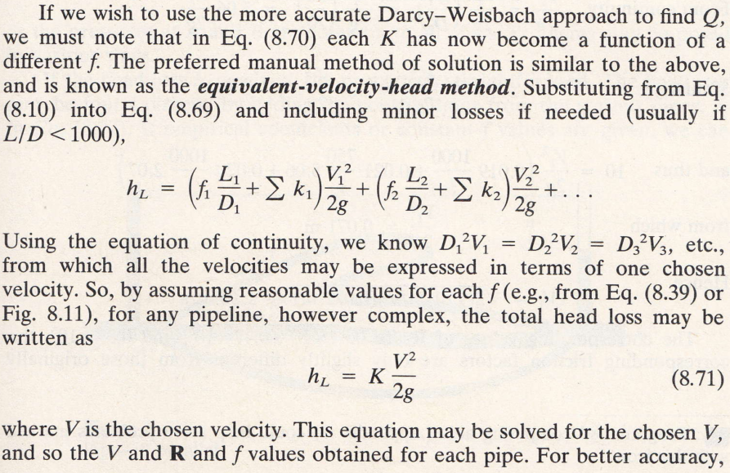
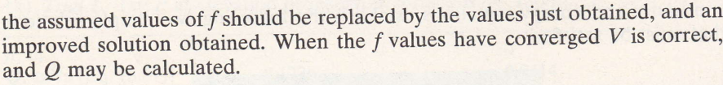
i.e., either V₁, V₂ or V₃

Slide 16
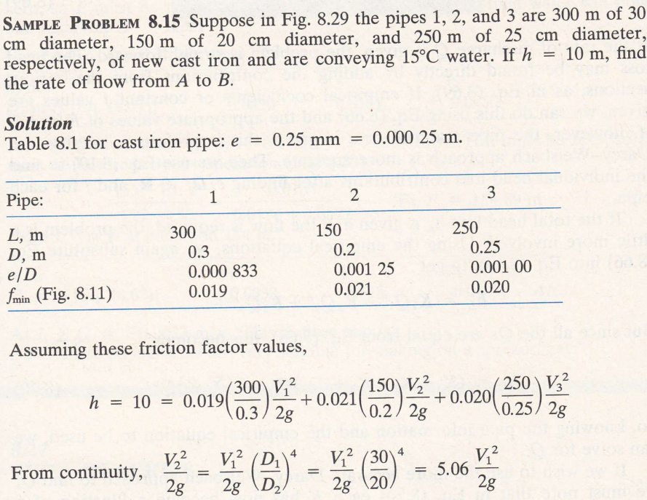

Using e/D and at Re = 10⁸ the max Re value in Moody diagram, meaning this is the minimum f value for a given e/D. As Re decreases into transition zone, the f values go up

Slide 17
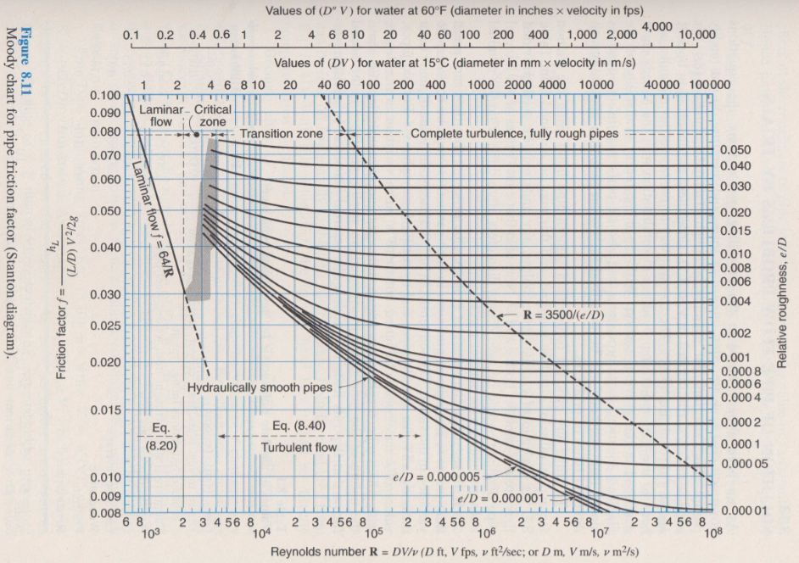

Slide 18
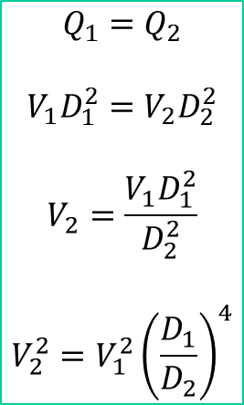
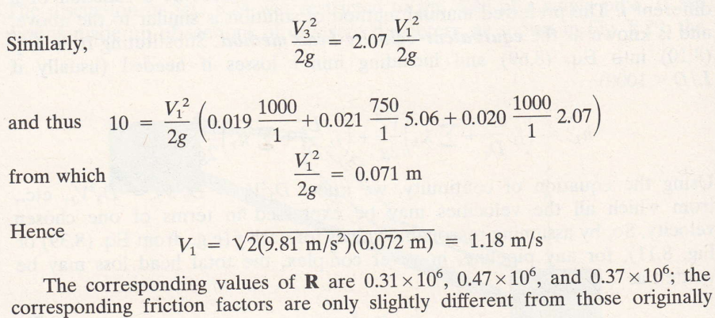

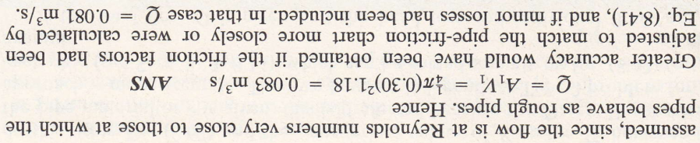

Slide 19
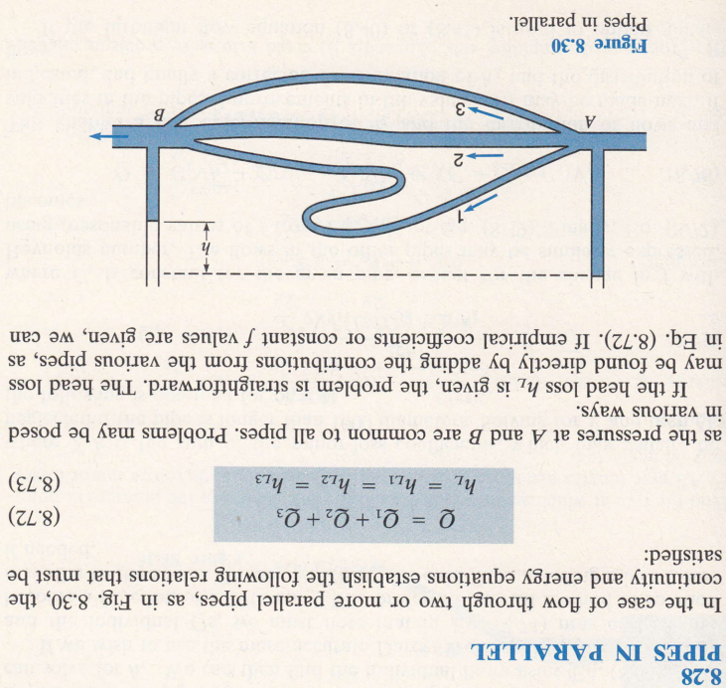
Pipes in parallel

Slide 20
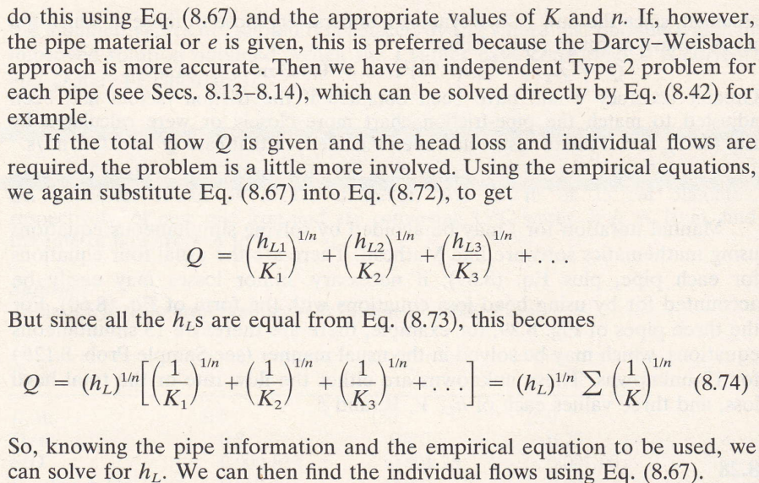
Pipes in parallel
Solutions
If the head loss is given, the problem is straight forward. The head loss may be found directly by adding the contributions from the various pipes, as in Eq. 8.72.
If empirical coefficients or constant f values are given, we can do this using Eq. 8.67 and the appropriate values of K and n.
If, however, the pipe material or e is given, this is preferred because the Darcy-Weisbach approach is more accurate. Then we have an independent Type 2 problem for each pipe, see Lecture 16, which can be solved directly by Eq. 8.42, for example.

Slide 21
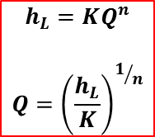
Pipes in parallel
Solutions

Slide 22
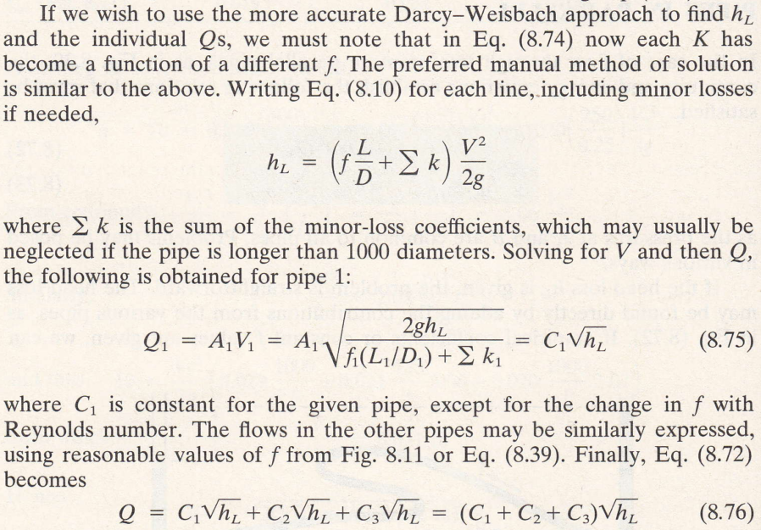
Solutions
If we wish to use the more accurate Darcy-Weisbach approach to find h_{L}
Since h_{L} is the same for all pipes

Slide 23
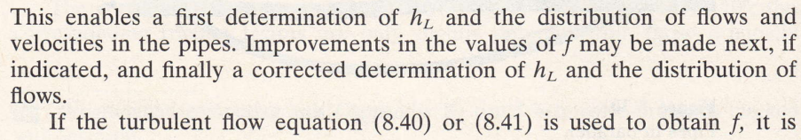
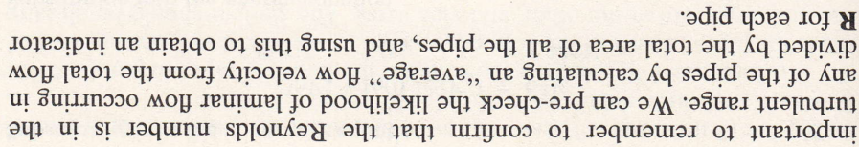

Slide 24
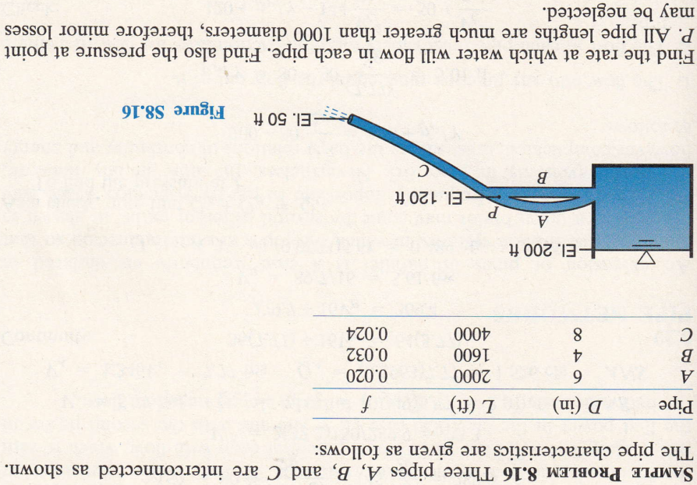

Slide 25
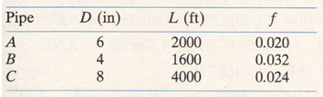

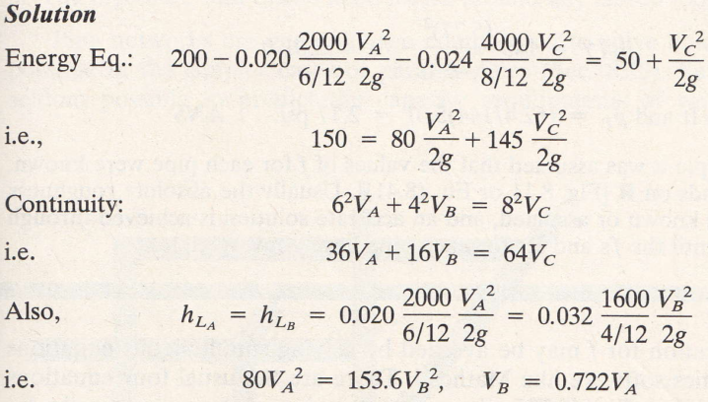
1
2
0
0
0
0
0
Note that h_{L} is the same in pipe A and B and so only one pipe is used, in this case pipe A. If pipe B is used, then pipe A will not be used
Between points 1 & 2

Slide 26
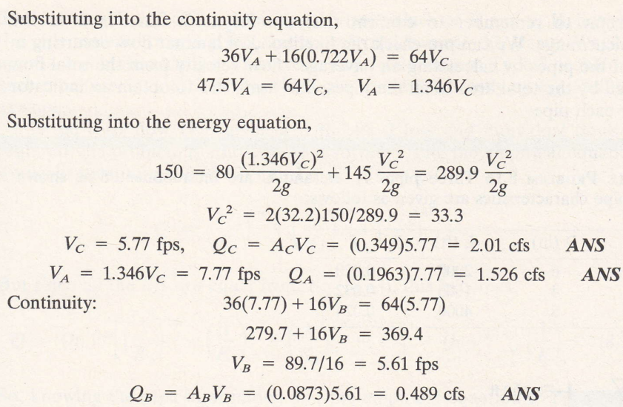

Slide 27
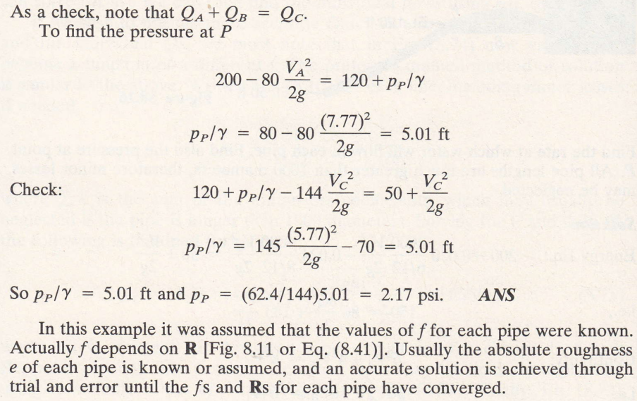

Slide 28
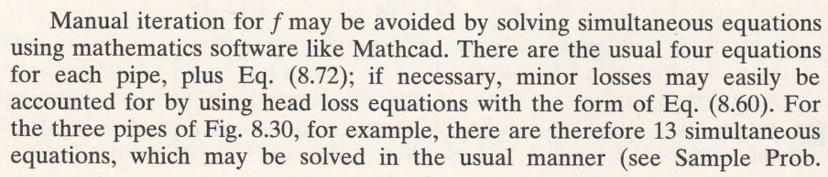
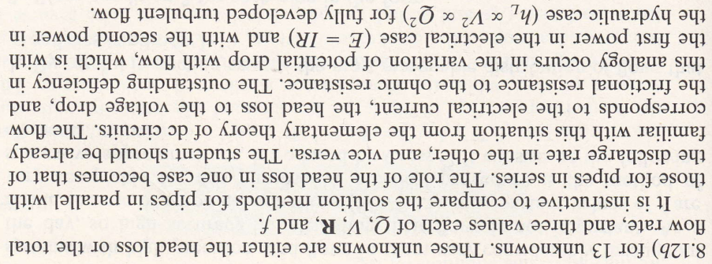

Slide 29
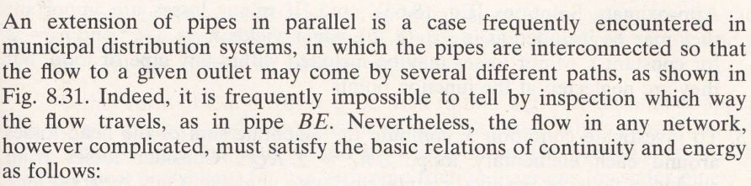
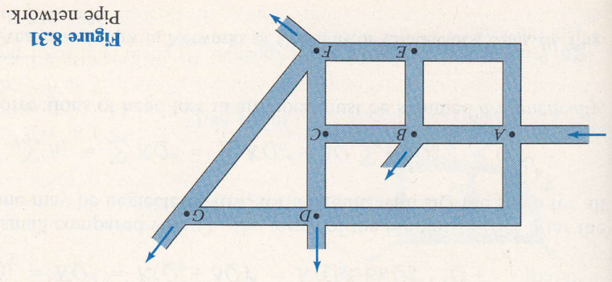
Pipe networks: Hardy Cross method

Slide 30
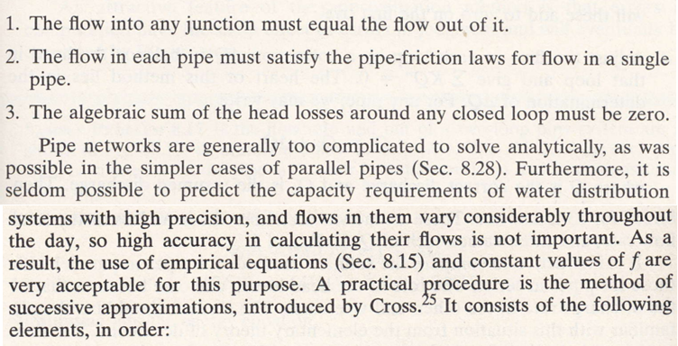
As it is the same as considering that there is no flow from the start point, therefore no head loss

Slide 31
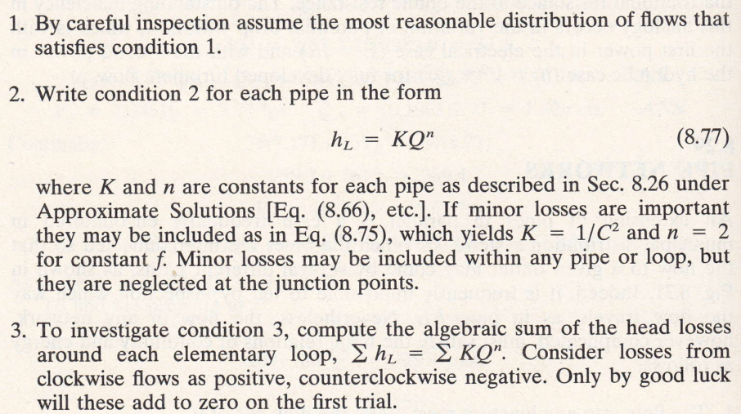

2. The flow in each pipe must satisfy the pipe-friction laws for flow in a single pipe

Slide 32
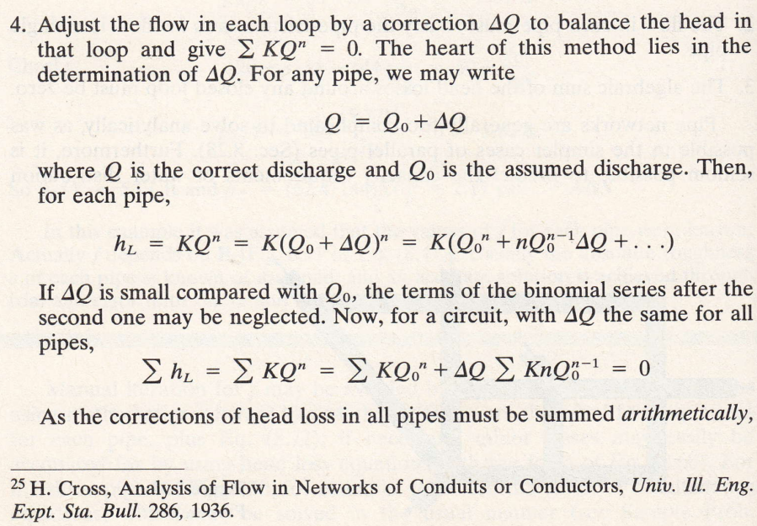

Slide 33
we may solve this equation for ΔQ by making ΔQ the subject of the formula in the above equation

Slide 34
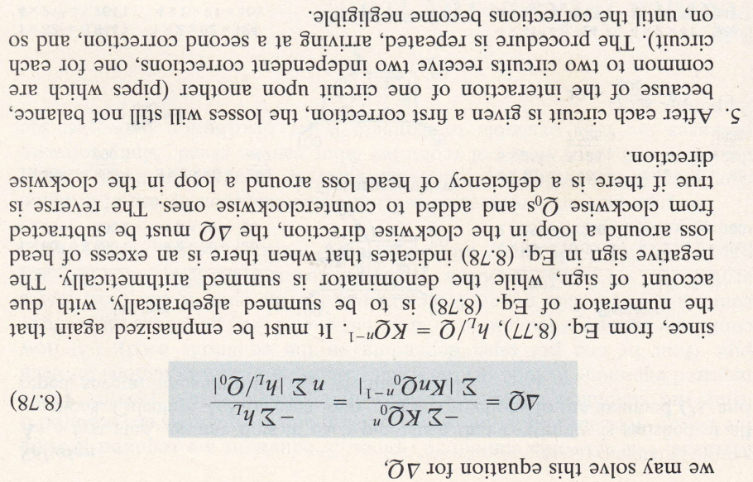
Since ;and
Therefore 8.78

Slide 35
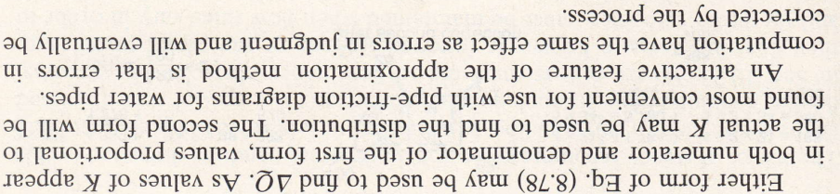

Slide 36
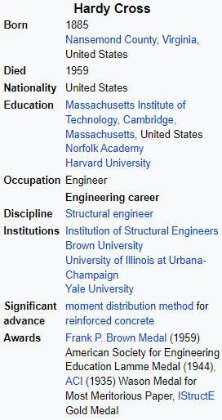
The Hardy Cross method is an iterative method for determining the flow in pipe network systems where the inputs and outputs are known, but the flow inside the network is unknown.^{[1]} The method was first published in November 1936 by its namesake, Hardy Cross, a structural engineering professor at the University of Illinois at Urbana–Champaign.^{[2]} The Hardy Cross method is an adaptation of the Moment distribution method, which was also developed by Hardy Cross as a way to determine the forces in statically indeterminate structures.
The introduction of the Hardy Cross method for analyzing pipe flow networks revolutionized municipal water supply design. Before the method was introduced, solving complex pipe systems for distribution was extremely difficult due to the nonlinear relationship between head loss and flow. The method was later made obsolete by computer solving algorithms employing the Newton-Raphson method or other numerical methods that eliminate the need to solve nonlinear systems of equations by hand.
In 1930, Hardy Cross published a paper called "Analysis of Continuous Frames by Distributing Fixed-End Moments" in which he described the moment distribution method, which would change the way engineers in the field performed structural analysis.^{[3]} The moment distribution method was used to determine the forces in statically indeterminate structures and allowed for engineers to safely design structures from the 1930s through the 1960s, till the computer oriented methods.^{[3]} In November 1936, Cross applied the same geometric method to solving pipe network flow distribution problems, and published a paper called "Analysis of flow in networks of conduits or conductors."^{[1]}

Slide 37
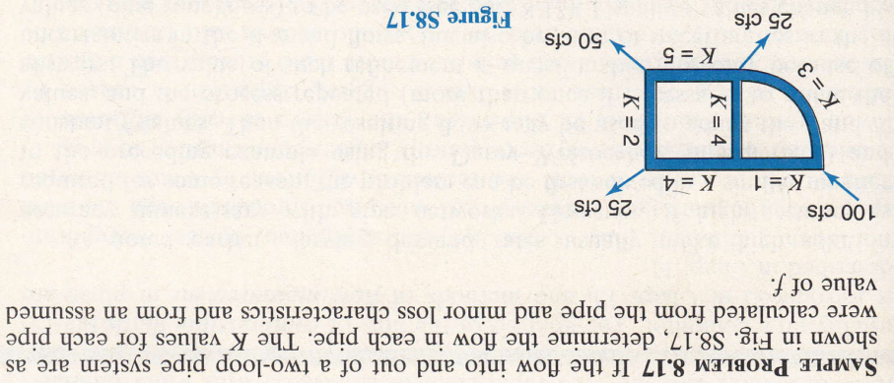

Slide 38
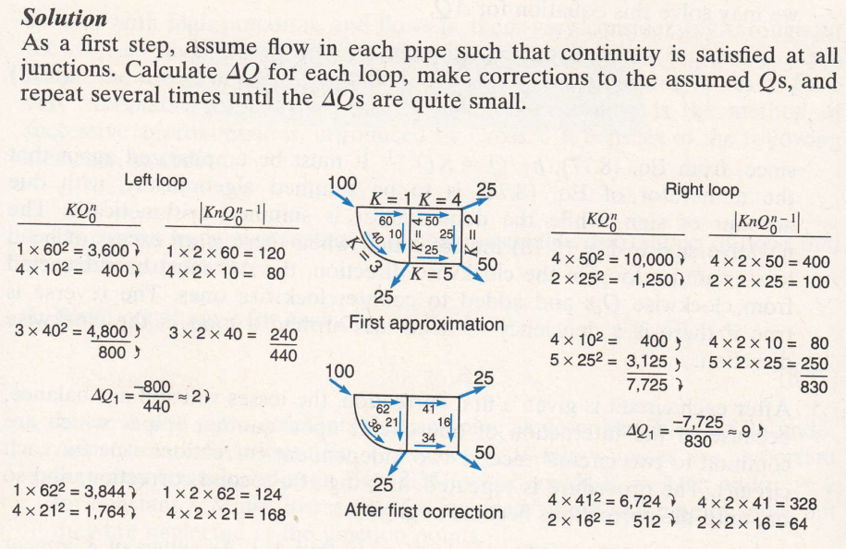

n=2
=10 + (2 + 9 )= 21
Q =50 – 9 = 41

Slide 39
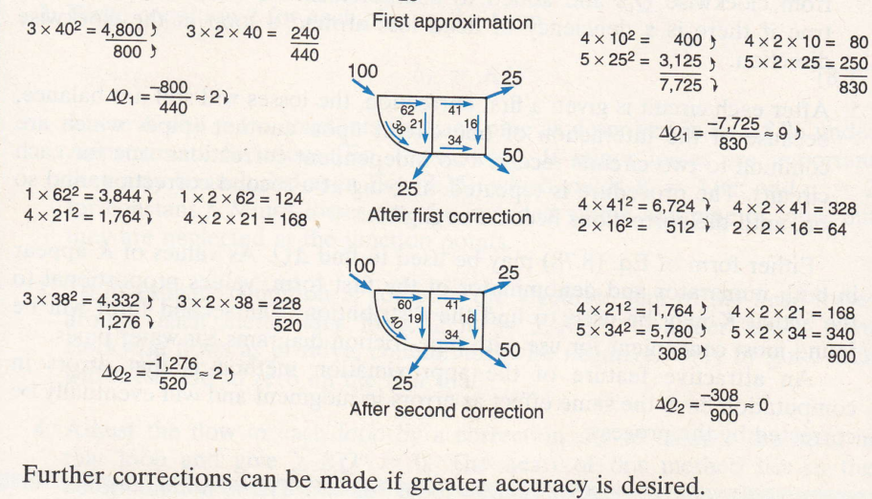

Slide 40
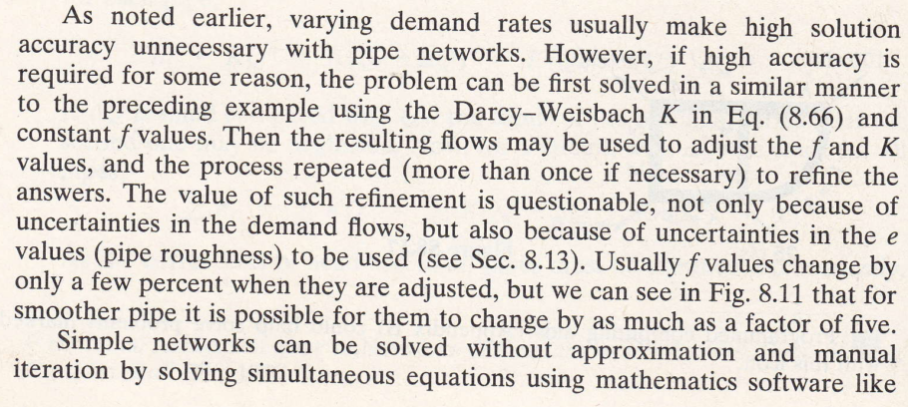

Slide 41
