Slide 1

Fluid Mechanics CEE 3311
LECTURE 16
Flow in Pipes
(Internal Flows)
L. Handia

Slide 2
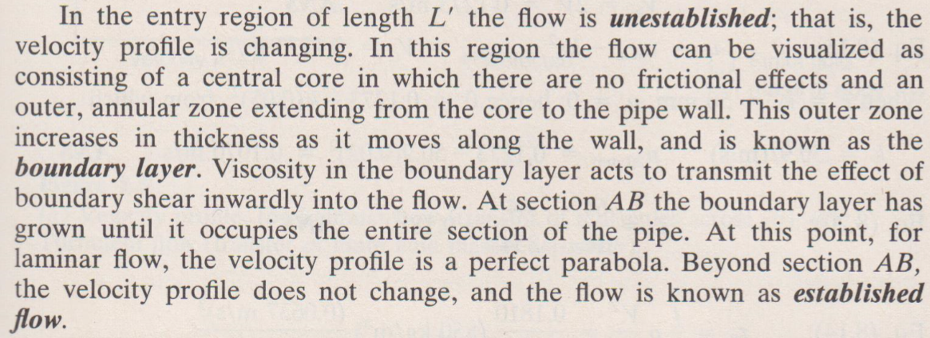
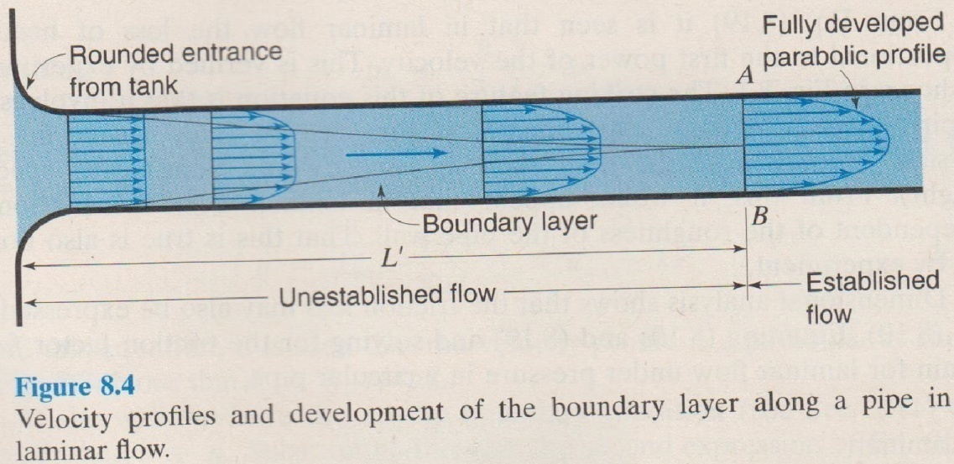
Boundary layer: Laminar flow

Slide 3
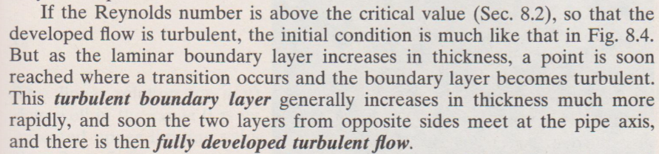
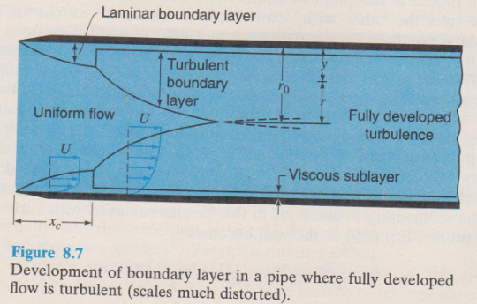
Boundary layer: Turbulent flow
The viscous sublayer is a layer where shear is predominantly due to viscosity alone. It is extremely thin, usually only a few hundredths of a mm, but its effect is great because of the very steep velocity gradient within it and because τ = μ du/dy in that region

Slide 4
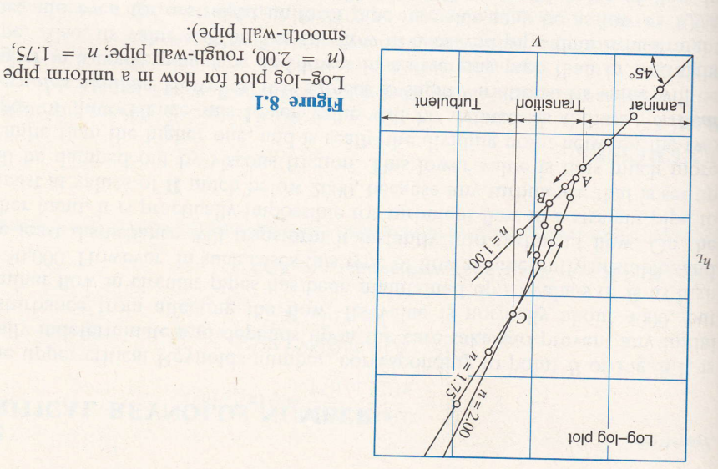
Laminar and turbulent flow
If the head loss in a given length of uniform pipe is measured at different velocities, it will be found that, as long as the velocity is low enough to secure laminar ﬂow, the head loss, due to friction, will be directly proportional to the velocity, as shown in the Fig.
But with increasing velocity, at some point B, where visual observation of dye injected in a transparent tube would show that the ﬂow changes from laminar to turbulent, there will be an abrupt increase in the rate at which the head loss varies.

Slide 5
Laminar and turbulent flow
If these two variables are plotted on log-log paper, it will be found that, after a certain transition region (BCA) has been passed, lines will be obtained with slopes ranging from about 1.75 to 2.00.
It is thus seen that for laminar ﬂow the drop in energy due to friction varies as V, while for turbulent ﬂow the friction varies as V^{n}, where n ranges from about 1.75 to 2. The lower value of 1.75 for turbulent ﬂow is found for pipes with very smooth walls; as the wall roughness increases, the value of n increases up to its maximum value of 2.
Point B is known as the higher critical point, and A as the lower critical point.

Slide 6
Laminar and turbulent flow
However, velocity is not the only factor that determines whether the ﬂow is laminar or turbulent. The criterion is Reynolds number, which has been discussed in previous lectures.
For a circular pipe the signiﬁcant linear dimension L is usually taken as the diameter D, and thus

Slide 7
Laminar and turbulent flow
Critical Reynolds Number
The upper critical Reynolds number, corresponding to point B of Figure is really indeterminate and depends upon the care taken to prevent any initial disturbance from affecting the ﬂow. Its value is normally about 4000 but laminar ﬂow in circular pipes has been maintained up to values of Re as high as 50,000. However, in such cases this type of ﬂow is inherently unstable, the least disturbance will transform it instantly into turbulent ﬂow.
On the other hand, it is practically impossible for turbulent ﬂow in a straight pipe to persist at values of Re much below 2000, because any turbulence that is set will be damped out by viscous friction.
However, for normal cases of ﬂow in straight pipes of uniform diameter and usual roughness, the critical value may be taken as Re_{crit} = 2000.

Slide 8
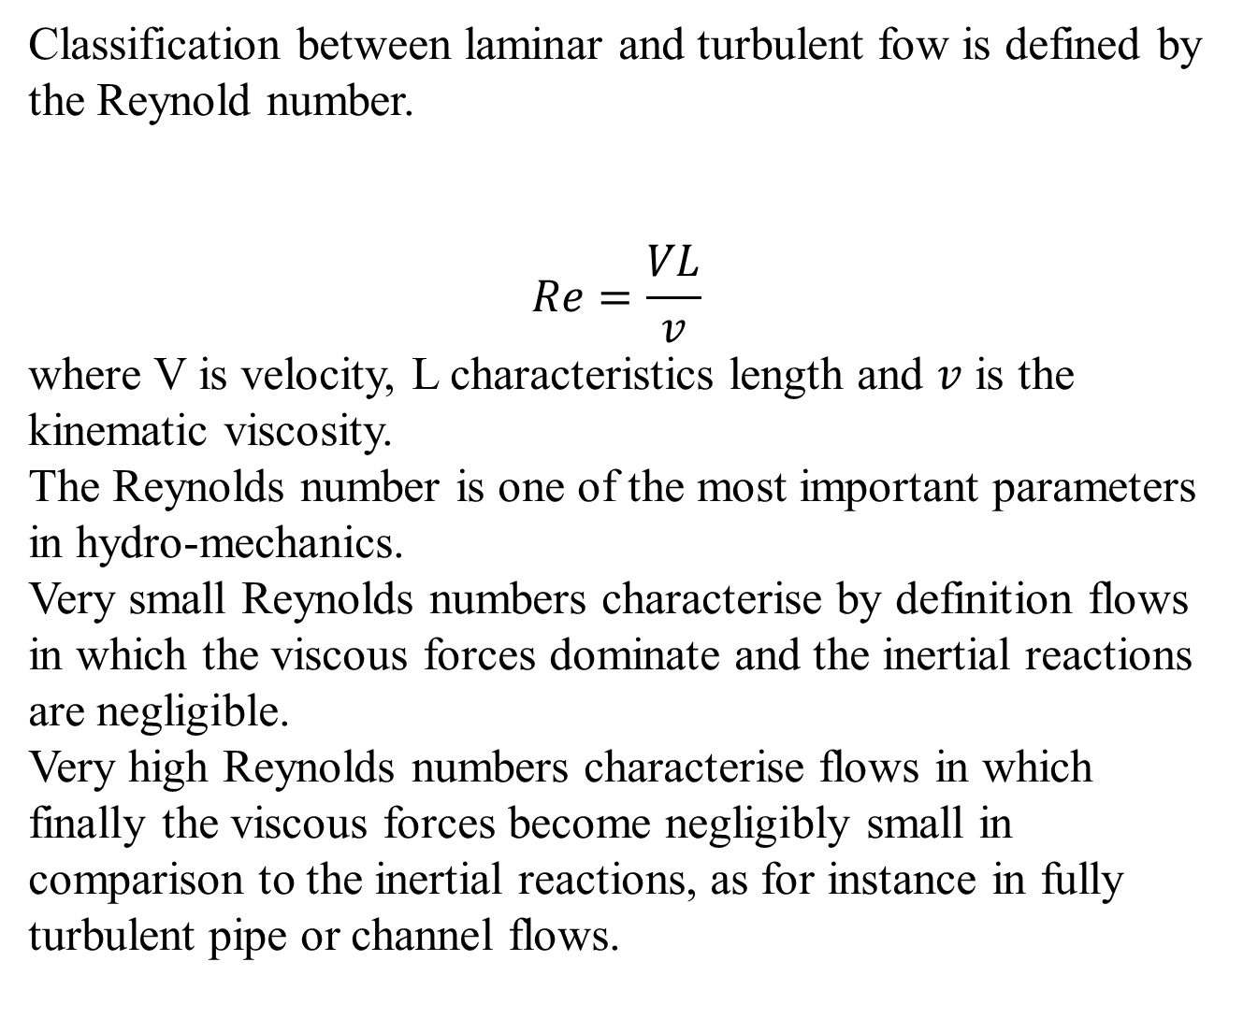

Slide 9
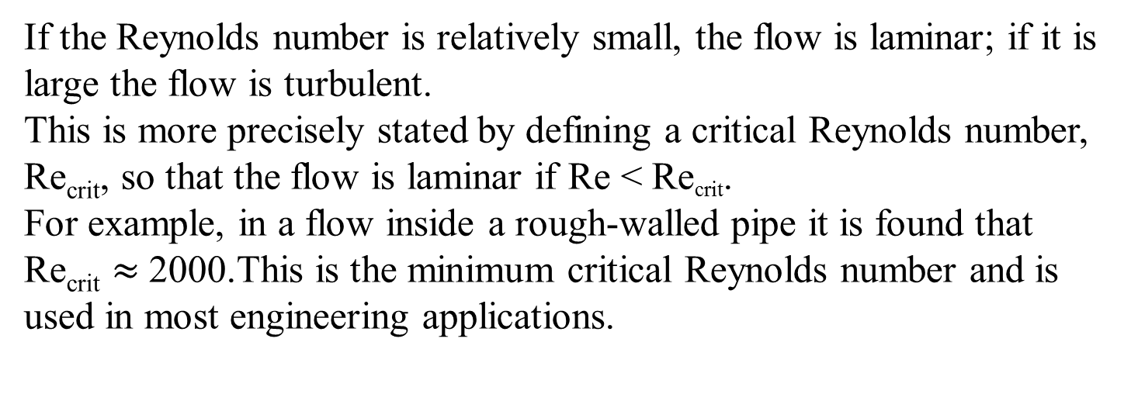

Slide 10
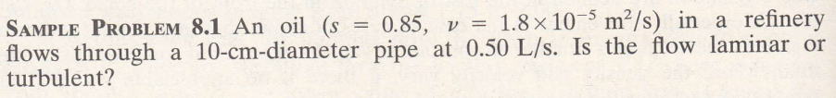
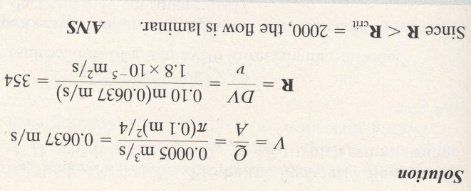
Laminar and turbulent flow

Slide 11
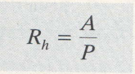
Hydraulic radius
For conduits having noncircular cross sections, some value other than the diameter must be used for the linear dimension in the Reynolds number. Such a characteristic is the hydraulic radius, deﬁned as
where A is the cross-sectional area of the ﬂowing ﬂuid, and P is the wetted perimeter, that portion of the perimeter of the cross section where there is contact between ﬂuid and solid boundary.

Slide 12
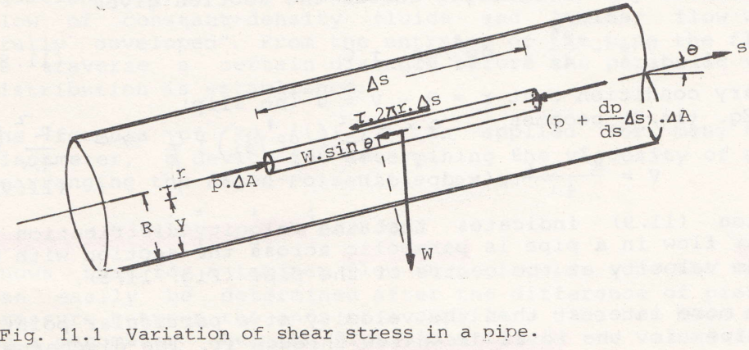
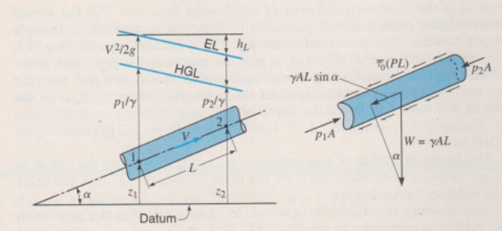
Laminar flow (Hagen-Poiseuille’s formula)
Consider steady flow in a conduit of uniform cross section A, not necessarily circular. The pressures at sections 1 and 2 are P₁ and P₂, respectively. The distance between them is Δs. For equilibrium in steady flow, the summation of forces acting on any fluid element must be equal to zero (i.e., ΣF = ma = 0). Thus in the direction of flow
2
1

Slide 13

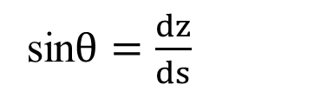

Laminar flow (Hagen-Poiseuille’s formula)
Where and . Therefore equation 11.1 reduces to
$$W=ρg ∆A ∆s$$
sin$θ=\frac{dz}{ds}$
$$− \frac{dP}{ds}∆s∆A−ρg ∆A ∆s\frac{dz}{ds} −τ2πr∆s=0$$
Δz

Slide 14
Laminar flow (Hagen-Poiseuille’s formula)
Divide by ΔA Δs
where P* = P + ρgz = piezometric pressure

Slide 15
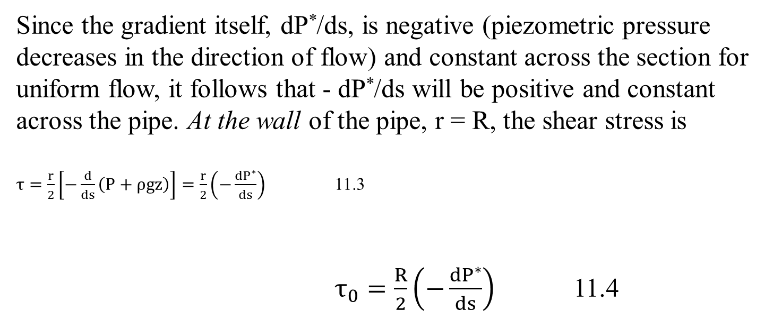
Laminar flow (Hagen-Poiseuille’s formula)
Since the gradient itself, dP*/ds, is negative (piezometric pressure decreases in the direction of flow) and constant across the section for uniform flow, it follows that - dP*/ds will be positive and constant across the pipe. At the wall of the pipe, r = R, the shear stress is
$τ=\frac{r}{2}\left[−\frac{d}{ds}\left(P+ρgz\right)\right]=\frac{r}{2}\left(−\frac{dP^{∗}}{ds}\right)$ 11.3
$τ_{0}=\frac{R}{2}\left(−\frac{dP^{∗}}{ds}\right)$ 11.4

Slide 16
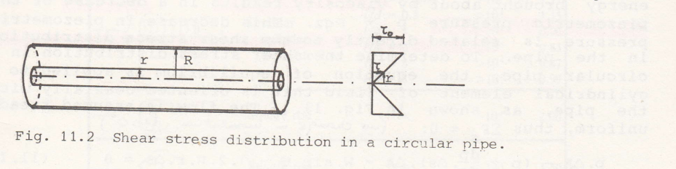

Laminar flow (Hagen-Poiseuille’s formula)
Thus, dividing 11.3 by 11,4 gives
$\frac{τ=\frac{r}{2}\left(−\frac{dP^{∗}}{ds}\right)}{τ_{0}=\frac{R}{2}\left(−\frac{dP^{∗}}{ds}\right)}$$\frac{τ}{τ_{0}}=\frac{r}{R_{0}}$$τ=\frac{r}{R_{0}}τ_{0}$ 11.5
Consequently $τ$ varies linearly with r from a value of zero at the centerline of the pipe to a maximum at the wall. This distribution of stress is represented graphically in Fig 11.2
Note: in the derivation of 11.5 no restrictions concerning laminar or turbulent flow have been made. Therefore, the law of linear distribution of shear stress over a circular section, represented by 11,5, holds for both flow conditions

Slide 17
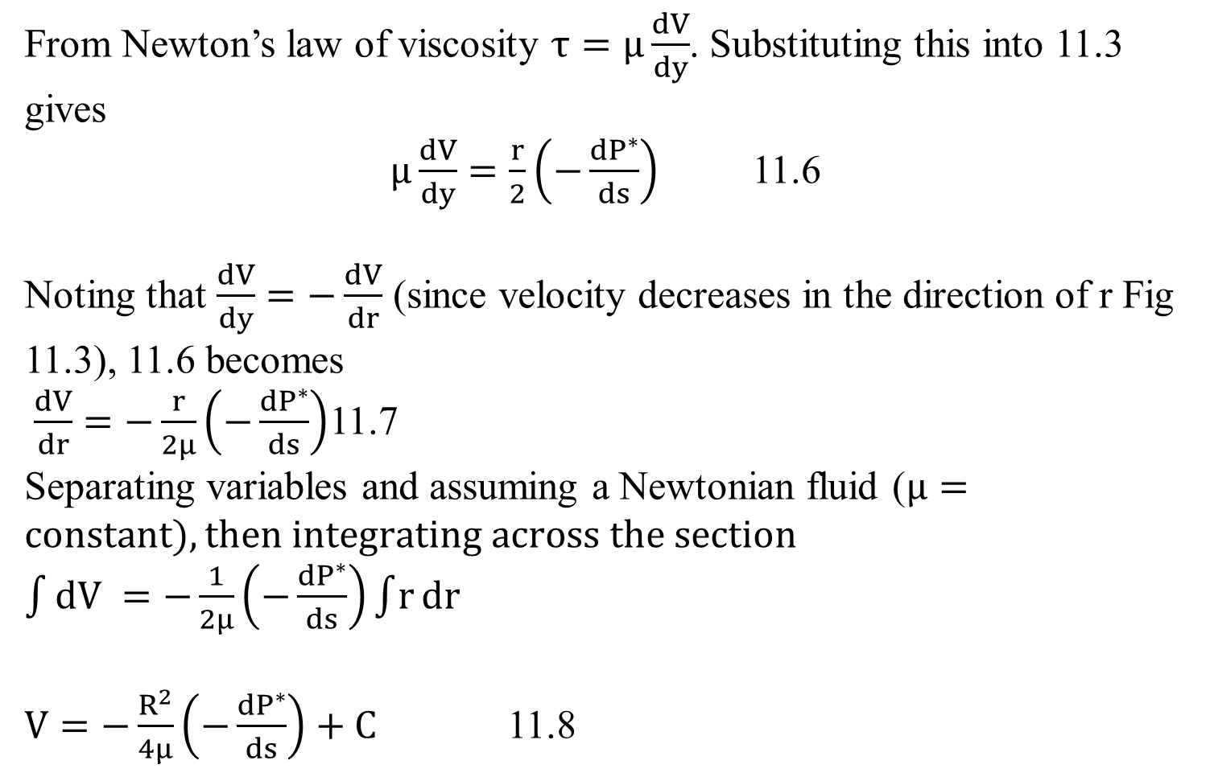
Steady laminar flow in circular pipes
From Newton’s law of viscosity $τ=μ\frac{dV}{dy}$. Substituting this into 11.3 gives
$μ\frac{dV}{dy}=\frac{r}{2}\left(−\frac{dP^{∗}}{ds}\right)$ 11.6
Noting that $\frac{dV}{dy}=−\frac{dV}{dr}$ (since velocity decreases in the direction of r Fig 11.3), 11.6 becomes
$\frac{dV}{dr}=−\frac{r}{2μ}\left(−\frac{dP^{∗}}{ds}\right)$11.7
Separating variables and assuming a Newtonian fluid ($μ=constant), then integrating across the section$
$\int{dV} =−\frac{1}{2μ}\left(−\frac{dP^{∗}}{ds}\right)\int{r}dr$
$V=−\frac{R^{2}}{4μ}\left(−\frac{dP^{∗}}{ds}\right)+C$ 11.8

Slide 18
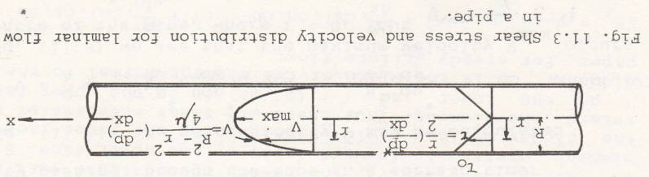
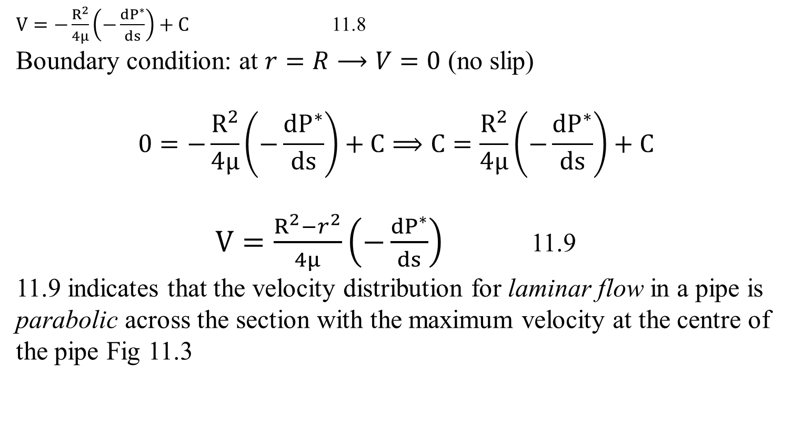
Steady laminar flow in circular pipes
$V=−\frac{R^{2}}{4μ}\left(−\frac{dP^{∗}}{ds}\right)+C$ 11.8
Boundary condition: at $r=R⟶V=0$ (no slip)
$$0=−\frac{R^{2}}{4μ}\left(−\frac{dP^{∗}}{ds}\right)+C⟹C=\frac{R^{2}}{4μ}\left(−\frac{dP^{∗}}{ds}\right)+C$$
$V=\frac{R^{2}−r^{2}}{4μ}\left(−\frac{dP^{∗}}{ds}\right)$ 11.9
11.9 indicates that the velocity distribution for laminar flow in a pipe is parabolic across the section with the maximum velocity at the centre of the pipe Fig 11.3
Putting this in 11.8 becomes

Slide 19
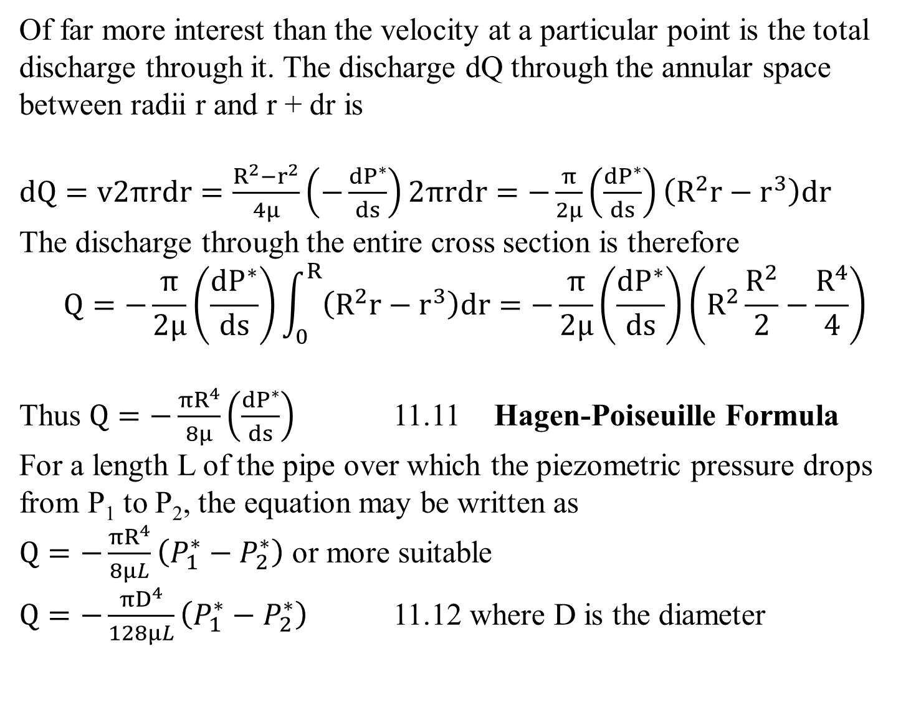
Steady laminar flow in circular pipes
Of far more interest than the velocity at a particular point is the total discharge through it. The discharge dQ through the annular space between radii r and r + dr is
$dQ=v2πrdr=\frac{R^{2}−r^{2}}{4μ}\left(−\frac{dP^{∗}}{ds}\right)2πrdr=−\frac{π}{2μ}\left(\frac{dP^{∗}}{ds}\right)\left(R^{2}r−r^{3}\right)dr$
The discharge through the entire cross section is therefore
$$Q=−\frac{π}{2μ}\left(\frac{dP^{∗}}{ds}\right)\int_{0}^{R}{\left(R^{2}r−r^{3}\right)dr=−\frac{π}{2μ}\left(\frac{dP^{∗}}{ds}\right)\left(R^{2}\frac{R^{2}}{2}−\frac{R^{4}}{4}\right)}$$
Thus $Q=−\frac{πR^{4}}{8μ}\left(\frac{dP^{∗}}{ds}\right)$ 11.11 Hagen-Poiseuille Formula
For a length L of the pipe over which the piezometric pressure drops from P₁ to P₂, the equation may be written as
$Q=−\frac{πR^{4}}{8μL}\left(P_{1}^{∗}−P_{2}^{∗}\right)$ or more suitable
$Q=−\frac{πD^{4}}{128μL}\left(P_{1}^{∗}−P_{2}^{∗}\right)$ 11.12 where D is the diameter
dr

Slide 20
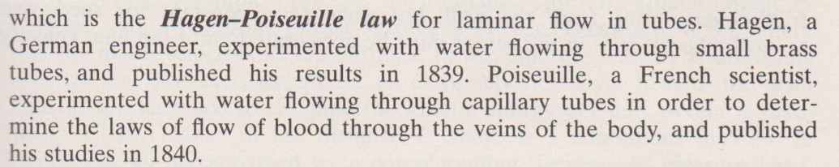
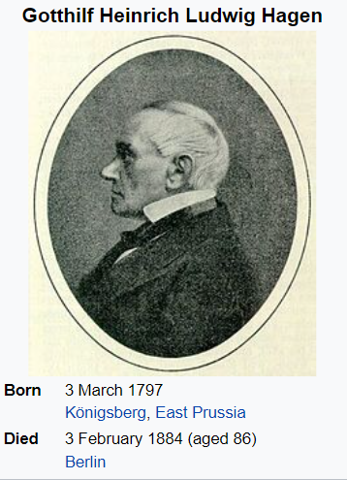
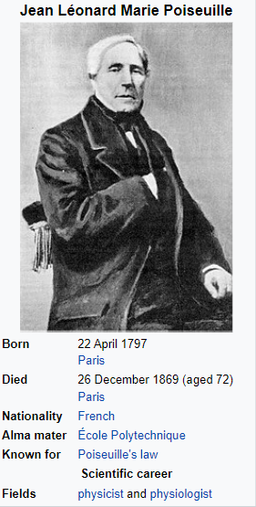
Laminar flow (Hagen-Poiseuille’s formula)

Slide 21
Laminar flow (Hagen-Poiseuille’s formula)
In nonideal fluid dynamics, the Hagen–Poiseuille equation, also known as the Hagen–Poiseuille law, Poiseuille law or Poiseuille equation, is a physical law that gives the pressure drop in an incompressible and Newtonian fluid in laminar flow flowing through a long cylindrical pipe of constant cross section. It can be successfully applied to air flow in lung alveoli, or the flow through a drinking straw or through a hypodermic needle. It was experimentally derived independently by Jean Léonard Marie Poiseuille in 1838 and Gotthilf Heinrich Ludwig Hagen, and published by Poiseuille in 1840–41 and 1846. The theoretical justification of the Poiseuille law was given by George Stokes in 1845.

Slide 22

Steady laminar flow in circular pipes
Eq. 11.12 is strictly applicable only to the laminar flow of constant density fluids and laminar flow which is "fully developed". From the entrance of the pipe the fluid has to traverse a certain distance before the parabolic velocity distribution is established.
The formula of Eq.11.12 is applied for many types of viscometer, a device for determining the viscosity of a fluid.
Rearranging the Hagen-Poiseuille law as
shows that for a laminar flow in a circular tube, the viscosity can easily be determined after the difference of piezometric pressure between the ends of a capillary tube has been measured by a manometer. When the fluid is a liquid, the volume flow rate Q may be determined simply by collecting and measuring the quantity passing through the tube in a certain time.

Slide 23

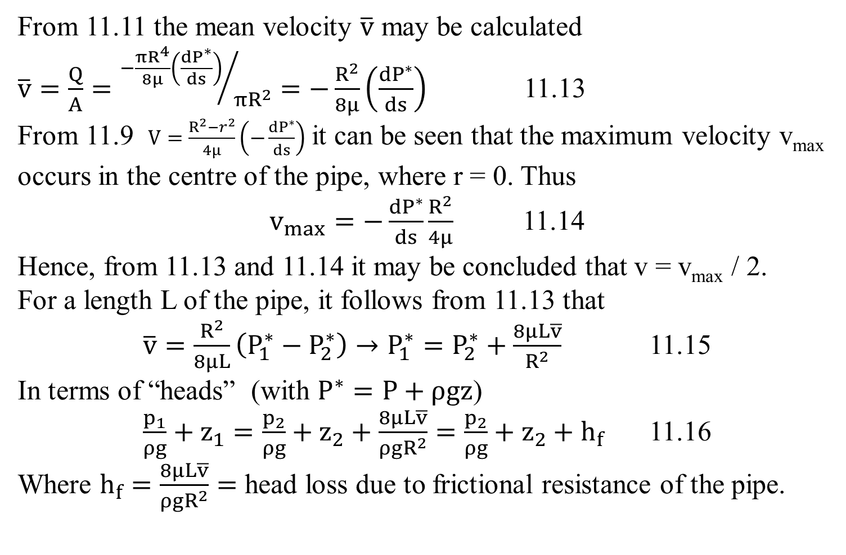
Steady laminar flow in circular pipes
From 11.11 the mean velocity $\overline{v}$ may be calculated
$\overline{v}=\frac{Q}{A}={−\frac{πR^{4}}{8μ}\left(\frac{dP^{∗}}{ds}\right)}/{πR^{2}}=−\frac{R^{2}}{8μ}\left(\frac{dP^{∗}}{ds}\right)$ 11.13
From 11.9 $V=\frac{R^{2}−r^{2}}{4μ}\left(−\frac{dP^{∗}}{ds}\right)$ it can be seen that the maximum velocity v_{max} occurs in the centre of the pipe, where r = 0. Thus
$v_{max}=−\frac{dP^{∗}}{ds}\frac{R^{2}}{4μ}$ 11.14
Hence, from 11.13 and 11.14 it may be concluded that v = v_{max} / 2.
For a length L of the pipe, it follows from 11.13 that
$\overline{v}=\frac{R^{2}}{8μL}\left(P_{1}^{∗}−P_{2}^{∗}\right)→P_{1}^{∗}=P_{2}^{∗}+\frac{8μL\overline{v}}{R^{2}}$ 11.15
In terms of “heads” (with $P^{∗}=P+ρgz$)
$\frac{p_{1}}{ρg}+z_{1}=\frac{p_{2}}{ρg}+z_{2}+\frac{8μL\overline{v}}{{ρgR}^{2}}=\frac{p_{2}}{ρg}+z_{2}+h_{f}$ 11.16
Where $h_{f}=\frac{8μL\overline{v}}{{ρgR}^{2}}=$ head loss due to frictional resistance of the pipe.
and dividing by ρg
Equation 11.16 is the same as the energy equation except there are no velocity, turbine and pump heads

Slide 24
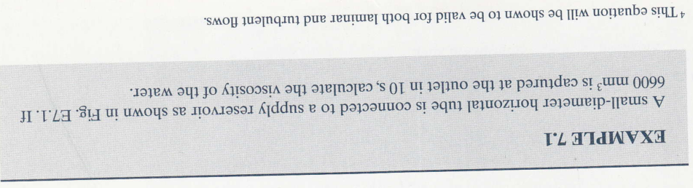
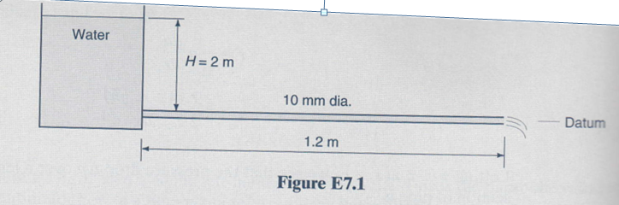

Slide 25
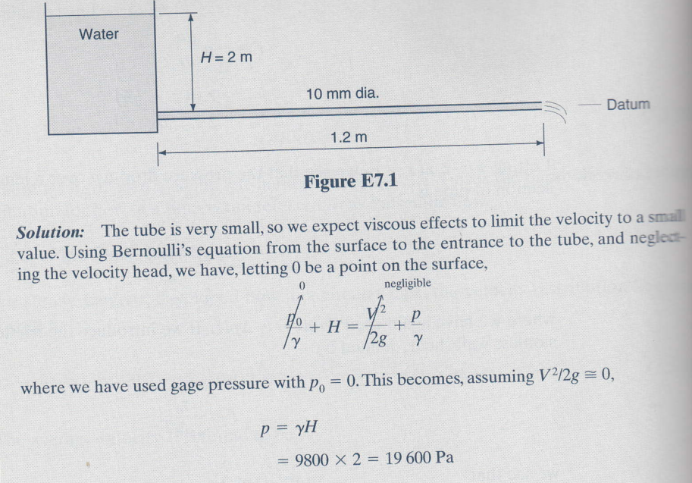

Slide 26
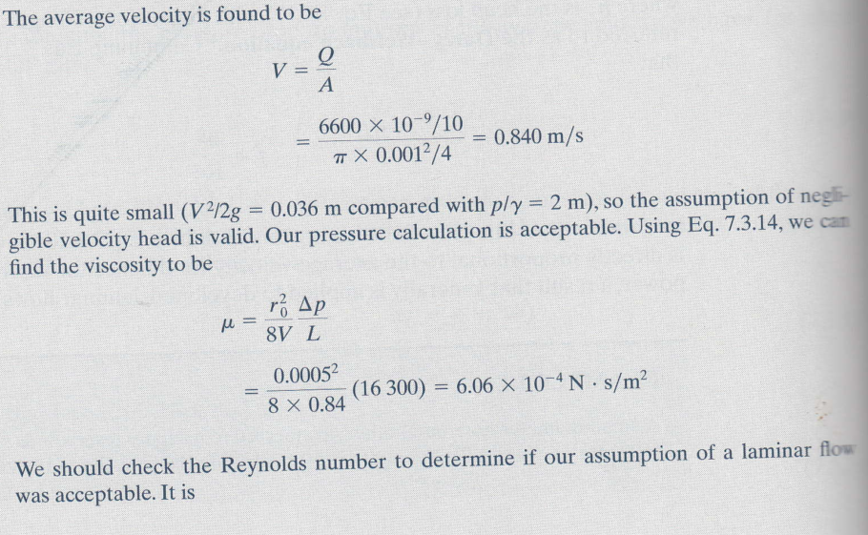


Slide 27
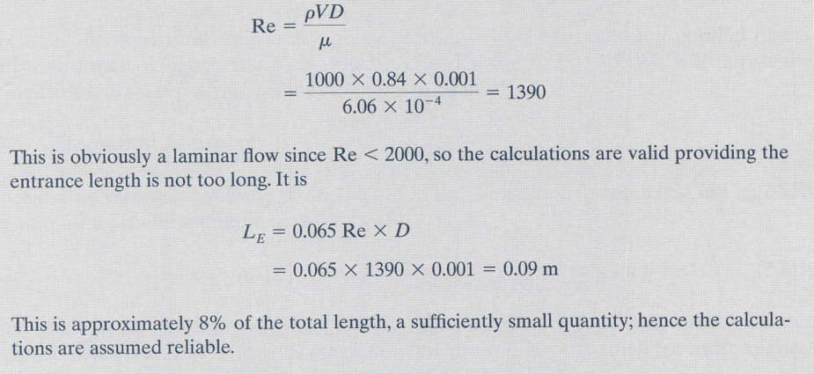

Slide 28
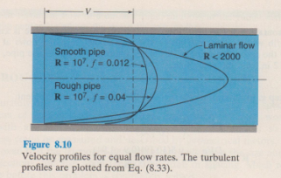
Turbulent flow (Darcy-Weisbach formula)
Velocity profile in turbulent flow
In Fig. 8.10 may be seen profiles for both a smooth and a rough pipe.
Comparing the turbulent-flow velocity profiles with the laminar-flow
velocity proﬁle (Fig. 8.10) shows the turbulent-flow profiles to be much flatter near the central portion of the pipe and steeper near the wall.
It is also noticeable that the turbulent proﬁle for the smooth pipe is ﬂatter near the central section (i.e., blunter) than for the rough pipe.
In contrast, the velocity proﬁle in laminar ﬂow is independent of pipe roughness.

Slide 29


Turbulent flow (Darcy-Weisbach formula)
In the previous lecture 15, the shear force on a flat plate, friction drag, was expressed as
The shear stress on a flat plate is then .
For pipe flow it is customary to express τ₀ in a similar manner; however, we use the mean velocity as the reference velocity, and the coefficient of proportionality is given as f/4 instead of C_{f}. Here f is called the resistance coefficient, or more usual, the friction factor of the pipe.

Slide 30
Turbulent flow (Darcy-Weisbach formula)
Thus we have
12.5
In section on Laminar Flow it was found that the shear stress at the wall of the pipe
11.4
Equating 12.5 and 11.4

Slide 31

Turbulent flow (Darcy-Weisbach formula)
12.6 Darcy Weisbach Equation
where h_{L} = head loss created by viscous effects and is equal to the change of piezometric head.
Although the Darcy Weisbach Equation is for turbulent flow, it can still be used for laminar flow. For laminar flow, where (Eq.11.16), it can easily be shown that
f = 64/Re 12.7
Hence, if Re is less than 2,000 (laminar flow), one may use Eq. 12.6 with the value of f as given by Eq. 12.7

Slide 32
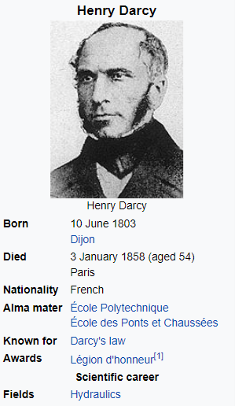
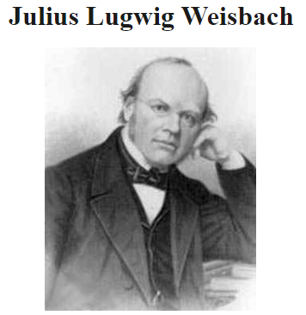
Turbulent flow (Darcy-Weisbach formula)

Slide 33
Turbulent flow (Darcy-Weisbach formula)
As a member of the Corps, Dracy built an impressive pressurized water distribution system in Dijon following the failure of attempts to supply adequate fresh water by drilling wells. The system carried water from Rosoir Spring 12.7 kilometres (7.9 mi) away through a covered aqueduct (watercourse) to reservoirs near the city, which then fed into a network of 28,000 meters of pressurized pipes delivering water to much of the city. The system was fully closed and driven by gravity, and thus required no pumps with just sand acting as a filter. He was also involved in many other public works in and around Dijon, as well as in the politics of the Dijon city government.
During this period he modified the Prony equation for calculating head loss due to friction, which after further modification by Julius Weisbach would become the well-known Darcy–Weisbach equation still in use today.
In 1848 he became Chief Engineer for the département of which Dijon is the capital. Soon thereafter he left Dijon due to political pressure, but was promoted to Chief Director for Water and Pavements and took up office in Paris. While in that position, he was able to focus more on his hydraulics research, especially on flow and friction losses in pipes. During this period he improved the design of the Pitot tube, into essentially the form used today.
He resigned his post in 1855 due to poor health, but was permitted to continue his research in Dijon. In 1855 and 1856 he conducted column experiments that established what has become known as Darcy's law; initially developed to describe flow through sands, it has since been generalized to a variety of situations and is in widespread use today. The unit of measure of material permeability, the darcy is named in his honour.
Darcy died of pneumonia while on a trip to Paris in 1858, and is buried in Cimetière de Dijon (formerly known as Péjoces) in Dijon.
Julius Ludwig Weisbach (born 10 August 1806 in Mittelschmiedeberg (now Mildenau Municipality), Erzgebirge, died 24 February 1871, Freiberg) was a German mathematician and engineer.
Weisbach studied at the Bergakademie in Freiberg from 1822 - 1826. After that, he studied with Carl Friedrich Gauss in Göttingen and with Friedrich Mohs in Vienna.^{[1]}
In 1831 he returned to Freiberg where he worked as mathematics teacher at the local Gymnasium. In 1833 he became teacher for Mathematics and the Theory of Mountain Machines at the Freiberg Bergakademie. In 1836 he was promoted to Professor for applied mathematics, mechanics, theory of mountain machines and so-called Markscheidekunst.^{[2]}
Weisbach wrote an influential book for mechanical engineering students, called Lehrbuch der Ingenieur- und Maschinenmechanik, which has been expanded and reprinted on numerous occasions between 1845 and 1863.^{[3]}
He also refined the Darcy equation into the still widely used Darcy–Weisbach equation.
In 1868 he was elected a foreign member of the Royal Swedish Academy of Sciences.

Slide 34
Chart (and equations) for friction factor
The friction factor f depends on the various quantities that affect the ﬂow, written as
f = f (ρ, μ, V, D, e) (7.6.24)
where the average wall roughness height e accounts for the influence of the wall roughness elements. A dimensional analysis, not covered in this course, provides us with
where e/D is the relative roughness and the first term is Reynolds number.
Experimental data that relate the friction factor to the Reynolds number have been obtained for fully developed pipe ﬂow over a wide range of wall roughnesses. The results of these data are presented in Fig. 7.13, which is commonly referred to as the Moody diagram.
Wall roughness leads to increased turbulence and fluid mixing in the boundary layer. This phenomenon manifests itself as increased turbulent and wall shear stress. For most surfaces the increased skin friction depends somehow on ‘k,’ the roughness height.

Slide 35
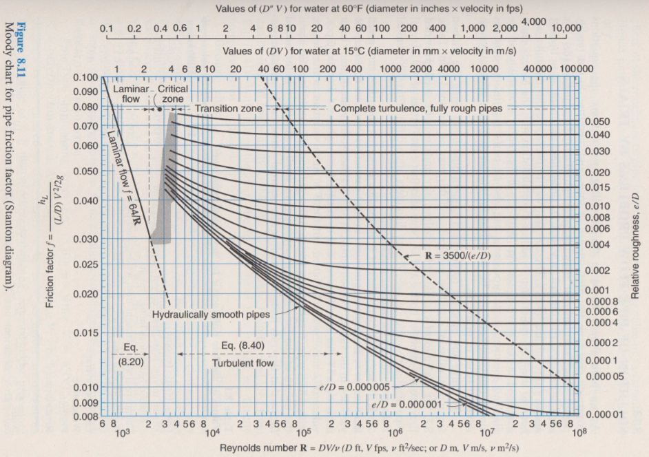

Slide 36
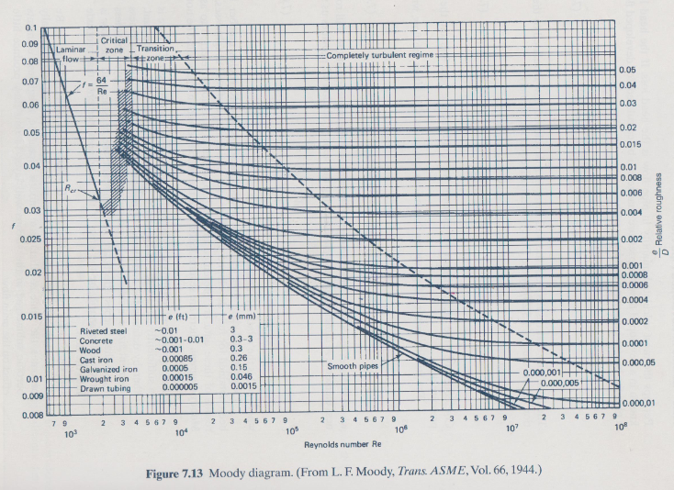

Slide 37
There are several features of the Moody diagram that should be noted.
    For a given wall roughness, measured by the relative roughness e/D, there is a sufficiently large value of Re above which the friction factor is constant, thereby defining the completely turbulent regime. The average roughness element size e is substantially greater than the viscous wall layer thickness δ_{v}, so that viscous effects are not significant; the resistance to the flow is produced primarily by the drag of the roughness elements that protrude into the flow.

Slide 38
    For the smaller relative roughness e/D values it is observed that, as Re decreases, the friction factor increases in the transition zone and eventually becomes the same as that of a smooth pipe. The roughness elements become submerged in the viscous wall layer so that they produce little effect on the main flow.

Slide 39
    For Reynolds numbers less than 2000, the friction factor of laminar flow is shown. The critical zone couples the turbulent flow to the laminar flow and may represent an oscillating flow that alternately exists between turbulent and laminar flow.

Slide 40
    The e values in this diagram are for new pipes. With age a pipe will corrode and become fouled, changing both the roughness and the pipe diameter, with a resulting increase in the friction factor. Such factors should be included in design considerations; they will not be reviewed in this course.

Slide 41
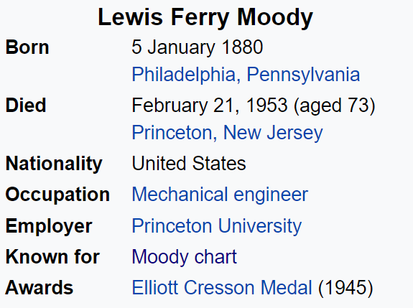
In 1944, Lewis Ferry Moody plotted the Darcy–Weisbach friction factor against Reynolds number Re for various values of relative roughness ε / D.^{[1]} This chart became commonly known as the Moody Chart or Moody Diagram. It adapts the work of Hunter Rouse^{[2]} but uses the more practical choice of coordinates employed by R. J. S. Pigott,^{[3]} whose work was based upon an analysis of some 10,000 experiments from various sources.^{[4]} Measurements of fluid flow in artificially roughened pipes by J. Nikuradse^{[5]} were at the time too recent to include in Pigott's chart.
The chart's purpose was to provide a graphical representation of the function of C. F. Colebrook in collaboration with C. M. White,^{[6]} which provided a practical form of transition curve to bridge the transition zone between smooth and rough pipes, the region of incomplete turbulence

Slide 42
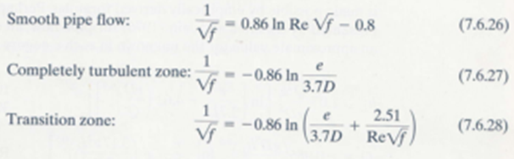
Empirical equations for the moody diagram
The following empirical equations represent the Moody diagram for Re > 4000:
Good approximations can be made for the head loss in conduits with noncircular cross sections by using the hydraulic radius R.
The transition zone equation (7.6.28) that couples the smooth pipe equation to the completely turbulent regime equation is known as the Colebrook equation. Note that Eq.7.6.26 is the Colebrook equation with e = 0 (since it is smooth), and Eq. 7.6.27 is the Colebrook equation with Re = ∞.

Slide 43
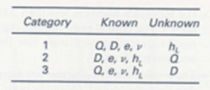
Solution of pipe flow problems by trials
Three categories of problems can be identified for developed turbulent flow in a pipe length L:
A category 1 problem is straightforward and requires no iteration procedure when using the Moody diagram.
Category 2 and 3 problems are more like problems encountered in
engineering design situations and require an iterative trial-and-error process when using the Moody diagram.

Slide 44
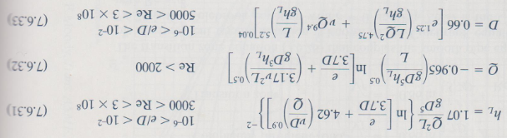
Solution of pipe flow problems using empirical equations
An alternative to using the Moody diagram that avoids any trial-and-error process is made possible by empirically derived formulas.
Perhaps the best of such formulas were presented by Swamee and Jain (1976) for pipe ﬂow; an explicit expression that provides an approximate value for the unknown in each category above is as follows:

Slide 45
Solution of pipe flow problems using empirical equations
Equation 7.6.32 is as accurate as the Moody diagram, and Eqs. 7.6.31 and 7.6.33 are accurate to within approximately 2% of the Moody diagram. These tolerances are acceptable for engineering calculations. It is important to realise that the Moody diagram is based on experimental data that likely is accurate to within no more than 5%.
Hence the foregoing three formulas of Swamee and Jain, which can easily be input on a programmable hand-held calculator or computer, are often used by design engineers.

Slide 46
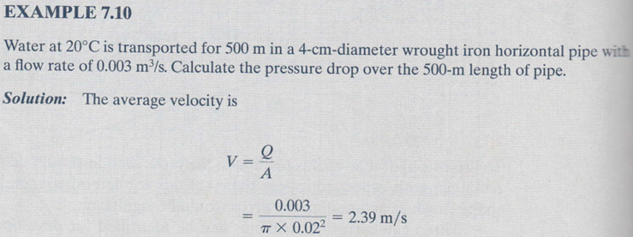
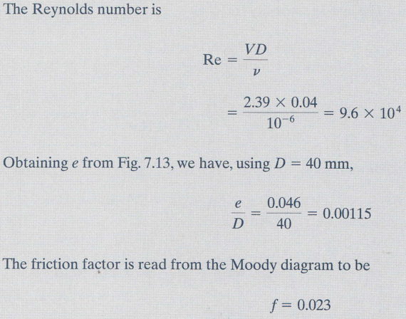

Slide 47
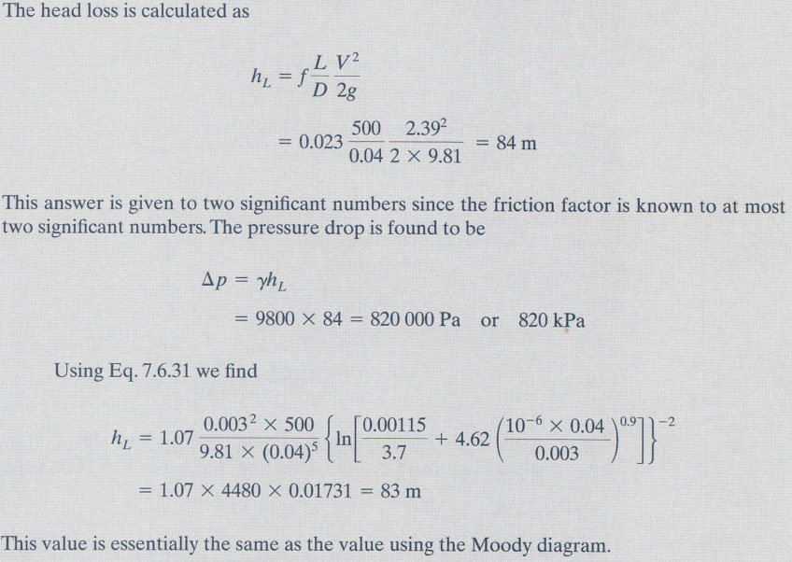

Slide 48
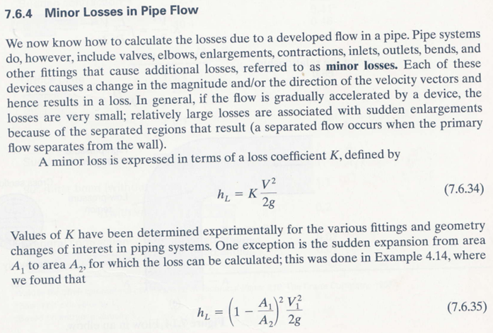
Minor losses in pipe flow

Slide 49
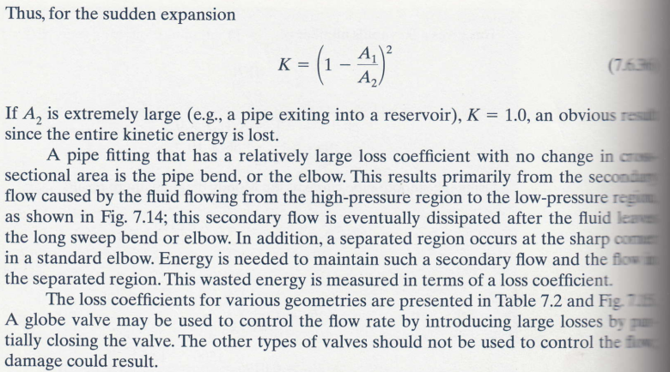
Minor losses in pipe flow

Slide 50
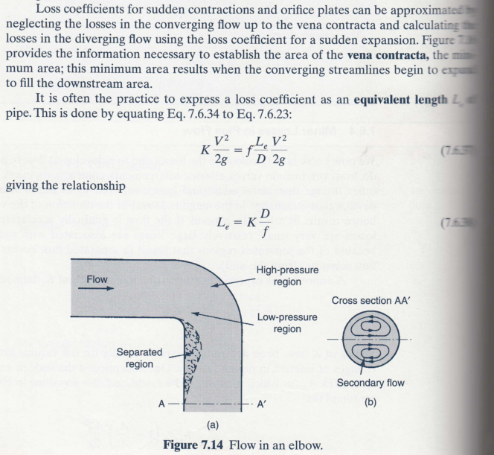


Minor losses in pipe flow

Slide 51
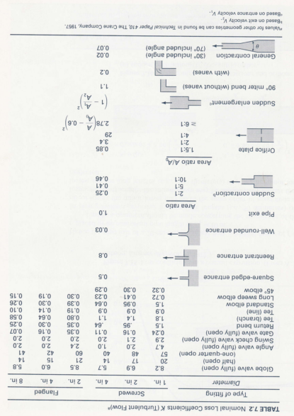

Slide 53
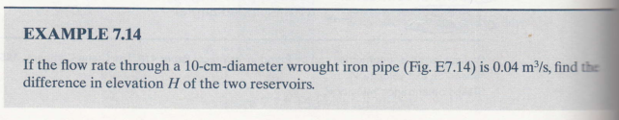
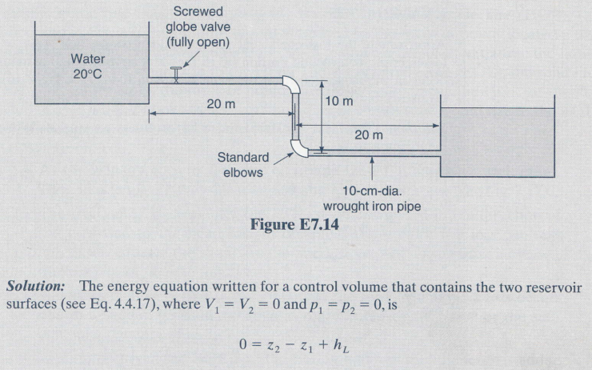


Slide 54
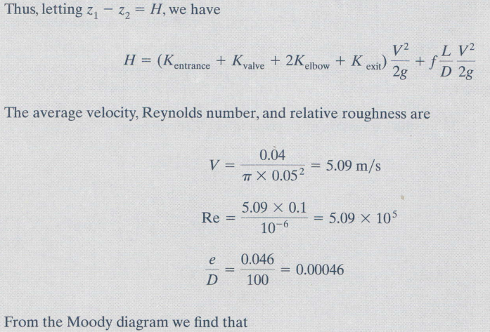

Slide 55
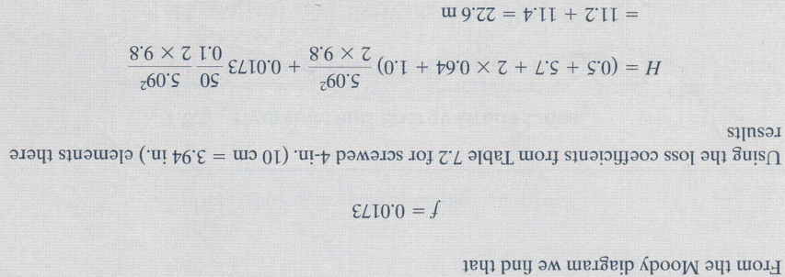

Difference in elevation between the two reservoirs is equal to the head loss between the two reservoirs

