Slide 1
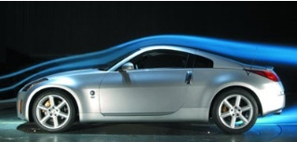
Fluid Mechanics CEE 3311
LECTURE 15
Flow of a Real Fluid
(External Flows)
L. Handia

Slide 2
Real fluid

Slide 3
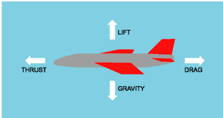

Forces on immersed bodies
When bodies are completely surrounded by a ﬂowing ﬂuid, as for example are airplanes, birds, automobiles, raindrops, submarines, and ﬁsh, the ﬂows are known as external ﬂows.
Such a body, wholly immersed in a homogeneous ﬂuid, may be subject to two kinds of forces arising from relative motion between the body and the ﬂuid.
These forces are termed the drag and the lift, depending on whether the force is parallel to the motion or perpendicular to it, respectively.

Slide 4
Forces on immersed bodies
Fluid mechanics draws no distinction between two cases of relative motion, namely, when a body moves rectilinearly at constant speed through a stationary ﬂuid or when a ﬂuid travels at constant velocity past a stationary body.
Thus it is possible to test airplane models in wind tunnels and torpedo models in water tunnels and predict with conﬁdence the behavior of their prototypes when moving through still ﬂuid.
For instructional purposes, it is somewhat simpler to ﬁx our ideas on the stationary body in the moving ﬂuid, while the practical result desired is more frequently associated with a body moving through still ﬂuid such as a flying plane & moving vehicle.

Slide 5
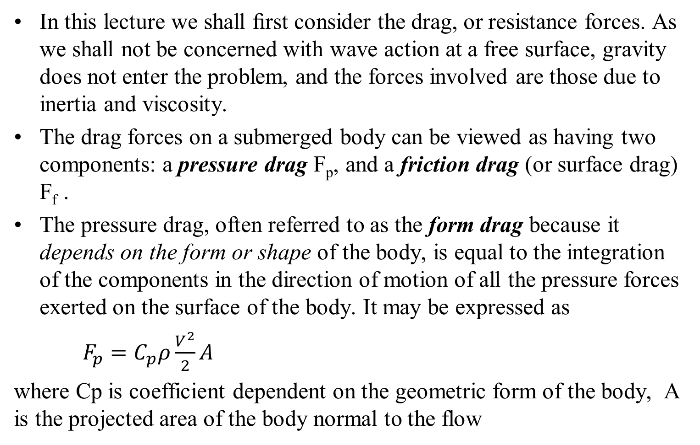
Forces on immersed bodies
In this lecture we shall ﬁrst consider the drag, or resistance forces. As we shall not be concerned with wave action at a free surface, gravity does not enter the problem, and the forces involved are those due to inertia and viscosity.
The drag forces on a submerged body can be viewed as having two components: a pressure drag F_{p}, and a friction drag (or surface drag) F_{f} .
The pressure drag, often referred to as the form drag because it depends on the form or shape of the body, is equal to the integration of the components in the direction of motion of all the pressure forces exerted on the surface of the body. It may be expressed as
$F_{p}=C_{p}ρ\frac{V^{2}}{2}A$
where Cp is coefficient dependent on the geometric form of the body, A is the projected area of the body normal to the flow

Slide 6
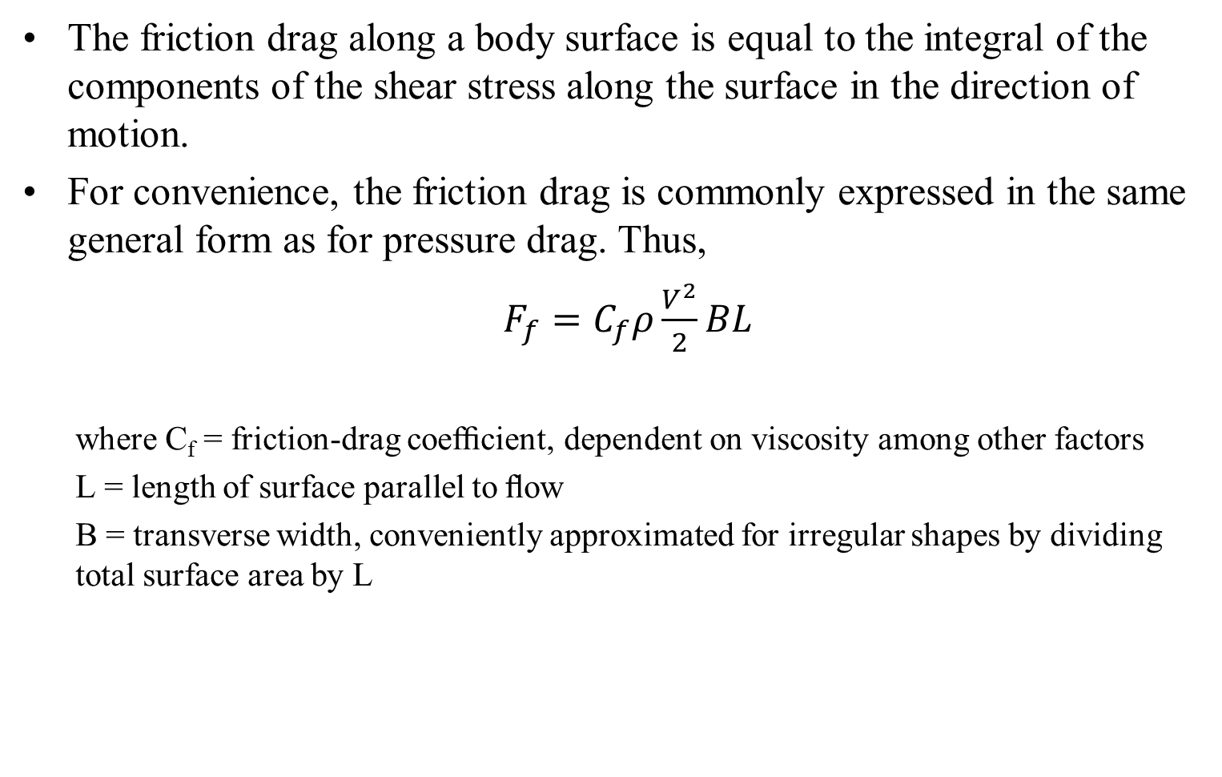
Forces on immersed bodies
The friction drag along a body surface is equal to the integral of the components of the shear stress along the surface in the direction of motion.
For convenience, the friction drag is commonly expressed in the same general form as for pressure drag. Thus,
$F_{f}=C_{f}ρ\frac{V^{2}}{2}BL$
  where C_{f} = friction-drag coefﬁcient, dependent on viscosity among other factors
  L = length of surface parallel to ﬂow
  B = transverse width, conveniently approximated for irregular shapes by dividing total surface area by L

Slide 7
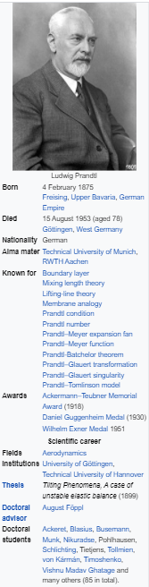
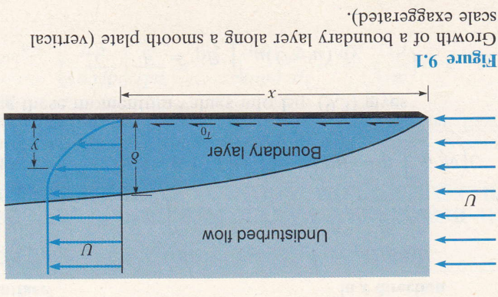
Boundary layer
The boundary layer is a very thin layer of ﬂuid adjacent to surface, in which viscosity is important, while outside this layer the ﬂuid can be considered as frictionless or ideal.
This concept, originated by Ludwig Prandtl in 1904, is one of the important advances in modern ﬂuid mechanics.
In 1904 Ludwig Prandtl published a key paper, proposing that the flow fields of low-viscosity fluids be divided into two Zones, namely
    a thin, viscosity-dominated boundary layer near solid surfaces, and
    an effectively inviscid outer zone away from the boundaries.

Slide 8
Boundary layer
It means that the mathematical theory of ideal ﬂuid ﬂow, including the ﬂow net method discussed in Lecture 14, can actually be used to determine the streamlines in the real ﬂuid at a short distance from a solid boundary.
The Bernoulli theorem may then be used to determine the normal pressures on the surface, for such pressures are practically the same as those outside this thin layer.

Slide 9
Boundary layer
The boundary layer may be entirely laminar, or it may be primarily turbulent with a viscous sublayer. This is a layer where shear is predominantly due to viscosity alone.
The thickness δ of the boundary layer is usually deﬁned as the distance from the boundary to the point where the velocity is 99% of the undisturbed velocity, i.e., to where u = 0.99U.
δ increasing with x

Slide 10
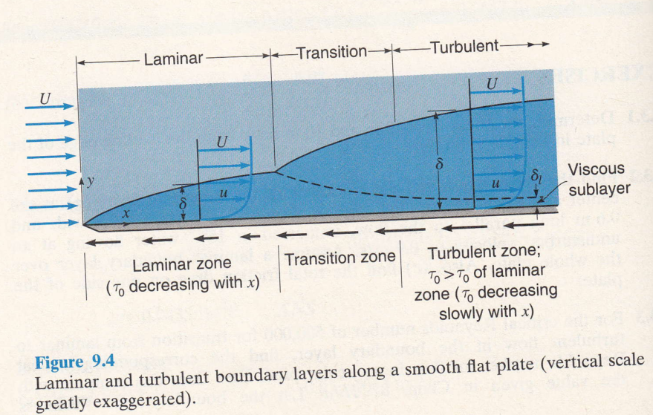
Turbulent boundary layer for flow along a smooth flat plate
Comparing the laminar and turbulent boundary layers in Fig. 9.4, the velocity distribution in the turbulent boundary layer shows a much steeper gradient near the wall and a ﬂatter gradient throughout the remainder of the layer.
As would be expected, then, the wall shear stress is greater (due to higher du/dy) in the turbulent boundary layer than in the laminar layer at the same Reynolds number.

Slide 11
Turbulent boundary layer for flow along a smooth flat plate

Slide 12
Boundary layer separation and pressure drag
The motion of a thin stratum of ﬂuid lying wholly inside the boundary layer is determined by three forces:
The forward pull of the outer free-moving ﬂuid, transmitted through the laminar boundary layer by viscous shear and through the turbulent boundary layer by momentum transfer;
The viscous retarding effect of the solid boundary, which must, by deﬁnition, hold the ﬂuid stratum immediately adjacent to it at rest;
The pressure gradient along the boundary: the stratum is accelerated by a pressure gradient whose pressure decreases in the direction of ﬂow and is retarded by an adverse gradient.

Slide 13
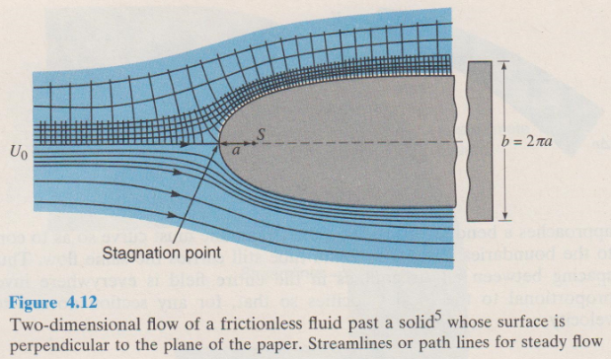
Boundary layer separation and pressure drag
The treatment of ﬂuid resistance in the foregoing sections has been restricted to the drag of the boundary layer along a smooth ﬂat plate located in an unconﬁned ﬂuid, that is to say, in the absence of a pressure gradient.
In the presence of a favorable pressure gradient, the boundary layer is “held” in place. This is what occurs in the accelerated ﬂow around the forebody, or upstream portion, of a cylinder, sphere, or other object, such as that of Fig. 4.12.

Slide 14
Boundary layer separation and pressure drag
If a particle enters the boundary layer near the forward stagnation point with a low velocity and high pressure, its velocity will increase as it ﬂows into the lower-pressure region along the side of the body.
But there will be some retardation from wall friction (force 2 above), so that its total useful energy will be reduced by a corresponding conversion into thermal energy.

Slide 15
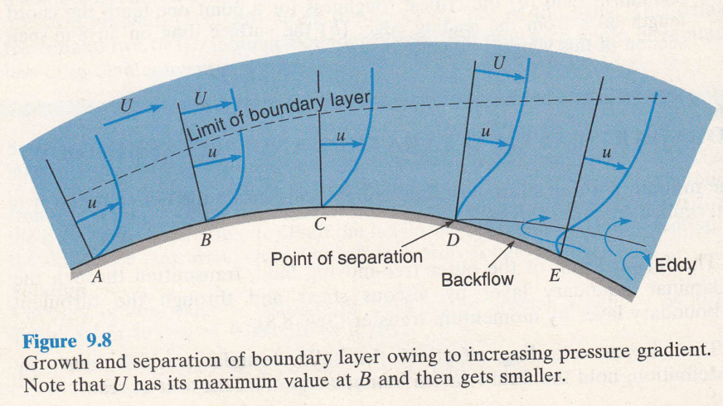
Boundary layer separation and pressure drag
What happens next may best be explained by reference to Fig. 9.8.
Let A represent a point in the region of accelerated ﬂow with a normal velocity distribution in the boundary layer (either laminar or turbulent), while B is the point where the velocity outside the boundary layer reaches a maximum.

Slide 16
Boundary layer separation and pressure drag
Then C, D, and E are points downstream where the velocity outside the boundary layer decreases, resulting in an increase in pressure in accordance with ideal-ﬂow theory (no friction loss).
Thus the velocity of the layer close to the wall is reduced at C and ﬁnally brought to a stop at D. Now the increasing pressure calls for further retardation; but this is impossible, and so the boundary layer actually separates from the wall.
At E there is a backﬂow next to the wall, driven in the direction of decreasing pressure (pressure increases downstream)-upstream in this case-and feeding ﬂuid into the boundary layer that has left the wall at D.

Slide 17
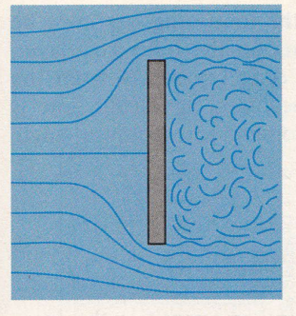
Boundary layer separation and pressure drag
Downstream from the point of separation, the ﬂow is characterised by irregular turbulent eddies, formed as the separated boundary layer becomes rolled up in the reversed ﬂow. This condition generally extends for some distance downstream until the eddies are worn away by viscous attrition. The whole disturbed region is called the turbulent wake of the body (Fig. 9.9).
Figure 9.9 Turbulent wake behind a flat plate held normal to the flow

Slide 18

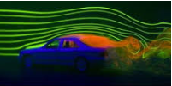

Boundary layer separation and pressure drag
Because the eddies cannot convert their kinetic energy of rotation into an increased pressure, as the ideal-ﬂuid theory would dictate, the pressure within the wake remains close to that at the separation point.
Since this is always less than the pressure at the forward stagnation point, there results a net pressure difference tending to move the body with the ﬂow, and this force is the pressure drag.
For a moving body such as a plane or car, the front has higher pressure than the rear and therefore the drag is opposite to the plane or car movement and therefore pressure drag tends to resist motion of the plane/car. It drags/resists the plane/car.

Slide 19
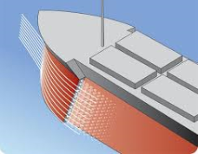
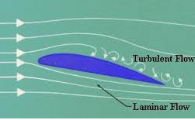

Drag on three –dimensional bodies
The total drag on a body is the sum of the friction drag and the pressure drag:
$F_{D}=F_{f}{+F}_{p}$
In the case of a well-streamlined body, such as an airplane wing or the hull of a submarine, the friction drag is the major part of the total drag, and may be estimated by the methods of the preceding sections on the boundary layer. Only rarely is it desired to compute the pressure drag separately from friction drag. Usually, when the wake resistance becomes signiﬁcant, one is interested in the total drag only. Indeed, it is customary to employ a single equation that gives the total drag
$F_{D}=C_{D}ρ\frac{V^{2}}{2}A$ 9.32
where $C_{D}$ is overall drag coefﬁcient

Slide 20
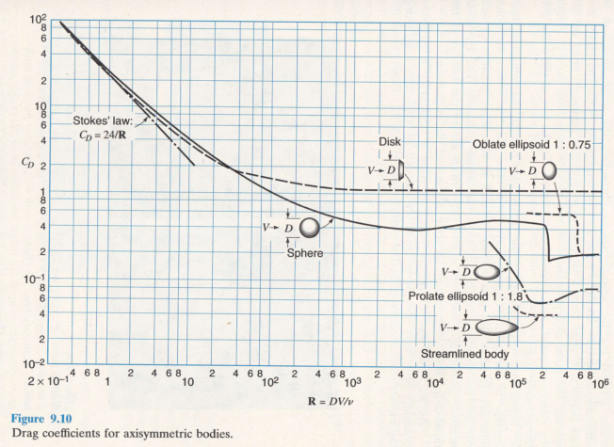
Drag on three –dimensional bodies
Drag coefficients

Slide 21
Drag on three –dimensional bodies
It may be pointed out here that the object of streamlining a body is to move the point of separation as far back as possible and thus to produce the minimum size of turbulent wake. This decreases the pressure drag, but by making the body longer so as to promote a gradual increase in pressure, the friction drag is increased. The optimum amount of streamlining, then, is that for which the sum of the friction and pressure drag is a minimum.
Attention in streamlining must be given to the rear end, or downstream part, of a body as well as to the front.
The shape of the forebody is important principally to the extent that it governs the location of the separation point(s) on the afterbody. A rounded nose produces the least disturbance in the streamlines, and is therefore the best for incompressible or compressible ﬂow at subsonic velocities (less than speed of sound (in air) 1,200km/h).

Slide 22
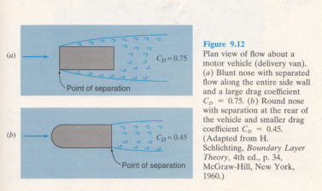
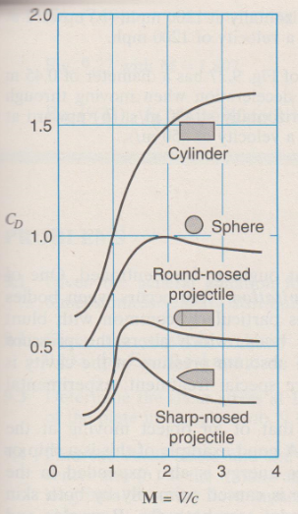
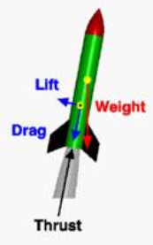

Drag on three –dimensional bodies
This is illustrated in Fig. 9.12, where ﬂow about a blunt-nosed motor vehicle is compared with that about a round-nosed vehicle.
For supersonic ﬂow (>1200km/h), a sharp-nosed body has less drag than a round-nosed body (Fig. 9.27).

Slide 23
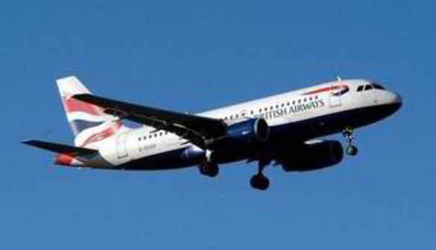
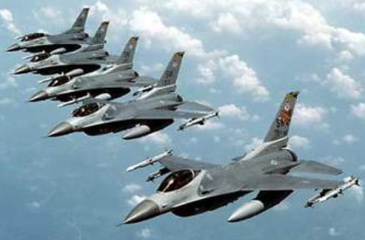

Drag on three –dimensional bodies
Subsonic vs supersonic

Slide 24
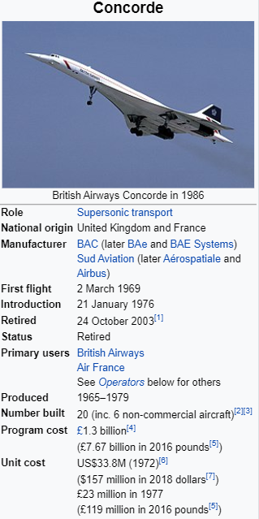

Slide 25
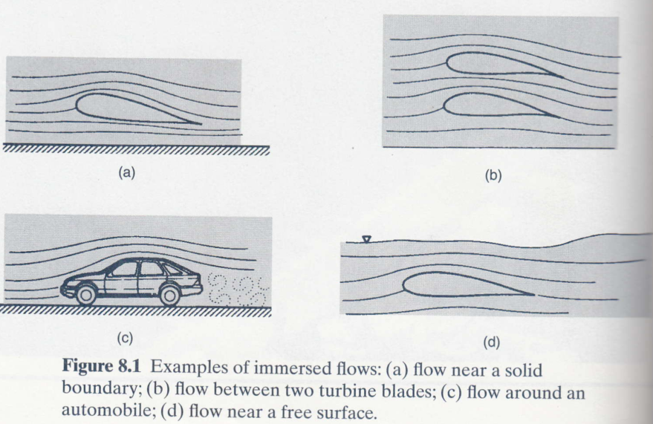
Drag on three –dimensional bodies

Slide 26
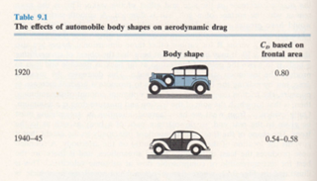
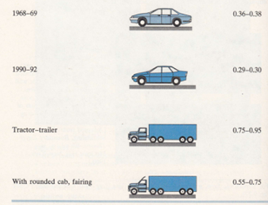
Drag on three –dimensional bodies
Efforts to reduce the drag force on automobiles and trucks, and thereby improve their fuel efficiency, have strongly inﬂuenced body design. Examples of historical body shapes and the resulting drag coefﬁcients are given in the figure below
WW 1
WW 2

Slide 27
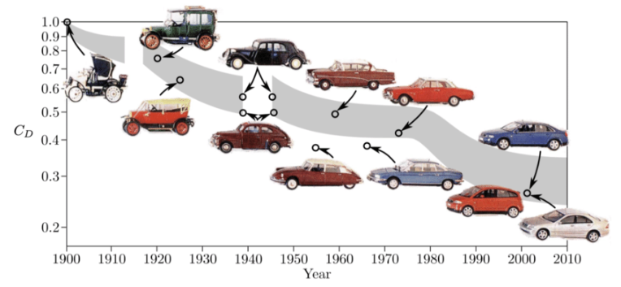
Drag on three –dimensional bodies

Slide 28

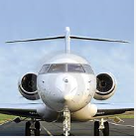



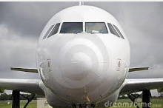







Slide 29
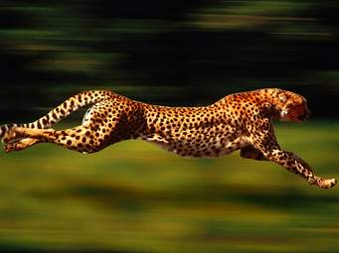


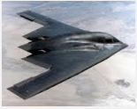
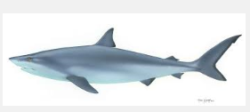
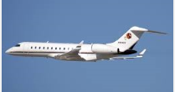

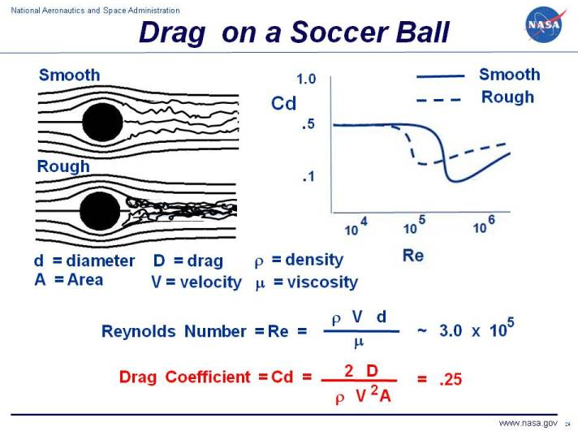
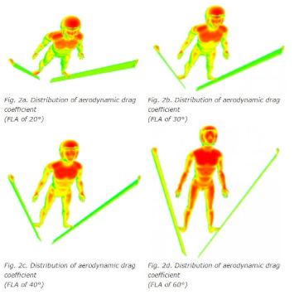

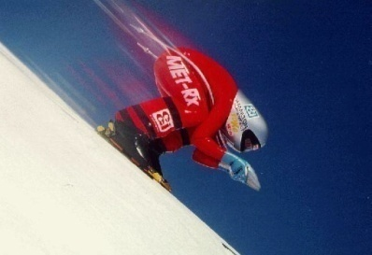

Slide 30
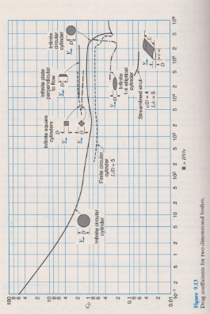
Drag on two –dimensional bodies
Two dimensional bodies are also subject to friction and pressure drag. However, the flow about a two-dimensional body exhibits some peculiar properties that are not ordinarily found in the three-dimensional case of flow around a sphere.

Slide 31
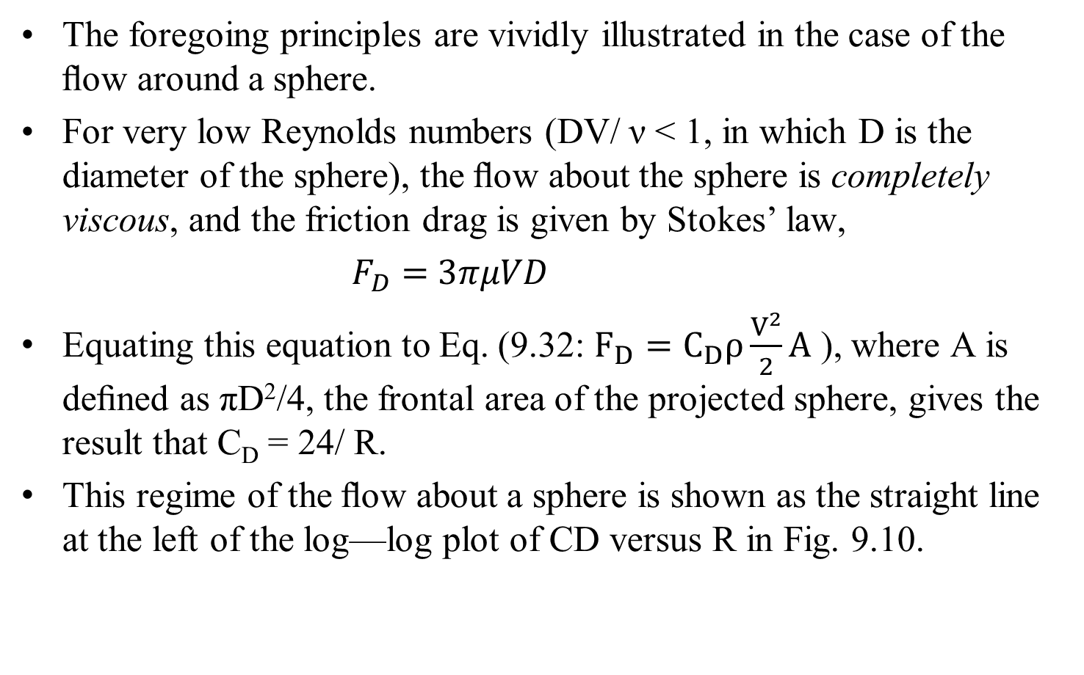
Application to falling sphere (Stoke’s law)
The foregoing principles are vividly illustrated in the case of the ﬂow around a sphere.
For very low Reynolds numbers (DV/ ν< 1, in which D is the diameter of the sphere), the ﬂow about the sphere is completely viscous, and the friction drag is given by Stokes’ law,
$F_{D}=$$3πμVD$
Equating this equation to Eq. (9.32: $F_{D}=C_{D}ρ\frac{V^{2}}{2}A$), where A is deﬁned as πD²/4, the frontal area of the projected sphere, gives the result that C_{D} = 24/ R.
This regime of the ﬂow about a sphere is shown as the straight line at the left of the log—log plot of CD versus R in Fig. 9.10.

Slide 32
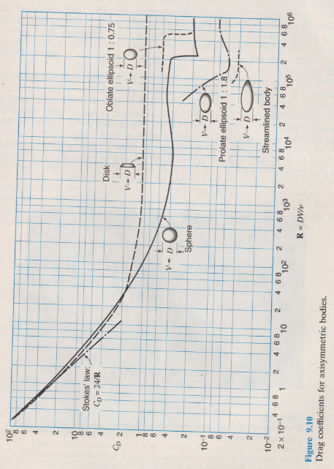
Application to falling sphere (Stoke’s law)
Fig. 9.10
This regime of the ﬂow about a sphere is shown as the straight line at the left of the log—log plot of CD versus R in Fig. 9.10.

Slide 33
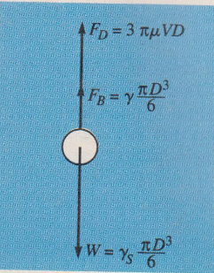

Application to falling sphere (Stoke’s law)
The falling-sphere viscometer is used to measure viscosity, which is a fluid property (Lecture 1).
In such a device the liquid is placed in a tall transparent cylinder and a sphere of known weight and diameter is dropped in it.
If the sphere is small enough, Stokes’ law will prevail and the fall velocity of the sphere will be approximately inversely proportional to the absolute viscosity of the liquid.
That this is so may be seen by examining the free-body diagram of such a falling sphere (Fig. 11.2).

Slide 34
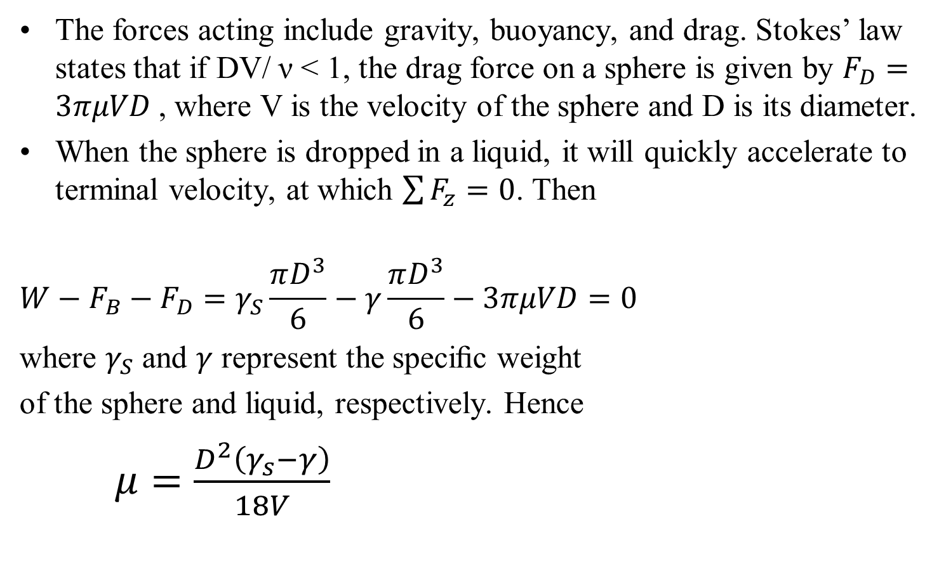
Application to falling sphere (Stoke’s law)
The forces acting include gravity, buoyancy, and drag. Stokes’ law states that if DV/ ν< 1, the drag force on a sphere is given by $F_{D}=$$3πμVD$, where V is the velocity of the sphere and D is its diameter.
When the sphere is dropped in a liquid, it will quickly accelerate to terminal velocity, at which $\sum{F_{z}=0}$. Then
$$W−F_{B}−F_{D}=γ_{S}\frac{πD^{3}}{6}−γ\frac{πD^{3}}{6}−3πμVD=0$$
where $γ_{S}$ and $γ$ represent the speciﬁc weight
of the sphere and liquid, respectively. Hence
$μ=\frac{D^{2}\left(γ_{s}−γ\right)}{18V}$

Slide 35
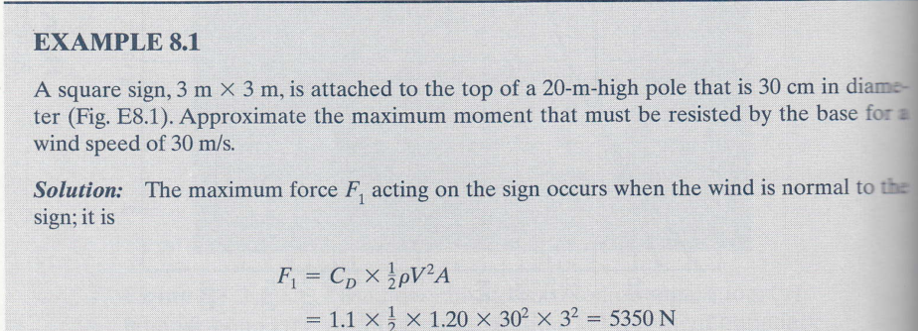
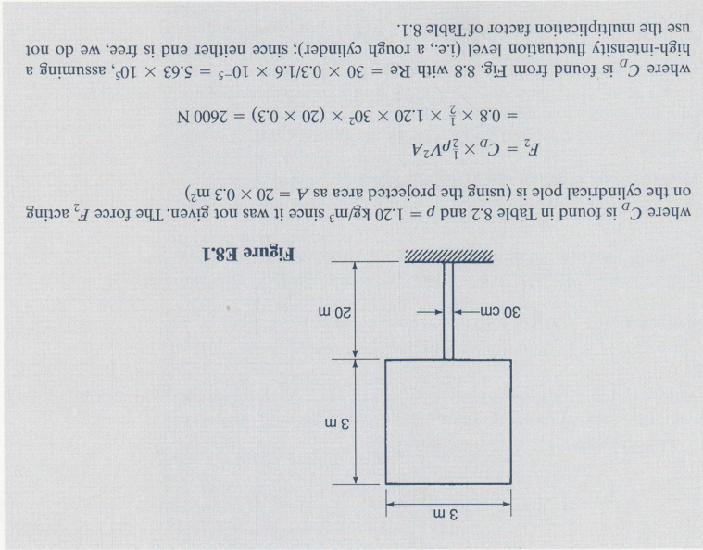
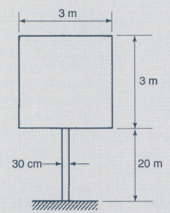

Example
$F_{D}=C_{D}ρ\frac{V^{2}}{2}A$ 9.32

Slide 36
Example

Slide 37
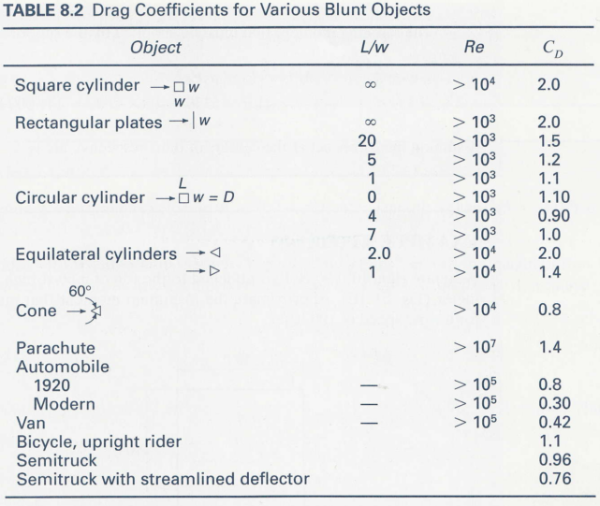
Example

