Slide 1
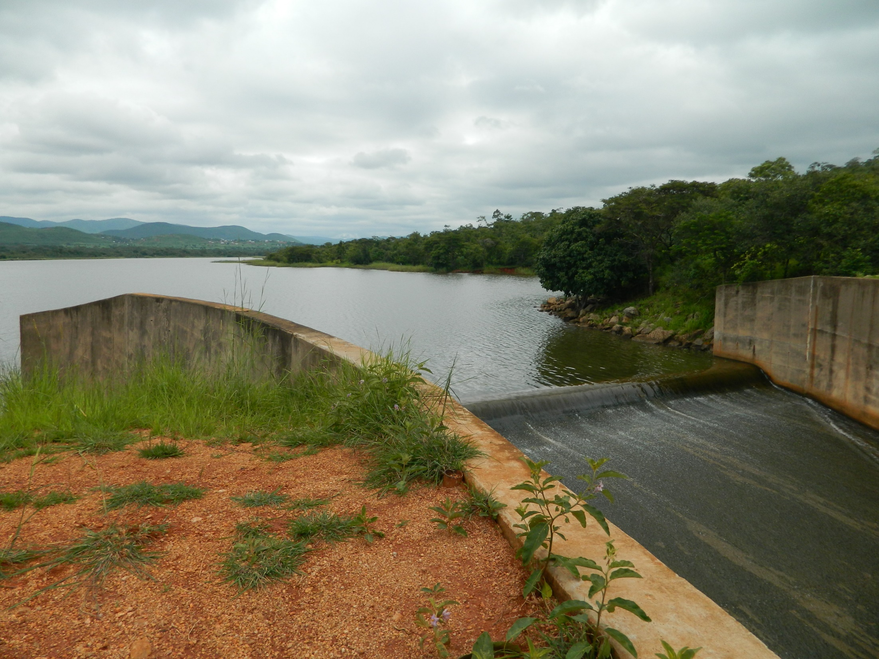
Fluid Mechanics CEE 3311
LECTURE 19
Flow in Open Channels
L. Handia

Slide 2
Open channels
An open channel is one in which the stream is not completely enclosed by solid boundaries and therefore has a free surface subjected only to atmospheric pressure.
The flow in such a channel is caused not by some external head, but rather only by the gravity component along the slope of the channel. Thus open-channel flow is often referred to as free-surface flow or gravity flow.
For convenience in dealing with large channel systems, they are often divided into reaches. A reach is a continuous stretch of a waterway, often chosen to have reasonably uniform properties like cross section, slope, and discharge.

Slide 3
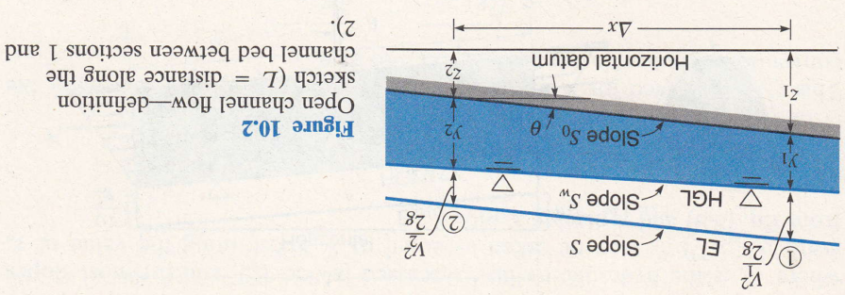
Reynolds number in open channels
Open-channel flow is usually fully rough; that is, it occurs at high
Reynolds numbers. For open channels the Reynolds number is defined by Re = R_{h}v/ν, where R_{h} is the hydraulic radius. Since R_{h} = D/4, the critical value of Reynolds number at which the change over occurs from laminar ﬂow to turbulent flow in open channels is 500, whereas in pressure conduits the critical value is 2,000.

Slide 4
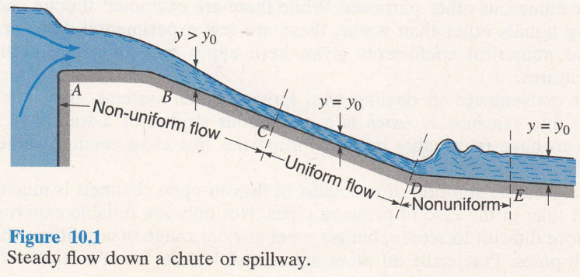
Uniform flow
Uniform flow means that the water cross section and depth remain constant over a certain reach of the channel as well as over time. This requires that the drop in potential energy due to the fall in elevation along the channel be exactly that consumed by the energy dissipation through boundary friction and turbulence.
The depth in uniform flow is commonly referred to as the normal flow, y_{o}
Uniform flow is an equilibrium condition that flow tends to if the channel is sufficiently long with constant slope, cross section, and roughness.

Slide 5
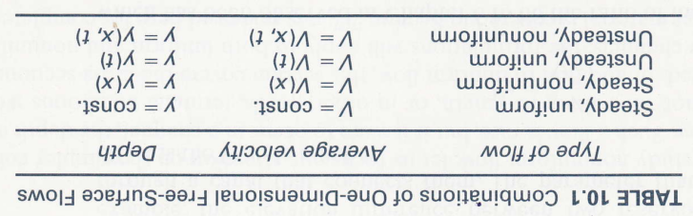
Uniform flow

Slide 6
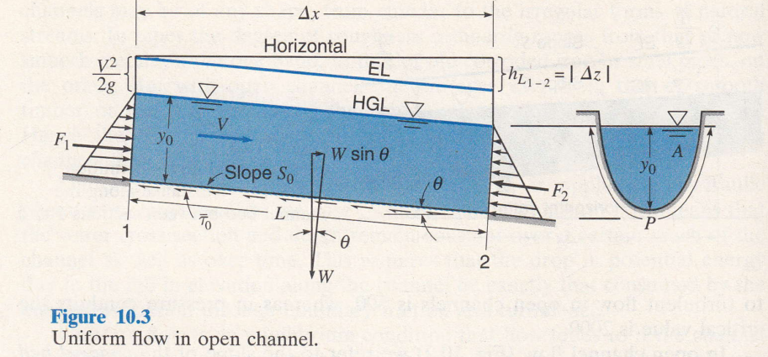
Uniform flow
In uniform flow (Fig. 10.3) the cross section through which flow occurs is constant along the channel, and so also is the velocity.
Thus, y₁ = y₂ and v₁ = v₂ and the channel bed, water surface, and energy line are parallel to one another. Also, S_{W} = S₀ = -Δz/ Δ x = tan θ, while S = h_{L}/L = sin θ, where θ is the angle the channel bed makes with the horizontal.

Slide 7


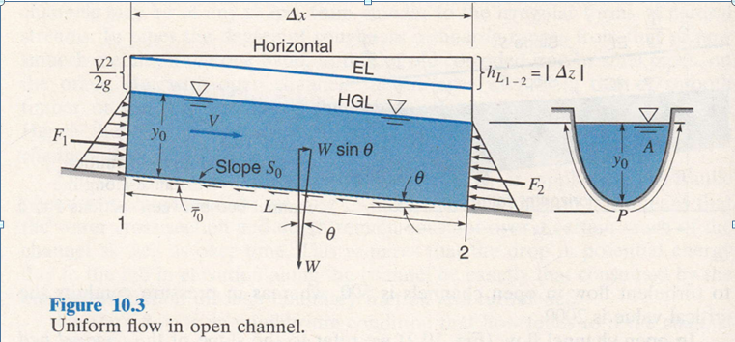
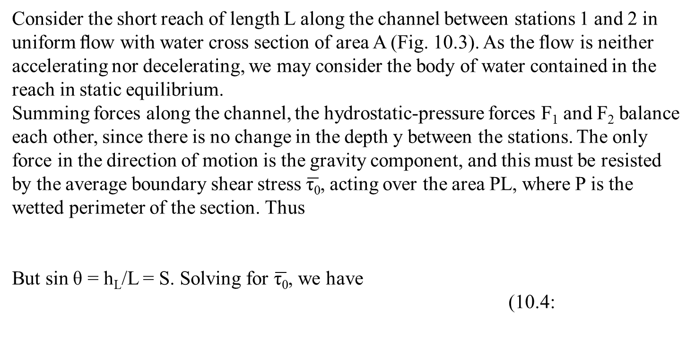
Consider the short reach of length L along the channel between stations 1 and 2 in uniform ﬂow with water cross section of area A (Fig. 10.3). As the flow is neither accelerating nor decelerating, we may consider the body of water contained in the reach in static equilibrium.
Summing forces along the channel, the hydrostatic-pressure forces F₁ and F₂ balance each other, since there is no change in the depth y between the stations. The only force in the direction of motion is the gravity component, and this must be resisted by the average boundary shear stress $\overline{\text{τ}\text{0}}$, acting over the area PL, where P is the wetted perimeter of the section. Thus
But sin θ = h_{L}/L = S. Solving for $\overline{\text{τ}\text{0}}$, we have
(10.4:

Slide 8


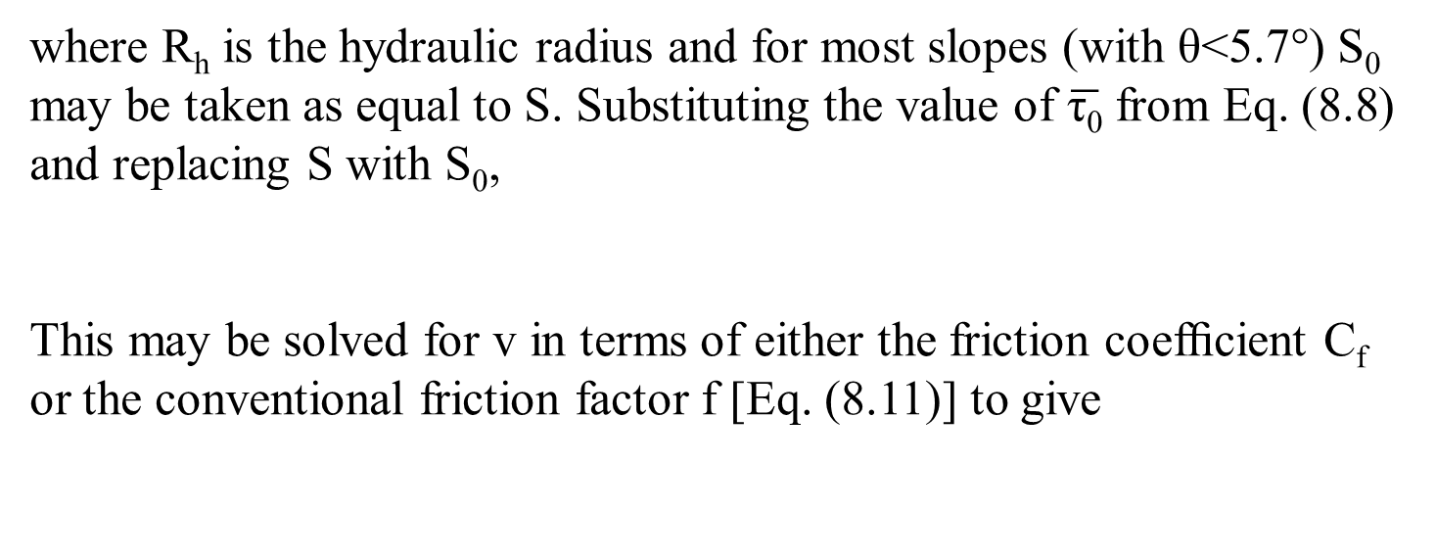
where R_{h} is the hydraulic radius and for most slopes (with θ<5.7°) S₀ may be taken as equal to S. Substituting the value of $\overline{\text{τ}\text{0}}$ from Eq. (8.8) and replacing S with S₀,
This may be solved for v in terms of either the friction coefﬁcient C_{f} or the conventional friction factor f [Eq. (8.11)] to give

Slide 9
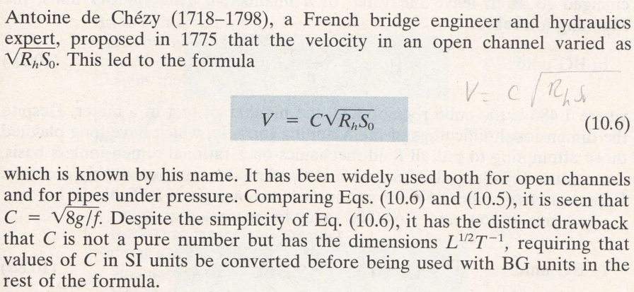
Chezy equation

Slide 10

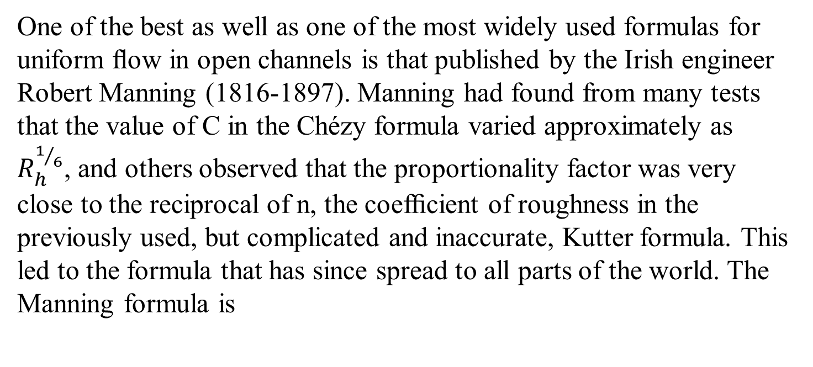
Mannings formula
One of the best as well as one of the most widely used formulas for uniform ﬂow in open channels is that published by the Irish engineer Robert Manning (1816-1897). Manning had found from many tests that the value of C in the Chézyformula varied approximately as $R_{h}^{1/6}$, and others observed that the proportionality factor was very close to the reciprocal of n, the coefﬁcient of roughness in the previously used, but complicated and inaccurate, Kutter formula. This led to the formula that has since spread to all parts of the world. The Manning formula is

Slide 11
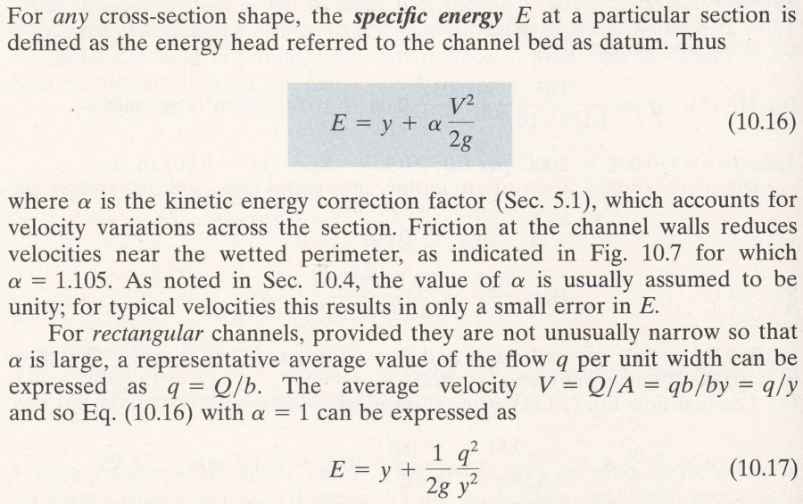
Specific energy and alternate depths

Slide 12
Specific energy and alternate depths

Slide 13

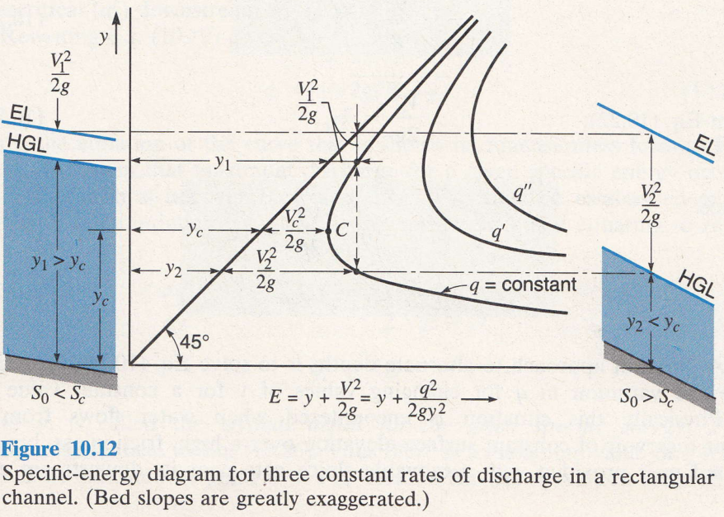
Let us consider how E will vary with y if q remains constant.
A plot of E vs. y is hyperbola-like with asymptotes (E - y) = 0 (that is, E = y) and y = 0. Such a curve, shown in Fig. 10.12, is known as the specific energy diagram. Actually each different value of q will give a different curve, as shown in Fig. 10.12. For a particular q, we see there are two possible values of y for a given value of E. These are known as alternate depths. Equation (10.19) is a cubic equation with three roots, the third root being negative has no physical meaning. The two alternate depths represent two

Slide 14
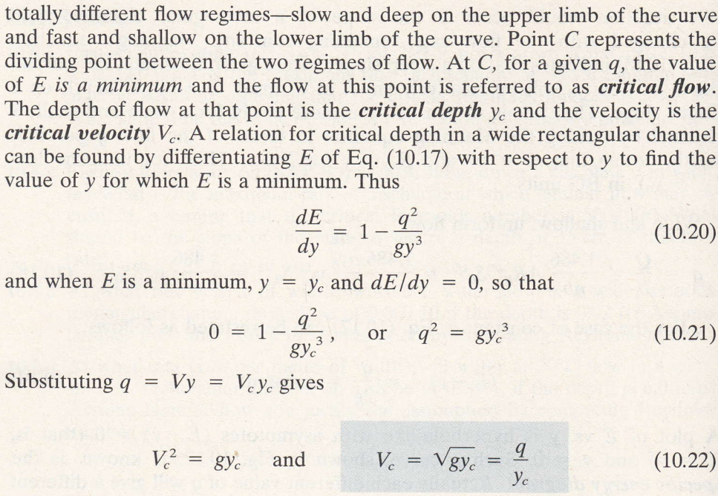


Slide 15


$$⇒V^{2}=\frac{q^{2}}{y^{2}}=\frac{gy^{3}}{y^{2}}=gy$$

Slide 16
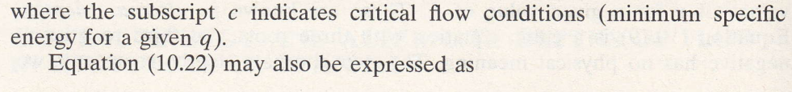

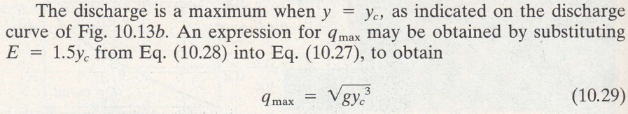
10.23
From Eq 10.22
10.24
Hence 10.25
And 10.26

Slide 17
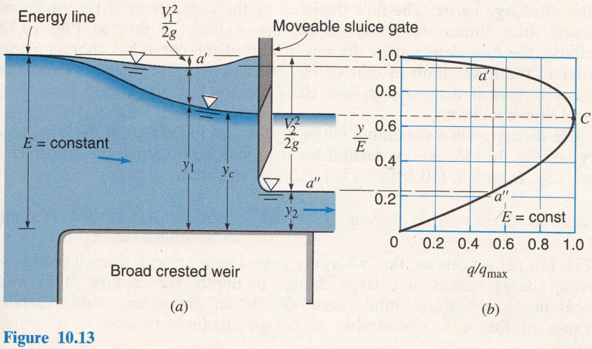

Slide 18
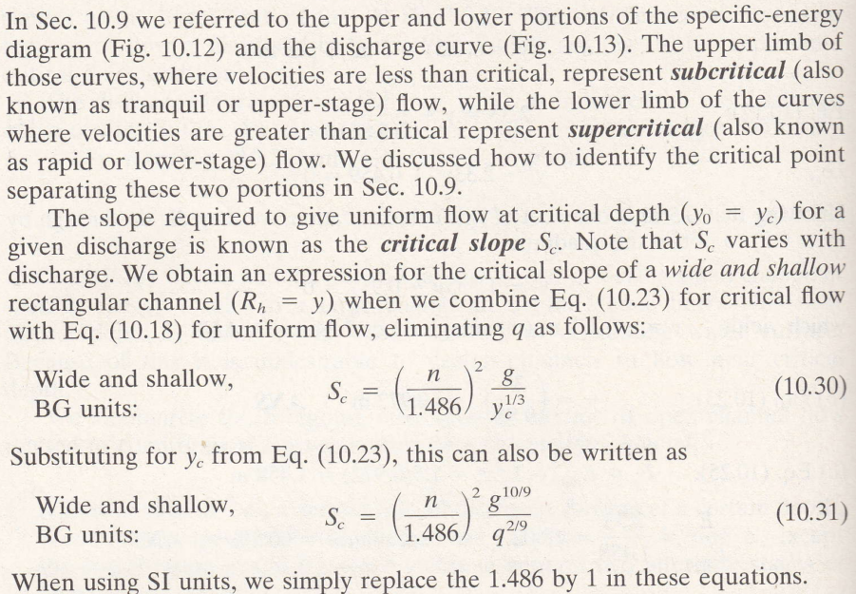
Subcritical and supercritical flows

Slide 19
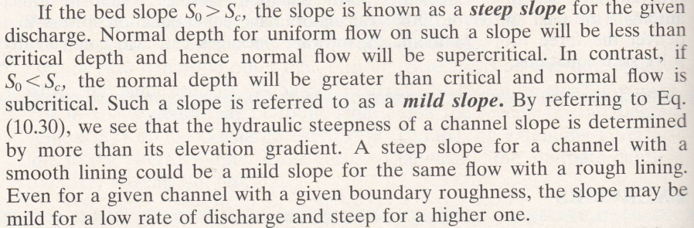
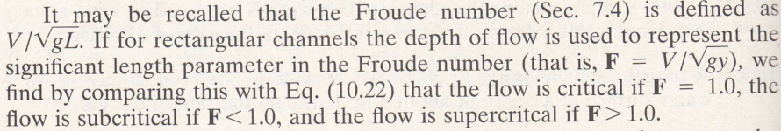

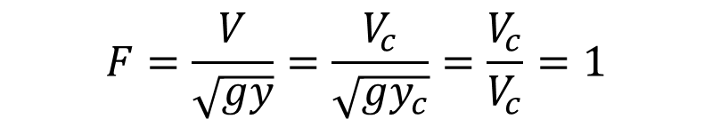
$$F=\frac{V}{\sqrt{gy}}=\frac{V_{c}}{\sqrt{gy_{c}}}=\frac{V_{c}}{V_{c}}=1$$

Slide 20
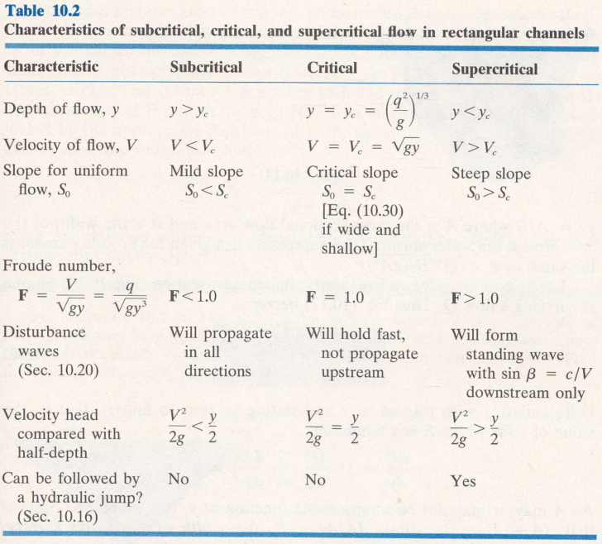

Slide 21
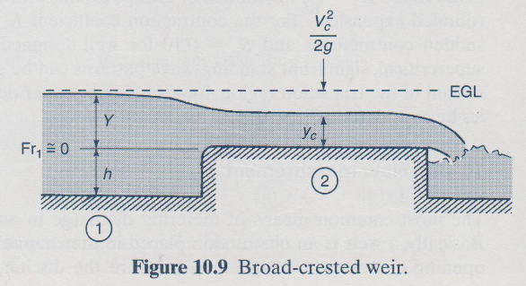
Occurrence of critical depth
Weir
For thin plate weir
Q = C_{d} b 2 g h ^{3 / 2}

Slide 22
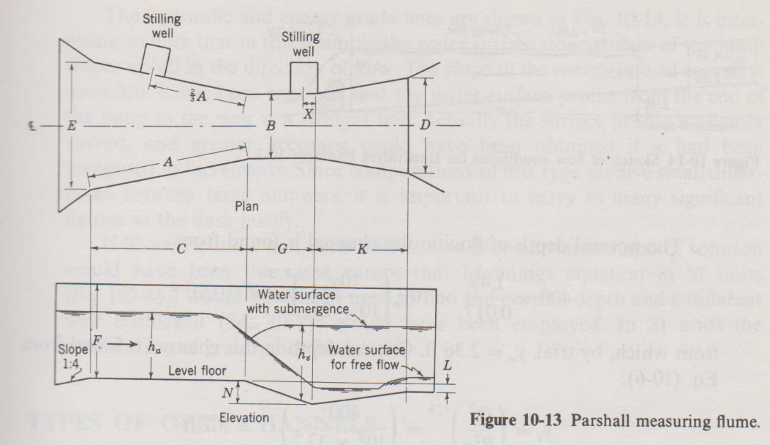
Occurrence of critical depth
Flumes

Slide 23
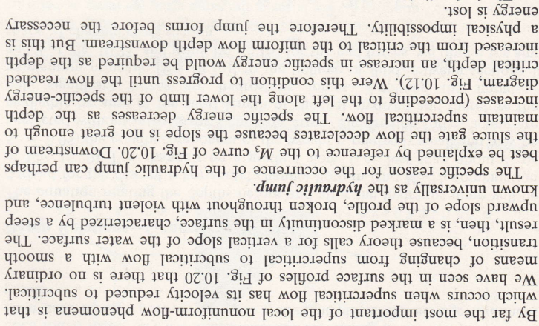
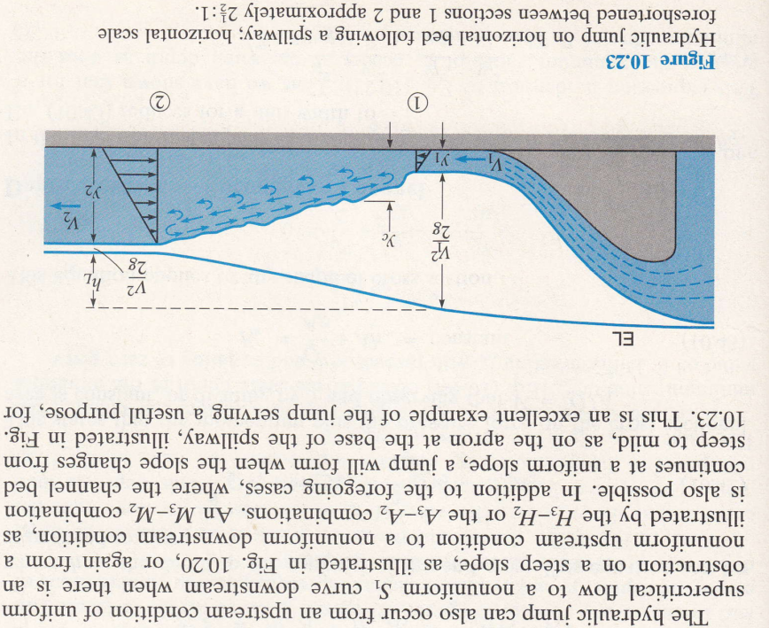
Hydraulic jump

Slide 24
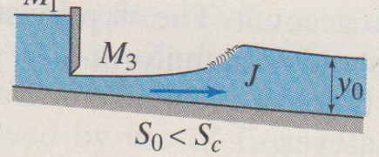
Hydraulic jump

Slide 25
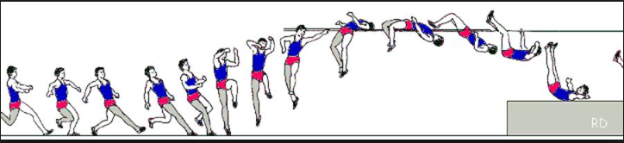
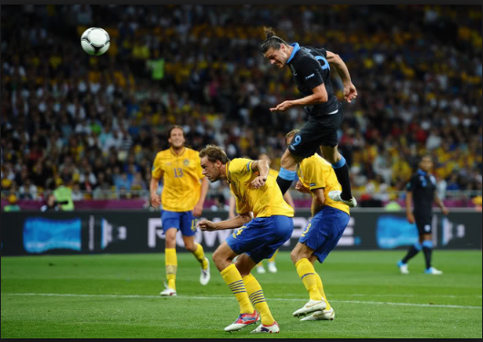

Slide 26
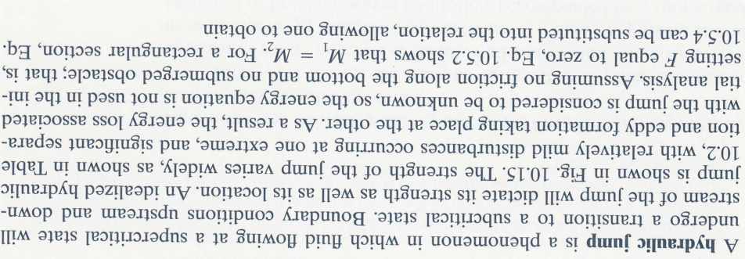

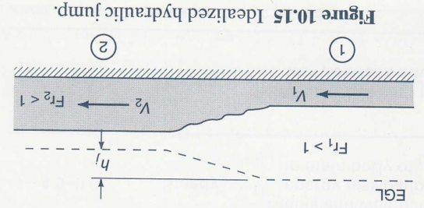

Slide 27
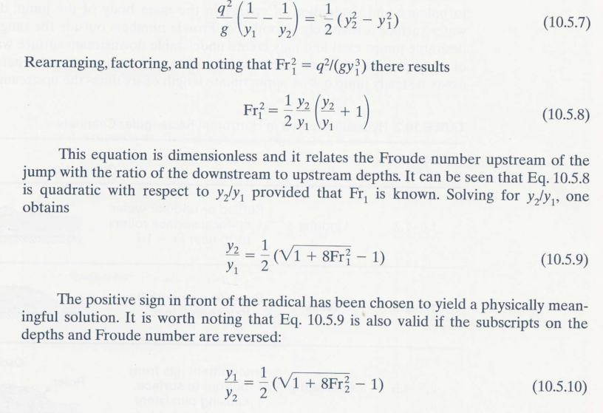
Derivation of formula for conjugate depths-Method A

Slide 28
Derivation of formula for conjugate depths-Method B
Applying the momentum equation in the x- direction
per unit width
per unit width

Slide 29
Derivation of formula for conjugate depths-Method B
5
From the continuity equation v₂=v₁y₁/y₂. substitute this into 5 and simplify
g

Slide 30
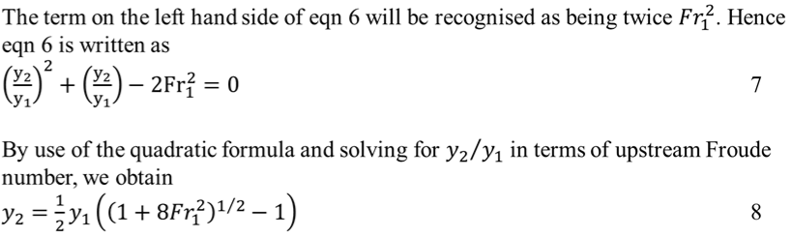
Derivation of formula for conjugate depths-Method B

Slide 31
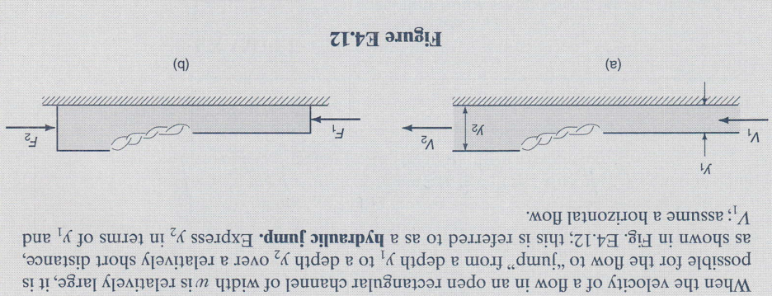
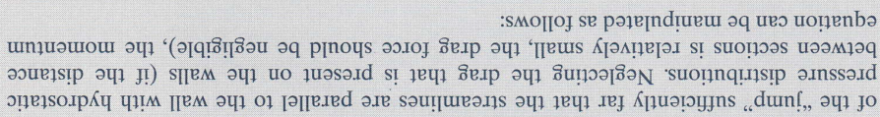
Derivation of formula for conjugate depths-Method C

Slide 32
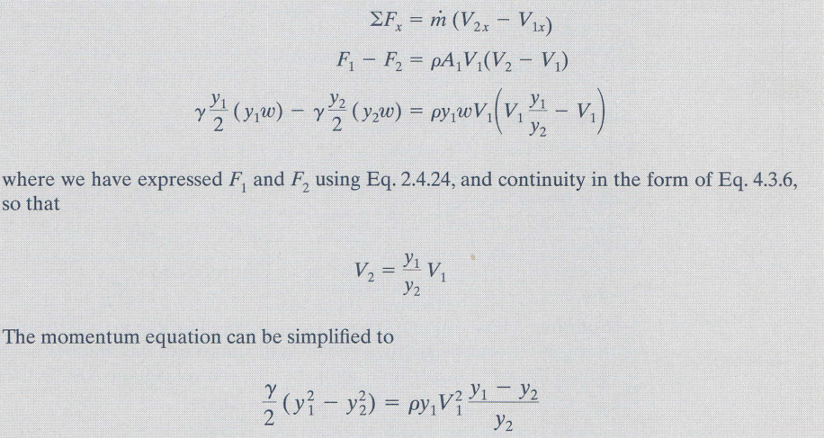
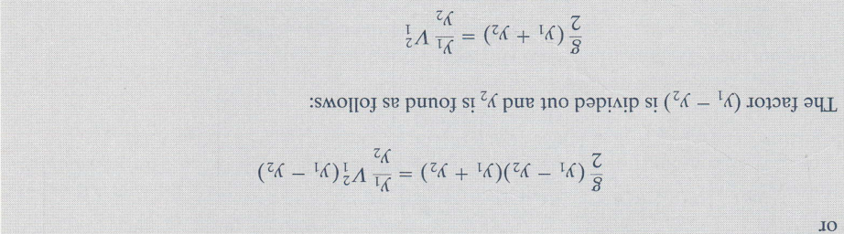

Slide 33
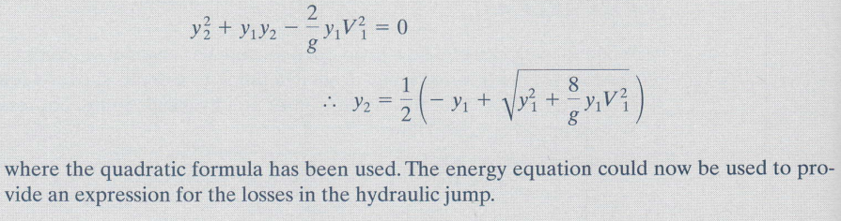

Slide 34
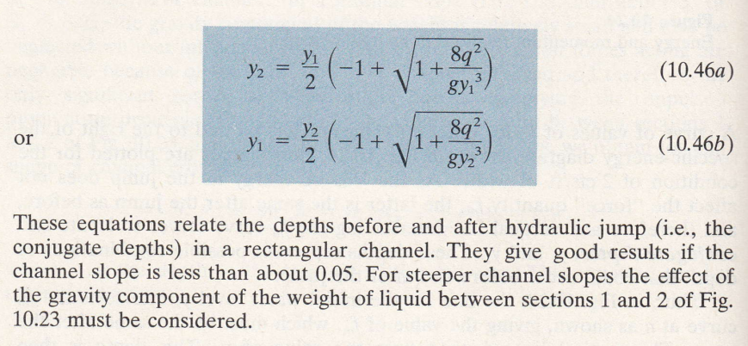

Slide 35
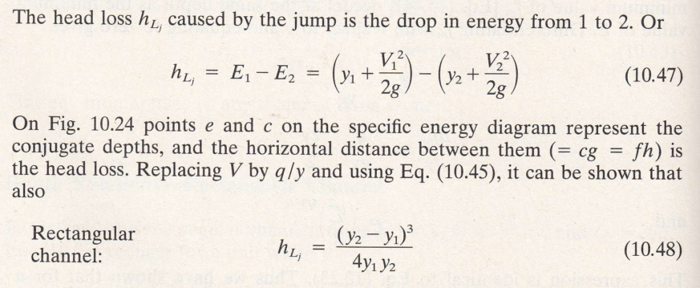
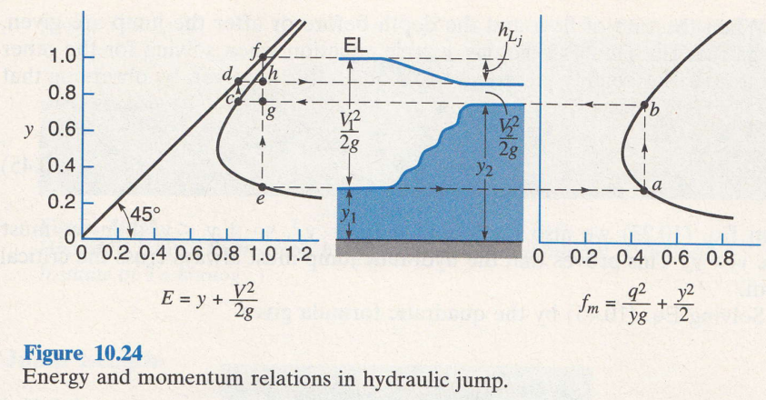
Energy loss in a hydraulic jump

Slide 36
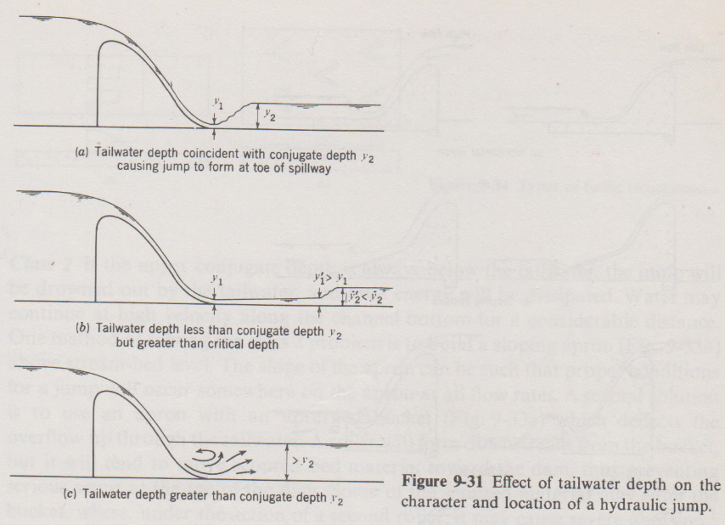
Applications of hydraulic jump
Scour protection

Slide 37
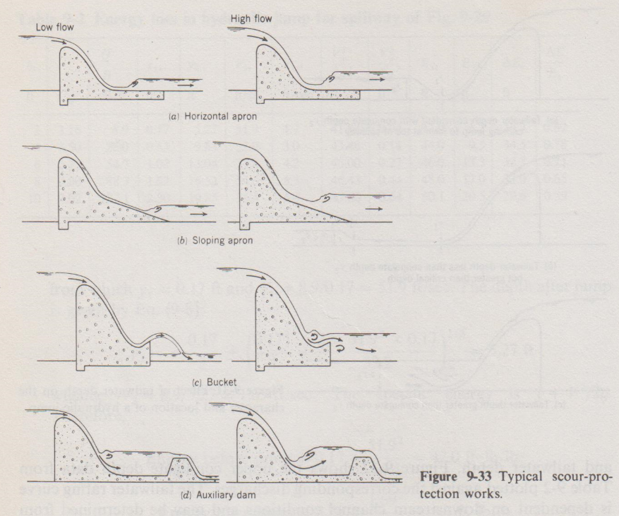
Applications of hydraulic jump

Slide 38
Applications of hydraulic jump
Where velocity of fluid has to be reduced

Slide 39
Best wishes for the exam, without any turbulence, pressure drag but with all the buoyancy

