Slide 1
Fluid Mechanics CEE 3311
LECTURE 1
L. Handia

Slide 2
Introduction
Mechanics
Mechanics is the science that describes and
predicts the conditions of rest or motion of bodies
under the action of forces.
Mechanics is divided into 3 categories:
Mechanics of rigid bodies
Mechanics of deformable bodies
Fluid Mechanics or Mechanics of fluids is the science dealing with the action of forces on fluids.

Slide 3
Introduction
A fluid: gas or liquid
    Gas (compressible fluid)
    Liquid (incompressible fluid-not always)
    In medicine: fluid usually used to mean liquid e.g. intravenous fluid
    A liquid is a state of matter in which the molecules are relatively free to change their positions with respect to each other but restricted by cohesive forces so as to maintain a relatively fixed volume
    A gas is a state of matter in which the molecules are practically unrestricted by cohesive forces. A gas has neither definite shape nor volume

Slide 4
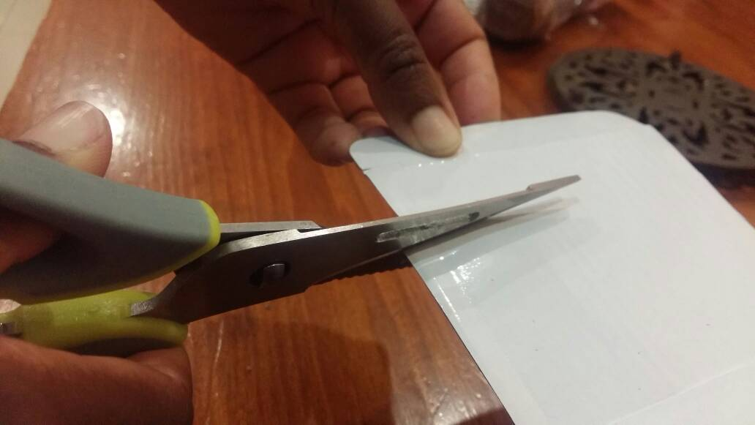
Introduction
In contrast to a solid, a fluid is a substance that deforms continuously when subjected to a shear stress, no matter how small that shear stress may be
Shear stress is defined as the force component tangent to a surface divided by the area of that force. (like shears or scissors, which cut object tangent to surface area)

Slide 5
Introduction
Principles of FM same as in solid particle motion:
  Conservation of mass
  Conservation of energy
  Conservation of momentum
  The subject of FM will be divided into 3 broad categories:
    Fluid statics (fluid at rest)
    Classical fluid dynamics (mathematical approach of fluids in motion)
    Fluid dynamics (real fluids in motion)

Slide 6
Introduction
Actual fluid relationship is made up of a collection of discrete molecules.
In most engineering applications, however, we are interested in the average conditions of velocity, pressure, temperature, density, etc.
Therefore, a fluid will be regarded as a continuum: a continuous distribution of matter with no empty space (instead of the actual conglomeration of separate molecules). In FM, this assumption is normally justifiable because the no. of molecules is so enormous and the distance between them is very small.

Slide 7
Properties of fluids
Properties involving the mass or weight of the fluid
Water = 1000kg/m³
Air = 1.23kg/m³

Slide 8
Properties of fluids
Viscosity
Definitions
Viscosity is that property of a fluid by virtue of which it offers resistance to shear stress
Viscosity of a fluid is a measure of its resistance to shear or angular deformation
Viscosity can be thought of as the internal stickiness of a fluid.
Note: stress is pressure like pressure of exams, stress due to social problems
e.g., motor oil has high viscosity and resistance to shear , whereas gasoline (petrol) has low viscosity. More energy required to pump a more viscous fluid
(A fluid is a substance which continuously deforms when subjected to a small amount of shear)

Slide 9

Properties of fluids
Viscosity
Consider the classic case of two parallel plates, sufficiently large that edge conditions may be neglected, placed a small distance Y apart, the space being filled with the fluid.
The lower surface is assumed to be stationary, while the upper one is moved parallel to it with a velocity U by the application of a force F corresponding to some area A of the moving plate.

Slide 10
Properties of fluids
Viscosity
The lower plate is fixed, and a force F is
applied to the upper plate, which exerts a shear stress on any substance between the plates

Slide 11
Properties of fluids
Viscosity
At boundaries, particles of fluid adhere to the walls, and so their velocities are zero relative to the wall. This so-called no-slip condition occurs with all viscous fluids. Thus the fluid velocities must be zero where in contact with the plate at the lower boundary and U at the upper boundary.
The form of the velocity variation with distance between these two extremes is called a velocity profile.

Slide 12
Properties of fluids
Viscosity
If the separation distance Y is not too great, the velocity U is not too high, and if there is no net flow of fluid through the space, the velocity profile will be linear, as shown in Fig. The behaviour is much as if the fluid were composed of a series of thin layers, each of which slips a little relative to the next.

Slide 13
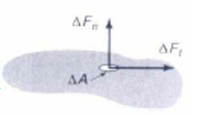
Properties of fluids
Viscosity
Experiments have shown that for a large class of fluids under such conditions
where A is the area over which shear is acting i.e., along the surface of the moving plate or for any depth y, the surface of the thin water layer (U x width) & not cross section of the water (Y x width)
A

Slide 14
Properties of fluids
Viscosity
From similar triangles in Fig, U/Y can be replaced by velocity gradient (with v=0 at bottom and v=U at the top)

Slide 15
Properties of fluids
Viscosity
If a constant of proportionality µ is now introduced, the shearing stress τ between any two thin sheets of fluid may be expressed by
    Newton’s Equation of Viscosity
which is called absolute viscosity, dynamic viscosity, coefficient of viscosity or simply the
viscosity of the fluid

Slide 16
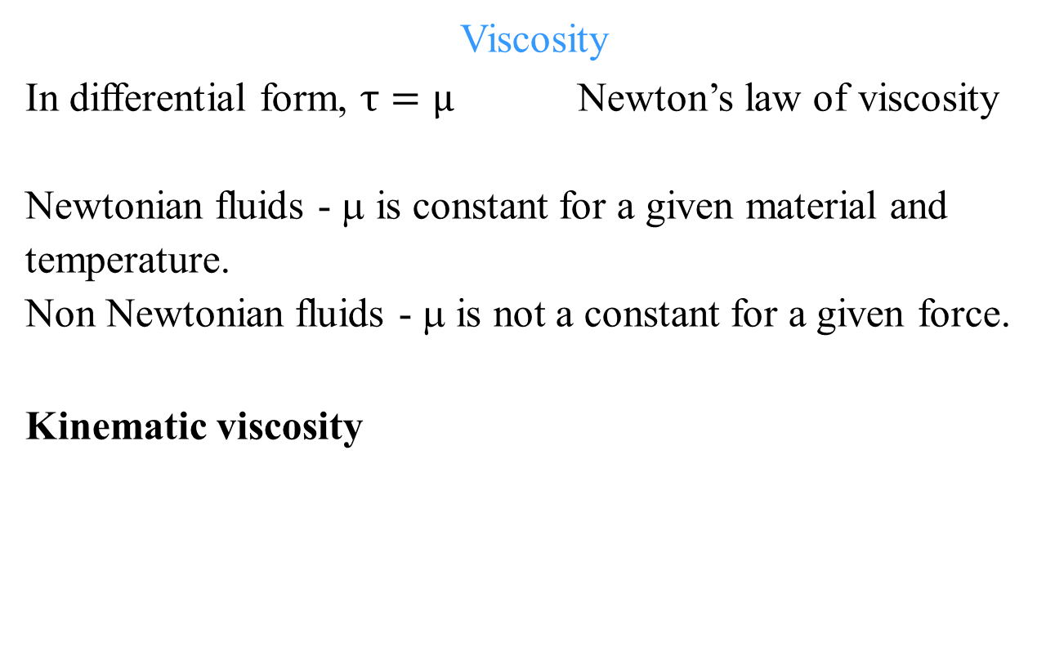
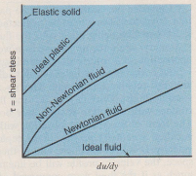
Properties of fluids

Slide 17
Properties of fluids
Perfect gas
Molecules of a perfect gas:
Would behave like tiny, perfectly elastic spheres in random motion
Would influence each other only at collision
Form a volume which would be negligible in comparison with the volume in which they moved

Slide 18
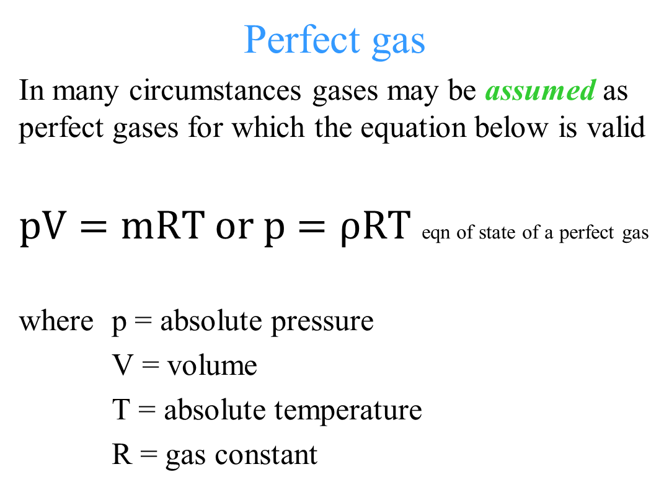
Properties of fluids

Slide 19
Properties of fluids
Compressibility
All liquids compress if the pressure increases, resulting in an increase in density
Compressibility is expressed by its bulk modulus of elasticity or coefficient of compressibility, K
Small density changes in liquids can be very significant when large pressure changes are present e.g. water hammer which can be heard shortly after sudden closing of a valve in a pipeline: when the valve is closed an internal pressure wave propagates down the pipe, producing a hammering sound due to pipe motion when the wave reflects from the closed valve

Slide 20
Properties of fluids
Surface tension
Surface tension is the property of a fluid surface to behave as if it were covered with a tight skin (the meniscus), so that a needle or fine powder can be made to float on cold water without being wetted (dictionary of civil engineers).
Surface tension is a property that results from the attractive forces between molecules.
As such it manifests itself only in liquids at an interface, usually a liquid-gas interface.

Slide 21

Properties of fluids
Surface tension
The forces between molecules in the bulk of a liquid are equal in all directions, and as a result no net force is exerted on the molecules.
However, at an interface the molecules exert a force that has a resultant in the interface layer:
  force holds drop of water suspended on a rod
  force causes the small drops from a sprayer to assume spherical shapes
  force plays significant role when two immiscible liquids (e.g., oil & water) are in contact with each other

Slide 22
Properties of fluids
Surface tension
In most cases of fluid mechanics and hydraulics, surface tension and its effects may be neglected in comparison with hydrostatic and dynamic forces

Slide 23
Properties of fluids
Vapour pressure
Liquids evaporate because of molecules escaping from the liquid surface.
Vaporisation will terminate when equilibrium is reached between the liquid & gaseous states of the substance in the container i.e., when the no. of molecules escaping from the water surface is equal to the no. of molecules striking the liquid surface and condensing (the conversion of a vapour or gas to a liquid).
The pressure resulting from molecules in the gaseous state is the vapour pressure.
Boiling occurs when the pressure above a liquid equals the vapour pressure.

Slide 24
Properties of fluids
Vapour pressure
In general, a transition from the liquid state to the gaseous state occurs if the local absolute pressure is less than the vapour pressure of the liquid.
When this happens, bubbles are formed locally
This phenomenon, called cavitation, can be very damaging when these bubbles are transported by the flow to higher pressure regions.
The bubbles collapse (implosion) upon entering the higher pressure regions, and this collapse produces local pressure spikes which have the potential to damage hydraulic pumps and turbines, ship’s propeller, pipes, overflow spillway in dams (pitting, spongy appearance)

Slide 25
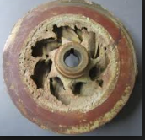
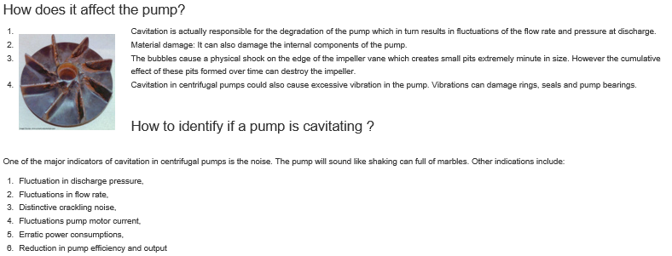
Properties of fluids
Vapour pressure
damage hydraulic pumps

Slide 26
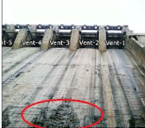
Properties of fluids
Vapour pressure
overflow spillway in dams (pitting, spongy appearance)
Ways are there to avoid cavitation-for later courses

