Slide 1
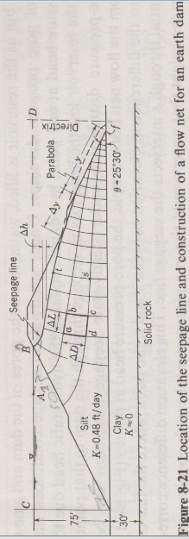
Fluid Mechanics CEE 3311
LECTURE 15
Ideal Flow
L. Handia

Slide 2
Introduction
An ideal fluid may be defined as a fluid in which there is no friction; it is inviscid (its viscosity is zero).
In this chapter we discuss various mathematical methods for describing the flow of imaginary ideal (frictionless) fluids. This subject is often referred to as hydrodynamics. It is a vast subject, so that the presentation here provides only an introduction, but it does give a good idea of the possibilities of a rigorous mathematical approach to flow problems.
Even though such an approach does not consider all the real properties of fluids, the results often closely approximate the behavior of real fluids. This is because there are numerous situations in which friction plays only a minor role.
For example, for fluids of low viscosity the viscosity affects only a thin region at the fluid boundaries. Turbulence and separation of the boundary layer occur far more readily with decelerating flows, and that accelerating flows generally have thin boundary layers. For such flows, mathematical analysis of ideal fluids yields results, often elegant, that can and do provide many useful and important insights into real fluid behavior.
To concentrate on fundamentals, after the next section we shall limit our discussions to incompressible fluids and to two-dimensional, steady flow fields. It is rather interesting how the same methods can be applied to the flow of a real fluid through porous media such as an earth dam and underground aquifers. However, this will not be covered in this course but in Hydrology (CEE 4311) and Hydraulic Structures (CEE 5311) for CEE students.

Slide 3


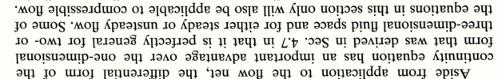
DIFFERENTIAL EQUATION OF CONTINUITY

Slide 4
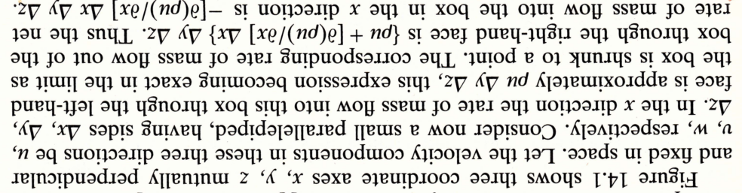
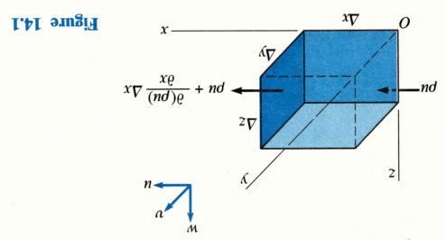
DIFFERENTIAL EQUATION OF CONTINUITY

Slide 5
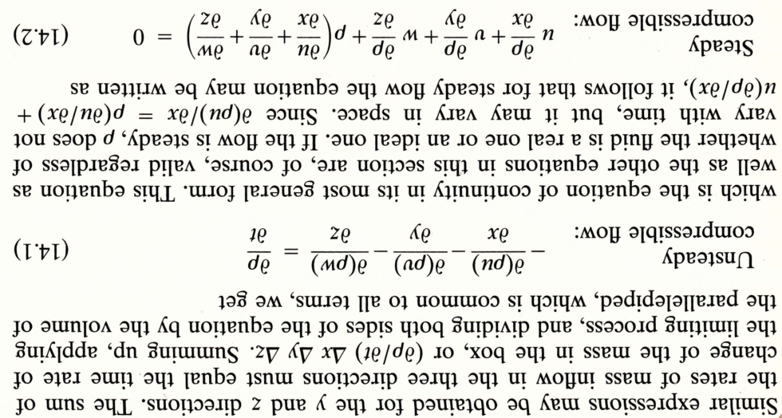
DIFFERENTIAL EQUATION OF CONTINUITY

Slide 6
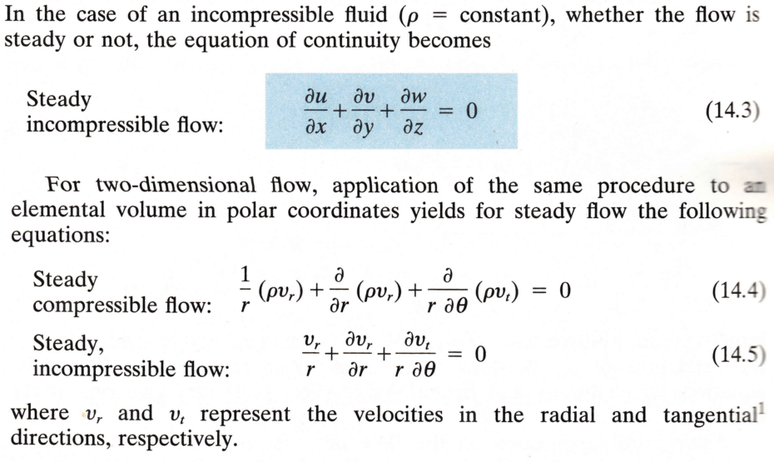
DIFFERENTIAL EQUATION OF CONTINUITY

Slide 7
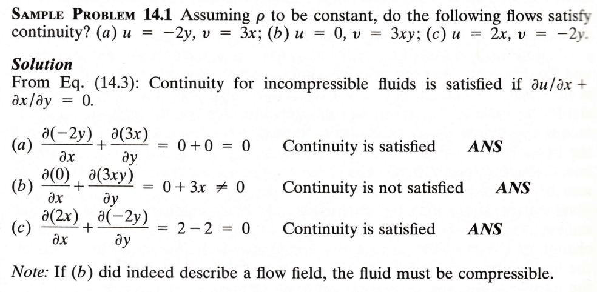

DIFFERENTIAL EQUATION OF CONTINUITY
δv
Since it is 2 dimensional

Slide 8
ROTATIONAL AND IRROTATIONAL FLOW
Irrotational flow may be briefly described as flow in which each element of the moving fluid suffers no net rotation from one instant to the next, with respect to a given frame of reference.
The classic example of irrotational motion (although not a fluid) is that of the carriages on a Ferris wheel used for amusement rides.

Slide 9
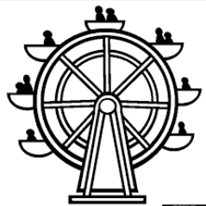
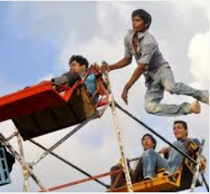

Slide 10
ROTATIONAL AND IRROTATIONAL FLOW
Each carriage describes a circular path as the wheel revolves , but does not rotate with respect to the earth.
i.e., the carriage is always horizontal (with respect to the earth) so that people do not fall

Slide 11
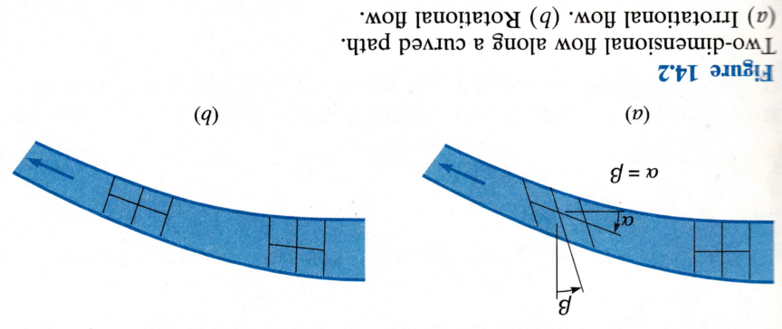
ROTATIONAL AND IRROTATIONAL FLOW
In irrotational flow, however, a fluid element may deform as shown in Fig 14.2a, where the axes of the element rotate equally toward or away from each other (like in a Ferris wheel). As long as the algebraic average rotation is zero, the motion is irrotational.
In Fig 14.2b is depicted an example of rotational flow. In this case there is a net rotation of the fluid element. Actually, the deformation of the element in Fig. 14.2b is less than that of Fig. 14.2a.

Slide 12
ROTATIONAL AND IRROTATIONAL FLOW
Let us now express the condition of irrotationality in mathematical terms.
It will help to restrict the discussion at first to two-dimensional motion in the x y plane

Slide 13
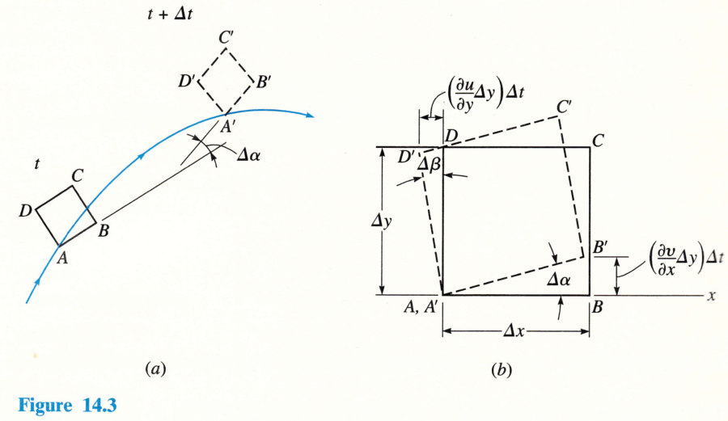

ROTATIONAL AND IRROTATIONAL FLOW
Consider a small fluid element moving as depicted in Fig. 14.3a.
During a short time interval Δt, the element moves from one position to another and in the process it deforms as indicated.
Superimposing A' on A, defining an x axis along AB, and enlarging the diagram, we get Fig. 14.3b. u and v are velocities in x and y axes, respectively
v
u
$\left(\frac{∂v}{∂x}∆x\right)$∆t

Slide 14



ROTATIONAL AND IRROTATIONAL FLOW
The angle Δα between AB and A'B' can be expressed from Fig. 14.3b as
Hence the rate of rotation of the edge of the element that was originally aligned with AB is
tan Δα= Δα when Δα is small
$\left(\frac{∂v}{∂x}∆x\right)$∆t

Slide 15




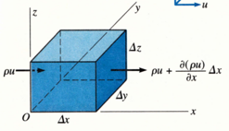

ROTATIONAL AND IRROTATIONAL FLOW
Likewise
and the rate of rotation of the edge of the element that was originally aligned with AB is
with the negative sign because +u is directed to the right.
The rate of rotation of the element about the z axis is now defined to be ω_{z}, the average of ω_{α} and ω_{β}; thus
$\left(\frac{∂v}{∂x}∆x\right)$∆t

Slide 16


ROTATIONAL AND IRROTATIONAL FLOW
But the criterion we originally stipulated for irrotational ﬂow was that the rate of rotation be zero. Therefore we have
      irrotational ﬂow
      in xy plane
In three-dimensional flow there are corresponding expressions for the components of angular-deformation rates about the x and y axes. Finally, for the general case, irrotational flow is defined to be that for which
In Slide 17, we shall see that the primary significance of irrotational ﬂow is that it is defined by a velocity potential.

Slide 17
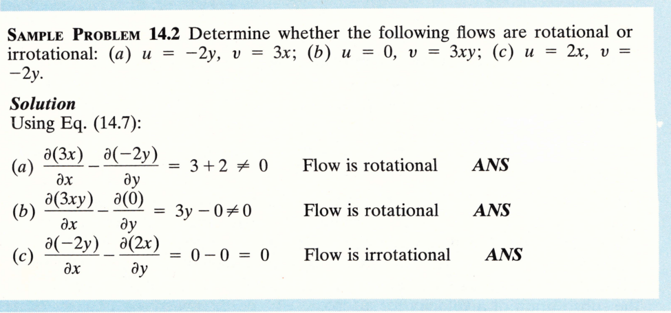
ROTATIONAL AND IRROTATIONAL FLOW
for irrotational flow

Slide 18
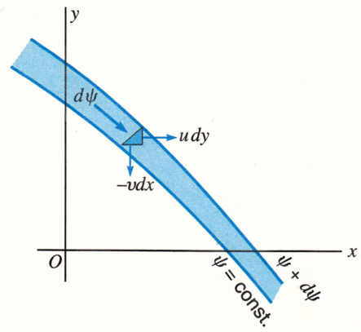


THE STREAM FUNCTION
The stream function ψ (psi), based on the continuity principle, is a mathematical expression that describes a flow field. In Fig. 14.6 are shown two adjacent streamlines of a two-dimensional flow field. Let ψ (x, y) represent the streamline nearest the origin. Then ψ + dψ is representative of the second streamline. Since there is no flow across a streamline, we can let ψ be indicative of the flow carried through the area from the origin O to the first streamline. And thus dψ represents the flow carried between the two streamlines of Fig. 14.6. From continuity, referring to the triangular fluid element of Fig. 14.6, we see that for an incompressible fluid 14.14
The total derivative dψ may also be expressed as
14.15

Slide 19


THE STREAM FUNCTION
Comparing these last two equations, we note that
14.16
Thus, if ψ can be expressed as a function of x and y, we can find the velocity components (u and v) at any point of a two-dimensional flow field by application of Eqs. (14.16).
Conversely, if u and v are expressed as functions of x and y, we can find ψ by integrating Eq. (14.14).
However, it should be noted that since the derivation of ψ is based on the principle of continuity, it is necessary that continuity be satisfied for the stream function to exist.
Also, since vorticity (the circulation per unit of enclosed
area) was not considered in the derivation of ψ, the flow need not be irrotational for the stream function to exist.

Slide 20




THE STREAM FUNCTION
The equation of continuity ( )
may be expressed in terms of ψ by substituting the expressions for u and v from Eqs. (14.16); doing so, we get
which shows that, if , the derivatives taken in either order give the same result and that a flow described by a stream function automatically satisfies the continuity equation.

Slide 21
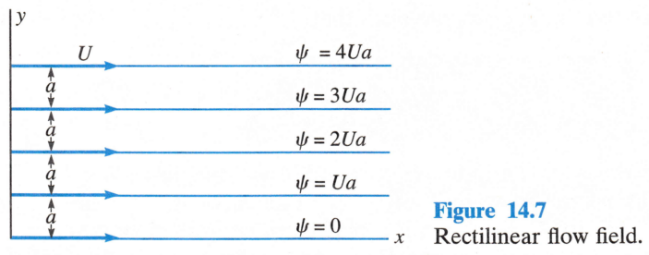

BASIC FLOW FIELDS
In this section we shall discuss one of the basic flow fields that is commonly encountered. Though these flow fields imply an ideal fluid, they closely depict the flow of a real fluid outside the zone of viscous influence provided there is no separation of the flow from the boundaries (see Sec. 4.10). The simplest of all flows is that in which the streamlines are straight, parallel, and evenly spaced as indicated in Fig. 14.7. In this case v = 0 and u = constant. Thus, from Eq. (14.14), , and hence , where U is the velocity of flow. If the distance between streamlines is a, the values of ψ for the streamlines are as indicated in Fig. 14.7.
v
u

Slide 22



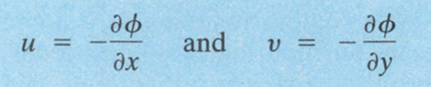
VELOCITY POTENTIAL
Let us define the potential
14.20
Mathematically, this is termed an “exact” differential, and therefore the function ϕ(x, y) exists, if
14.21
14.21 will be proved in 14.25
But the total derivative is defined to be
14.22
By comparing (14.20) with (14.22) we see that in Cartesian coordinates
14.23
The use of a minus sign in Eq. (14.20) led to the minus signs in the expressions (14.23), which indicate that the velocity potential decreases in the direction of flow, i.e., flow moves from areas of high potential (head) to low potential (head). E.g., the Zambezi River flows from Kaleni Hills to the Indian Ocean. Some authors prefer the opposite, and so change these signs.

Slide 23




VELOCITY POTENTIAL
For two-dimensional flow, ϕ with conditions (14.23) is termed the
velocity potential function. In polar coordinates, the corresponding expressions are
Differentiating Eqs. (14.23), we get
14.25
Since the right-hand sides of these two last quantities are equal, this satisfies the requirement (14.21), which, from equation of vorticity
, proves that ξ = 0. Thus it follows that if a flow is irrotational
(ξ = 0) then a velocity potential exists, and vice versa. Because of the existence of a velocity potential, such flow is often referred to as potential flow.

Slide 24

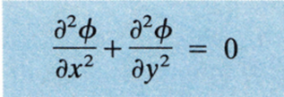
VELOCITY POTENTIAL
The rotation of fluid particles requires the application of torque ( defined as a measure of how much a force acting on an object causes that object to rotate), which in turn depends on shearing forces. Such forces are possible only in a viscous fluid. In inviscid (or ideal) fluids there can be no shears and hence no torques.
If we substitute Eqs. (14.23) into the continuity Eq. (14.3), we get
14.26
This is the Laplace equation, named after the French mathematician and astronomer, Marquis Pierre Simon de Laplace (1749-1827). It is possibly the best known of all partial differential equations, important also in solid mechanics and thermodynamics. For fluids, if a function ϕ satisfies Laplace’s equation, the resulting flow must be irrotational.

Slide 25


ORTHOGONALITY OF STREAMLINES AND EQUIPOTENTIAL LINES
From Eqs. (14.14) and (14.20) we have
and
Along a streamline, ψ = constant, so dψ = 0, and from the first equation (14.14) we get dy/dx = v/u. Along an equipotential line, ϕ = constant, so dϕ = 0, and from the second equation (14.20) we get dy/dx = -u/v. Geometrically, this tells us that the streamlines and equipotential lines are orthogonal, or everywhere perpendicular to each other. As a result, the stream function and the velocity potential are known as conjugate functions.

Slide 26
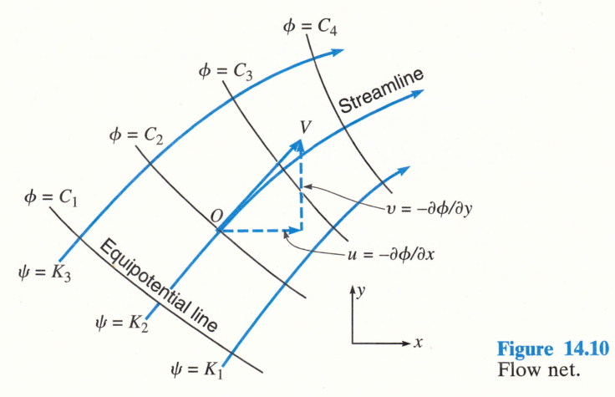


ORTHOGONALITY OF STREAMLINES AND EQUIPOTENTIAL LINES
The equipotential lines ϕ = C, and the streamlines ψ = K, where the C and the K have equal increments between adjacent lines, form a network of intersecting perpendicular lines that is called a flow net (Fig. 14.10).
The small quadrilaterals must evidently become squares as their size approaches zero, if the x and y scales are the same (e.g., length: head (y axis) & length (x axis)), since from Eqs. (14.16) and (14.23) |u| = |δϕ/δx| = | δψ/δy |, or for finite increments |Δϕ/Δx| = |Δψ/Δy|.
The difference in value of the stream function between adjacent streamlines is called the strength of the stream tube bounded by two streamlines, and it represents the two-dimensional flow through the tube.

Slide 27
ORTHOGONALITY OF STREAMLINES AND EQUIPOTENTIAL LINES
Stream functions can exist in the absence of irrotationality, and potential functions are possible even though continuity is not satisfied.
But, since lines of ϕ and ψ are required to form an orthogonal network, a flow net can only exist if irrotationlity (the condition for the existence of ϕ) and continuity (the condition for the existence of ψ) are satisfied. The Laplace equation was derived assuming the existence of velocity potentials and the satisfaction of continuity. Thus, if a given flow satisfies the Laplace equation, a flow net can be constructed for that flow.
Because of irrotationality requirement such potential flows are usually those of ideal fluids.

Slide 28
ORTHOGONALITY OF STREAMLINES AND EQUIPOTENTIAL LINES
Example of an earth dam
The small quadrilaterals must evidently become squares as their size approaches zero, if the x and y scales are the same (e.g., length: head (y axis) & length (x axis)), since Eqs. (14.16) and (14.23) |u| = |δϕ/δx| = | δψ/δy |, or for finite increments |Δϕ/Δx| = |Δψ/Δy|.
The difference in value of the stream function between adjacent streamlines is called the strength of the stream tube bounded by two streamlines, and it represents the two-dimensional flow through the tube.

Slide 29

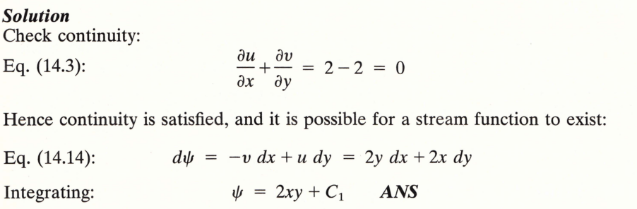
ORTHOGONALITY OF STREAMLINES AND EQUIPOTENTIAL LINES

Slide 30
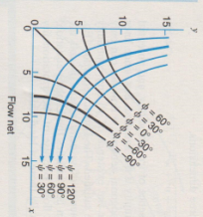
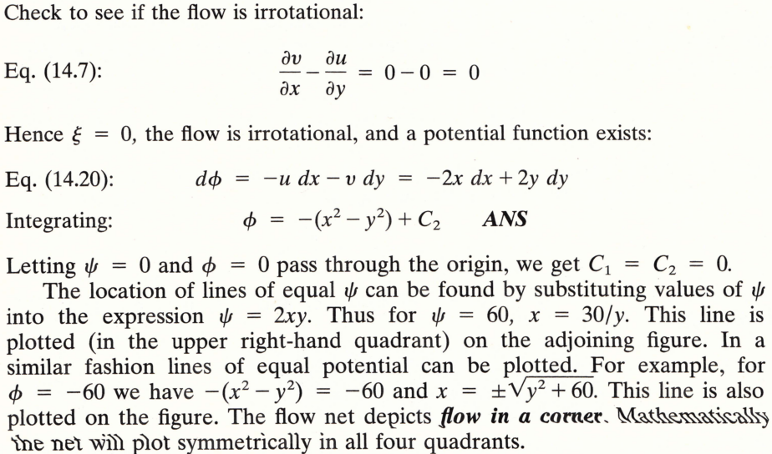
ORTHOGONALITY OF STREAMLINES AND EQUIPOTENTIAL LINES

Slide 31
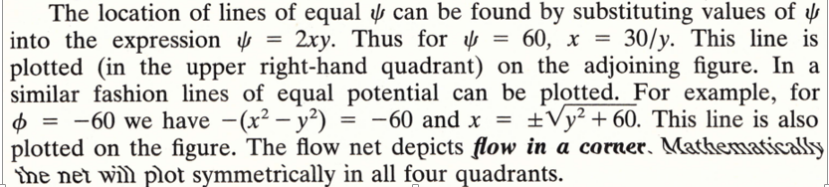
ORTHOGONALITY OF STREAMLINES AND EQUIPOTENTIAL LINES

Slide 32
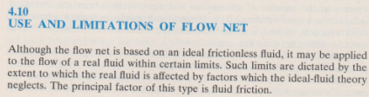
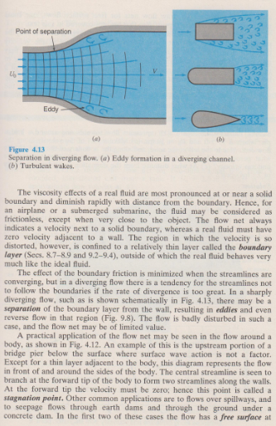
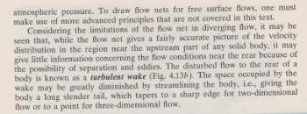
USE AND LIMITATIONS OF FLOW NET

Slide 33
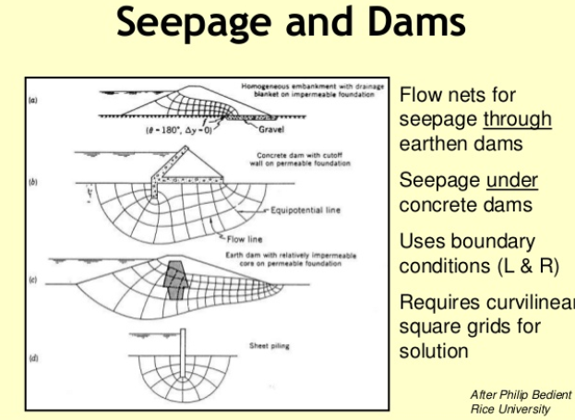
EXAMPLES OF FLOWNETS

Slide 34
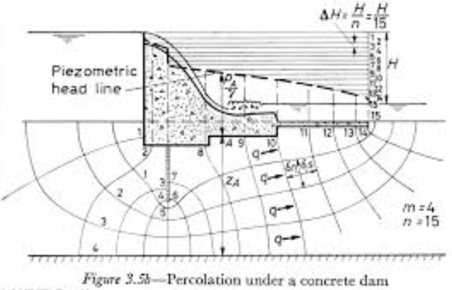
EXAMPLES OF FLOWNETS

Slide 35
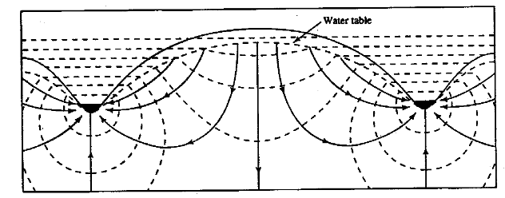
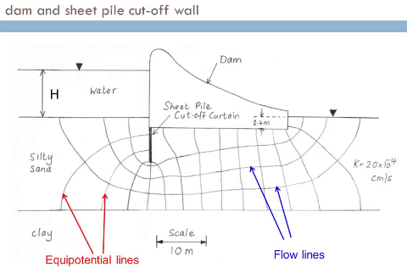
EXAMPLES OF FLOWNETS

