Slide 1
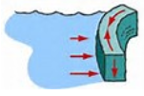
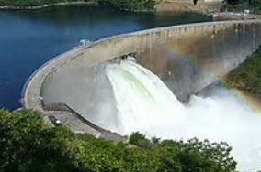
Fluid Mechanics CEE 3311
LECTURE 2
FLUID STATICS
L. Handia

Slide 2


FLUID STATICS
There are no shear stresses in fluids at rest (∆F_{t}= 0);
hence only normal pressure forces (∆F_{n}≠ 0) are present.
When F= 0, then velocity is zero. From Newton’s Equation of Viscosity

Slide 3
FLUID STATICS
Normal forces produced by static fluids are often very important:
  water pushing against dam
  wall (they tend to overturn
  concrete dams)
  burst pressure vessels
  break lock gates on canals
Obviously, to design such facilities, we need to be able to compute the magnitudes and locations of normal pressure forces.

Slide 4
FLUID STATICS
Note that normal pressure forces alone can occur in a moving fluid if the fluid is moving in bulk without deformation, i.e., as if it were solid or rigid.
The average pressure intensity p is defined as the force exerted on a unit area.

Slide 5
FLUID STATICS
If F represents the total normal pressure force on some finite area A, while dF represents the force on an infinitesimal area dA, the pressure is
If the pressure is uniform over the total area, then p = F /A

Slide 6

Pressure
Pressure at a point the same in all directions
No tangential stresses can exist in a fluid at rest, and the only forces between adjacent surfaces are pressure forces normal to the surfaces.
Therefore the pressure at any point in a fluid at rest is the same in every direction.
This can be proved by
reference to Fig.,
showing a very small
wedge-shaped element
of fluid at rest whose
thickness perpendicular
to the plane of the paper is constant and equal to dy.

Slide 7
Pressure
Pressure at a point the same in all directions
Let p be the average pressure in any direction in the plane of the paper, let α be defined as shown, and let p_{x} and p_{z} be the average pressures in the horizontal and vertical directions
The forces acting on the element of ﬂuid, with the exception of those in the y direction on the two faces parallel to the plane of the paper, are shown in the diagram.

Slide 8
Pressure
Pressure at a point the same in all directions
For our purpose, forces in the y direction need not be considered because they cancel.
Since the ﬂuid is at rest, no tangential forces are involved. As this is a condition of equilibrium, the sum of the force components on the element in any direction must be equal to zero.

Slide 9
Pressure
Pressure at a point the same in all directions
Writing such an equation for the components in the x direction
p dl dy cos α - p_{x} dy dz = 0.
Since dz = dl cos α, it follows from above eqn. that p = p_{x} as shown below:
p dl dy cos α - p_{x} dy dz = 0
p dl dy cos α - p_{x} dy dl cos α = 0
p = p_{x}

Slide 10
Pressure
Pressure at a point the same in all directions
Similarly, summing forces in the z direction gives
p_{z} dx dy - p dl dy sin α – ½ γ dx dy dz = 0
The third term is of higher order than the other two terms and so may be neglected. It follows from this that p = p_{z} as shown below
p_{z} dx dy - p dl dy sin α – ½ γ dx dy dz = 0
Since dx = dl sin α.
p_{z} dx dy - p dl dy sin α – 0= 0
p_{z} dl sin α dy - p dl dy sin α = 0
p = p_{z}

Slide 11
Pressure
Pressure at a point the same in all directions
It can also be proved that p = p_{y} by considering a three-dimensional case.
The results are independent of α; hence the pressure at any point in a ﬂuid at rest is the same in all directions (i.e., p_{x =} p_{y=}p_{z})

Slide 12
Pressure
Pressure at a point the same in all directions
Pascal’s Law states that the pressure at a point in a fluid at rest is the same in all directions independent of the orientation of the surface around that point.

Slide 13
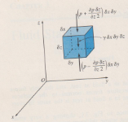
Pressure
Variation of pressure in a static fluid
Consider the differential element of static ﬂuid shown in Fig below.
Since the element is very small, we can assume that the density of the ﬂuid within the element is constant.
Assume that the pressure at the center of the element is p and that the dimensions of the element are δx, δy and δz.

Slide 14
Pressure
Variation of pressure in a static fluid
The forces acting on the ﬂuid element in the vertical direction are
  the body force, the action of gravity on the mass within the element, and
  the surface forces, transmitted from the surrounding ﬂuid and acting at right angles against the top, bottom, and sides of the element.

Slide 15
Pressure
Variation of pressure in a static fluid
Because the ﬂuid is at rest, the element is in equilibrium and the summation of forces acting on the element in any direction must be zero.
If forces are summed in the horizontal direction, that is, x or y, the only forces acting are the pressure forces on the vertical faces of the element.
To satisfy and , the pressures on the opposite vertical faces must be equal. Thus
for the case of the
fluid at rest
(i.e., there is no change in pressure in the x-direction and also in the
y-direction, the horizontal direction)

Slide 16
Pressure
Variation of pressure in a static fluid
Summing forces in the vertical direction and setting the sum equal to zero
This results in , which,
since p is independent of
x and y, can be written as
Rate of change of p in z direction multiplied by distance over which change occurs

Slide 17
Pressure
Variation of pressure in a static fluid
z
This is the general expression that relates variation of
pressure in a static ﬂuid to vertical position.
The minus sign indicates that as z gets larger (increasing elevation), the pressure gets smaller.
To evaluate pressure variation in a fluid at rest, one must integrate the above equation between appropriately chosen limits.
For incompressible ﬂuids (γ = constant. This is earlier assumption), above equation can be integrated directly. For compressible ﬂuids, however, γ must be expressed algebraically as a function of z or p if one is to determine pressure accurately as a function of elevation.

Slide 18
Pressure
Variation of pressure in a static fluid
Where subscript 1 indicates conditions at a reference elevation. Integration gives
where p is the pressure at an elevation z. This expression is generally applicable to liquids, since they are only slightly compressible. Only where there are large changes in elevation, as in the ocean, need the compressibility of the liquid be considered, to arrive at an accurate determination of pressure
variation. For small changes in elevation, equation will give accurate results

Slide 19
Pressure
Variation of pressure in a static fluid
For the case of a liquid at rest, it is convenient to measure distances vertically downward from the free liquid surface. If h is the distance below the free liquid surface and if the pressure of air and vapor on the surface is arbitrarily taken to be zero, equation can be written as
As there must always be some pressure on the surface of any liquid, the total pressure at any depth h is given by the above equation plus the pressure on the surface.
In many situations this surface pressure may be disregarded
h

Slide 20
Pressure
Variation of pressure in a static fluid
From , it may be seen that all points in a connected body of constant density fluid at rest are under the same pressure if they are at the same depth below the liquid surface (Pascal’s law).
This indicates that a surface of equal pressure for a liquid at rest is a horizontal plane.
Strictly speaking, it is a surface everywhere normal to the direction of gravity and is approximately a spherical surface concentric with the earth. For practical purposes, a limited portion of this surface may be considered a plane area.
h

Slide 21
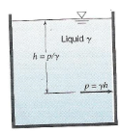
Pressure
Pressure expressed in height of fluid
Imagine an open tank of liquid upon whose surface there is no
pressure, though in reality the minimum pressure upon any
liquid surface is the pressure of its own vapor.
Disregarding this for the moment, by the
previous equation, the pressure at any
depth h is p = γ h.
If γ is assumed constant, there is a deﬁnite
relation between p and h. That is, pressure
(force per unit area) is equivalent to a height
h of some ﬂuid of constant speciﬁc weight γ.
It is often more convenient to express
pressure in terms of a height of a column of
ﬂuid rather than in pressure per unit area e.g., pressure in the
pipeline is 10m of water.

Slide 22
Pressure
Pressure expressed in height of fluid
Even if the surface of the liquid is under some pressure, it is necessary only to convert this pressure into an equivalent height of the fluid in question and add this to the value of h (Fig) to obtain the total pressure.

Slide 23
Pressure
Pressure expressed in height of fluid
The preceding discussion has been applied to a liquid, but it is equally possible to use it for a gas or vapor by specifying some constant speciﬁc weight γ for the gas or vapor in question. Thus pressure p may be expressed in the height of a column of any ﬂuid by the relation
When pressure is expressed in meters,
it is commonly referred to as
pressure head e.g., pressure head in
the pipeline is 10m of water.

Slide 24
Pressure
Pressure expressed in height of fluid
It is convenient to express pressures occurring in one fluid in terms of height of another fluid, e.g., barometric pressure in millimeters of mercury.
Equation p - p₁ = - γ (z – z₁) may be expressed as follows:
This shows that for an incompressible fluid at rest, at any point in the fluid the sum of the elevation z and the pressure head p/ γ is equal to the sum of these two quantities at any other point. The significance of this statement is that, in a fluid at rest, with an increase in elevation there is a decrease in pressure head, and vice versa. This concept is depicted in Fig below.

Slide 25
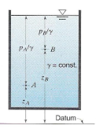
Pressure
Pressure expressed in height of fluid

Slide 26
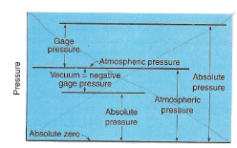
Pressure
Absolute and gauge pressures
If pressure is measured relative to absolute zero, it is called absolute pressure;

Slide 27
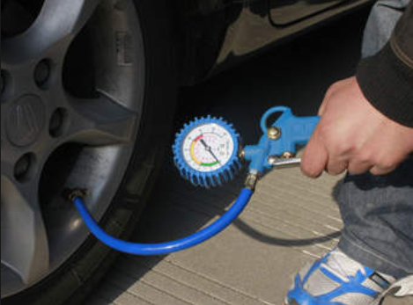
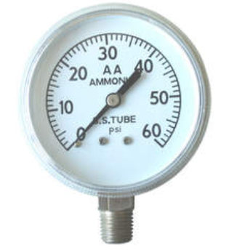
Pressure
Absolute and gauge pressures
when measured relative to atmospheric pressure as a base, it is called gauge pressure.
This is because practically all pressure gages register zero when open to the atmosphere, and hence measure the difference between the pressure of the fluid to which they are connected and that of the surrounding air.

Slide 28
Pressure
Absolute and gauge pressures
If the pressure is below that of the atmosphere, it is designated as a vacuum, and its gauge value is the amount by which it is below that of the atmosphere. What is called a “high vacuum” is really a low absolute pressure. A perfect vacuum would correspond to absolute zero pressure.

Slide 29
Pressure
Absolute and gauge pressures
Gauge pressures are positive if they are above that of the atmosphere and negative if they are vacuum.
It can be seen from the foregoing discussion that the following relation holds:
where p_{gauge} may be positive or negative (vacuum).

Slide 30
Pressure
Measurement of absolute pressure
BAROMETER
The absolute pressure of the atmosphere is measured with a barometer.
Types of barometers. (a) Mercury barometer. (b) Aneroid barometer.

Slide 31

Pressure
Pressure measurement in a fluid
There are many ways by which pressure in a fluid may be measured.
1. Bourdon gauge
Pressures or vacuums are commonly measured by the bourdon gage
A curved tube of elliptical cross section will change its curvature with changes in pressure within the tube

Slide 32
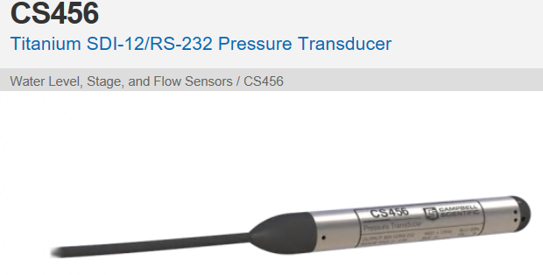
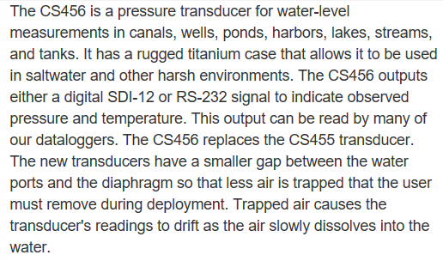
Pressure
Pressure measurement
Pressure transducer (a device that converts variations in a physical quantity, such as pressure, into an electrical signal, or vice versa)

Slide 33
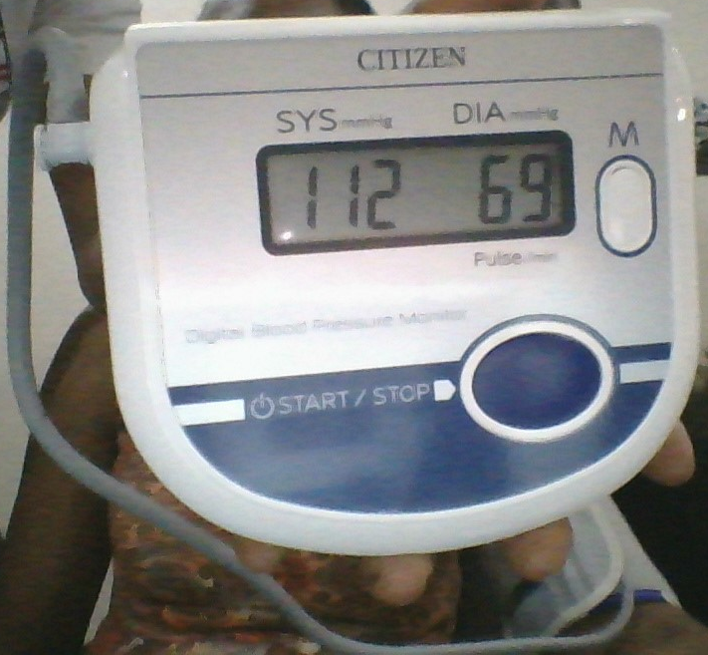
Pressure
Pressure measurement
Pressure transducer (a device that converts variations in a physical quantity, such as pressure, into an electrical signal, or vice versa)

Slide 34


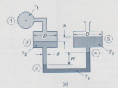

Pressure
Pressure measurement
Manometers
Manometers are instruments that use columns of liquids to measure pressures

Slide 35
Pressure
Pressure measurement
a. U-tube Manometer (small pressures)
The datum from which z₁ and z₂ are measured is located at any desired position such as through point 1.
Since p₂ = 0 (gauge pressure is selected; if absolute pressure is desired, we would select p₂ = p_{atm}) & z₂ – z₁= h
2
datum
1
Liquid from the pipe
By measuring h, one computes p₁, the pressure in the pipe

Slide 36
Pressure
Should pass through point 1 at the centre of the pipe
Pressure measurement
b. U-tube Manometer (large pressures)
Manometer used to measure relatively large pressures since we can select γ₂ to be quite large (e.g., mercury γ₂ = 13.6 γ_{water}
The pressure can be determined by introducing three points as indicated. This is necessary because applies throughout one ﬂuid; γ must be constant. The value of γ changes abruptly at point 2; hence we write for γ₁ for γ₂

Slide 37
Pressure
Pressure measurement
b. U-tube Manometer (large pressures)
where γ₁ and γ₂ are for liquids 1 and 2, respectively.
Equation 1 becomes
Setting p₃ = 0 (gauge pressure is used), Equation 2 yields
Should pass through point 1 at the centre of the pipe
1
2
3
4

Slide 38
Pressure
Should pass through point 1 at the centre of the pipe
Pressure measurement
U-tube Manometer (large pressures)
Putting Eqn 4 into Eqn 3 results in
In the analysis above we recognize that the pressure at point 2' is equal to the pressure at point 2, since points 2 and 2' are at the same elevation in the same ﬂuid above a datum passing through the horizontal bottom of the manometer.
3
4

Slide 39
Pressure
Pressure measurement
b. U-tube Manometer (large pressures)
Interpret the manometer by starting at the left water pipe, add pressure when the elevation decreases, and subtract pressure when the elevation increases until the end is encountered.
h = - ( z₂ - z₁ )

Slide 40
Pressure
Pressure measurement
c. Micromanometer (very small pressure changes)
Example

Slide 41
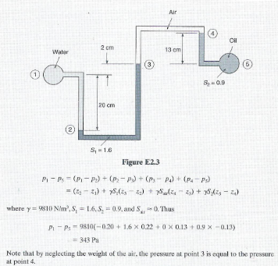
Pressure
Pressure measurement

Slide 42
Pressure
Pressure measurement
An alternative method of interpreting the manometer is to start at the left water pipe, add pressure when the elevation decreases, and subtract pressure when the elevation increases until the pipe at the right is encountered (From )

Slide 43
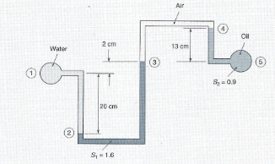
Pressure
Pressure measurement
Note that by neglecting the weight of the air (, the pressure at point 3 is equal to that at point 4 i.e., (if you want, you can include it)
          This yields the same answer

