Slide 1


Fluid Mechanics CEE 3311
LECTURE 5
Buoyancy
L. Handia

Slide 2
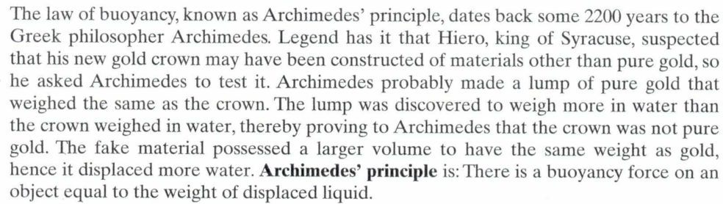
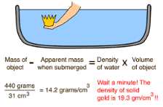
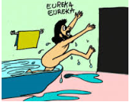
Principle of Archimedes: when a body is immersed in a fluid, it loses weight by an amount equal to the weight of the fluid which it displaces called its buoyancy (dictionary of civil engineers).

Slide 3
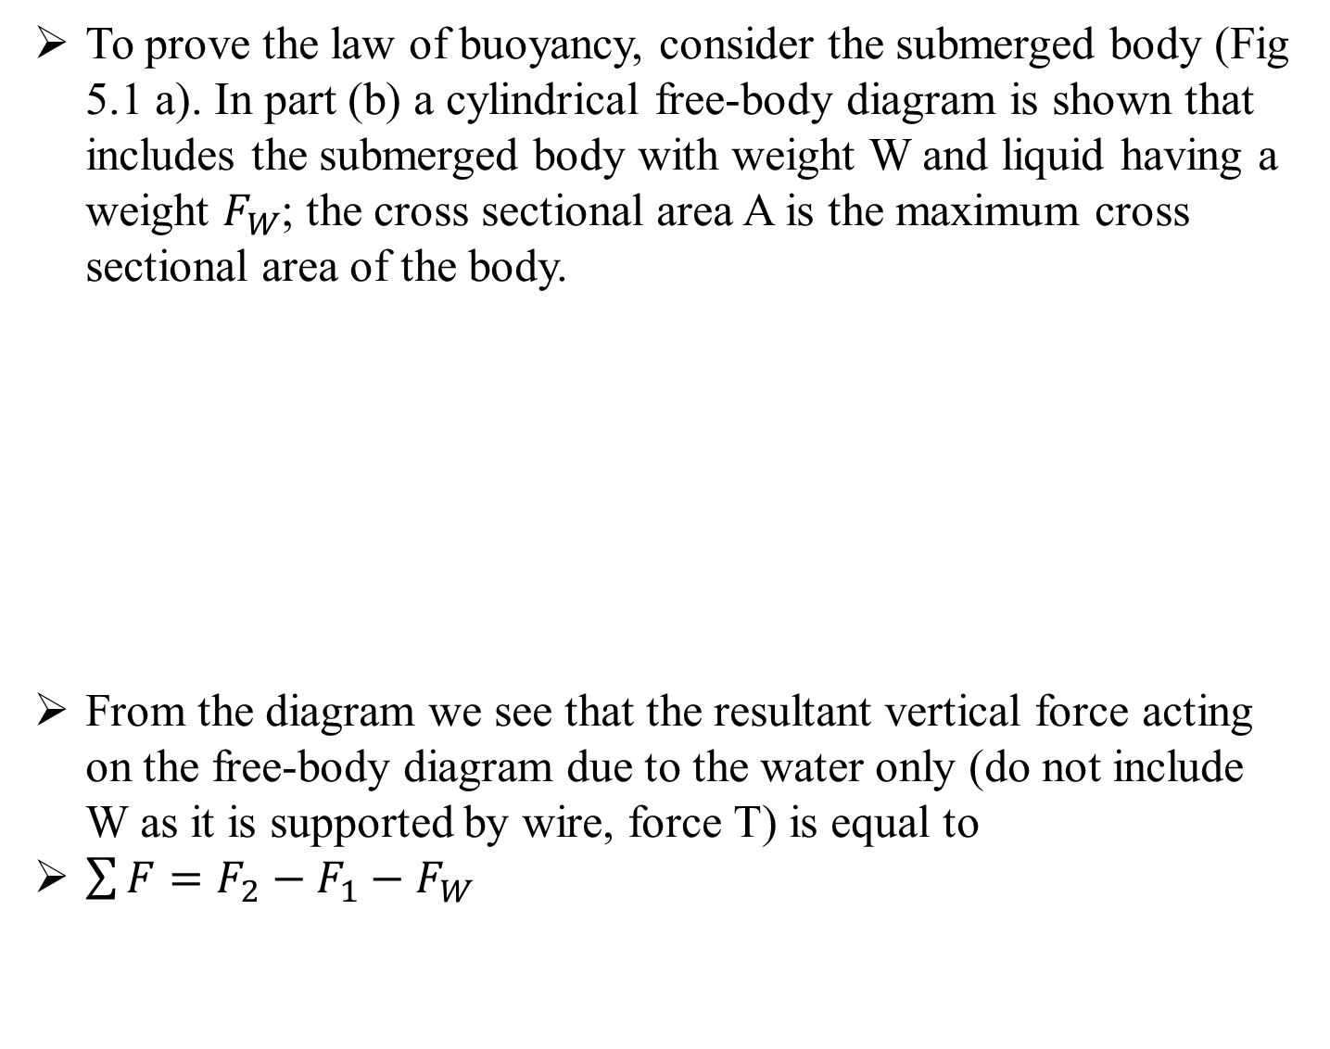
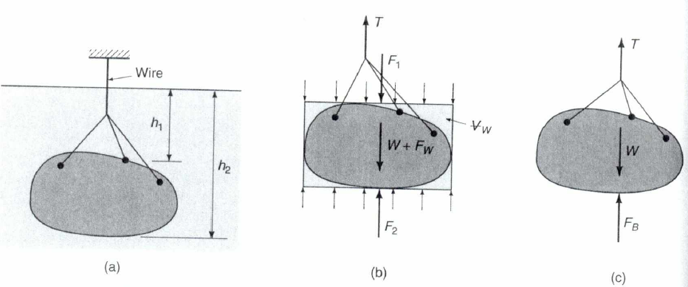
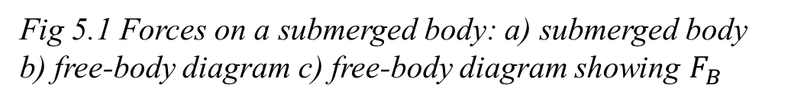
Proof of the Law of Buoyancy

Slide 4
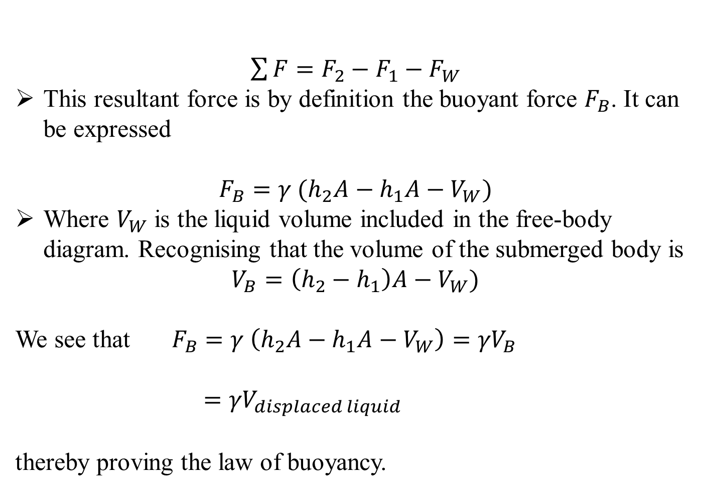
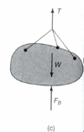
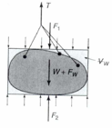
Proof of the Law of Buoyancy
Computed using forces
Computed using volume (geometry). Right handside equal to term in brackets of above eqn
Forces now equated to volume

Slide 5
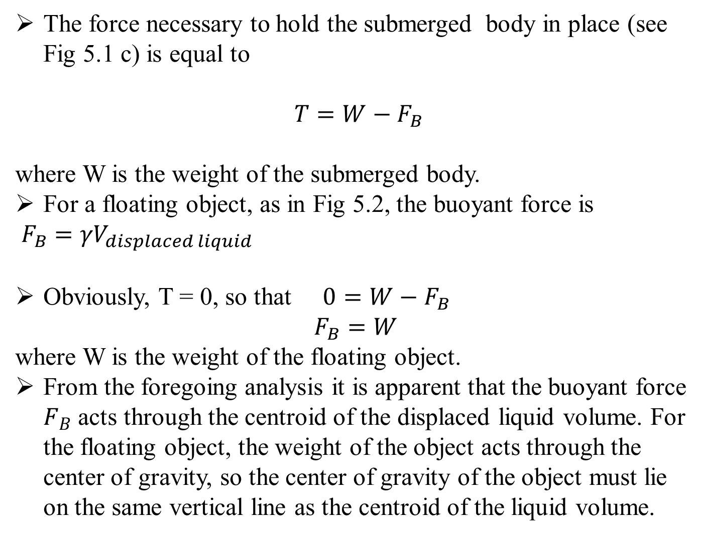
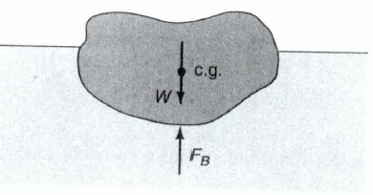
Buoyant Force
otherwise it will sink since it is denser than water
since it is floating
Fig 5.2 Forces on a floating object

Slide 6
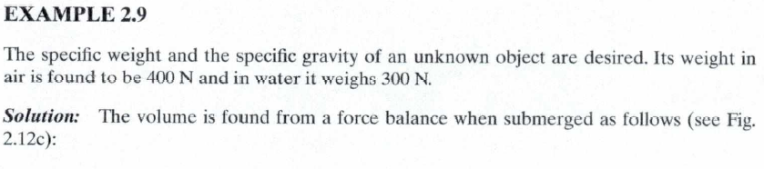
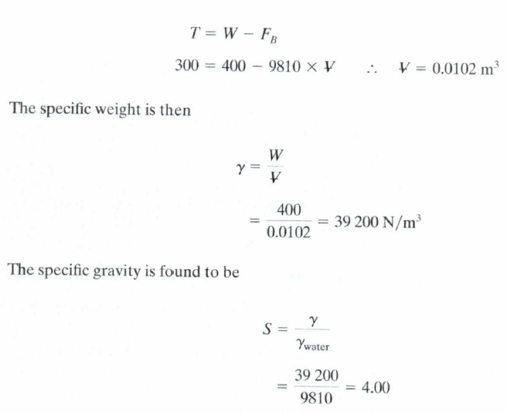
Example

Slide 7
Example

Slide 8
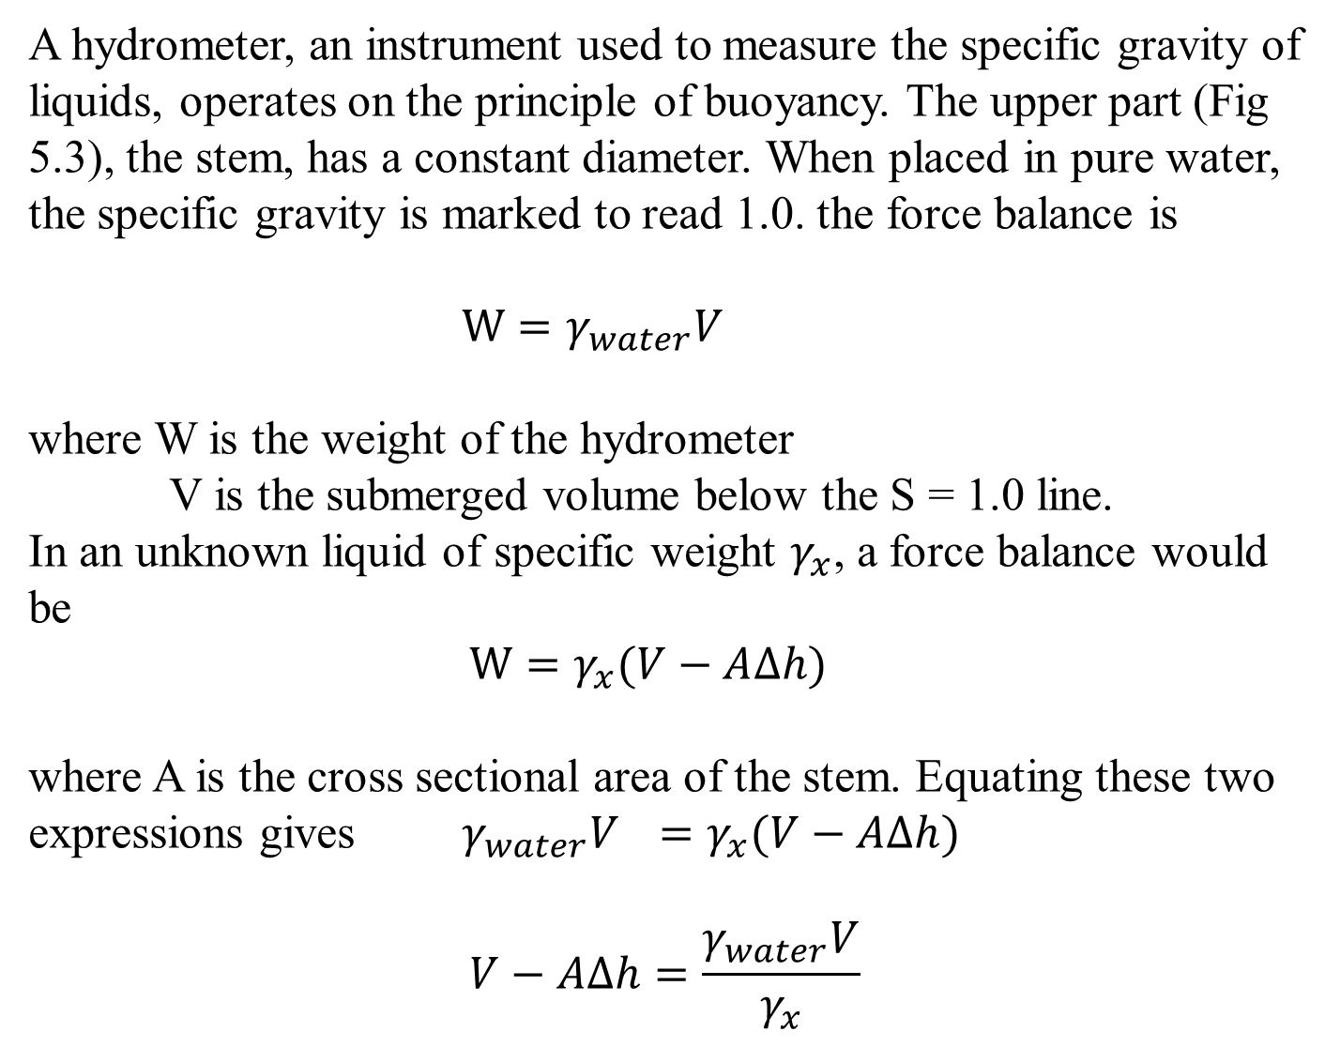
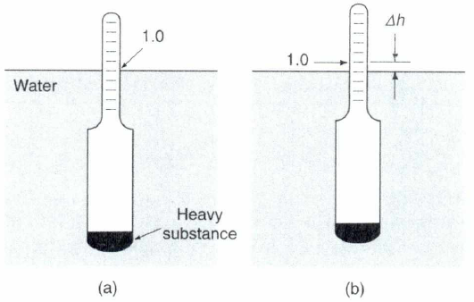
Hydrometer

Slide 9
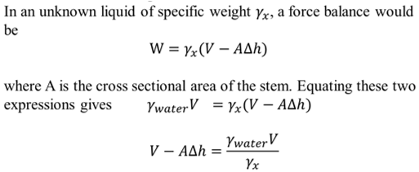
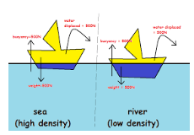
Hydrometer
since W is the same
Fig 5.3 Hydrometer a) in water b) in an unknown liquid

Slide 10
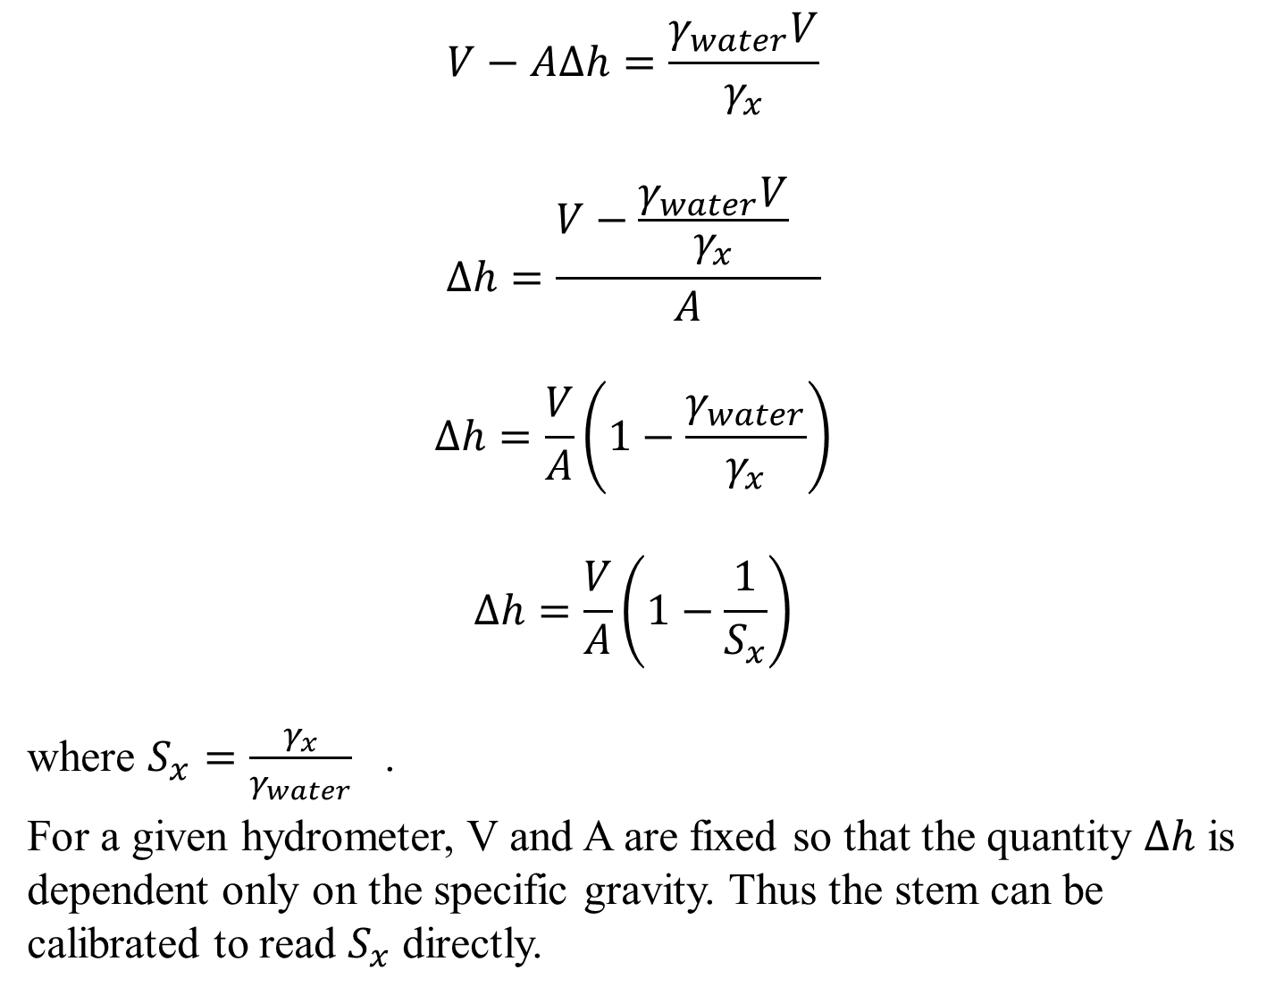

Slide 11
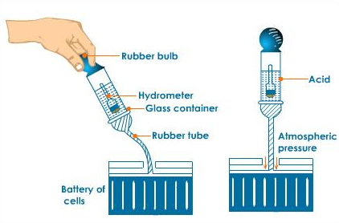
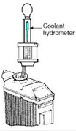
Application
Hydrometers are used to measure
the amount of antifreeze in the radiator of an automobile
the charge in a battery since the density of water changes when subjected to an electrical charge

