Slide 1
Fluid Mechanics CEE 3311
LECTURE 9
Conservation of mass
L. Handia

Slide 2

The continuity principle is based on the conservation of mass. In this case extensive property N=mass
intensive property η=1
Then control volume equation becomes

Slide 3
If the flow is steady, there results
For one dimensional flow can be written as
For steady one dimensional flow the formula diminishes to

Slide 4
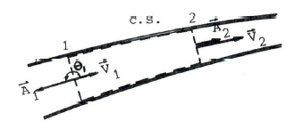
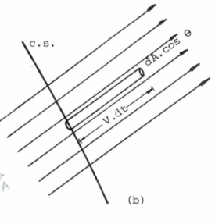
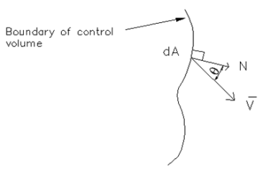
For steady one dimensional flow the formula diminishes to
This formula may be used, e.g., in a steady flow case in a conduit
The continuity equation takes the form

Slide 5
The equation takes the form
If the density is constant in the control volume, the continuity equation then reduces to
This form of the equation is used quite often, particularly with liquids and low speed gas

Slide 6
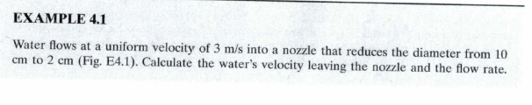
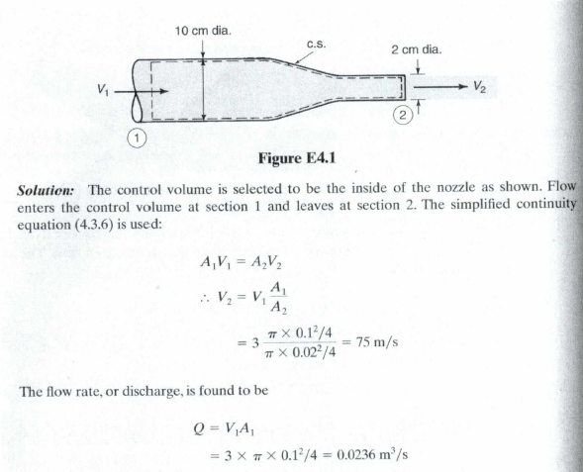

Slide 7


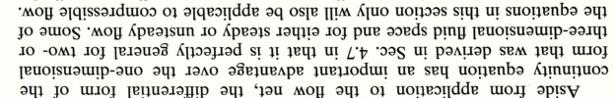
DIFFERENTIAL EQUATION OF CONTINUITY

Slide 8
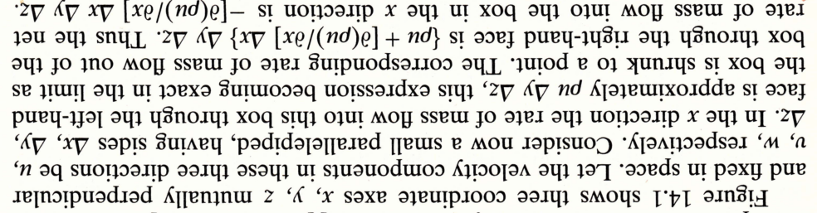
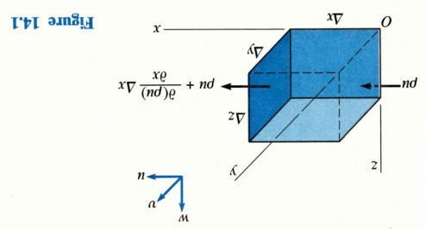
DIFFERENTIAL EQUATION OF CONTINUITY

Slide 9
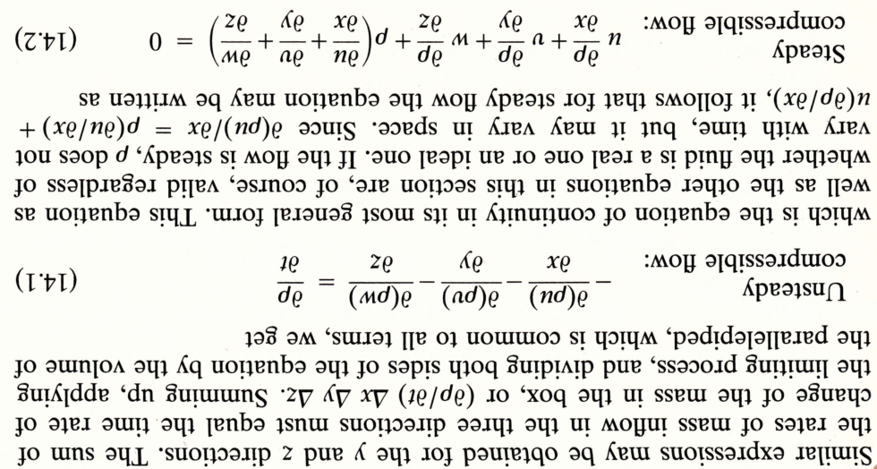
DIFFERENTIAL EQUATION OF CONTINUITY

Slide 10
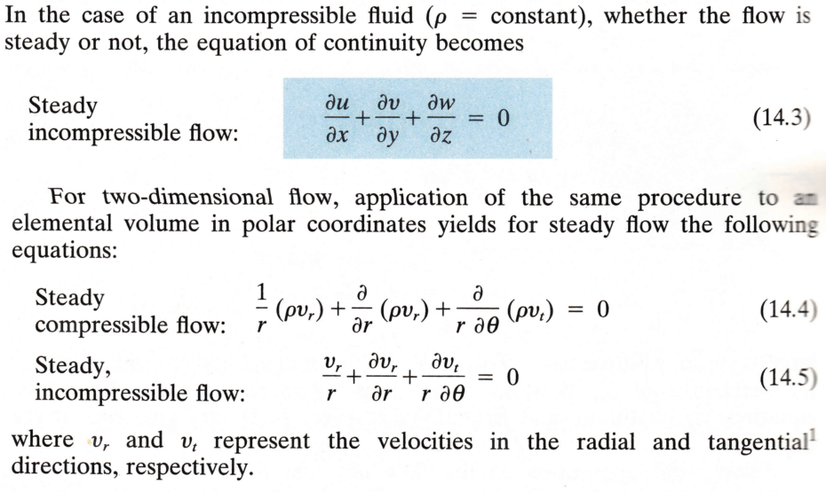
DIFFERENTIAL EQUATION OF CONTINUITY

Slide 11
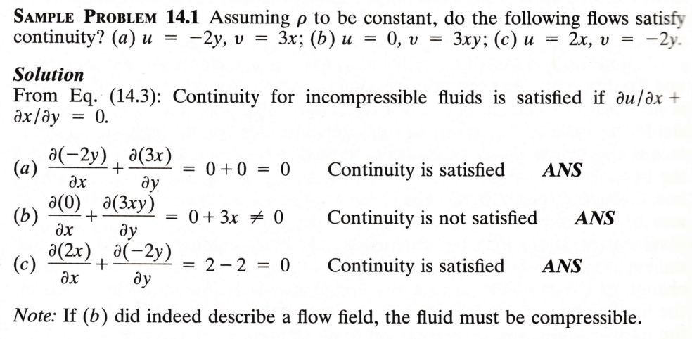

DIFFERENTIAL EQUATION OF CONTINUITY
δv
Since it is 2 dimensional

