Slide 1
Fluid Mechanics CEE 3311
LECTURE 8
Control volume equation
L. Handia

Slide 2
Introduction
In Lecture 1 it has been stated that for a continuous medium 3 conservation laws are valid:
  Conservation of mass
  Conservation of energy
  Conservation of momentum

Slide 3
System and control volume
In employing the basic laws, two modes of application may be adopted
System approach
Control volume approach

Slide 4
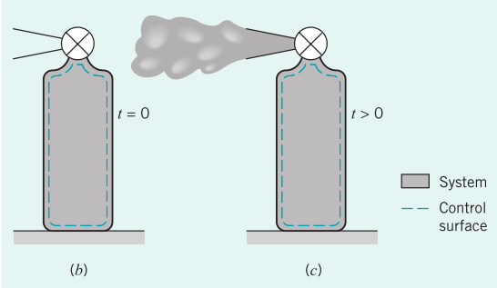
System approach
A ﬂuid system refers to a speciﬁc mass of ﬂuid within the boundaries deﬁned by a closed surface.
The shape of the system, and so the boundaries, may change with time, as when liquid ﬂows through a constriction or when gas is compressed; as a ﬂuid moves and deforms so the system containing it moves and deforms.
The size and shape of a system is entirely optional.

Slide 5
Control volume approach
A control volume refers to a ﬁxed region in space, which does not move or change shape.
It is usually chosen as a region that ﬂuid ﬂows into and out of.
Its closed boundaries are called the control surface. Again, the size and shape of a control volume is entirely optional, although the boundaries are often chosen to coincide with some solid or other natural ﬂow boundaries.
Actually, the control surface may be in motion through space relative to an absolute frame of reference; this is acceptable provided the motion is limited to constant-velocity translation.

Slide 6
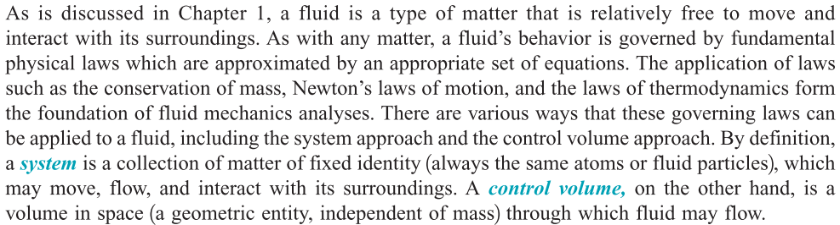
Another way of defining system and control volume

Slide 7
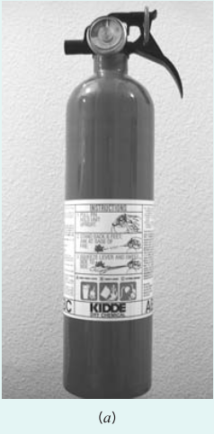
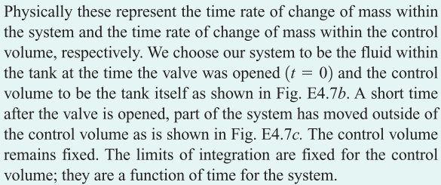
Example: fire extinguisher

Slide 8
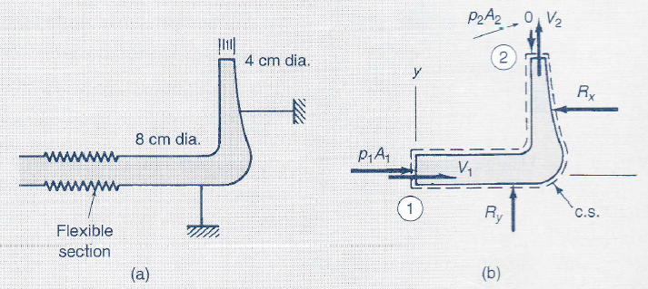
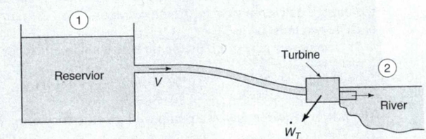
Other Examples

Slide 9
Introduction
We shall now derive a general relationship between a system and a control volume that provides an important basis for the equations of continuity, energy, and momentum for moving ﬂuids.
This relationship is derived from what is commonly referred to as the control volume approach, more formally known as the Reynolds transport theorem.
Addressing the motion of ﬂuid as it moves through a given region, the control volume approach is also called the Eulerian approach, in contrast to the Lagrangian approach; control volume does not move

Slide 10
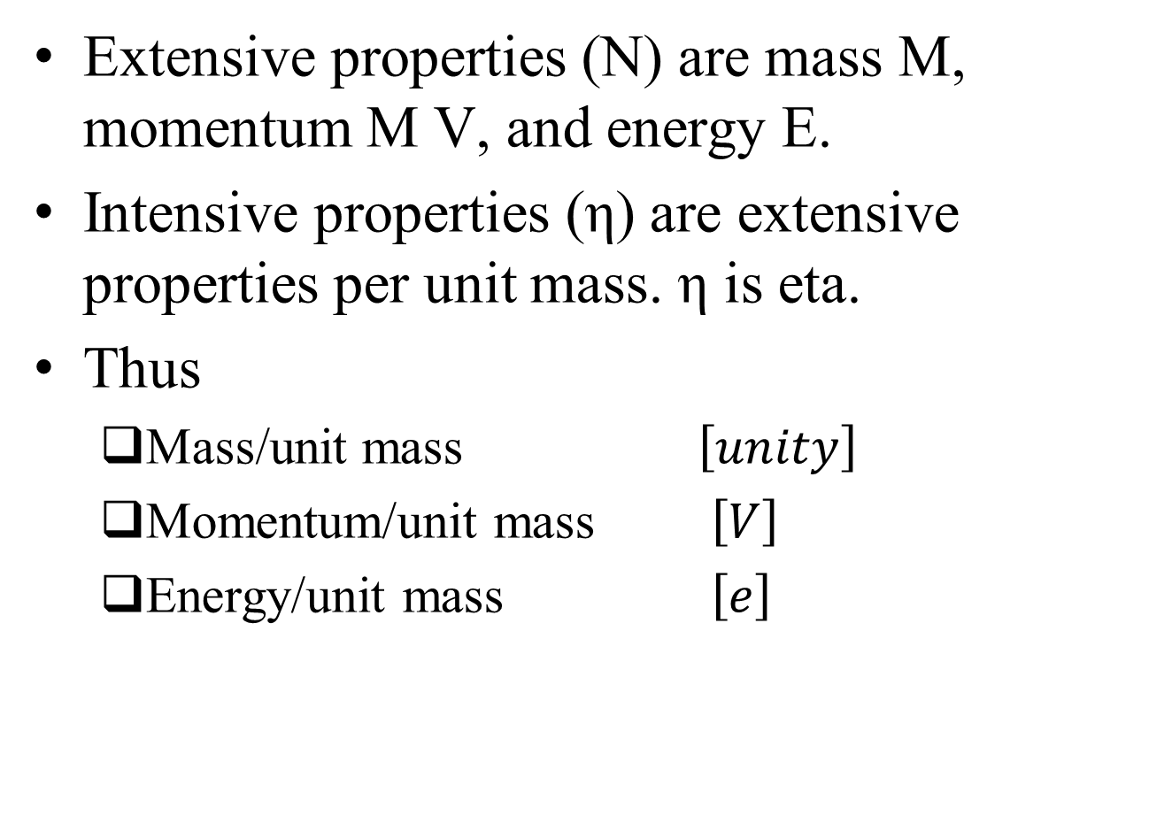
Derivation of the control volume equation
Extensive properties (N) are mass M, momentum M V, and energy E.
Intensive properties (η) are extensive properties per unit mass. η is eta.
Thus
  Mass/unit mass $\left[unity\right]$
  Momentum/unit mass $\left[V\right]$
  Energy/unit mass $\left[e\right]$

Slide 11
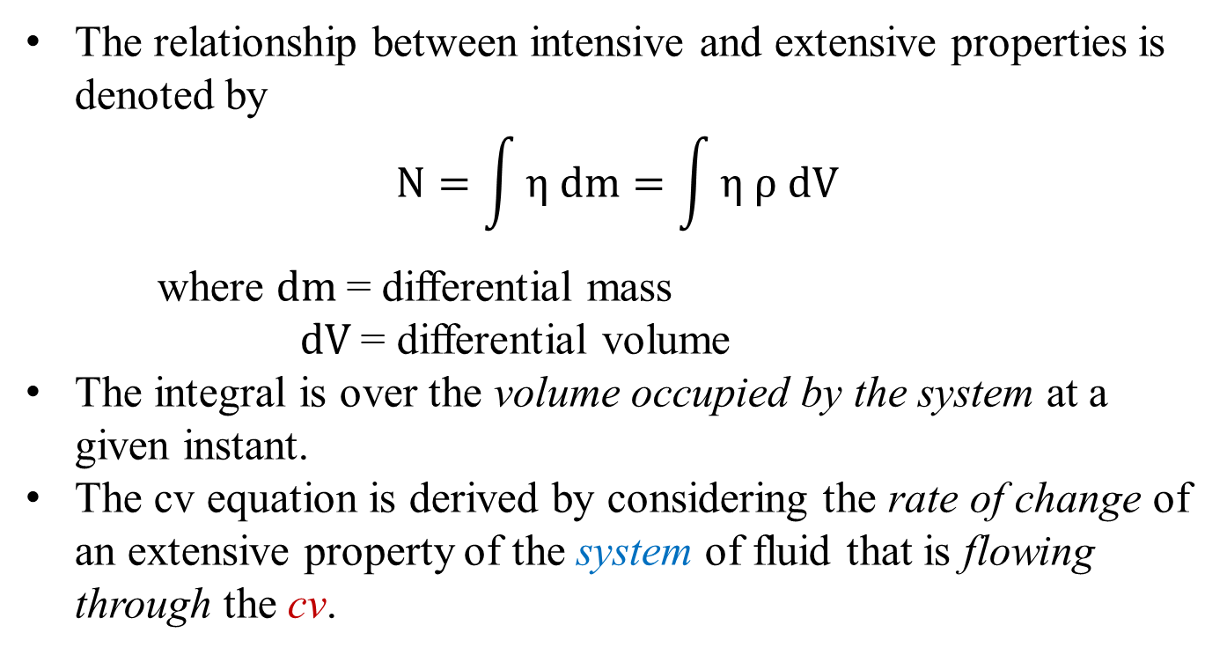
Derivation of the control volume equation
The relationship between intensive and extensive properties is denoted by
$$N=\int{η dm=\int{η ρ dV}}$$
where $dm$= differential mass
$dV$= differential volume
The integral is over the volume occupied by the system at a given instant.
The cv equation is derived by considering the rate of change of an extensive property of the system of fluid that is flowing through the cv.

Slide 12
Derivation of the control volume equation
Let N represent the total amount of some ﬂuid property, such as mass, energy, or momentum, contained within speciﬁed boundaries at a speciﬁed time.
The speciﬁed boundaries will be either those of a system, indicated by a subscript SYS, or those of a control volume, indicated by a subscript CV.

Slide 13
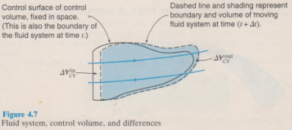
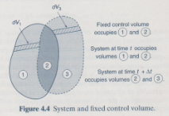
Derivation of the control volume equation
Consider the general ﬂow situation in Fig. below.
At time t, the boundaries of the system and the control volume were chosen to coincide, so (N_{SYS})_{t} = (N_{CV})_{t}.

Slide 14
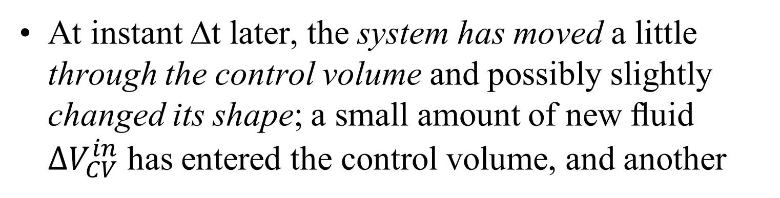
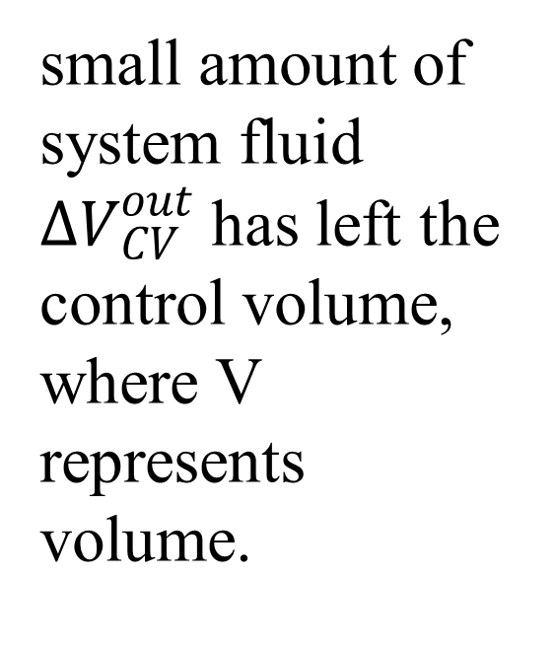
Derivation of the control volume equation
At instant ∆t later, the system has moved a little through the control volume and possibly slightly changed its shape; a small amount of new ﬂuid $∆V_{CV}^{in}$has entered the control volume, and another
small amount of system fluid $∆V_{CV}^{out}$ has left the control volume, where V represents volume.

Slide 15

Derivation of the control volume equation
These small volumes carry small amounts of property N with them, so that $∆V_{CV}^{in}$enters and $∆V_{CV}^{out}$ leaves the control volume.

Slide 16
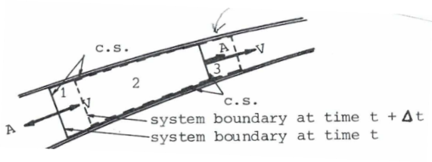
Derivation of the control volume equation
In Fig 8.1 the velocity vectors and area vectors are also indicated.
Area vectors are always pointing in outward direction perpendicular to that area
Fig 8.1 notation for derivation of cv equation

Slide 17
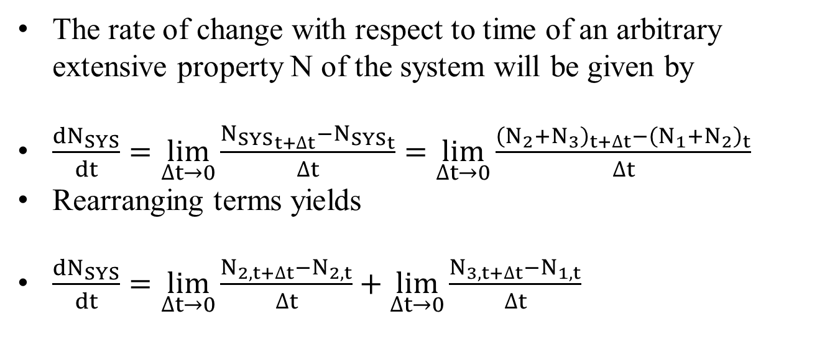
Derivation of the control volume equation
The rate of change with respect to time of an arbitrary extensive property N of the system will be given by
$\frac{{dN}_{SYS}}{dt}=\lim_{∆t→0}{\frac{{N_{SYS}}_{t+∆t}−{N_{SYS}}_{t}}{∆t}}=\lim_{∆t→0}{\frac{{\left(N_{2}+N_{3}\right)}_{t+∆t}−{\left(N_{1}+N_{2}\right)}_{t}}{∆t}}$
Rearranging terms yields
$\frac{{dN}_{SYS}}{dt}=\lim_{∆t→0}{\frac{N_{2,t+∆t}−N_{2,t}}{∆t}}+\lim_{∆t→0}{\frac{N_{3,t+∆t}−N_{1,t}}{∆t}}$

Slide 18
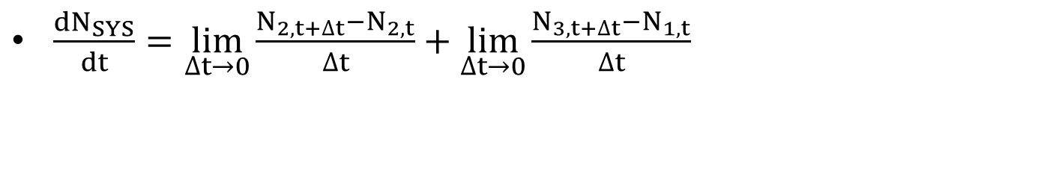
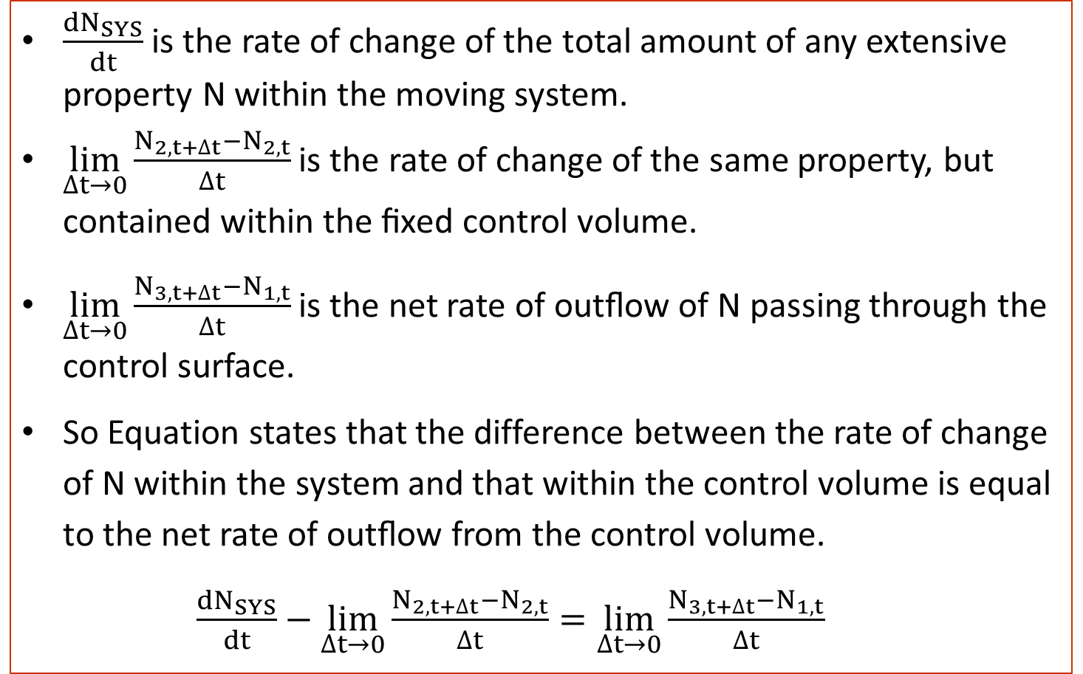
Derivation of the control volume equation
$\frac{{dN}_{SYS}}{dt}=\lim_{∆t→0}{\frac{N_{2,t+∆t}−N_{2,t}}{∆t}}+\lim_{∆t→0}{\frac{N_{3,t+∆t}−N_{1,t}}{∆t}}$
$\frac{{dN}_{SYS}}{dt}$ is the rate of change of the total amount of any extensive property N within the moving system.
$\lim_{∆t→0}{\frac{N_{2,t+∆t}−N_{2,t}}{∆t}}$ is the rate of change of the same property, but contained within the ﬁxed control volume.
$\lim_{∆t→0}{\frac{N_{3,t+∆t}−N_{1,t}}{∆t}}$ is the net rate of outﬂow of N passing through the control surface.
So Equation states that the difference between the rate of change of N within the system and that within the control volume is equal to the net rate of outﬂow from the control volume.
      $\frac{{dN}_{SYS}}{dt}−\lim_{∆t→0}{\frac{N_{2,t+∆t}−N_{2,t}}{∆t}}=\lim_{∆t→0}{\frac{N_{3,t+∆t}−N_{1,t}}{∆t}}$

Slide 19
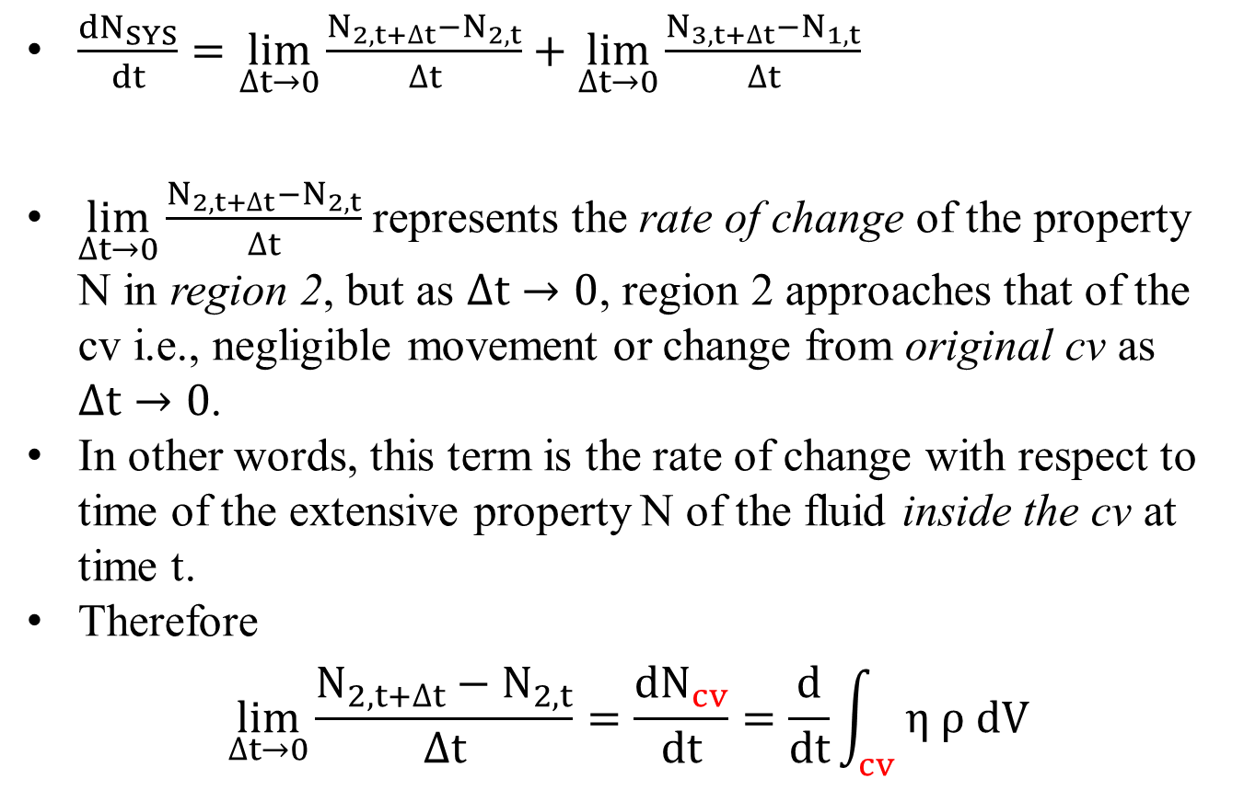
Derivation of the control volume equation
$\frac{{dN}_{SYS}}{dt}=\lim_{∆t→0}{\frac{N_{2,t+∆t}−N_{2,t}}{∆t}}+\lim_{∆t→0}{\frac{N_{3,t+∆t}−N_{1,t}}{∆t}}$
$\lim_{∆t→0}{\frac{N_{2,t+∆t}−N_{2,t}}{∆t}}$ represents the rate of change of the property N in region 2, but as $∆t→0$, region 2 approaches that of the cv i.e., negligible movement or change from original cv as $∆t→0$.
In other words, this term is the rate of change with respect to time of the extensive property N of the fluid inside the cv at time t.
Therefore
$$\lim_{∆t→0}{\frac{N_{2,t+∆t}−N_{2,t}}{∆t}=\frac{{dN}_{cv}}{dt}=\frac{d}{dt}\int_{cv}{η ρ dV}}$$

Slide 20
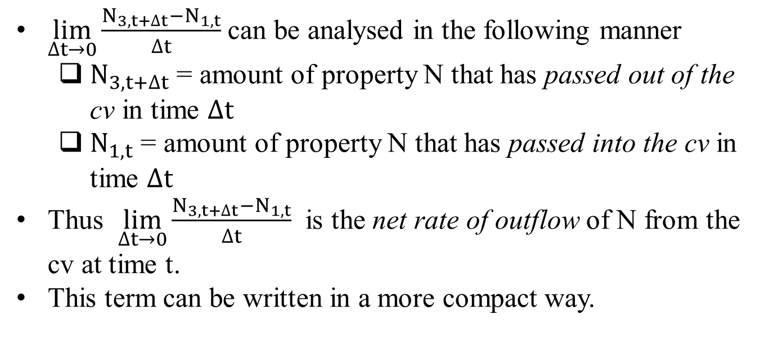
Derivation of the control volume equation
$\lim_{∆t→0}{\frac{N_{3,t+∆t}−N_{1,t}}{∆t}}$ can be analysed in the following manner
  $N_{3,t+∆t}$ = amount of property N that has passed out of the cv in time $∆t$
  $N_{1,t}$ = amount of property N that has passed into the cv in time $∆t$
  Thus $\lim_{∆t→0}{\frac{N_{3,t+∆t}−N_{1,t}}{∆t}}$ is the net rate of outflow of N from the cv at time t.
  This term can be written in a more compact way.

Slide 21
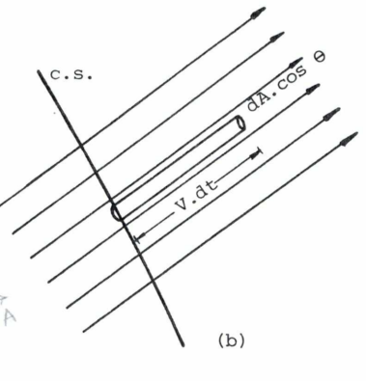
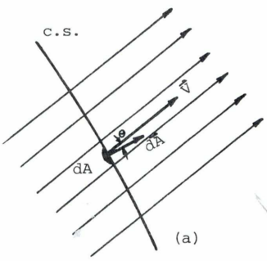
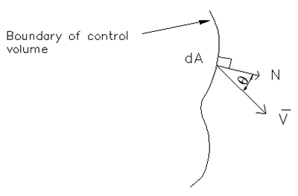
Derivation of the control volume equation
Consider a steady flow velocity field and a portion of a cs.
In Fig (a) dA is the interface of fluid that is just touching the cs at time t.
In Fig (b) the interface has moved v.dt along a direction tangent to the streamline at that point.
Fig. Flow across the cs a) at time t, b) at time t + dt

Slide 22

Derivation of the control volume equation
Volume of the stream tube
$dV=\left(v∙dt\right)dAcosθ=(\vec{v} d\vec{A}) dt$
θ is the angle the velocity vector makes with a unit vector normal to the area
$\vec{v} d\vec{A}$ is called the vector dot product of the velocity vector $\vec{v}$ and area vector $d\vec{A}$.
dV is the volume that has crossed dA of the cs in time dt.

Slide 23
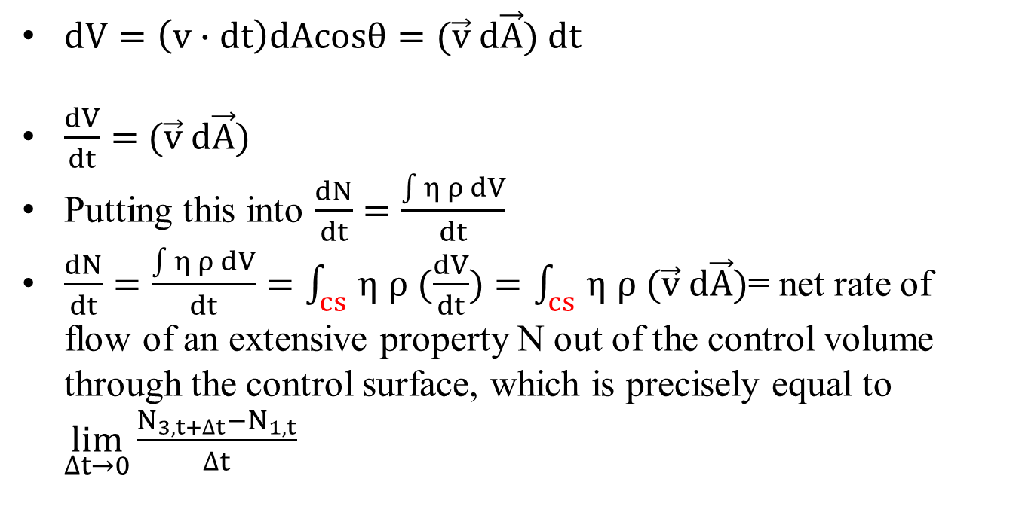
Derivation of the control volume equation
$dV=\left(v∙dt\right)dAcosθ=(\vec{v} d\vec{A}) dt$
$\frac{dV}{dt}=$$(\vec{v} d\vec{A})$
Putting this into $\frac{dN}{dt}=\frac{\int{η ρ dV}}{dt}$
$\frac{dN}{dt}=\frac{\int{η ρ dV}}{dt}=\int_{cs}{η ρ (\frac{dV}{dt})}=\int_{cs}{η ρ (\vec{v} d\vec{A})}$= net rate of flow of an extensive property N out of the control volume through the control surface, which is precisely equal to $\lim_{∆t→0}{\frac{N_{3,t+∆t}−N_{1,t}}{∆t}}$

Slide 24
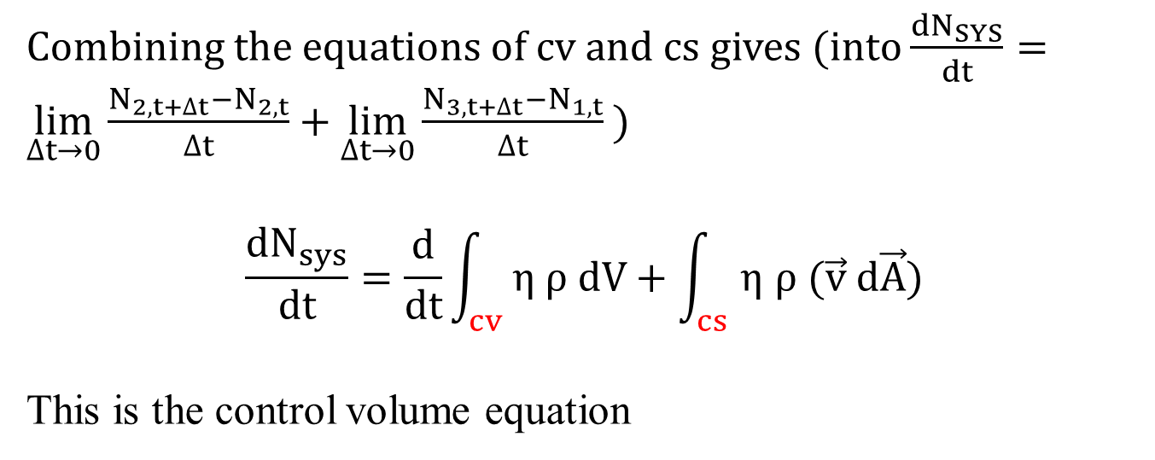
Derivation of the control volume equation
Combining the equations of cv and cs gives (into $\frac{{dN}_{SYS}}{dt}=\lim_{∆t→0}{\frac{N_{2,t+∆t}−N_{2,t}}{∆t}}+\lim_{∆t→0}{\frac{N_{3,t+∆t}−N_{1,t}}{∆t}}$ )
$$\frac{{dN}_{sys}}{dt}=\frac{d}{dt}\int_{cv}{η ρ dV}+\int_{cs}{η ρ (\vec{v} d\vec{A})}$$
This is the control volume equation

Slide 25

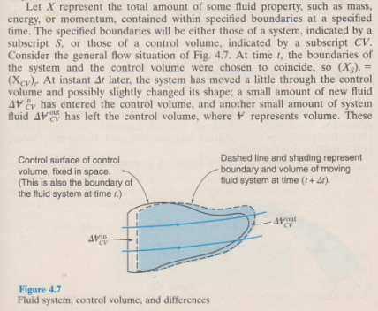
Alternative derivation of

Slide 26
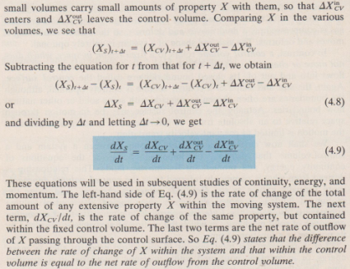
Alternative derivation of

