Slide 1
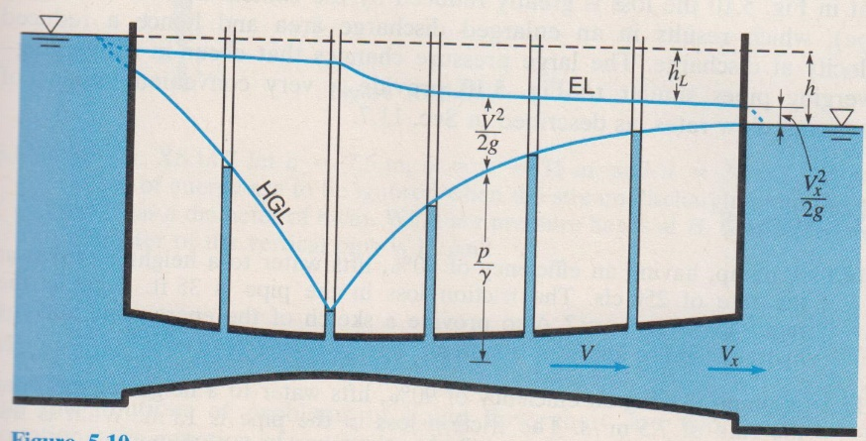
Fluid Mechanics CEE 3311
LECTURE 12
Conservation of energy
Concept of hydraulic and energy grade lines
L. Handia

Slide 2
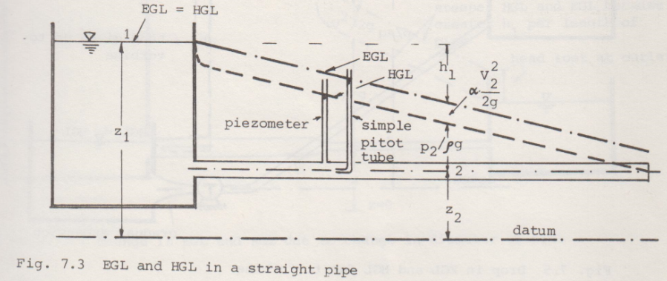

Slide 3
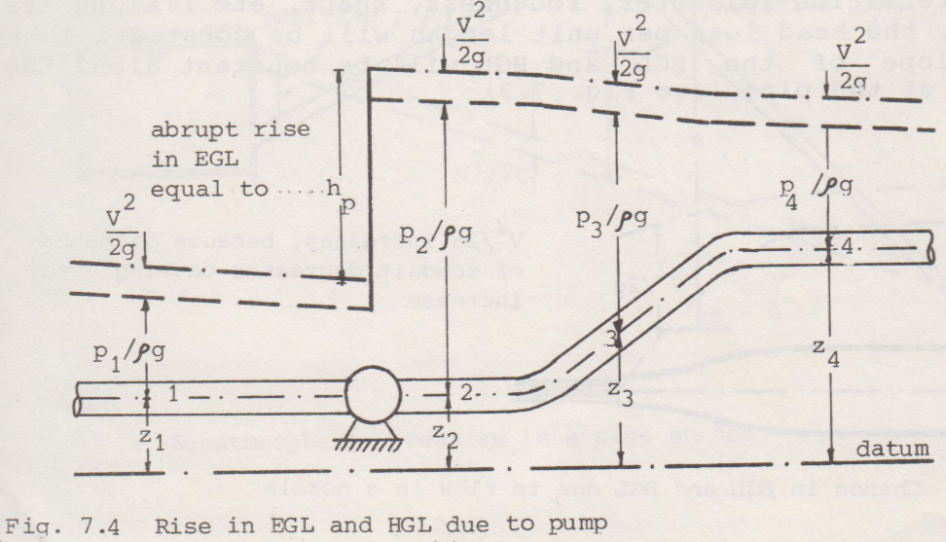
Pump head is like what happened to Lazarus when Jesus resurrected him. His blood pressure rose from zero to a high value due to the pump (heart) just like the pump head (heart head)

Slide 4
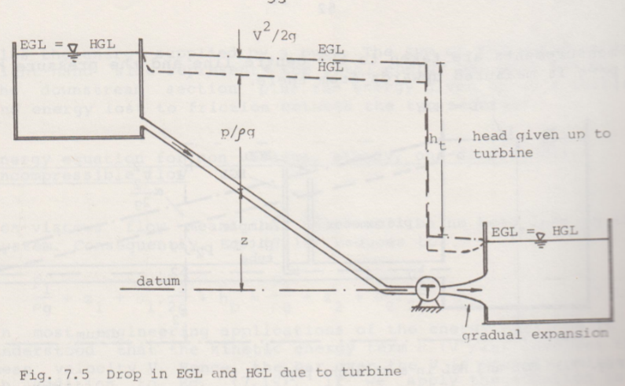
Turbine operates opposite to a pump. Some machines can be operated as a turbine or pump depending on the direction of flow of the water.

Slide 5
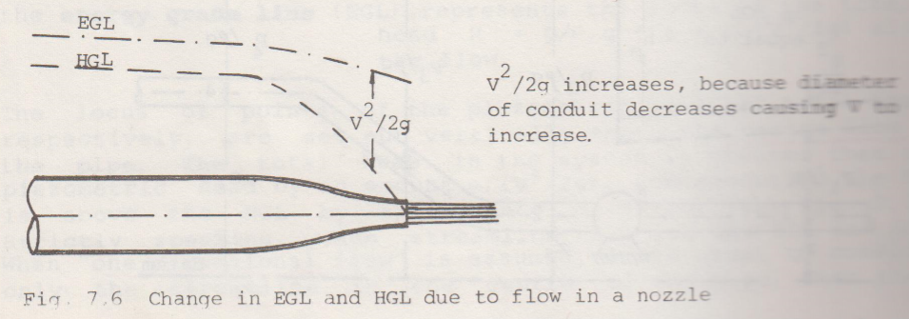

Slide 6
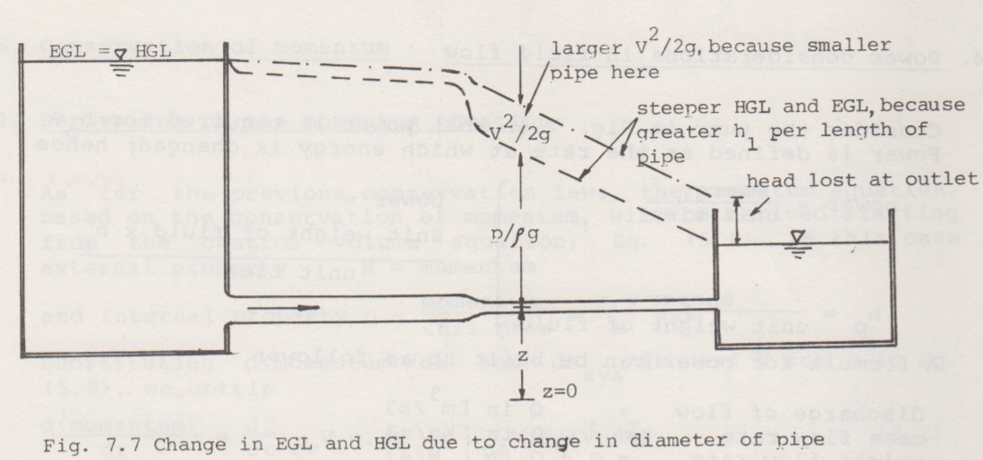

Slide 7
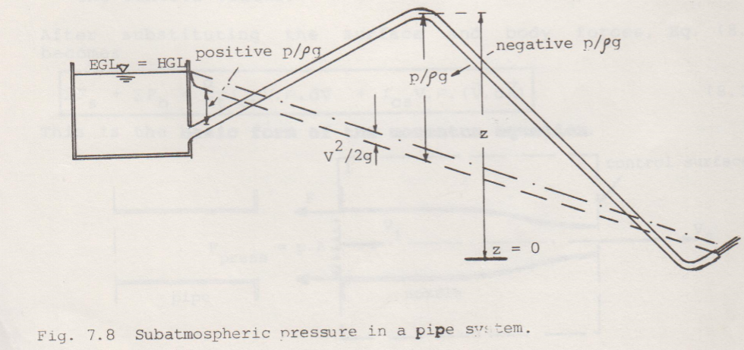

Slide 8
Power considerations in fluid flow
Consider the pump. What power is required for h_{p}?
Power is defined as the rate at which energy is changed, hence
=unit weight of fluid x h_{p}/unit time
power required for h_{p}
power delivered to a turbine

