Slide 1
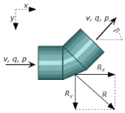
Fluid Mechanics CEE 3311
LECTURE 13
Conservation of momentum
L. Handia

Slide 2
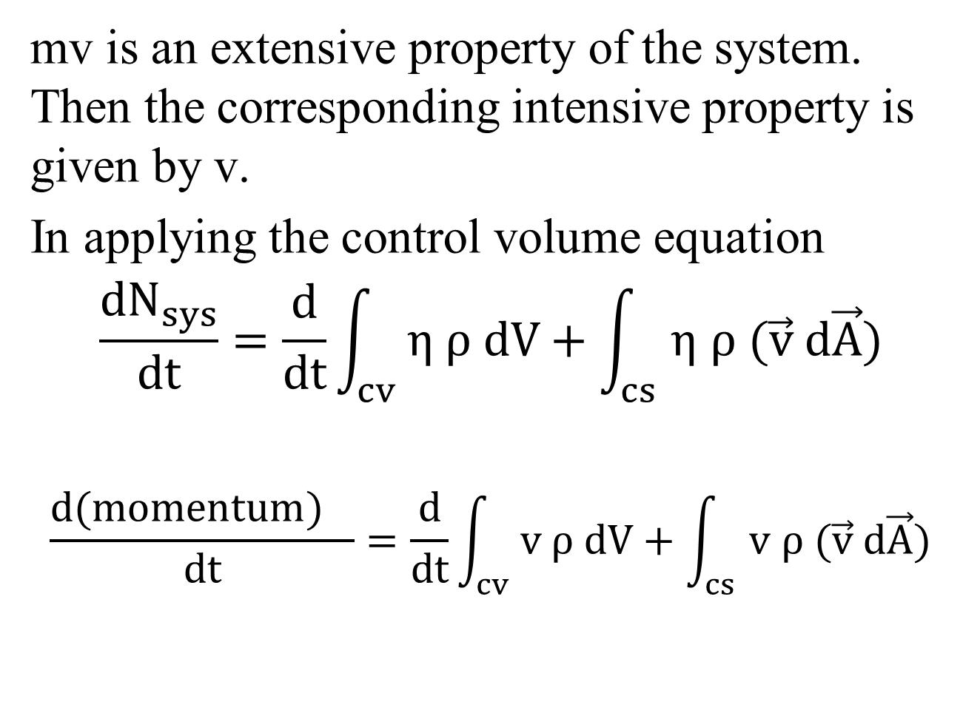
mv is an extensive property of the system. Then the corresponding intensive property is given by v.
In applying the control volume equation
$$\frac{{dN}_{sys}}{dt}=\frac{d}{dt}\int_{cv}{η ρ dV}+\int_{cs}{η ρ (\vec{v} d\vec{A})}$$
$$\frac{{d(momentum)}_{}}{dt}=\frac{d}{dt}\int_{cv}{v ρ dV}+\int_{cs}{v ρ (\vec{v} d\vec{A})}$$
13.1
13.2

Slide 3
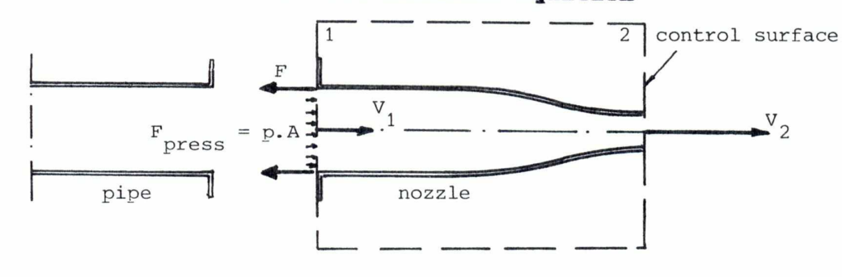
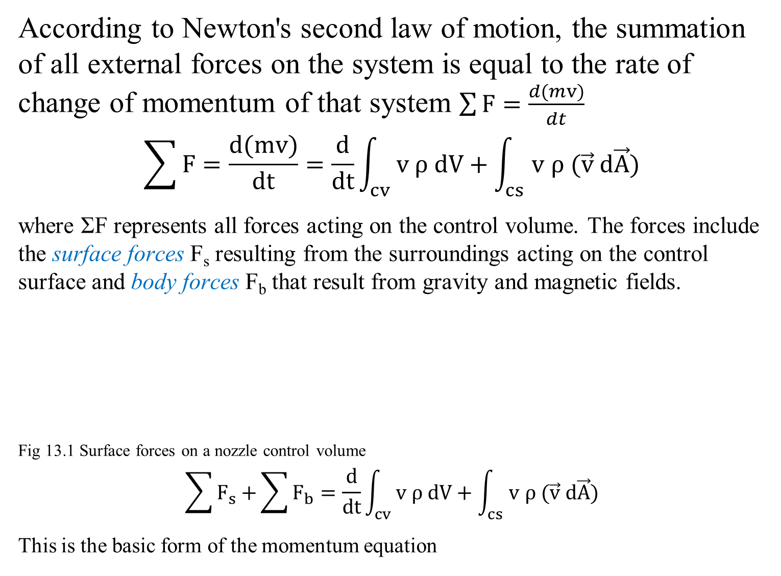
According to Newton's second law of motion, the summation of all external forces on the system is equal to the rate of change of momentum of that system $\sum{F}=\frac{d(mv)}{dt}$
$$\sum{F}=\frac{d(mv)}{dt}=\frac{d}{dt}\int_{cv}{v ρ dV}+\int_{cs}{v ρ (\vec{v} d\vec{A})}$$
where ΣF represents all forces acting on the control volume. The forces include the surface forces F_{s} resulting from the surroundings acting on the control surface and body forces F_{b} that result from gravity and magnetic fields.
Fig 13.1 Surface forces on a nozzle control volume
$$\sum{F_{s}+}\sum{F_{b}}=\frac{d}{dt}\int_{cv}{v ρ dV}+\int_{cs}{v ρ (\vec{v} d\vec{A})}$$
This is the basic form of the momentum equation
same as d(momentum)/dt in eq. 13.2
13.3
13.4

Slide 4
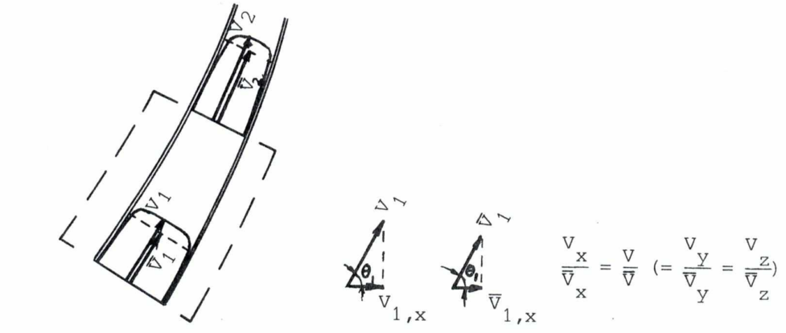
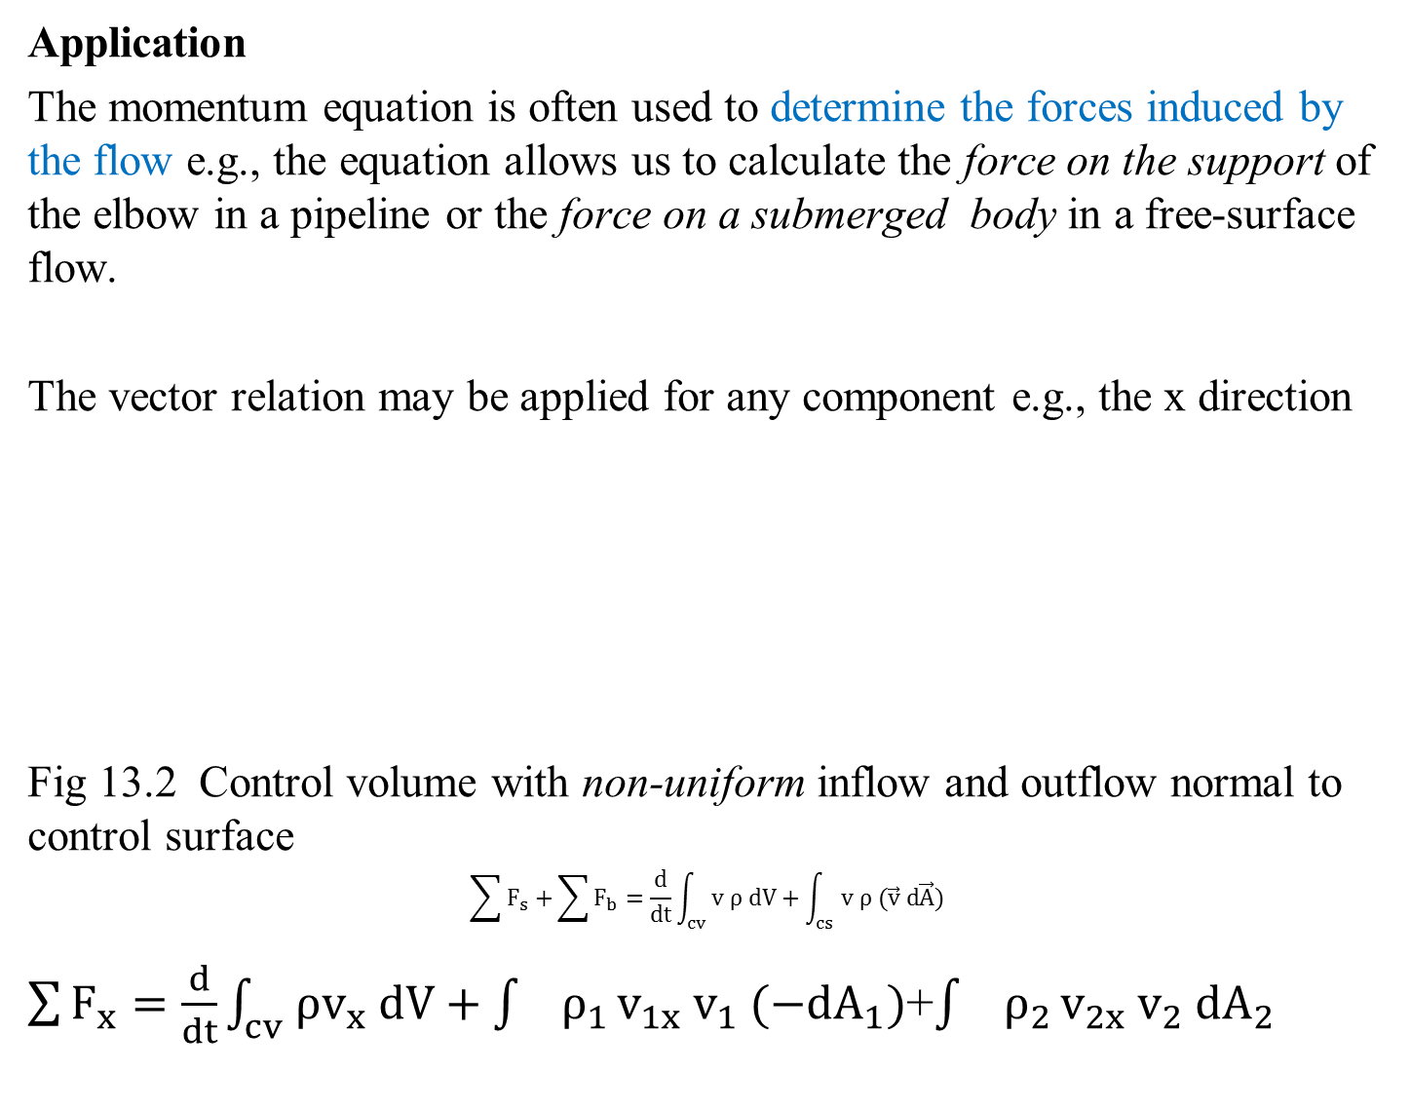
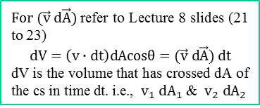
Application
The momentum equation is often used to determine the forces induced by the flow e.g., the equation allows us to calculate the force on the support of the elbow in a pipeline or the force on a submerged body in a free-surface flow.
The vector relation may be applied for any component e.g., the x direction
Fig 13.2 Control volume with non-uniform inflow and outflow normal to control surface
$$\sum{F_{s}+}\sum{F_{b}}=\frac{d}{dt}\int_{cv}{v ρ dV}+\int_{cs}{v ρ (\vec{v} d\vec{A})}$$
$\sum{F_{x}}=\frac{d}{dt}\int_{cv}{ρv_{x} dV}+\int{ρ_{1 }v_{1x}{ v}_{1} (−dA_{1})}$+$\int{ρ_{2 }v_{2x}{ v}_{2} dA_{2}}$
$For (\vec{v} d\vec{A})$ refer to Lecture 8 slides (21 to 23)
$$dV=\left(v∙dt\right)dAcosθ=(\vec{v} d\vec{A}) dt$$
dV is the volume that has crossed dA of the cs in time dt. i.e., ${ v}_{1} dA_{1}$&${ v}_{2} dA_{2}$
13.4
13.5

Slide 5
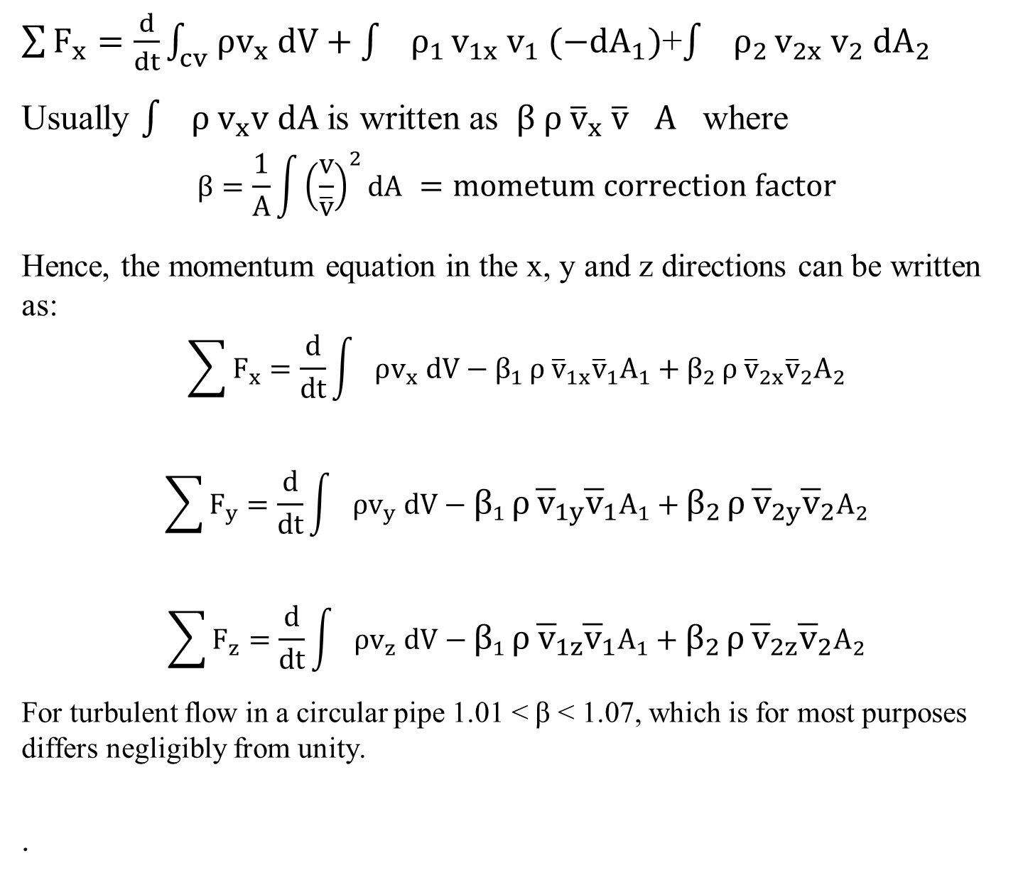
$\sum{F_{x}}=\frac{d}{dt}\int_{cv}{ρv_{x} dV}+\int{ρ_{1 }v_{1x}{ v}_{1} (−dA_{1})}$+$\int{ρ_{2 }v_{2x}{ v}_{2} dA_{2}}$
Usually $\int{ρ_{ }v_{x}v dA }$is written as ${β ρ}_{ }{\overline{v}}_{x}{ \overline{v}}_{}A_{}$where
$$β=\frac{1}{A}\int{{\left(\frac{v}{\overline{v}}\right)}^{2}dA =mometum correction factor}$$
Hence, the momentum equation in the x, y and z directions can be written as:
$$\sum{F_{x}}=\frac{d}{dt}\int{ρv_{x} dV}−{β_{1 }ρ}_{ }{\overline{v}}_{1x}{\overline{v}}_{1}A_{1}+{β_{2 }ρ}_{ }{\overline{v}}_{2x}{\overline{v}}_{2}A_{2}$$
$$\sum{F_{y}}=\frac{d}{dt}\int{ρv_{y} dV}−{β_{1 }ρ}_{ }{\overline{v}}_{1y}{\overline{v}}_{1}A_{1}+{β_{2 }ρ}_{ }{\overline{v}}_{2y}{\overline{v}}_{2}A_{2}$$
$$\sum{F_{z}}=\frac{d}{dt}\int{ρv_{z} dV}−{β_{1 }ρ}_{ }{\overline{v}}_{1z}{\overline{v}}_{1}A_{1}+{β_{2 }ρ}_{ }{\overline{v}}_{2z}{\overline{v}}_{2}A_{2}$$
For turbulent flow in a circular pipe 1.01 <β< 1.07, which is for most purposes differs negligibly from unity.
.
13.5
13.6a
13.6b
13.6c
These equation are really

