Slide 1
Theory of Bending Stress

Slide 2
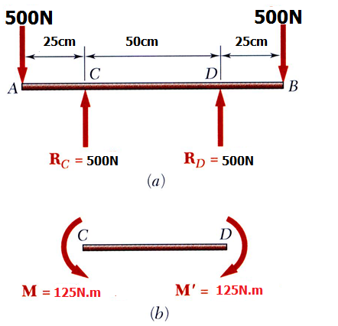
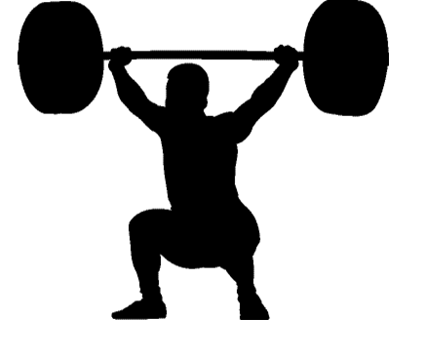
Pure Bending in Beams
Pure Bending: Prismatic members subjected to equal and opposite couples acting in the same longitudinal plane

Slide 3
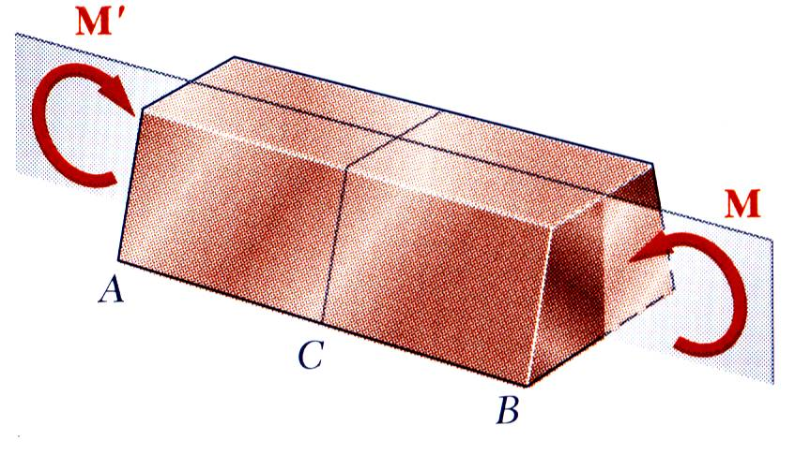
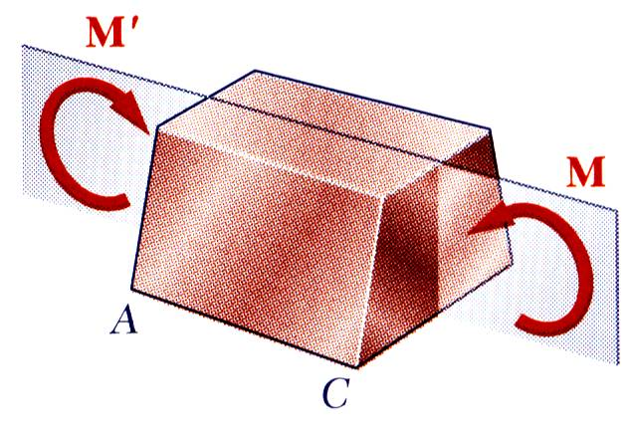
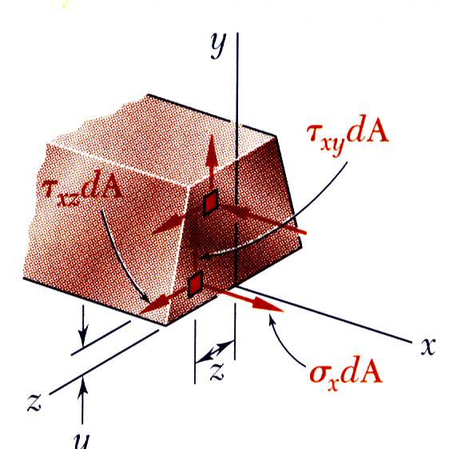
Symmetric Member in Pure Bending
Internal forces in any cross section are equivalent to a couple. The moment of the couple is the section bending moment.
From statics, a couple M consists of two equal and opposite forces.
The sum of the components of the forces in any direction is zero.
The moment is the same about any axis perpendicular to the plane of the couple and zero about any axis contained in the plane.
These requirements may be applied to the sums of the components and moments of the statically indeterminate elementary internal forces.

Slide 4
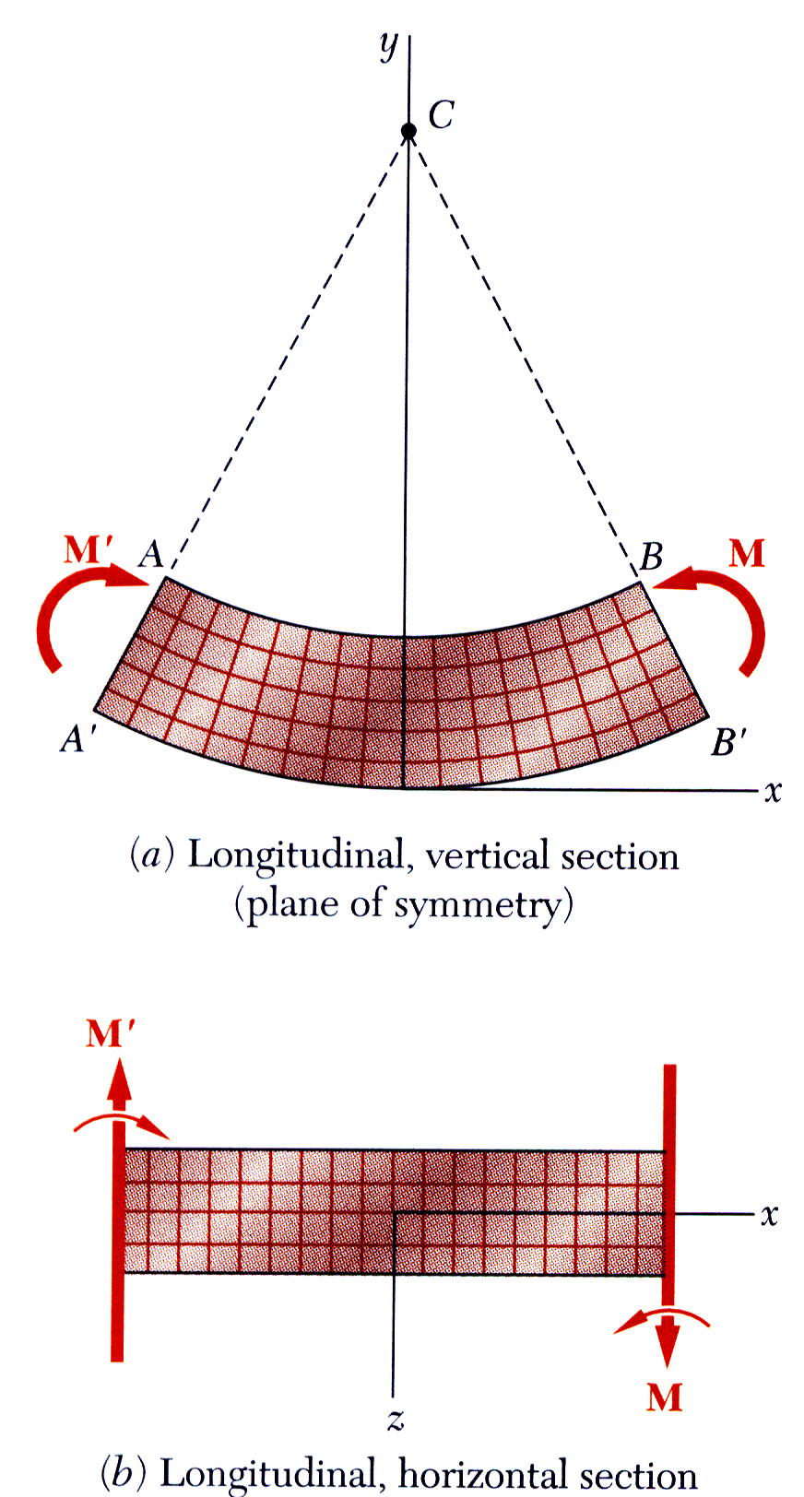
Bending Deformations
Beam with a plane of symmetry in pure bending:
member remains symmetric
bends uniformly to form a circular arc
cross-sectional plane passes through arc center and remains planar
length of top decreases and length of bottom increases
a neutral surface must exist that is parallel to the upper and lower surfaces and for which the length does not change
stresses and strains are negative (compressive) above the neutral plane and positive (tension) below it

Slide 5
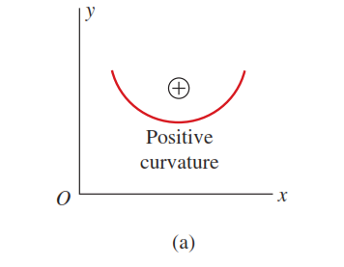
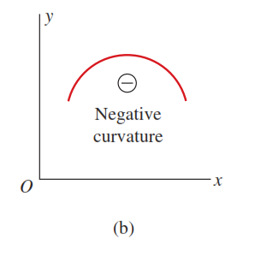
Sign Convention
The sign convention for curvature depends upon the orientation of the coordinate axes.
If the x axis is positive to the right and the y axis is positive upward, as shown below:
curvature is positive when the beam is bent concave upward and the center of curvature is above the beam
Conversely, the curvature is negative when the beam is bent concave downward, and the center of curvature is below the beam

Slide 6
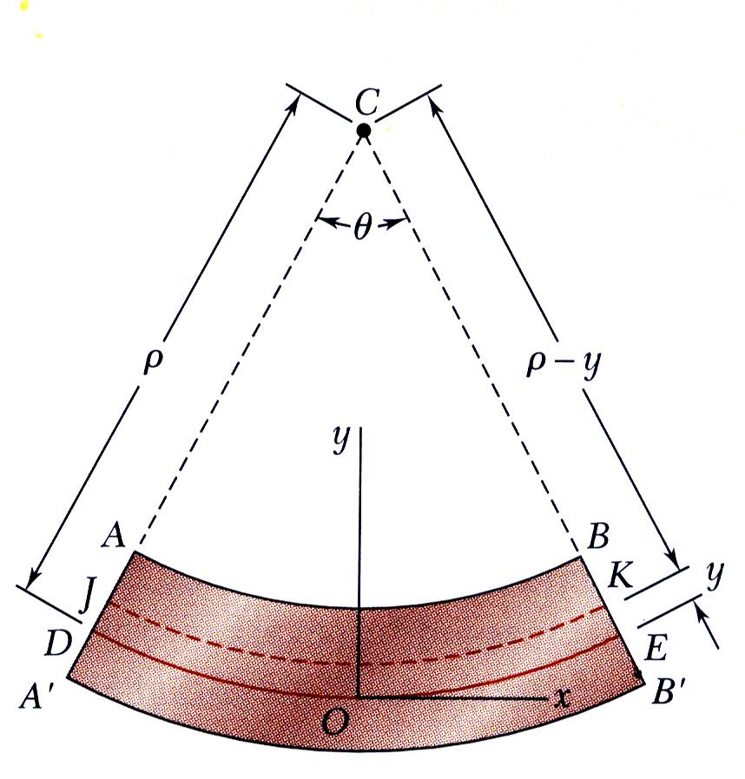
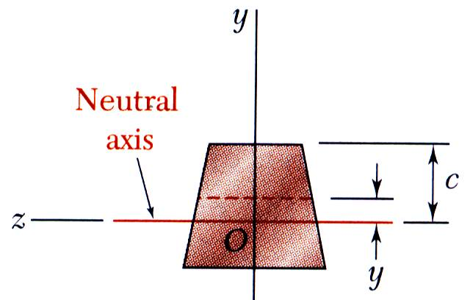



Strain Due to Bending
Consider a beam segment of length L.
After deformation, the length of the neutral surface remains L. At other sections,
observing that the length of DE is equal to the length L of the undeformed member, we write
$$L=ρθ$$
(i)
Considering now the arc JK located at a distance y above the neutral surface, we note that its length L’ is
(ii)
$$L^{′}=\left(ρ−y\right)θ$$
Since the original length of arc JK was equal to L, the deformation of JK is
$$δ=L−L^{′}$$
(iii)

Slide 7






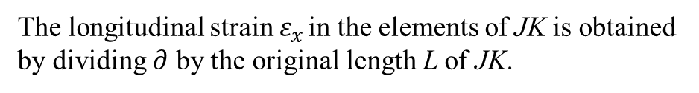

Strain Due to Bending
substituting from (i) and (ii) into (iii),
$$∂=\left(ρ−y\right)θ−ρθ=−yθ$$
The longitudinal strain $ε_{x}$ in the elements of JK is obtained by dividing $∂$ by the original length L of JK.
$$ε_{x}=\frac{δ}{L}=−\frac{yθ}{ρθ}$$
$$ε_{x}=−\frac{y}{ρ} (\text{strain} \text{varies} \text{linearly})$$
$$ε_{m}=\frac{c}{ρ} \text{or} ρ=\frac{c}{ε_{m}}$$
$$where ε_{m}$$
is the maximum absolute value
$$Thus;$$
$$ε_{x}=−\frac{y}{c}ε_{m}$$
Maximum strain occurs at the outermost fibre located at distance $y=c$from the Neutral axis

Slide 8
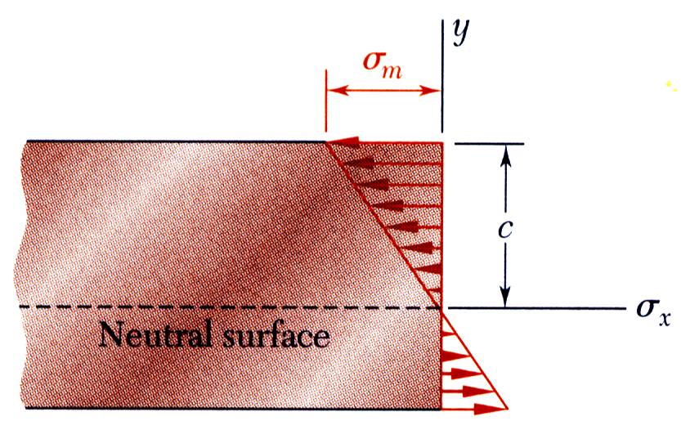
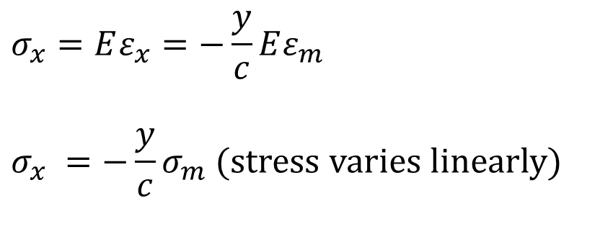
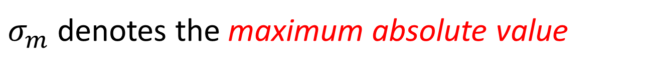
Stress Due to Bending
For a linearly elastic material,
$$σ_{x}=Eε_{x}=−\frac{y}{c}Eε_{m}$$
$$σ_{x} =−\frac{y}{c}σ_{m} (\text{stress} \text{varies} \text{linearly})$$
$σ_{m}$ denotes the maximum absolute value

Slide 9


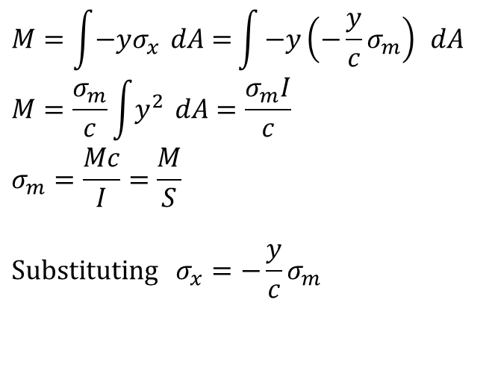
Stress Due to Bending
For static equilibrium,
For static equilibrium,
$$dF = σ dA$$
$$M=\int{−yσ_{x} dA=}\int{−y\left(−\frac{y}{c}σ_{m}\right) dA} \\ M=\frac{σ_{m}}{c}\int{y^{2} dA}=\frac{σ_{m}I}{c}$$
$$σ_{m}=\frac{Mc}{I}=\frac{M}{S}$$
$$\text{Substituting} σ_{x}=−\frac{y}{c}σ_{m}$$
Neutral axis can be located on the x -section by satisfying the condition that the resultant force produced by the stress distribution over the x-sectional area must be equal to zero
$$σ_{x}=−\frac{My}{I}$$
First moment with respect to neutral plane is zero. Therefore, the neutral surface must pass through the section centroid.
This equation is called the elastic
flexure formula

Slide 10
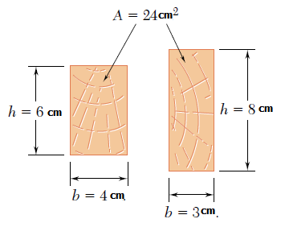
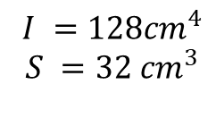

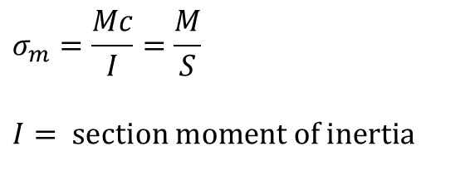
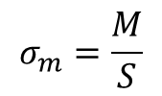
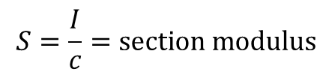
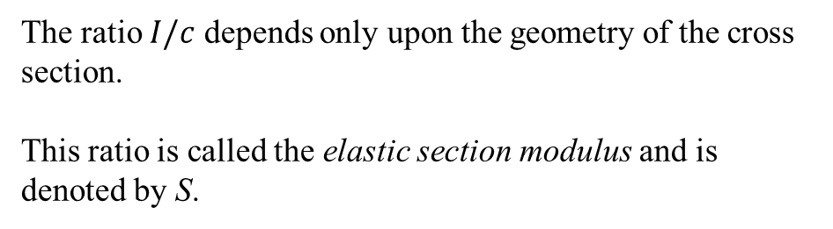
Beam Section Properties
The maximum normal stress due to bending,
$$σ_{m}=\frac{Mc}{I}=\frac{M}{S}$$
$$I= \text{section} \text{moment} \text{of} \text{inertia}$$
The ratio $I/c$ depends only upon the geometry of the cross section.
This ratio is called the elastic section modulus and is denoted by S.
$$I ={72cm}^{4}$$
$$S =24{cm}^{3}$$
$$I ={128cm}^{4}$$
$$S =32 {cm}^{3}$$
$$S=\frac{I}{c}=\text{section} \text{modulus}$$
$$σ_{m}=\frac{M}{S}$$
Thus;
A beam section with a larger section modulus will have a lower maximum stress

Slide 11
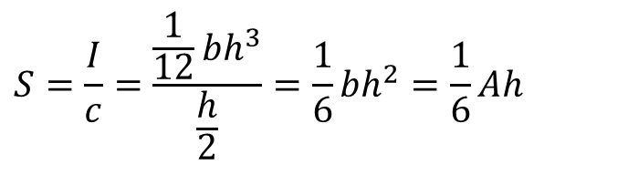
Beam Section Properties
The Influence of beam depth in the resisting bending
Consider a rectangular beam cross section,
$$S=\frac{I}{c}=\frac{\frac{1}{12}bh^{3}}{\frac{h}{2}}=\frac{1}{6}bh^{2}=\frac{1}{6}Ah$$
Between two beams with the same cross sectional area, the beam with the greater depth will be more effective in resisting bending.
This shows that, of two beams with the same cross-sectional area A, the beam with the larger depth h will have the larger section modulus and, thus, will be the more effective in resisting bending.

Slide 12
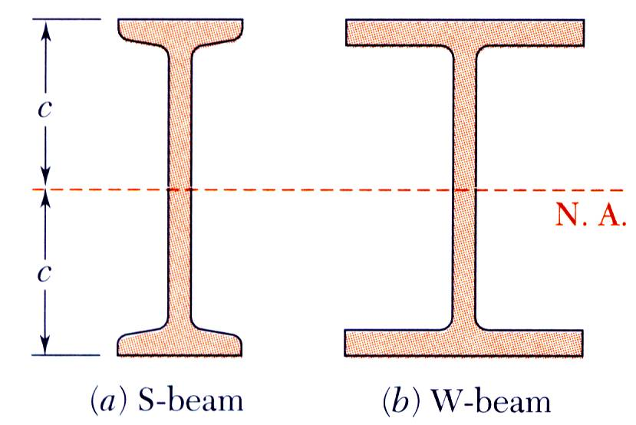
Beam Section Properties
Structural steel beams are designed to have a large section modulus.
In structural steel, standard beams (S-beams) and wide-flange beams (W-beams) are preferred to other shapes because a large portion of their cross section is located far from the neutral axis
Thus, for a given cross-sectional area and a given depth, their design provides large values of I and, consequently, of S
Values of the elastic section modulus of commonly manufactured beams can be obtained from tables listing the various geometric properties of such beams

