Slide 1
Bending of composite materials

Slide 2

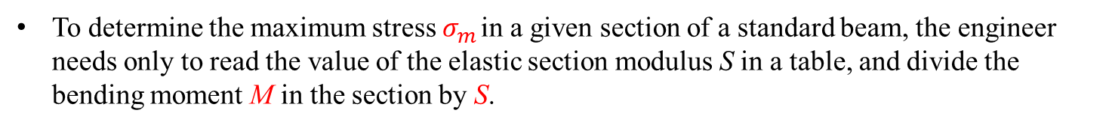
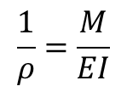
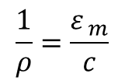
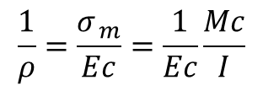
Beam Section Properties
To determine the maximum stress $σ_{m}$ in a given section of a standard beam, the engineer needs only to read the value of the elastic section modulus S in a table, and divide the bending moment M in the section by S.
The deformation of the member caused by the bending moment M is measured by the curvature of the neutral surface.
The curvature is defined as the reciprocal of the radius of curvature $ρ$, and can be obtained by solving
$$\frac{1}{ρ}=\frac{ε_{ m}}{c}$$
But, in the elastic range, $ε_{m}=σ_{m}/E.$
$$\frac{1}{ρ}=\frac{σ_{ m}}{Ec}=\frac{1}{Ec}\frac{Mc}{I}$$
$$\frac{1}{ρ}=\frac{M}{EI}$$

Slide 3
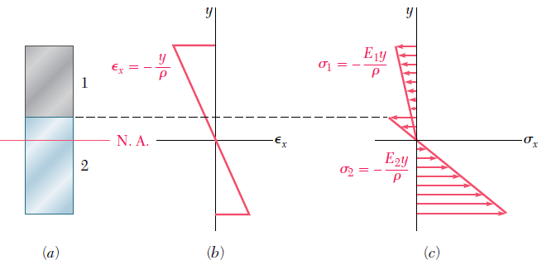
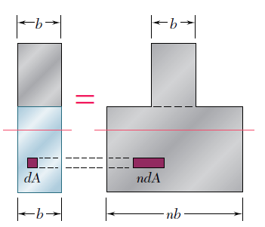
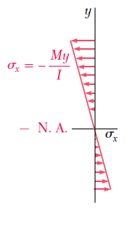
Bending of Composite Materials
Consider a composite beam formed from two materials with E₁ and E₂. with E₂ >E₁
Normal strain varies linearly.
Piecewise linear normal stress variation.
Neutral axis does not pass through section centroid of composite section.
Elemental forces on the section are
Define a transformed section such that

Slide 4
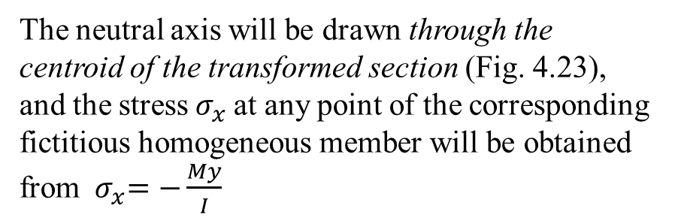
Bending of Composite Materials
In other words, the resistance to bending of the bar would remain the same if both portions were made of the first material, provided that the width of each element of the lower portion were multiplied by the factor n.
Note that this widening (if n > 1), or narrowing (if n < 1), must be effected in a direction parallel to the neutral axis of the section, since it is essential that the distance y of each element from the neutral axis remain the same
The new cross section obtained in this way is called the transformed section of the member
The neutral axis will be drawn through the centroid of the transformed section (Fig. 4.23), and the stress $σ_{x}$at any point of the corresponding fictitious homogeneous member will be obtained from ${ σ}_{x}=−\frac{My}{I}$
Where: y is distance from the neutral surface
I the moment of inertia of the transformed section with respect to its centroidal axis

Slide 5
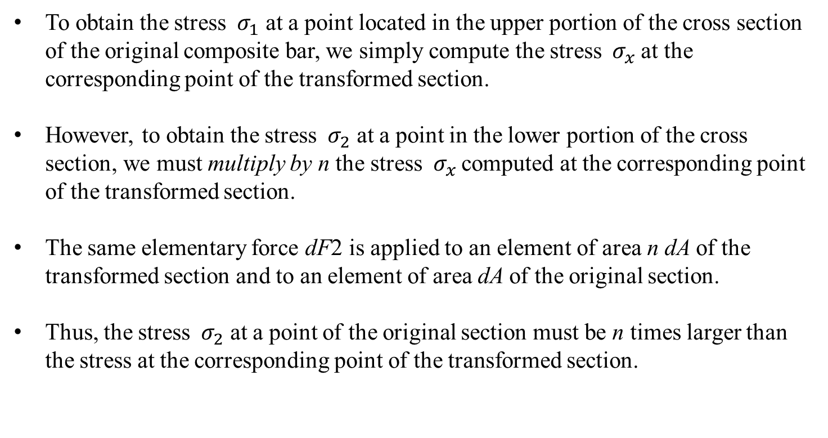
Bending of Composite Materials
To obtain the stress ${ σ}_{1}$ at a point located in the upper portion of the cross section of the original composite bar, we simply compute the stress ${ σ}_{x}$at the corresponding point of the transformed section.
However, to obtain the stress ${ σ}_{2}$ at a point in the lower portion of the cross section, we must multiply by n the stress ${ σ}_{x}$computed at the corresponding point of the transformed section.
The same elementary force dF2 is applied to an element of area n dA of the transformed section and to an element of area dA of the original section.
Thus, the stress ${ σ}_{2}$ at a point of the original section must be n times larger than the stress at the corresponding point of the transformed section.

Slide 6
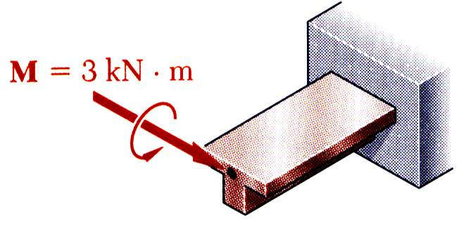
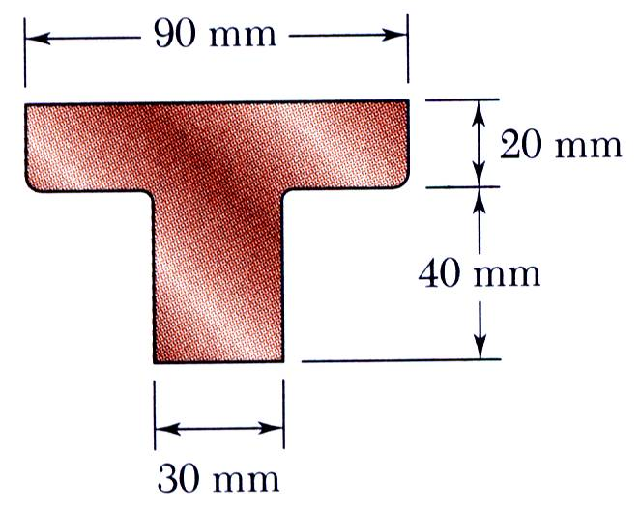
Example 1
SOLUTION:
Based on the cross section geometry, calculate the location of the section centroid and moment of inertia.
Apply the elastic flexural formula to find the maximum tensile and compressive stresses.
A cast-iron machine part is acted upon by a 3 kN-m couple. Knowing E = 165 GPa and neglecting the effects of fillets, determine (a) the maximum tensile and compressive stresses, (b) the radius of curvature.
Calculate the curvature

Slide 7
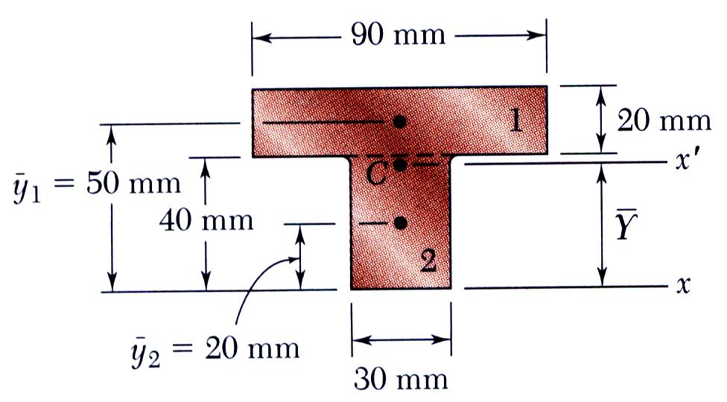
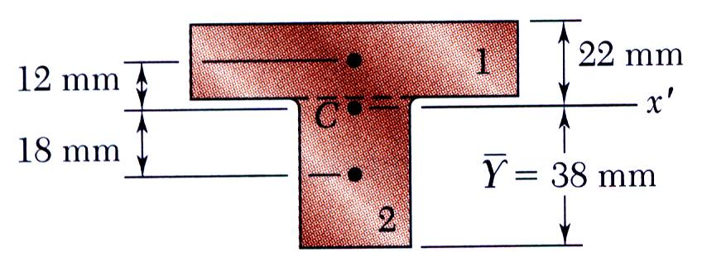
Example 1 – Cont’d
SOLUTION:
Based on the cross section geometry, calculate the location of the section centroid and moment of inertia.

Slide 8
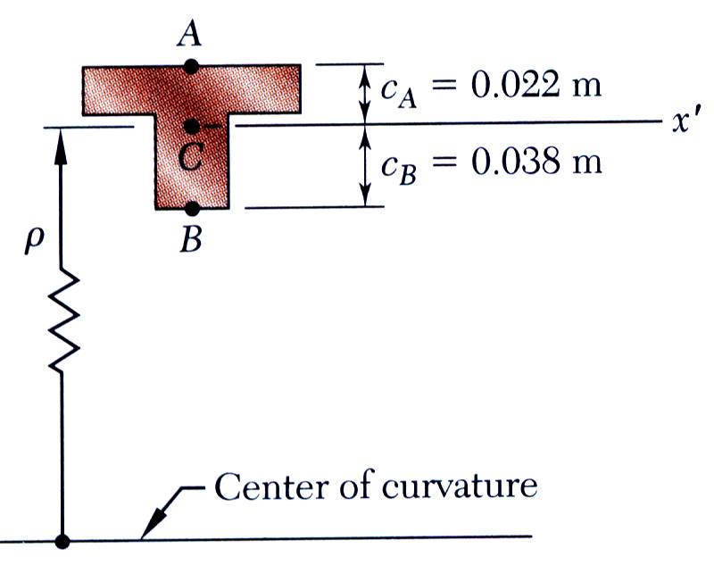
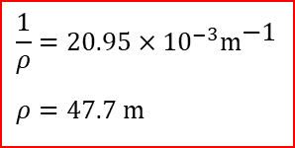
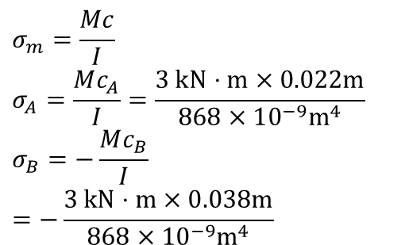
Example 1
Apply the elastic flexural formula to find the maximum tensile and compressive stresses.
$$σ_{m}=\frac{Mc}{I} \\ σ_{A}=\frac{Mc_{A}}{I}=\frac{3 \text{kN}⋅m×0.022m}{868×10^{−9}{\text{m}}^{4}} \\ σ_{B}=−\frac{Mc_{B}}{I}=−\frac{3 \text{kN}⋅m×0.038m}{868×10^{−9}{\text{m}}^{4}}$$
Calculate the curvature
$$\frac{1}{ρ}=20.95×10^{−3}m^{\text{−1}}$$
$$ρ=47.7 \text{m}$$

Slide 9
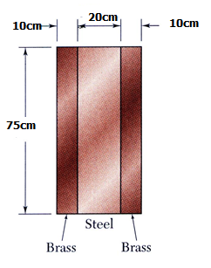
Example 2
SOLUTION:
Transform the bar to an equivalent cross section made entirely of brass
Evaluate the cross sectional properties of the transformed section
Calculate the maximum stress in the transformed section. This is the correct maximum stress for the brass pieces of the bar.
Bar is made from bonded pieces of steel (E_{s} = 200GPa) and brass (E_{b} = 105GPa). Determine the maximum stress in the steel and brass when a moment of 40 N.m is applied.
Determine the maximum stress in the steel portion of the bar by multiplying the maximum stress for the transformed section by the ratio of the moduli of elasticity.

Slide 10
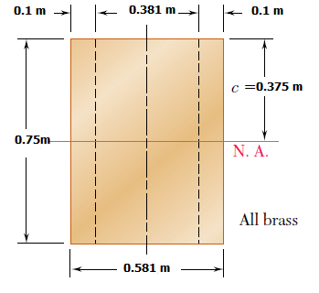
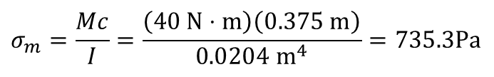
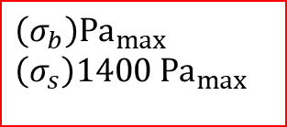
Example 2
SOLUTION:
Transform the bar to an equivalent cross section made entirely of brass.
Evaluate the transformed cross sectional properties Central portion of brass = (0.2m)(1.905) = 0.381m
Calculate the maximum stresses
$$σ_{m}=\frac{Mc}{I}=\frac{\left(40 \text{N}⋅m\right)\left(0.375 \text{m}\right)}{\text{0.0204 }{\text{m}}^{4}}=735.3\text{Pa}$$
$${\left(σ_{b}\right)\text{Pa}}_{max} \\ {\left(σ_{s}\right)\text{1400 }\text{Pa}}_{max}$$

Slide 11
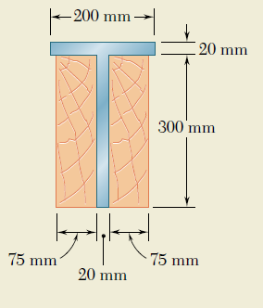
Example 3
Two steel plates have been welded together to form a beam in the shape of a T that has been strengthened by securely bolting to it the two oak timbers shown. The modulus of elasticity is 12.5 GPa for the wood and 200 GPa for the steel. Knowing that a bending moment M = 50 kN .m is applied to the composite beam, determine (a) the maximum stress in the wood, (b) the stress in the steel along the top edge.
SOLUTION
Transformed Section
Multiply horizontal dimensions of the steel portion of the section by n = 16, we obtain a transformed section made entirely of wood

Slide 12
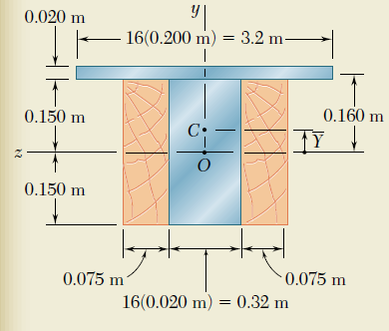
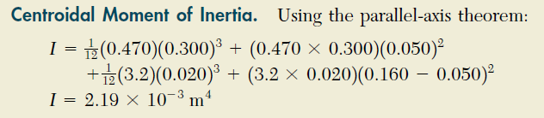
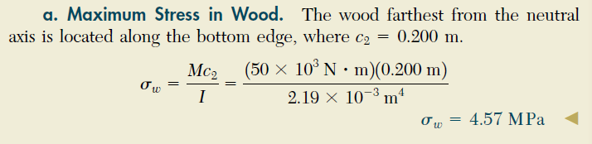
Example - 3
Neutral Axis. The neutral axis passes through the centroid of the transformed section. Since the section consists of two rectangles, we have
b_{t(bottom)} = 0.47m ; b_{t(top)} = 3.2m

Slide 13
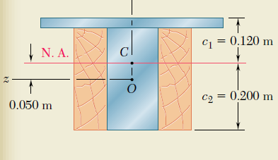
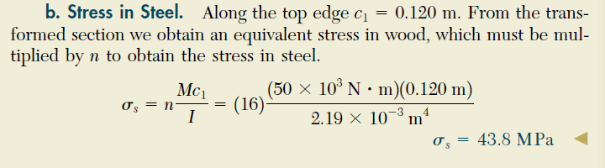
Example 3

