Slide 1
Nutritional Biochemistry
Dr Katayi Mwila- Kazimbaya
October 2022

Slide 2
Course Outline
Digestion, absorption and distribution and use of nutrients.
Vitamins and minerals.
Balanced diet formulations.
Fortification of foods.

Slide 3

Our Need for Food
Food affects almost everything we do. It affects how we look, feel, and act. It even affects our abilities – how well we function every day.
Food has an impact on life because it supplies nutrients, which are substances in food that body needs to function properly such as in growing, in repairing itself, and in having supply of energy.
Nutrition is both a pure science and a social science. As a pure science it looks at how the body uses nutrients. As a social science it looks at the relationship between food and human behavior and the environment, or how and why people eat.

Slide 4
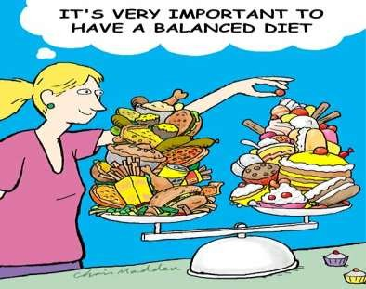



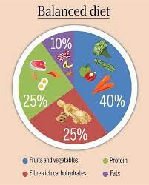
A BALANCED DIET is defined as one which contains a variety of foods in such quantities and proportions that the need for energy, amino acids, vitamins, minerals, fats, carbohydrates and other nutrients is adequately met for maintaining health, vitality and general well being and also makes a small provision for extra nutrients to withstand short duration of leanness. – Park.
A balanced diet has become an accepted means to safeguard a population from nutritional deficiencies.

Slide 5
In constructing balanced diet, following principles has to be followed---
Daily requirement of protein should be 15-20 % of daily energy intake.
Fat requirement should be limited to 20-30 % of daily energy intake.
Carbohydrates rich in natural fibers should remaining energy intake.
Requirements of micronutrients should be met.
constitute

Slide 6
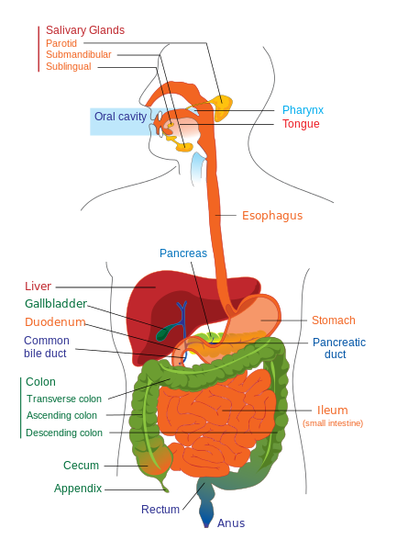
Digestion
Compartmentalized breakdown of foods
  Enzymes
  Stomach acid
How we get nutrients from the outside to the inside.
Smaller units are absorbed and carried by the bloodstream to the cells of our body.
From the Virtual Biology Classroom on ScienceProfOnline.com
Image: Digestive system diagram, Wiki

Slide 7
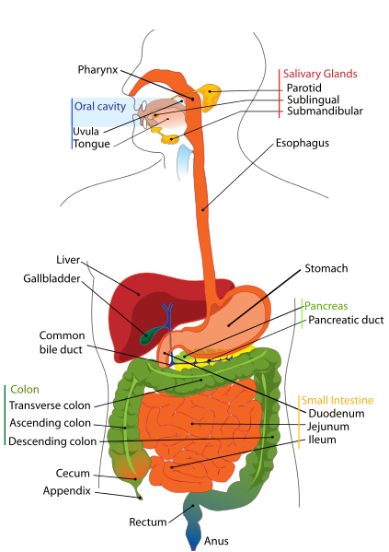
Digestive System (a.k.a. gastrointestinal tract & GI tract)
Digestion involves the breakdown of food into smaller components that can be absorbed by the body.
Process of digestion has many stages::
Oral cavity: Secretion of saliva (which contains digestive enzyme amaylase) helps produce a soft, moist bolus of food that can pass down the esophagus.
Esophagus: Passageway from oral cavity to stomach.
Stomach: Gastric juice and enzymes help break down food.
Small Intestine: Most digestion takes place in the small intestine where nutrients are absorbed.
  Gallbladder: Where bile (a fluid produced by the liver) is stored before release into small intestine to emulsify fats.
  Pancreas: Both an endocrine (hormone secreting) and a digestive organ. Secretes pancreatic juice with enzymes that help with digestion and absorption of nutrients in small intestine.
Large Intestine/Colon: Water and some minerals are reabsorbed back into the blood. Colon is where most of the bacteria in the GI tract live.
Rectum & Anus: Waste products of digestion are defecated
From the Virtual Biology Classroom on ScienceProfOnline.com
Image: Digestive System, Wiki

Slide 8


Nutrition and Nutrients
There are six types of nutrients:
Carbohydrates
Fats
Proteins
Vitamins
Minerals
Water

Slide 9


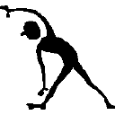



Variables which affect nutrient needs:
1. Age
2. Gender
3. Activity Level
4. Climate
5. Health
6. State of nutrition

Slide 10


Nutrients that Provide Energy
A food Calorie is actually a kilocalorie, which is equal to 1000 calories. Calorie is useful in comparing the energy available from different foods when we are deciding what food to eat. For example, a small apple contains only 80 Calories, while a slice of apple pie contains almost 350 Calories.
Carbohydrates, fats, and proteins provide energy and perform other important functions.
We need energy for all activities. When our body uses carbohydrates, fats, and proteins, energy is released: calories.

Slide 11

Carbohydrates
Athletes are not the only people who need carbohydrates. Everyone needs them.
Carbohydrates are the sugars and starches found in foods. They are made up of carbon, hydrogen, and oxygen.
There are two general types of carbohydrates: simple and complex.
DAILY REQUIREMENT: 300-500 gm/day

Slide 12



Simple Carbohydrates
Simple carbohydrates are the different forms of sugar, which are easy for the body to process. These sugars are fructose and glucose (found in fruits and vegetables, lactose (found in milk), and sucrose (refined and purified to produce table sugar).
The most important to the body is glucose – the form of the sugar that goes directly to the bloodstream and provides quick energy. All other sugars must be changed into glucose by the body before the cells can use them. The cells use glucose as their primary source of energy. Glucose that is not needed immediately is converted by body to glycogen, a form of starch stored in the muscles and liver, or it is converted to and stored as body fat.

Slide 13


Complex Carbohydrates
Starches are complex carbohydrates that are made up of many units of glucose or other sugars, which form long chains. These chains must be broken down by the body into single units of glucose before they can be used. Starches take longer than sugars to be broken down into glucose. Starches provide energy to the body over longer periods than do simple sugars. Breads, cereals, pasta, and potatoes contain starch.
Dietary Fiber is another complex carbohydrate, which comes from non-digestible part of plants. There two types of dietary fiber: soluble and insoluble. Soluble fiber combines with waste and other substances to assist in their removal from the body. (Found in: oat bran, beans, apples, carrots, and other vegetables). Insoluble fiber absorbs water and helps to provide needed bulk to the diet. (Found in: whole grains and the skins and seeds of fruits and vegetables).

Slide 14
FUNCTIONS
Primary function is to provide a source of energy to facilitate
body metabolism (1200 kcal).
Brain and nervous tissue utilize only glucose as energy source (5 grams per hour).
Muscles including the heart muscles derive energy for
contraction from stored glycogen.
Protein sparing effect- adequate carbohydrate spare protein during metabolism which can be utilized for growth and repair of the body.
Major components of the ground substance are derived from carbohydrates.

Slide 15

Fats (Lipids)
DAILY REQUIREMENTS:
10-20 gms/day
Fats are the nutrients that contains the most concentrated form of energy. Fats are a type of lipid.
Lipids are substances that are somewhat similar to carbohydrates, but they contain less oxygen and they do not dissolve in water.
Fat is one of essential nutrients important for properly body function. A small daily intake of fat is required. One gram of fat provides more than twice as much energy as one gram of carbohydrate.
Fats are part of many body tissues and are important as carriers of other nutrients, such as vitamins. Fats also carry the flavor of foods – making foods tastier, but consumption of fat should be closely monitored.

Slide 16
Types of Fats
Unsaturated fats are those fats that are liquid at room temperature.
Olive oil and peanut oil are called monounsaturated fats because they lack one pair of hydrogen atoms.
Fish oils and most vegetables oils, such as corn, soybean, and sunflower oils, are called polyunsaturated fats because they lack two or more pairs of hydrogen atoms.
Saturated fats are usually solid at room temperature. They contain maximum number of hydrogen atoms. Tropical oils, butter, and animal fats tend to be high in saturated fats.
A diet high in saturated fats can lead to an increased chance of heart and blood vessel disease, obesity, and some types of cancer.

Slide 17
Cholesterol
Eating foods high in fats, especially saturated fats may increase the level of cholesterol, a waxy, fat-like substance produced by body.
Cholesterol is part of cell membranes and nerve tissues. It is used by body to form vitamin D and other hormones. It is found only in foods that come from animals, such as butter, eggs, and meats. It is not an essential nutrient because the body produces cholesterol in liver.
As cholesterol levels in the body increase, the risk of heart and artery diseases increase. Some of the cholesterol tends to be deposited on the walls of the arteries, thereby reducing the flow of blood to the cells supplied by those arteries.

Slide 18


Two Forms of Cholesterol
Cholesterol is transported in the blood in two forms. LDL is the “bad” form that tends to deposit cholesterol on the walls of the blood vessels.
HDL is the “good” form that removes cholesterol from the cells and brigs it back to the liver and intestines to be recycled or excreted.
Exercise has been proven to raise HDL, low-fat diets lower LDL.

Slide 19
Function
Provide energy -- 9 kcal every gram.
Serve as vehicle for fat soluble vitamins.
Act as thermal insulators for skin.
Essential fatty acids are required for the body growth and structural integrity.
Disease states :
  obesity
  phrenoderma- deficiency of essential fatty acids in diet is associated with rough and dry skin(toad skin )
  coronary heart disease
  cancer
  atherosclerosis
  chronic swelling of parotid glands due to disturbances in lipid metabolism.

Slide 20
Protein
DAILY REQUIREMENT: 60-65 gms/day for adults.
Proteins are substances found in every cell. The body needs proteins to build and repair all body tissues. Protein is an important part of blood cells. Proteins are made up of carbon, hydrogen, oxygen, and nitrogen atoms that are formed into basic units called amino acids.
There are 20 different amino acids. Nine of them are essential, and the other eleven amino acids can be produced by the body.
Complete proteins
Incomplete proteins
Legumes

Slide 21
Functions:
Necessary for growth and repair of the body.
Build up new tissues during the period of growth or pregnancy & lactation.
Required for the formation of digestive enzymes, hormones, plasma proteins, hemoglobin and vitamins.
Provide 10-15% of the energy during emergencies e.g., starvation, inadequate food intake.
Act as buffers helping to maintain the PH of plasma at a constant level.

Slide 22
Protein Deficiency & Periodontal Disease
Degeneration of the connective tissue of the gingival and periodontal ligament.
Osteoporosis of alveolar bone.
Retardation in the deposition of cementum.
Delayed wound healing.
Atrophy of tongue epithelium.
Kwashiorkor
Marasmus

Slide 23
Nutrients that Regulate
Vitamins, minerals, and water are nutrients that work with the energy-providing nutrients to be sure that the body functions properly.
Water is the most vital nutrient because it provides the means for all other nutrients to be carry throughout the body.
Eating a variety of foods in the right amounts is usually all that is needed to get daily supply of vitamins and minerals.
Vitamins, minerals, and water are not digested by our body, and they do not provide Calories. Instead vitamins, minerals, and water are released from foods we eat and are absorbed by the body’s tissues. They work with carbohydrates, fats, and proteins to promote growth and regulate body processes.

Slide 24
Vitamins
Vitamins help build bones and tissues, and they also help change carbohydrates and fats into energy.
Because the body cannot make most vitamins, they must be supplied by the foods we eat.
Some diseases can develop because of lack of a particular vitamin.
Vitamins are compounds found in living things and are needed in small amounts for life and growth and to prevent diseases.

Slide 25
Fat-soluble Vitamins - dissolve fat and can be stored in the body.
Vitamin | Sources | Functions in Body | Signs of Toxicity | Signs of deficiency
Vitamin A | Orange, yellow, green vegetables, liver, margarine, and egg yolk | Maintains healthy eyes, skin, bone growth and tooth development, possible aid in cancer protection | Nausea, vomiting, dry skin, rashes, hair loss, headache, fatigue | Night blindness, eye-infections, rough skin, respiratory infections
Vitamin D | Milk, eggs, liver, exposure of skin to sun’s ultraviolet rays | Promotes absorption of phosphorus and calcium to build and maintain bones | Loss of appetite, headache, nausea, weakness, calcification of bone and soft tissue | Rickets (poor bone development), malformation of teeth
Vitamin E | Wheat germ, whole grains, vegetable oils, legumes, nuts, dark green leafy vegetables | Protects red blood cells; stabilizes cell membranes | General digestive discomfort | Rupture of red blood cells, anemia, nerve abnormalities
Vitamin K | Green leafy vegetables, liver, kale, cabbage; made in body by intestinal bacteria | Assists in normal clotting of blood | Anemia | Slow clotting of blood, hemorrhage especially in newborns

Slide 26
Water-soluble Vitamins
Water-soluble vitamins dissolve in water. Because water-soluble vitamins are not stored by the body to any extent, foods reach in these vitamins must be eaten more often than foods with fat-soluble vitamins.
Fruits and vegetables are good source of water soluble vitamins.
Water-soluble vitamins are: Thiamin (B1), Riboflavin (B2), Niacin, Vitamin B6, Folacin (Folic acid), Vitamin B12, Pantothenic acid, biotin, Vitamin C (Ascorbic acid).

Slide 27
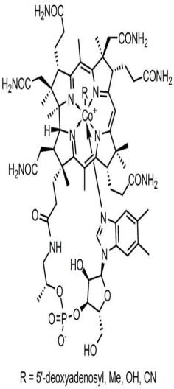
VITAMIN - B₁₂
Largest and most complex of all the vitamins.
Sources of B₁₂: Only bacteria can synthesize. Present in animal products such as meat, poultry, fish (including shellfish), and to a lesser extent, dairy. Vegans need to take supplements.
Involved in many aspects of our health. Required for proper red blood cell formation, neurological function, and DNA synthesis.
10-15% of people are believed to be deficient in this vitamin.
B₁₂ and Depression
Observational studies have found as many as 30% of patients hospitalized for depression to be deficient in vitamin B₁₂.
A recent cross-sectional study of 700 community-living, physically disabled women over the age of 65 found that vitamin B₁₂ deficient women were twice as likely to be severely depressed as non-deficient women.
The reasons for the relationship between vitamin B₁₂ deficiency and depression are not clear.
Learn more about Vitamin B12 from the website of the Office of Dietary Supplements, National Institutes of Health.
From the Virtual Biology Classroom on ScienceProfOnline.com
Image: Molecular structure of Vitamin B12, Wiki

Slide 28
Minerals
Minerals are simple substances found in the environment that are essential to the body’s functioning.
Minerals are used to regulate a wide range of body processes, from bone formation to blood clotting, and they are important for the body structure.
Most minerals are either quickly used or lost in waste products, therefore we must eat mineral-rich foods daily to replenish our supply. Iron is an exception –it tends to be kept and recycled by the body, except when there is a blood loss.

Slide 29
Major Minerals: calcium, phosphorus, magnesium, potassium, sulfur, sodium, and chlorine
Calcium keeps the nervous system working well and is needed for blood clotting. Osteoporosis is disease caused by calcium deficiency.
Sodium and potassium help regulate the passage of fluids in and out of cells. Too much sodium in the diet may aggravate high blood pressure or hypertension, increasing the risk of heart attack, stroke or kidney disease. Table salt is one source of sodium in the diet. Most sodium comes in food.
Deficiency of potassium can lead to muscle weakness and abnormal heart beat.

Slide 30
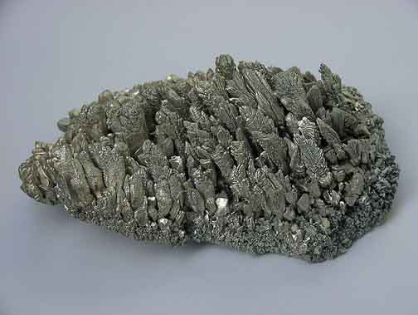
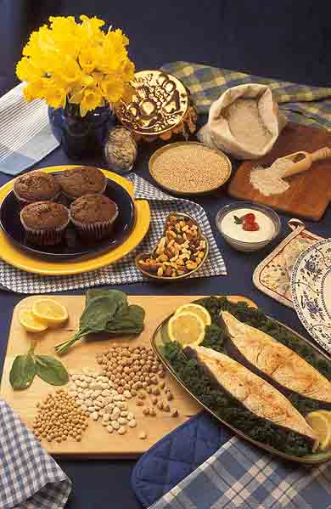
EXAMPLE: Magnesium
Mg
12
24.305
Magnesium plays an important role in the production and transport of ENERGY.
It is also important for:
  the contraction and relaxation of muscles.
  the synthesis of protein.
  assisting certain enzymes in the body.
Over 300 enzymes require magnesium ions for action, including all enzymes using or synthesizing ATP, or those that use other nucleotides to synthesize DNA and RNA.
Human magnesium deficiency is common
Magnesium supplements can help you go to the toilet (constipation)
Magnesium
From the Virtual Biology Classroom on ScienceProfOnline.com
Images: Magnesium crystals, Warut Roonguthai; Food sources of Magnesium, Peggy Greb

Slide 31
Trace Minerals: iron, iodine, manganese, zinc, copper, and fluorine
The majority of the minerals needed for the body to function are only required in very small, or trace amounts.
Iron is a vital part of hemoglobin – a substance in red blood cells that carries oxygen to all parts of the body. Insufficient iron may cause anemia, a disease in which the body has either too few red blood cells or too little hemoglobin. As result too little oxygen is carried to cells of the body.
Iodine is needed for the thyroid gland to function properly. The thyroid gland produces hormones that control how quickly chemical reactions occur in our body. Too little iodine – thyroid gland enlarged. The primary sources are seafood and iodized table salt.

Slide 32
Water
Water is found in every cell, in the spaces around the cells, in the fluid tissues of the body, and in body cavities
Water carries dissolved nutrients throughout our body and assists in all of its functions such as: digesting foods, removing wastes, regulating temperature, and cushioning sensitive parts of our body.
Each day we lose two to three quarts of water and if this water is not replaced the body can dehydrate.
When minerals are dissolved, they break apart into ions. The ions formed in body fluids are called electrolytes. These ions play a central role in water balance in the body.

Slide 33
Under-nutrition
The manifestation of inadequate nutrition
Common in sub-Saharan Africa
  1/3 of all children < 5 years old underweight
  38% of children with low height for age
Many causes
  Inadequate access to food/nutrients
  Improper care of mothers and children
  Limited health services
  Unhealthy environment

Slide 34
Conditions Associated with Under- and Overnutrition
Vitamin deficiency disorders
  Scurvy (deficiency of vitamin C)
  Rickets (deficiency of vitamin D)
  Mental, adrenal disorders (deficiency of B vitamins)
Mineral deficiency
  Osteoporosis (deficiency of calcium)
Diet-related non-communicable diseases
  Diabetes
  Coronary heart disease
  Obesity
  High blood pressure

Slide 35
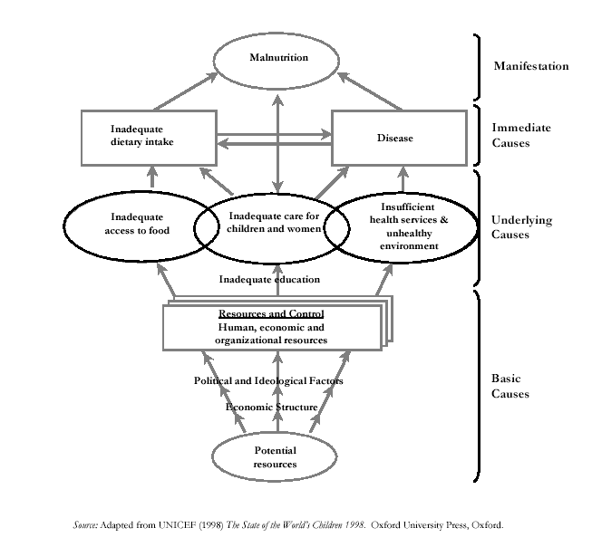
Causes of Under-nutrition

Slide 36
Nutritional Status
Determined by Anthropometry
Underweight: Low weight for age compared to reference standard, a composite measure of stunting and wasting
Stunting: Low height for age compared to reference standard, an indicator of chronic or past growth failure
Wasting: Low weight for height, an indicator of short-term nutritional stress

Slide 37
Other Anthropometric Measurements
MUAC (mid-upper arm circumference)
BMI (body mass index): Compares height and weight
BMI = Weight (kg) ÷ height (m)²

Slide 38
Manifestations of Protein-Energy Malnutrition (PEM)
Marasmus: Severe growth failure
  Weight < 60% weight for age
  Frailty, thinness, wrinkled skin, drawn-in face, possible extreme hunger
Kwashiorkor: Severe PEM
  Weight 60−80% weight for age
  Swelling (edema), dry flaky skin, changes in skin and hair, appetite loss, lethargy
Marasmic kwashiorkor: Most serious form of PEM, combining both conditions above
  Weight < 60% weight for age

Slide 39
Strategies to Prevent and Control Undernutrition
Improve household food security.
Improve diversity of diet.
Improve maternal nutrition and health care.
Improve child feeding practices.
Ensure child health care (immunization, medical care, growth monitoring).
Provide nutrition rehabilitation.

Slide 40
Nutritional Anemia
Most common type of anemia
Caused by malaria, hookworm, and inadequate iron and vitamin intake resulting in low hemoglobin levels
Affects mainly children < 5 years old and pregnant women
Detected by measuring blood hemoglobin levels

Slide 41
Effects of Anemia
Adults
  Reduced work capacity
  Reduced mental capacity
  Reduced immune competence
  Poor pregnancy outcomes
  Increased risk of maternal death
Infants and children
  Reduced cognitive development
  Reduced immune competence
  Reduced work capacity

Slide 42
Strategies to Prevent and Control Anemia
Promote iron, folic acid, and B12-rich foods.
Treat and prevent anemia-related diseases (malaria and worms).
Provide iron and folic acid supplements to infants and pregnant and lactating women.
Fortify foods.
Promote vitamin C-rich foods with meals.
Discourage drinking coffee or tea with meals.

Slide 43
Iodine Deficiency Disorders (IDD)
Caused by inadequate intake of iodine
Only 1 tsp. needed over entire lifetime
Iodine in food sources varies by geography.
  Less in highlands and mountain regions
  Leached from soil and carried to lowlands

Slide 44
Manifestations of IDD
Goiter: Enlarged neck region from overactive thyroid gland
Hypothyroidism: Dry skin, weight gain, puffy face, lethargy from underactive thyroid
Hyperthyroidism: Rapid pulse and weight loss from overactive thyroid
Cretinism: Mental retardation, physical development problems, spasticity from IDD in mother during pregnancy

Slide 45
Strategies to Control IDD
Iodize salt, dairy products, and bread where where iodine is deficient in local foods.
Provide iodine drops.
Inject people with iodized oil (expensive).

Slide 46
Causes of Vitamin A Deficiency (VAD)
Low consumption of vitamin A-rich foods.
Dietary deficiency due to food processing
Limited consumption of fats and oils
Poor breastfeeding (no colostrum, insufficient breastfeeding)
Diseases affecting absorption (e.g., worms, chronic diarrhea)

Slide 47
Manifestations of VAD
Xerophthalmia (eye conditions)
  Blindness (VAD is the leading cause of blindness in children < 5 years old)
  Bitot’s spots
  Damage to the cornea
Slowed growth and development
Reduced reproductive health
Increased risk of anemia

Slide 48
Strategies to Control VAD
Promote vitamin A-rich foods (fruits, vegetables, red palm oil).
Give infants and women low-dose iron supplements according to WHO protocols.
Improve food security.
Feed children properly.
Prevent disease and treat disease early.
Fortify foods.

