Slide 1
FINANCIAL FORECASTING
.

Slide 2
GROUP MEMBERS
1.GILBERT TEMBO 2019077647
2. JANET MUZUNDU 2020056852
3. LUCY NAMWIZYE 2020964856
4.LOVENESS MANANGISHA 2021502031
5.CHIPO MAILA 2021475344
6.THERESA MWILA NKONDE 2020034417
7.HABANJI MUKANKA 2019016010

Slide 3
INTRODUCTION
Financial forecasting; is the process of predicting the future performance of the business based on the historical and current data.
Financial forecasting is the process of predicting a company's future financial performance, typically by estimating income, expenses, assets, liabilities, and cash flows over a specific period. It's a crucial tool for businesses to make informed decisions, allocate resources, and achieve strategic goals.

Slide 4
IMPORTANCE OF FINANCIAL FORECASTING
-If you so wish to expand your business at some point ,financial forecasting must be used to convince the investors.
-Healthy cash flow in the business.
-helps the agribusiness owners to set realistic goals and targets. Weighing the financial muscle and capabilities of the business.
-Decision making.

Slide 5
TYPES OF FINANCIAL FORECASTING
QUALITATIVE : Based on Judgment , intuition or market research.
QUANTITATIVE : Numerical data and statistical models.

Slide 6
DISADVANTAGES OF FINANCIAL FORECASTING
-Uncertainty and Inaccuracy : Based on assumptions and historical data which can not predict future events.
-Overconfidence : creates false hope and poor decision making. The business owners become too relaxed.
-Too much emphasis on numbers. How mush is the business making? How much will it make? When are you going to consider consumer satisfaction, market reputation.

Slide 7

PURPOSE OF FINANCIAL STATEMENTS
THESE FINANCIAL STATEMENTS ARE:
THE BALANCE SHEET
THE INCOME STATEMENT
THE CASH FLOW STATEMENT
THESE FINANCIAL STATEMENTS ARE THE;
BALANCE SHEET
INCOME STATEMENT
CASH FLOW STATEMENT

Slide 8
RELEVANCE OF FINANCIAL STATEMENTS TO NEW VENTURES
Financial statement like the income statement, cash flow statement and balance sheet are relevant to start ups due to various reasons.
1. Performance evaluation- these statements provide insight into the financial performance of the startup, allowing founders and stakeholders to assess profitability, liquidity and solvency

Slide 9
RELEVANCE OF FINANCIAL STATEMENTS TO NEW VENTURES CONT`D
2. Investor confidence- investors rely on financial statements to evaluate the financial wealth and potential of the new venture before committing capital. Well prepared statements can enhance investors’ confidence and attract funding.

Slide 10
RELEVANCE OF FINANCIAL STATEMENTS TO NEW VENTURES CONT`D….
3.Compliance- financial statements are often required for regulatory compliance and tax purposes, ensuring that startups adhere to legal and accounting standards.
4. Planning and forecasting- startups use financial statements for budgeting, forecasting and setting financial goals, helping them to manage cash flow, track progress and plan for future growth.5. Navigating uncertainty- by tracking performance and understanding how to utilize resources enables informed decision making when uncertainty arise. They include KPIs, key performance indicators.

Slide 11
PROJECTED OR PRO FORMA STATEMENTS
These are financial statements prepared to provide a forward-looking perspective.
Gives estimate of financial position and performance that may evolve in the future. These include: balance sheet, income statement and cash flow statement Provides past, present and future financial performance.

Slide 12
BALANCE SHEET
Balance sheet Provides information about the financial position at a specific
period of time for the business. It highlights the business’ assets and liabilities

Slide 13
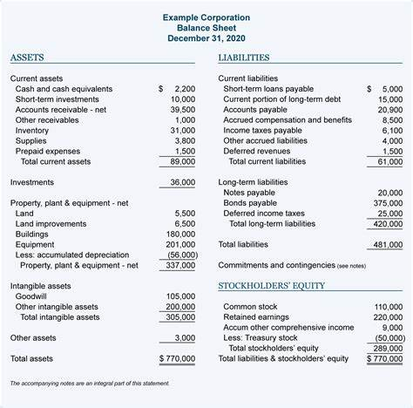
BALANCE SHEET TABLE

Slide 14
ASSETS VS LIABILITIES
ASSETS are resources owned by the business of economic value.
Fixed assets- long term, lifespan of more than a year, may depreciate overtime
Current assets- short term, can be converted into cash within a year, examples; cash, debtors, inventory, prepaid expenses.
LIABILITIES are resources that the business owes other firms.
Long term- due for more than a year,
e.g., mortgage, loans, Current liabilities- due within a year, e.g., credit, short term loan, accruals.
Accruals are obligations a business needs to bill off. E.g., wages and taxes.

Slide 15
INCOME STATEMENT CONT`D…
Also known as profit and loss account. It shows how finances were generated throughout the business cycle.
The income statement connects the balance sheet at the start and end of the time period of operation.
It illustrates the accumulation of income.
Format;
Turnover- sales, sales returns, discounts, interests, discount received, rent, commission.
Turnover is the money generated throughout the business cycle.

Slide 16
INCOME STATEMENT CONT`D…
Cost of goods sold- for a specific time period.
Gross profit- difference between total sales and cost of goods sold.
Gross profit is the money available to cover operating expenses and to generate profit.
Depreciation Loss of value of a fixed asset over a period of time due to wear and tear effect

Slide 17
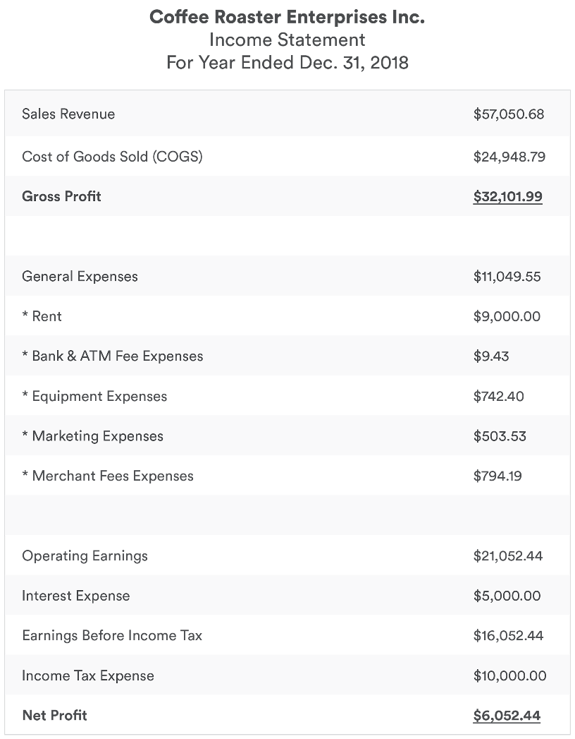
INCOME STATEMENT

Slide 18
PREPARING FINANCIAL BUDGET
OPERATING BUDGETING
Operation Budget refers to the process of planning, managing, and controlling financial
resources to achieve organizational goals and objectives.
Operation Budget is a comprehensive financial plan outlining projected income and expenses
for an organization over a specific period, typically a year.

Slide 19
OPERATING BUDGETING cont`d
Identifies revenue sources and estimates income
- Categorizes and estimates expenses (fixed, variable, and semi-variable)
- Sets financial goals and objectives (e.g., profit margins, cash reserves)
- Allocates resources to various departments and activities
- Establishes financial controls and monitoring
Regularly reviews and updates the budget to reflect changing circumstances

Slide 20
OPERATING BUDGETING cont`d
methods to generate sales forecasts
1. statistical Forecasting Techniques; are mathematical models and methods used to predict future values of a time series based on its past behavior and patterns.
These techniques use historical data to identify trends, seasonality, and other patterns, and then extrapolate that information to make predictions about future values.

Slide 21
METHODS TO GENERATE SALES FORECASTS
2. Trend analysis is a statistical technique used to identify and analyze patterns in data over time, with the goal of predicting future trends and making informed decisions.
It involves examining a sequence of data points, such as sales figures, stock prices, etc.
This method assumes that seasonal variations will remain consistent.
Trend analysis is particularly suitable for established ventures with a history of reliable sales data

Slide 22
METHODS TO GENERATE SALES FORECASTS
Ensures effective financial management and accountability
Helps prioritize spending and allocate resources efficiently
Facilitates decision-making and strategic planning
Provides a framework for monitoring and controlling expenses
Enables organizations to respond to changes and challenges
Supports long-term sustainability and growth

Slide 23
INCOME STATEMENT
Just generating profits is not sufficient for the survival of a business.
Severe limitations are faced by many profitable businesses due to insufficient cash flow.
The inability to meet current financial obligations can lead to the collapse of businesses since creditors typically require cash for settlements.
Managing cash is critical for seizing commercial opportunities as they arise and ensuring the business's survival.
Generating sufficient cash is essential for meeting obligations as they emerge.

Slide 24
PROFITABILITY AND LIQUIDITY
There may not always be a correlation between cash generated and the profit/loss in a given period.
Profit=Total Revenue - Total Cost(expenses).
Revenue does not necessarily represent cash received because some sales can be made on credit.
Expenses also are not equivalent to the cash paid.
Profitability and liquidity are not necessarily aligned or correlated.
Profit measures achievement and productivity, while cash is just one form in which wealth can be held.

Slide 25
PROFITABILITY AND LIQUIDITY
Here are some factors that might affect profit and cash differently;
Repayment of a loan might not have any impact on the current profits but might reduce the amount of cash in the business.
Making a sales on credit: profit will increase while cash won`t change.
Buying a fixed asset: profit will not change while cash will obviously reduce.
Receiving cash from a debtor: cash increases while profits remain the same.
Depreciating a fixed asset: profit will decrease while cash remains constant.

Slide 26
PROFITABILITY AND LIQUIDITY
A cash flow statement summarizes the company's cash balance changes over a period by presenting cash receipts and disbursements.
It differs from a cash flow budget, which projects future cash needs and income.
A cash flow statement aims to understand a business's cash flow on a monthly basis, including assessing its ability to generate positive cash flows and plan and control cash for meeting financial obligations and responding to major events or transactions.
It is also used by banks when applying for loans.

Slide 27
CONSTRUCTION OF A CASH FLOW STATEMENT
Preparing a cash flow statement involves three key stages:
Estimating of cash inflows: Cash inflows come from various sources such as cash sales, selling fixed assets, bank cash loans, and capital investments.
Estimating cash outflows include drawings, purchases, credit payments, operating expenses, and loan repayments.
Determining the net cash flows and current cash position: Calculate net cash flow by subtracting total cash outflows from total cash inflows for each month, then add this to the opening bank balance to determine the closing balance for the next month

Slide 28
EXPLANATION OF THE MAIN FEATURES OF A CASH FLOW STATEMENT
A cash flow statement tracks the cash inflows and outflows of a business over a given period, including three primary activities:
i. Operating activities: These involve the primary operating activities of the company. Cash inflows may come from sales, while cash outflows relate to operating expenses, interest paid, and income taxes

Slide 29
EXPLANATION OF THE MAIN FEATURES OF A CASH FLOW STATEMENT
ii. Investing activities: These include the acquisition and disposal of long-term assets and other investments. Cash inflows may result from selling property and investments, while cash outflows come from purchasing assets or investments.
iii. Financing activities result in changes in the size and composition of equity capital and borrowings. Cash inflows can come from issuing shares or debentures, while cash outflows include repayments of amounts borrowed, capital lease payments, and share repurchases

Slide 30
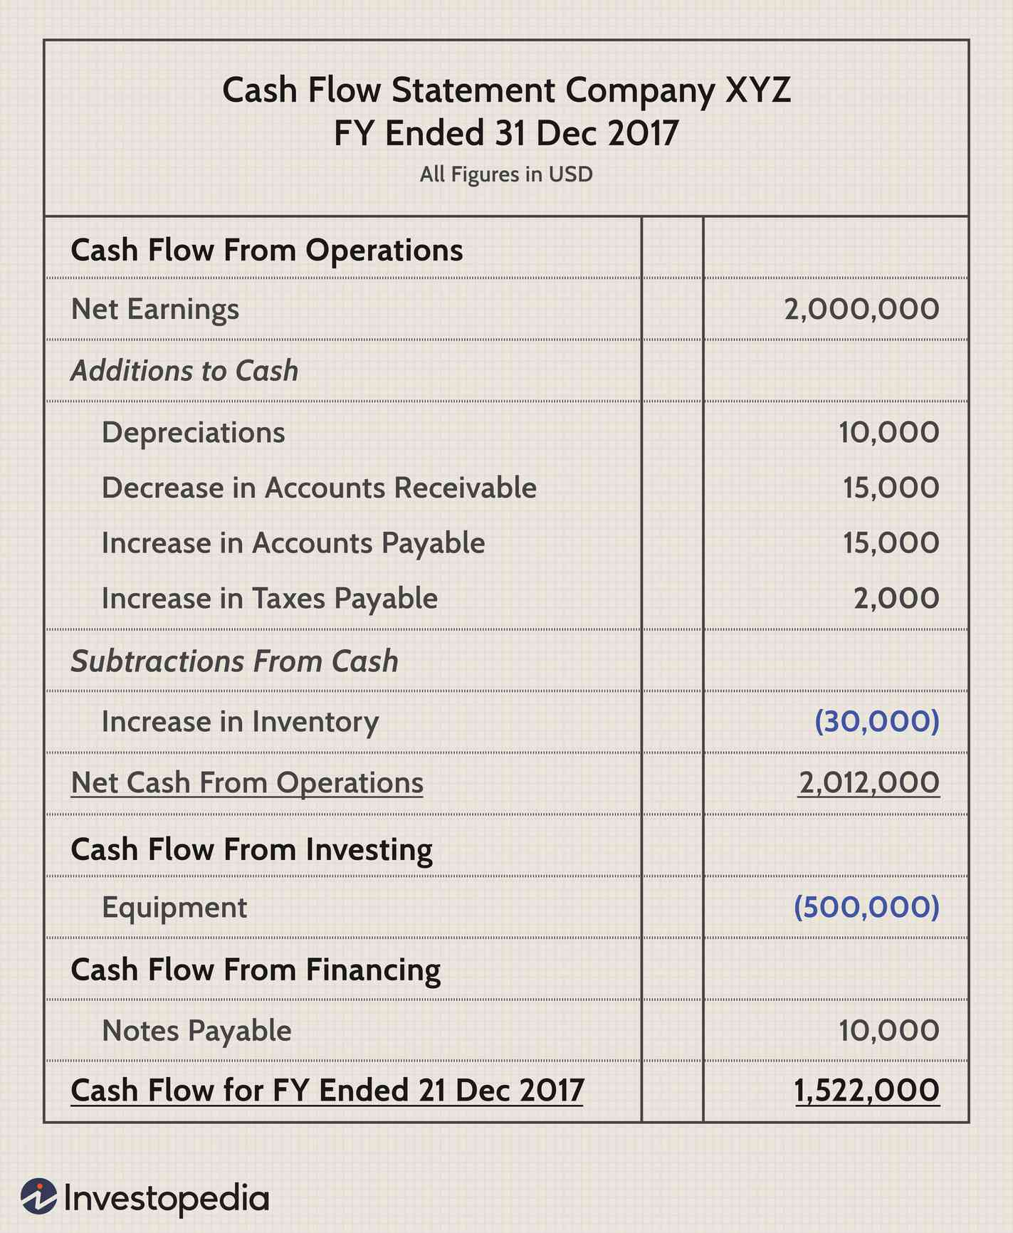
ILLUSTRATION OF A CASH FLOW STATEMENT

Slide 31
THE CASH FLOW BUDGET
Creating a Cash Flow Budget is the next step in making the financial budgets after the creations of the operating budget
This budget is a statement that estimates cash receipts and expenditures over a specified period, providing insights into cash inflows and outflows.
Management can make the necessary financial arrangements to ensure smooth operations by identifying potential cash flow issues in advance.

Slide 32
PRO FORMA STATEMENT.
Pro forma in Latin means “as matter of form” or “for the sake of form”.
This is a method of calculating financial results using certain projects or presumptions.
Pro forma statements are statements that provide a forward looking perspective, estimating how a start up financial and performance may evolve in the future.

Slide 33
IMPORTANCE OF PRO FORMA STATEMENTS;
-it is crucial for creating business plans and financial forecast.-allows entrepreneurs to demonstrate their ventures potential profitability and sustainability to potential and stakeholders.
it is a helpful tool for businesses in the sense that it shows how much a business or company expects to make in sales and revenue.
it highlights forecasted fixed or variable operating expenses and ultimately shows how much profits and retained earnings can be made at the end of a future financial period

Slide 34
IMPORTANCE OF PRO FORMA STATEMENTS CONT`D…
it highlights forecasted fixed or variable operating expenses and ultimately
shows how much profits and retained earnings can be made at the end of a
future financial period.

