Slide 1
FEASIBILITY ASSESSMENT OF THE AGRIBUSINESS IDEA
PREPARED/PRESENTED
BY

Slide 2
CHIWILA
CORMAC CHITENJI
GRACE MWAPE
ASAD MWALE
ROYCE
SUBLIME BORA
CHANSA KATEBE
CHIKONDI
THEDDEUS MUKUMA
PRINCE MOOBA
VERNON CHEWE KANDA

Slide 3
INTRODUCTION
The presentation will cover:
What a feasibility study is,
Steps to consider for a successful feasibility,
Pitfalls,
Critical factors, and
Reasons for failure in new agribusiness ventures, as well as
Process of conducting a feasibility analysis.

Slide 4
AGENDA
What is a feasibility study?
Steps to consider for a successful feasibility
1. Pitfalls in Selecting New Ventures
2. Critical Factors for New Venture Development
3. Why New Ventures Fail
4. Feasibility Analysis
4.1 Stages in Feasibility Assessment
4.2 Conducting a Feasibility Study

Slide 5
1. PITFALLS IN SELECTING NEW AGRIBUSINESS VENTURES
Pitfalls are simply risks or mistakes that can lead to failure in an agribusiness venture.
Before embarking on an agribusiness venture, it is necessary to note some of the mistakes that can lead to the collapse of the agribusiness and learn about ways to prevent them.

Slide 6
MOST COMMON PITFALLS CONT...
1. LACK OF CLEAR MARKET RESEARCH
Pitfall:
As a new business, not having enough information about the strengths of the market demand may hinder the progression of the business both in the short run and long run.
Solution:
Investing quality time in crafting a detailed business plan which outlines the target market demand and a clear value proposition that better serves the needs of the customers would help prevent this shortfall.

Slide 7
MOST COMMON PITFALLS CONT...
2. IGNORING STATUTORY REGULATIONS
Pitfall:
The agribusiness sector is very sensitive when it comes to rules regarding how food is produced, processed and stored.
Not considering these stringent policies when venturing into the business may hinder the businesses growth if it compromises the set standards and it may even be forced to shut down operations.
Solution:
Always ensure that the model of the business protects the welfare of the consumers as well as the environment I which it exists.

Slide 8
MOST COMMON PITFALLS CONT..
3. POOR FINANCIAL MANAGEMENT
Pitfall:
Improper financial management is yet another pitfall when selecting new agribusiness ventures.
When there is no proper structure of accounting for the cashflow or how money should be allocated the business risks losing out on resources and eventually collapse.
Solution:
The emerging business founders can carry out research on educational materials which encapsule financial management and closely monitoring the expenses, cashflow and plan for taxes.
Another technique might be to establish clear boundaries between the business and personal finances as well as utilizing efficient budgeting tools.
If the business can afford, they could consider engaging financial advisors that could help balance their books.

Slide 9
MOST COMMON PITFALLS CONT...
4. LIMITED ADAPTABILITY
Pitfall:
Agribusiness markets are highly dynamic and are constantly changing.
Periodically the global economy experiences changes in global trade dynamics, consumer preferences and technological advances.
Failure to adapt may lead to loss of market share
Solutions:
With the coming in of new world systems business models ought to be flexible enough to accommodate all these changes and cope within the prevailing business environment.

Slide 10
MOST COMMON PITFALLS CONT...
5. ISOLATION
Pitfall:
New businesses penetrating new markets try to have absolute control over every aspect of the value chain.
When the business is just starting this can be very expensive because it may end up spending more money than they could have if they had engaged other entities or partners.
Solution:
New emerging businesses should embrace partnerships and collaborations if they are to sustain the business for the starting period.
identifying areas that need certain specialized skills and considering

Slide 11
MOST COMMON PITFALLS CONT..
6. LIMITED RISK ANALYSIS
Pitfall:
The intricate nature of agribusinesses is that they are very risky.
Without critically assessing the risks involved the business may end up losing all resources invested.
Solution:
Considering all angles of the business and taking note of the risks would enhance how the business handles the challenges involved.
Other alternatives such as taking on insurance for the business venture would help prevent loss of business for the firm or entrepreneur.

Slide 12
2.CRITICAL FACTORS FOR NEW VENTURE DEVELOPMENT
Founder characteristics and entrepreneurial skills
Entrepreneurial ventures are driven by their;
Founders’ vision,
Passion,
Skills,
Risk-taking propensity,
Creativity, and
Leadership qualities.

Slide 13
CRITICAL FACTORS FOR NEW VENTURE DEVELOPMENT CONT...
Access to financial resources
Capital, funding, and investment should be secured adequately in order to fuel business expansion and support innovation.
Market opportunities and industry dynamics
Entrepreneurs should have the ability to identify and capitalize on market opportunities.
They should also understanding industry dynamics, market demands and consumer preferences enables entrepreneurs to develop competitive advantages and sustainable growth strategies.

Slide 14
CRITICAL FACTORS FOR NEW VENTURE DEVELOPMENT CONT...
Technology
Adopting cutting-edge technologies can improve:
Product offerings,
Streamline operations, and
Enhance customer experiences.
Technological advancements can also open new markets and revenue streams, accelerating growth.

Slide 15
CRITICAL FACTORS FOR NEW VENTURE DEVELOPMENT CONT...
Business model innovation and adaptability
New ventures should be willing to innovate and adapt their business models in reaction to changing market conditions.
Flexible business strategies allow entrepreneurs to pivot and remain strong in dynamic environments.
Networking and social capital
As evident in qualitative research, entrepreneurs benefit from access to mentors, industry experts, and supportive networks.
Strong relationships within the entrepreneurial ecosystem facilitates knowledge exchange and resource mobilization.

Slide 16
CRITICAL FACTORS FOR NEW VENTURE DEVELOPMENT CONT...
Regulatory environment and government support
Supportive policies, incentives and entrepreneurship-friendly regulations are important in fostering entrepreneurial success.

Slide 17
ELEMENTS OF A NEW VENTURE CREATION
2. OPPORTUNITY
4. RESOURCES
3. TEAM
COMMUNICATION
AMBIGUITY
BUSINESS PLAN
FITS & GAPS
BUUSINESS PLAN
CREATIVITY
LEADERSHIP
UNCERTAINTY
CAPITAL MARKET
1. FOUNDATION

Slide 18
3. WHY NEW VENTURE FAIL
1. Many business fail not because the idea is not relevant but because of not understanding the art of marketing.
Business owners never get to understand:
1) how marketing works,
2) how to make offers and
3) how to articulate their product in a market setting.
2. Not knowing the business
Business owners tend to enter into a business before they can understand the ins and outs of that particular business.
They have a shallow idea and not the full picture of what's on the ground.

Slide 19
WHY NEW VENTURE FAIL CONT..
3. Not understanding the customers problem.
As a small scale farmer your goal is satisfy a real need
Communicate the problem \& solution in a motivating way
4. Not analyzing the competition
Different is better than better.

Slide 20
WHY NEW VENTURE FAIL CONT...
5. Business owners think a good product or service is enough
Certain things that small business owners don't put into consideration such as:
Visibility- how well the product or brand is marketed .
Credibility - the reputation that the business owner builds through good customer relation, quality goods and services
Marketing strategy- business owners don't take time to lay out a plan of how to sell there product
Customer experience- not understanding the impact of a the experience the customer has.
Good customer experience in most cases helps a business increase return customers

Slide 21
WHY NEW VENTURE FAIL CONT...
6. Not creating a brand - If you don't create a brand, your customer will create it for you.
7. Business tend to be static - Culture and customer needs doesn't stan still
8. Not having a real market plan and thinking you know it all
Having a comprehensive market plan is crucial for effectively navigating the complexities of the business landscape.
It involves conducting detailed market analysis, clearly defining target audiences, identifying distribution channels, and outlining strategies for promoting products or services.

Slide 22
WHY NEW VENTURE FAIL CONT...
9. Not investigating the market - You have to find an opening or unmet need within a market and then fill it rather than try and push your product or service in.
10. Not setting up proper business plan -A solid and realistic busineas plan is the basis of a successful business.
In the plan, you will outline achievable goals for your business, how your business can meet those goals, and possible problems and solutions.
The plan will figure out if there's a need for the business through research and surveys;
It will figure out the costs and inputs needed

Slide 23
WHY NEW VENTURE FAIL CONT...
11. Remaining Rigid/Stagnant - Once you've done the planning, established your business, and gained a customer base, don't become complacent.
The need that you're fulfilling may not always be there.
Monitor the market and know when you may need to alter your business plan.
Being on top of key trends will allow you lots of time to adjust your strategy so that you can remain successful. One must only look at the music industry or Blockbuster video to know that successful industries can

Slide 24
WHY NEW VENTURE FAIL CONT...
12. Inadequate financing - If you have started a company and things aren't working out, and you have little capital and a struggling business, you're not in a good position to ask for another loan.
If you're realistic at the beginning, you can plan to start with enough money that will last you to the point where your business is up and running and cash is actually flowing in.
Other Reason includes;
1. Ineffective Marketing
2. Lack of planning and research
3. Unwillingness to learn adapt and diversify

Slide 25
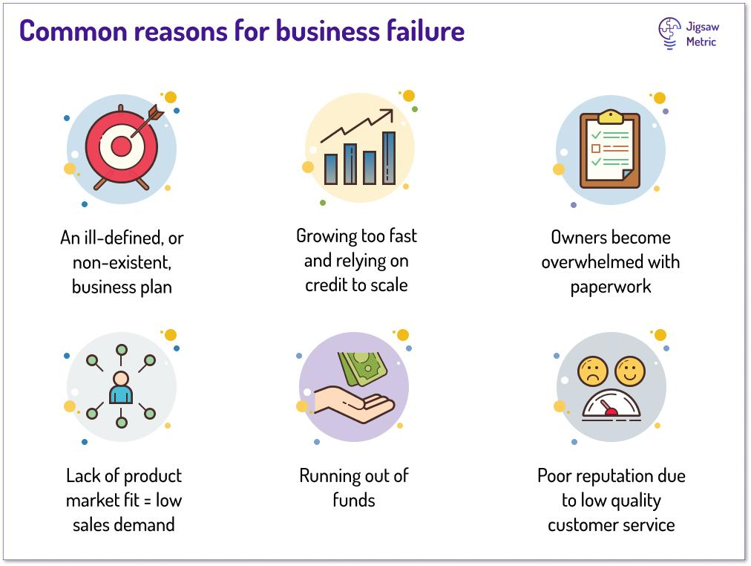
WHY NEW VENTURE FAIL CONT...

Slide 26

FEASIBILITY ANALYSIS

Slide 27
3.1 FEASIBILITY ASSESSMENT
FEASIBILITY ANALYSIS
--The word feasibility refers to the likelihood of success of a proposed project, plan, or course of action.
--This is a vital procedure in coming up with a new agribusiness enterprise.
--It requires systematic and detailed evaluation of the viability and potential success of the venture.
-- feasibility analysis is important in a new venture because it is through it that the entrepreneurs and investors figure out whether the agribusiness (or any other business) will be a success or not.

Slide 28
1.1 STAGES OF FEASIBILITY ASSESSMENT
1) Preliminary Assessment:
Identify alternative scenarios or business model of what the project will entail, how it will be organized, and how it will generate profits.
Analyze the barriers to entry of new competitors into the market.
Analyze the concentration and competitiveness of input suppliers and product or service buyers

Slide 29
STAGES OF FEASIBILITY ASSESSMENT CONT..
2) Market feasibility (strategy)
This is based on a market assessment that you have already completed.Industry or marketplace description
Describe the size and scope of the industry market or market segment(s).
Estimate the future direction of the business, industry or market segments
Describe the nature of the industry, market or market segments;
*Is it stable or going through rapid change and restructuring?
Describe the industry concentration;
1. Are they just a few large producers or many small producers?
2. Describe the major competitors?
3. Will you compete directly against them?

Slide 30
STAGES OF FEASIBILITY ASSESSMENT CONT..
3) Financial projection or Economic feasibility
Assess the “seed capital” needs of the business project during the investigation process and start-up, and how these needs to be met.
Estimate capital requirements for facilities, equipment and inventories.Estimate working capital needs.
Estimate start-up capital needs until revenues are realized at full capacity.
Estimate contingency capital needs due to construction delays, technology malfunction, market access delays etc.
Budget expected costs and returns of various alternatives
Estimate the expected revenue, costs and net profit
Calculate expected cash flows during the start period and when the business reaches capacity.
Identify limitations or constraints of the economic analysis.

Slide 31
STAGES OF FEASIBILITY ASSESSMENT CONT...
4) Technical considerations or technical feasibility
Facility needs
This stage assesses whether the technology required for the project is available or can be developed within the project constraints.
Estimate the size and type of production facilities.
Investigate the need for related buildings, equipment, rolling-stork, etc.
Availability and suitability of the siteInvestigate access to:
1.raw materials,
2.transportation,
3.Labor,
4.production inputs (electricity, natural gas, water, etc)
Investigate potential emissions problems.
Analyze other environmental impactsIdentify regulatory requirements

Slide 32
STAGES OF FEASIBILITY ASSESSMENT CONT..
Technical considerations or technical feasibility CONT...
Raw materialsEstimate the amount of raw materials needed.
Investigate the current and future availability and access to raw materials.
Assess the quality and cost of raw materials and other inputsInvestigate the amount of labor including:
wage rates,
skill level, etc.
Assess the potential to access and attract qualified management personnel.

Slide 33
STAGES OF FEASIBILITY ASSESSMENT CONT...
5) Organization structure and managerial feasibility or operational feasibility
This stage assess whether the business can be implemented smoothly within the organizations existing structure and process.
Business structure
Identify the proposed legal structure of the businessOutline the staffing and governance structure of the business along with lines of authority and decision making structure.
Identify any potential joint venture partners, alliances or other important stockholders.
Identify the availability of the skills needed and experienced business managers.
Identify the availability of consultants and service providers with the skills needed to realize the project, including legal, accounting, industry experts,etc.

Slide 34
STAGES OF FEASIBILITY ASSESSMENT CONT...
6) Schedule feasibility
This stage evaluates whether the project or business can be completed within the desired time frame, taking into account resource availability and potential delays.
7) Risk analysis
This involves identifying and analyzing potential risks associated with the business or project and developing strategies to mitigate them.
8) Final evaluation
Based on the findings of the feasibility study a final evaluation is conducted to determine whether the project should be pursued or not.
9) Legal feasibility
This stage examines whether the project complies with laws, regulations, and other legal requirements.

Slide 35
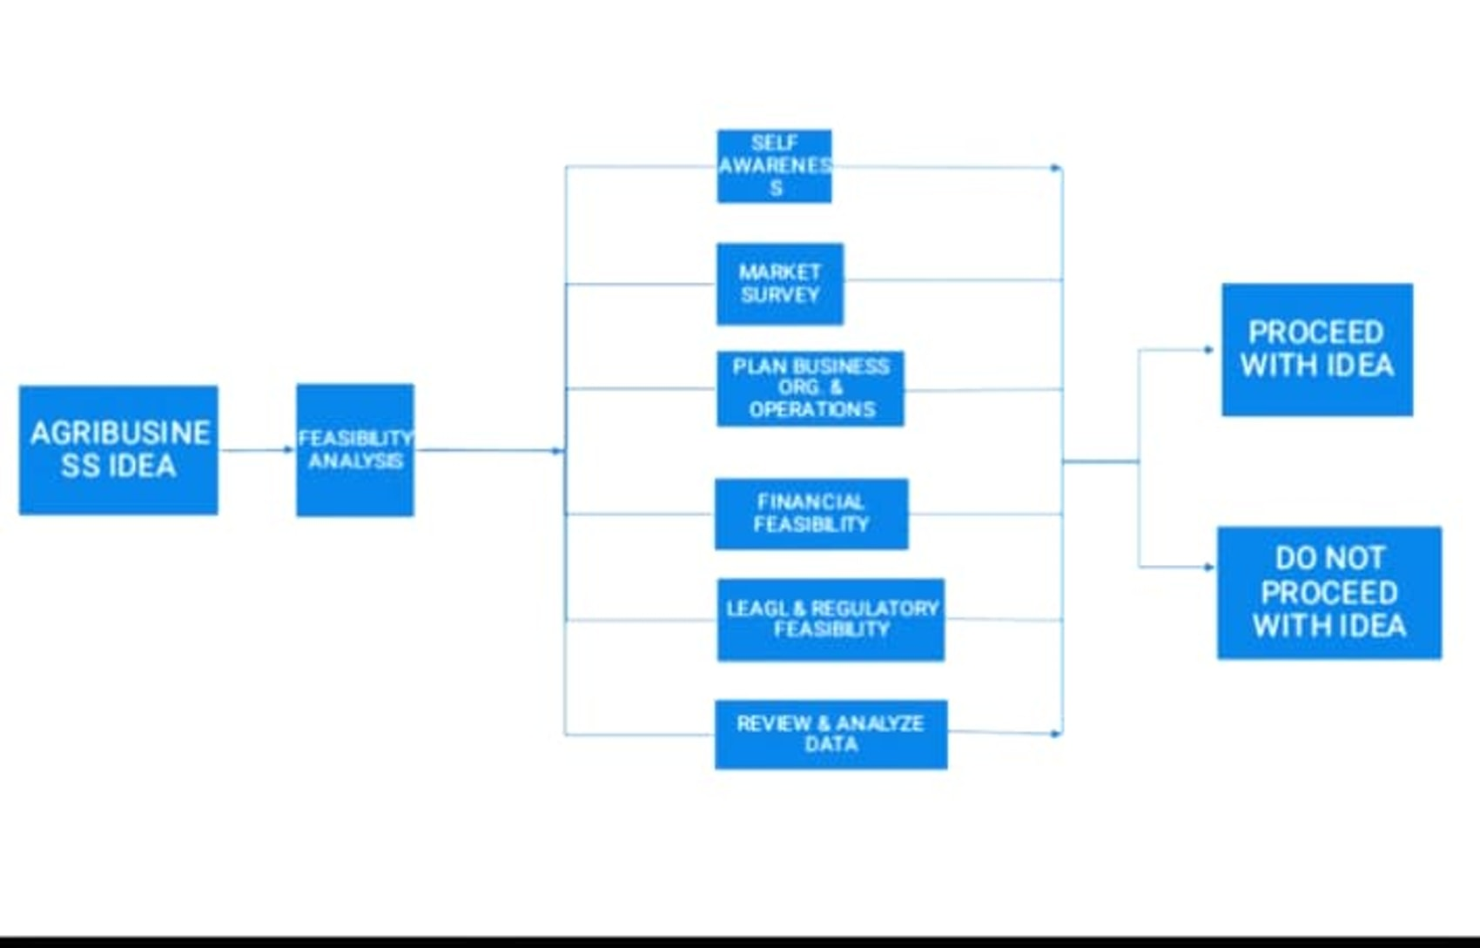
HOW TO CONDUCT A FEASIBILITY SAMPLE CONT...

Slide 36
WHAT IS A FEASIBILITY STUDY?
A feasibility study is a systematic analysis and evaluation of the potential viability of a proposed project, venture, or investment opportunity.
A Feasibility study examines if a proposed project is doable and evaluates it's changes of success.

Slide 37
3.2 HOW TO CONDUCT A FEASIBILITY SAMPLE
Feasibility - A Feasibility study examines if a proposed project is doable and evaluates it's changes of success.
For a successful Feasibility Study, the following steps have to be considered;
Step 1: Do the Preliminary Analysis
This is the initial process at the start of the project that determines whether the concept viable or capable of working successfully.
This can be done by;
1. Laying out what you want from the project and why it matter to your team of business.
2. Look for similar projects out there and see if they have been successful.
3. Figure out what sets your idea apart, maybe it's your team, the location, or the technology you use.
4. Determine the risk by listing out the things that could go wrong

Slide 38
STEPS TO CONSIDER FOR A SUCCESSFUL FEASIBILITY
Step 1:
Do the Preliminary Analysis
This is the initial process at the start of the project that determines whether the concept viable or capable of working successfully.
This can be done by;
1. Laying out what you want from the project and why it matter to your team of business.
2. Look for similar projects out there and see if they have been successful.
3. Figure out what sets your idea apart, maybe it's your team, the location, or the technology you use.
4. Determine the risk by listing out the things that could go wrong.
Once all this is done, you'll better understand whether it's worth digging deeper in the projects feasibility.

Slide 39
STEPS CONTINUES
Step 2:
Determine the Impact Of The Project.
To determine your project's impact, you have to nail down what the project is all about.
That means getting a clear idea it's goals, tasks, costs, and deadlines and identify everyone involved.

Slide 40
STEPS CONTINUES
Step 3:
Prepare a projected income statement.
This is done by looking into the business decisions.
The project income statement tells you all about the estimated revenue and expenses, serving as a vital tool for informed business decisions.
Factors shaping this statement include;
1. service provided
2. service fee
3. service volume.
4. Revenue adjustment

Slide 41
STEPS CONTINUES
Step 4:
Perform Market Research.
Market Research is crucial for understanding which your potential customers want and need, helping you understand whether there is a market for a product or service.
It also let's you size up your competition and determine the best way to position your business for success.
One way to conduct a Market Research is through Market Survey

Slide 42
STEPS CONTINUES
Step 5:
Create an Opening-day balance sheet
One of the smartest way to collect all your assets, liability and equity is by starting with an opening-day balance sheet.
Firstly, input all your assets you will need to run your operation smoothly.
This includes:
1. Day to day expense inventory (goods held for resale)
2. Equipment
3. Property all the essentials.
Next List Liabilities, like Loans and leases, and how much you will need to invest.
Although it may take time having these details, they put you on the right financial track.

Slide 43
STEPS CONTINUES
Step 6:
Review and analyse all the data.
Cross check the data against it's original source and flag any inconsistencies.
The whole point of feasibility study is to help you make better decisions so that the data you collect needs to back up those choices.
Hence, it is important to review the study by considering both the upsides and downsides of the project.

Slide 44
STEPS CONTINUES
Step 7:
Reach a Go or No-go decision.
This is where you decide to the project a greenlight or not.
Were you decide whether the project is worth your time, effort and money.
And whether it aligns with the Agribusiness venture on strategic goals and long-term aspiration.

Slide 45
HOW TO CONDUCT A FEASIBILITY SAMPLE CONT...
Step 2: Determine the Impact Of The Project.
To determine your project's impact
You have to nail down what the project is all about.
That means getting a clear idea it's goals, tasks, costs, and deadlines and identify everyone involved.
Step 3: Prepare a projected income statement.
This is done by looking into the business decisions.
The project income statement tells you all about the estimated revenue and expenses, serving as a vital tool for informed business decisions.
Factors shaping this statement include;
1. service provided
2. service fee
3. service volume.
4. Revenue adjustment

Slide 46
HOW TO CONDUCT A FEASIBILITY SAMPLE CONT...
Step 4: Perform Market Research.
Market Research is crucial for understanding which your potential customers want and need, helping you understand whether there is a market for a product or service.
It also let's you size up your competition and determine the best way to position your business for success.
One way to conduct a Market Research is through Market Survey

Slide 47
HOW TO CONDUCT A FEASIBILITY SAMPLE CONT...
Step 5: Create an Opening-day balance sheet
One of the smartest way to collect all your assets, liability and equity is by starting with an opening-day balance sheet.
Firstly, input all your assets you will need to run your operation smoothly.
This includes:
1. Day to day expense inventory (goods held for resale)
2. Equipment
3. Property all the essentials.
Next List Liabilities, like Loans and leases, and how much you will need to invest.
Although it may take time having these details, they put you on the right financial track.

Slide 48
HOW TO CONDUCT A FEASIBILITY SAMPLE CONT...
Step 6: Review and analyse all the data.
Cross check the data against it's original source and flag any inconsistencies.
The whole point of feasibility study is to help you make better decisions so that the data you collect needs to back up those choices.
Hence, it is important to review the study by considering both the upsides and downsides of the project.

Slide 49
HOW TO CONDUCT A FEASIBILITY SAMPLE CONT...
Step 7: Reach a Go or No-go decision
This is where you decide to the project a greenlight or not.
Were you decide whether the project is worth your time, effort and money .
And whether aligns with the Agribusiness venture on strategic goals and long-term aspiration.

