Slide 1
5. Water Quality
AGA 4531 INTRODUCTION TO AQUACULTURE

Slide 2
Production of fish, marine shrimp, and other species by aquaculture depends upon a supply of high-quality water.
Water quality also declines in aquaculture systems because of waste accumulation and, thus, water quality management must be applied to avoid stress and mortality of aquaculture species, and to ensure efficient production
Furthermore, the discharges from aquaculture facilities contain nutrients, organic matter, and suspended solids that pollute receiving water bodies.

Slide 3
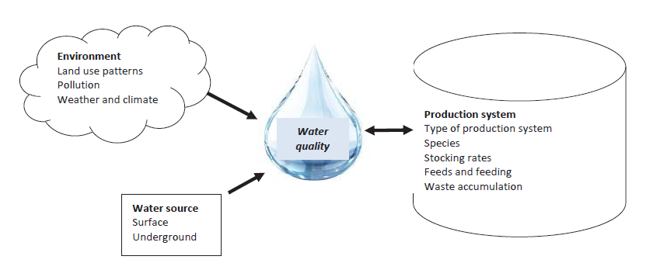
Factors that influence the water quality in fish farming

Slide 4
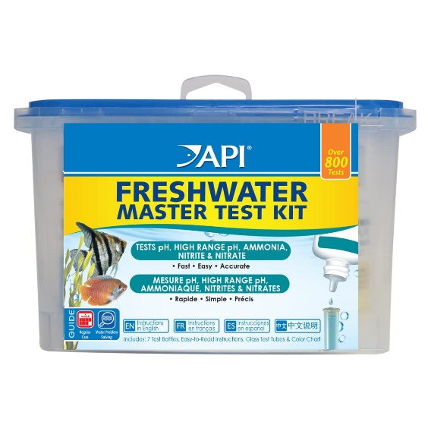
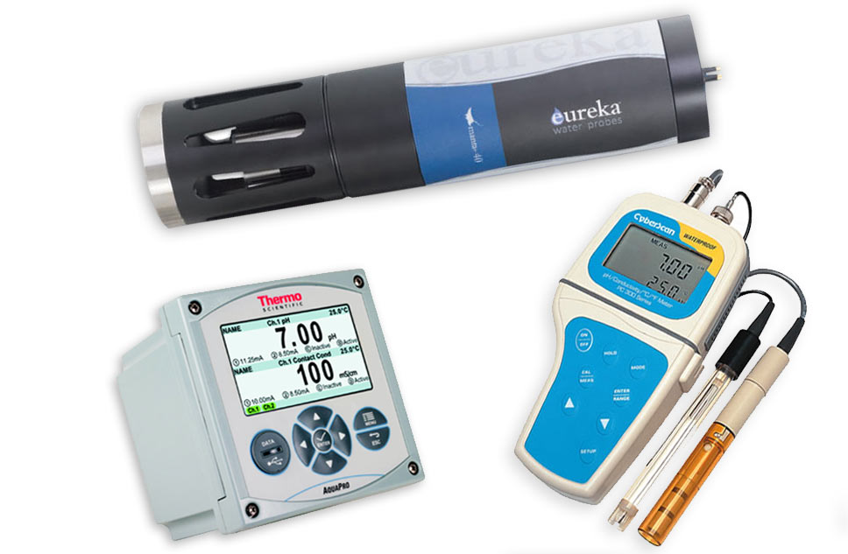
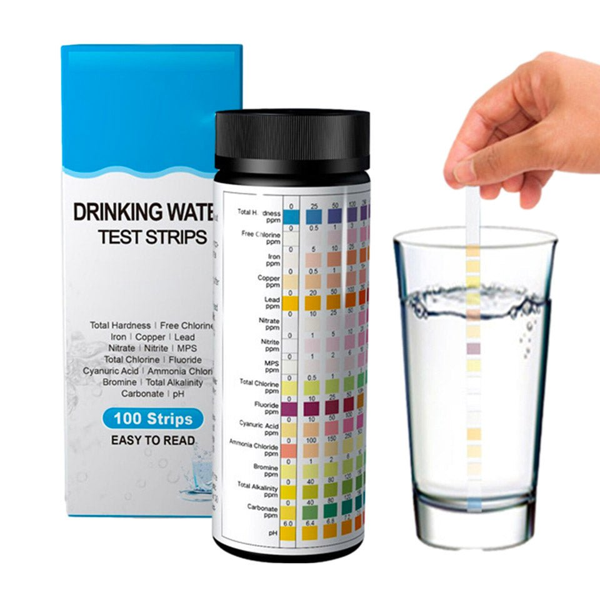
Test kits
Water quality tools
Multi-parameter meters
Test strips

Slide 5
Key water quality parameters
The key water quality parameters for pond production are
Temperature
Oxygen
pH
Alkalinity
Hardness
Nitrogenous waste

Slide 6
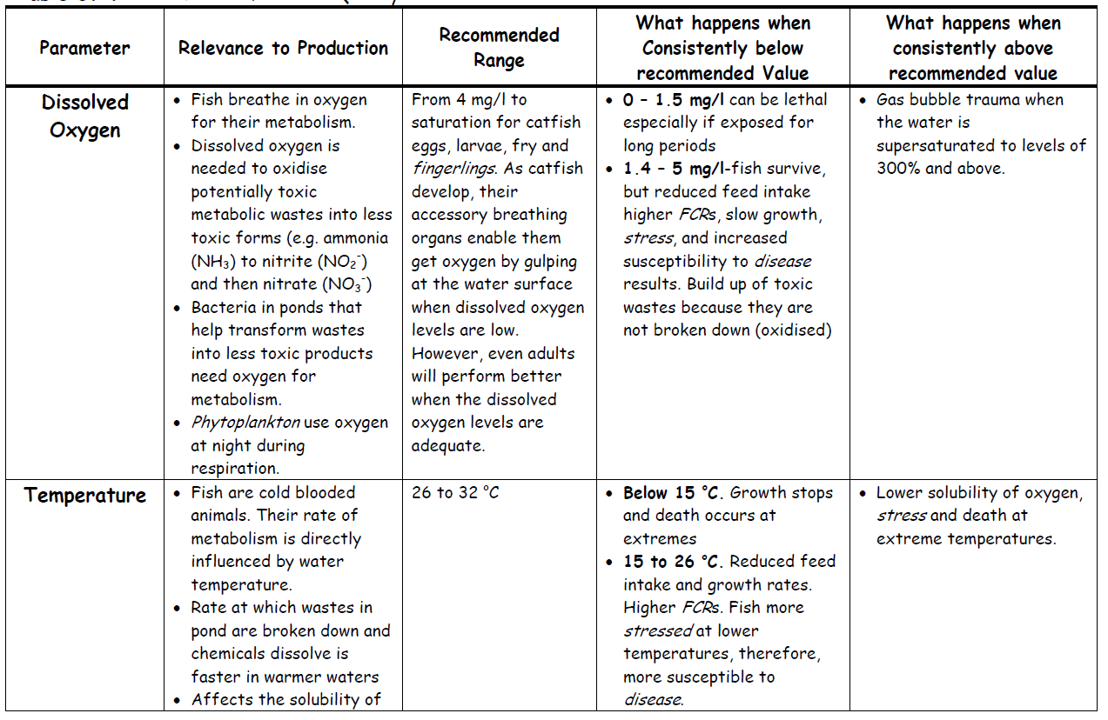

Slide 7
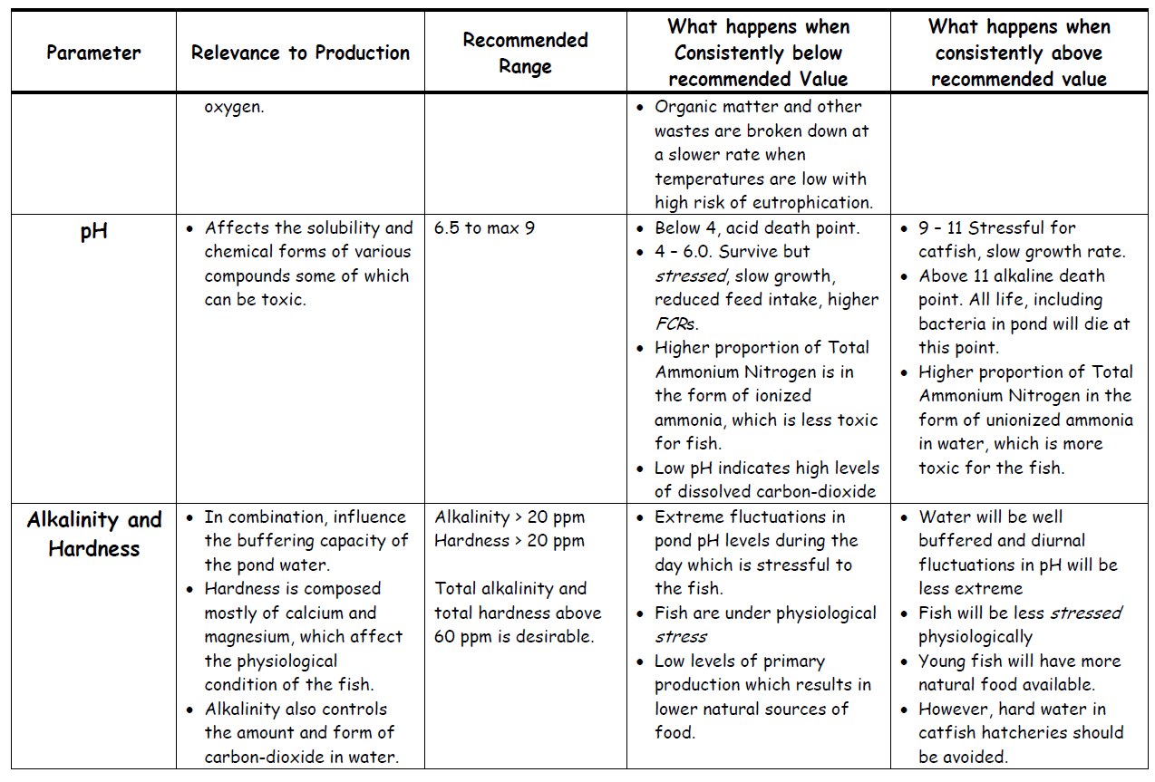

Slide 8
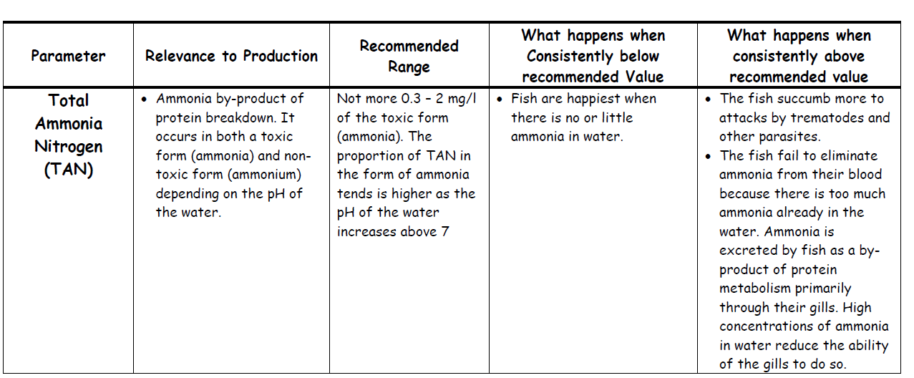

Slide 9

1. Dissolved Oxygen
Most of the dissolved oxygen in non-aerated fish ponds is generated as a result of photosynthesis by phytoplankton
Some oxygen is also incorporated into the water from the air, especially when the wind blows over the water surface and creates water movement (mixing)
Photosynthesis occurs only in the column where sunlight can penetrate because sunlight is a catalyst to the process

Slide 10

Therefore, only the water up to 70 cm to 1 m deep from the surface is oxygenated from photosynthesis in static water ponds.
Deep ponds and shade will affect DO
At night, however, the phytoplankton within the pond use up the dissolved oxygen in a process called respiration.
Because carbon dioxide is a weak acid, it causes the pond pH levels to drop at night.
Therefore dissolved oxygen levels in the pond are normally at their highest late in the afternoon and lowest after midnight towards early hours of the morning.
other factors that affect the levels of dissolved oxygen in ponds are water temperature, organic loading, and the number and size of fish as well as other aquatic animals in the pond.

Slide 11
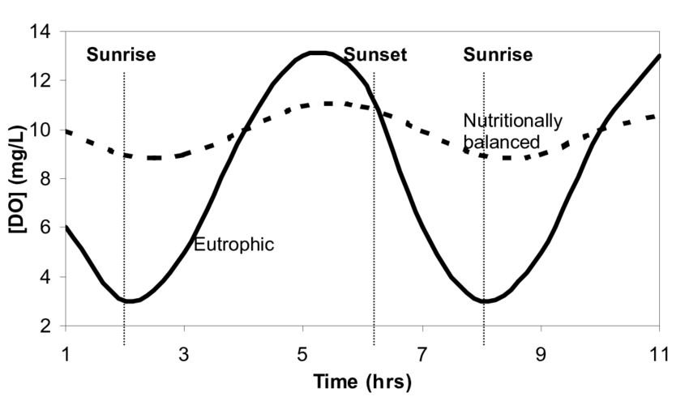
Fluctuation of DO during the day

Slide 12
2. Temperature
Tilapia and catfish are a warm-water fish, it is preferable to have warm water in the ponds for faster growth.
pond waters should be managed to maintain warm temperatures, the optimum for tilapia and catfish being 26-32C.
Remember, the lower the pond water temperature, the less food the fish will consume and the slower their growth rate will be
The higher the pond water temperature is, the lower the solubility of dissolved oxygen in water

Slide 13
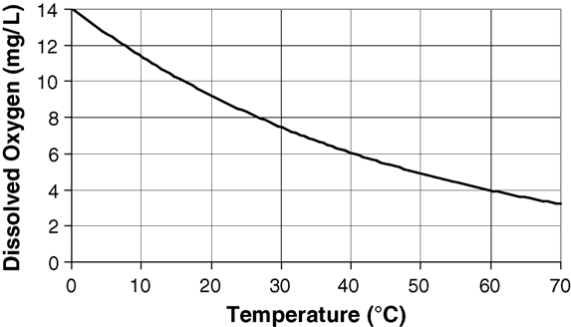
Effect of temperature on oxygen solubility in water (generated by extrapolation of data from Vesilind, 1996).

Slide 14
3. pH
pH is a measure of acidity (hydrogen ions) or alkalinity of the water.
It is important to maintain a stable pH at a safe range because it affects the metabolism and other physiological processes of culture organisms.
It can create stress, enhance the susceptibility to disease, lower the production levels and cause poor growth and even death. Signs of sub-optimal pH are besides
others increased mucus on the gill surfaces of fish, unusual swimming behavior, fin fray, harm to the eye lens as well as poor phytoplankton and zooplankton growth. Optimal pH levels in the pond should be in the range of 6.5 - 8.5.

Slide 15
Carbon dioxide (CO₂)
Carbon dioxide (CO₂) in ponds is primarily produced through respiration by fish/shrimp and the microscopic plants and animals that constitute the pond biota.
Carbon dioxide levels (and toxicity) are highest when DO levels are lowest (Figure 2). Thus, dawn is a critical time for monitoring DO and CO₂. High

Slide 16
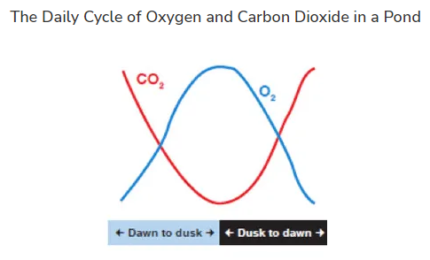
CO₂ concentrations inhibit the ability of fish and shrimp to extract O₂ from the water, reducing the tolerance to low O₂ conditions and inducing stress comparable to suffocation.
An increase in CO₂ may also decrease the pH, which can lead to toxicity of nitrite. If plants in the water absorb too much CO₂ for photosynthesis during the day, the pH will increase, and the fish and shrimp are subjected to higher un-ionized toxic ammonia (NH₃) concentrations.
Carbon dioxide concentrations above 60 ppm may be lethal. In an emergency, CO₂ can be removed by adding liming agents such as quicklime, hydrated lime or sodium carbonate to the pond water.

Slide 17
4. Ammonia
Ammonia is the by-product from protein metabolism excreted by fish and bacterial decomposition of organic matter.
Fish excrete ammonia across their gills.
Ammonia is toxic to fish. High levels in water affect ammonia excretion, blood pH, enzyme systems, and cause gill damage.
Because of the way the gills become affected, the efficiency with which the fish can extract oxygen from the water through their gills also falls

Slide 18
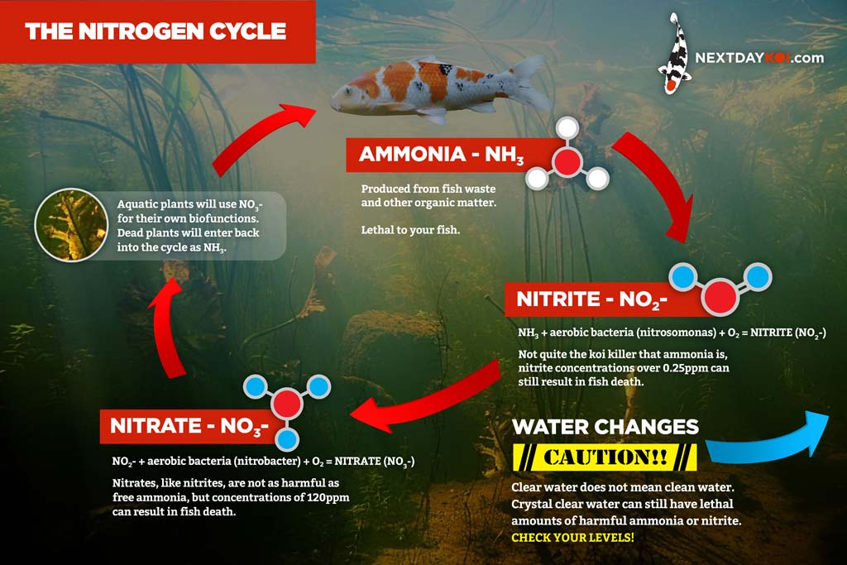

Slide 19
Ammonia occurs in two forms depending on the acidity of the water.
The unionised form of ammonia (NH3) is more dominant when the water is alkaline and the ionised form, ammonium (NH4+) when the water is acidic.
In most cases, both forms occur, hence the term Total Ammonia Nitrogen (TAN).
The unionised form, ammonia, is the most toxic of the forms of Total Ammonia Nitrogen, to fish.

Slide 20
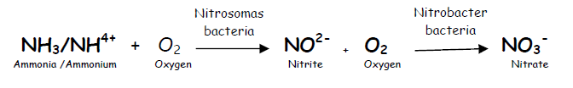
In ponds, ammonia can be directly used by phytoplankton as a direct nutrient source or is broken down by nitrifying bacteria into toxic nitrite and then nitrate, which is less toxic.
Oxygen is required to transform ammonia into nitrite then nitrate.
The bacteria that help in the process also require oxygen to live.

Slide 21
High levels of ammonia in water, therefore, indicate either a poor phytoplankton bloom or a nutrient over-load within the pond at levels the normal bacteria in the pond cannot assimilate.
Ammonia levels in ponds are therefore managed by Limiting Feeding Rates

Slide 22
5. Turbidity
Turbidity is a measure of the transparency of water in the pond.
The colour of the water gives an indication of what sort of turbidity it is. If it is brown it is often due to clay and if it is greenish, it is due to plankton.
Natural, unpolluted lakes may have Secchi disk visibilities of 5–10 m, but aquaculture ponds often have values <75 cm.
A Secchi disk is lowered into pond water
to determine the turbidity.

Slide 23
Alkalinity
Alkalinity is the buffering capacitiy of water and represents its amount of carbonates and bicarbonates.
Alkalinity can affect the potential for primary productivity and also the water pH. In case the water pH fluctuates greatly during the day, lime can be used to increase alkalinity in the water to stabilize the water pH.
Values of 50 to 100 mg/l are considered moderate and are recommended.
Total alkalinity has been traditionally expressed as milligrams per liter (ppm) of equivalent calcium carbonate (CaCO₃). Generally, alkalinity varies from site to site.
In the seawater, alkalinity is normally higher than 100 ppm but in freshwater areas, alkalinity is often low, particularly during the rainy season. Low alkalinity in freshwater or in low salinity areas will affect the survival rate and molting of shrimp.

Slide 24
Hardness
Hardness refers to the concentration of calcium and magnesium in water
Water can be classified to a degree of hardness
0 -75 mg/L | Soft
75 - 150 | Moderately hard
150 - 300 | Hard
>300 mg/L | Very hard

Slide 25
TDS
The weight of dissolved solids in natural waters results primarily from inorganic substances in ionic form
Natural water also contains soil particles, particulate organic matter, and micro-organisms in suspension.
Total solids (TS) are the weight of the residue remaining after a water sample is evaporated completely.
The weight of the residue after complete evaporation of a filtered sample is the total dissolved solids (TDS).
The TDS consists primarily of major ions

Slide 26
Rainwater may contain only 1 or 2 mg/L TDS in rural, inland regions, but near cities, industrialized areas or coastal regions, concentration may be 10–30 mg/L.
Freshwater is usually considered to have a TDS concentration<1000 mg/L.

Slide 27
Conductivity
Conductivity is a measure of the overall ionic content of water, and hence shows the freshness or otherwise of the water suggested by (Ogbeibu and Victor, 1995).
Primary production (chemical richness) and hence fish production may be measured using conductivity.
Water conductivity is depends on ionic concentrations (Ca2+, Mg2+, HCO3 - , CO3-, NO3-, and PO4-), temperature, and dissolved solids fluctuations.
Natural waters have a conductivity of 20-1500 mhos/cm, but distilled water has a conductivity of approximately 1 mhos/cm (Abowei, 2010).
Freshwater conductivity values from 50 to 1500 hs/cm (Boyd, 1979), but it can approach 10,000 hs/cm in polluted environments, while in sea water conductivity is approximately 35,000 hs/cm and more.

Slide 28
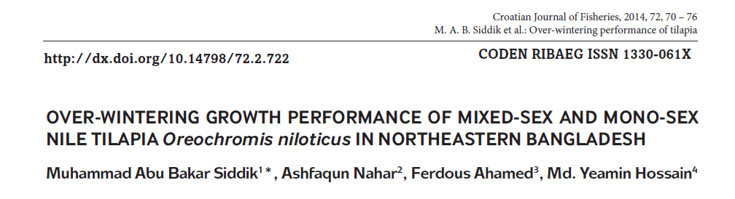
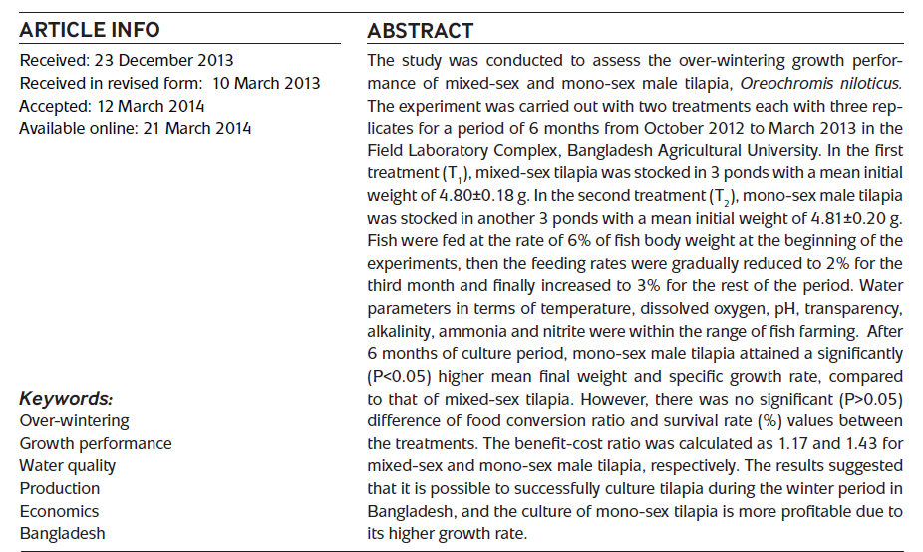

Slide 29
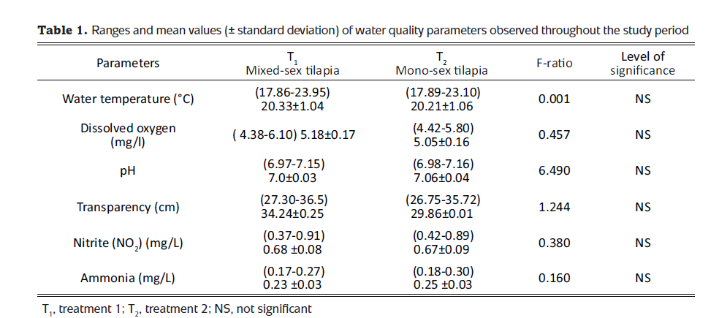
Water quality parameters

Slide 30

Effects of micro-organisms on water quality
Phytoplankton abundance is related to the availability of light and nutrients.
In water bodies of low nutrient status and clear water, underwater weeds will flourish. Waters with a greater availability of nutrients will develop phytoplankton blooms unless they are light-limited because of humic substances or clay turbidity
Plants produce organic matter and release oxygen through photosynthesis:
Organic matter from photosynthesis is the base of the food web in water bodies.

Slide 31
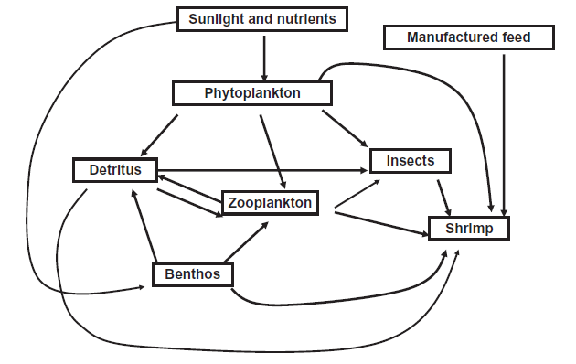
The food web of a shrimp pond

Slide 32

All organisms respire,and much of the oxygen produced in photosynthesis is used in respiration by the pond biota (including the phytoplankton and water weed at night).
Respiration, as an ecological process, is essentially the reverse of photosynthesis:
For our purposes, it is sufficient to note that plants produce organic matter that is either used in their respiration or in making their tissues.
Plant bodies become food for animals or substrate for organisms of decay.
Phytoplankton remove nutrients from the water, while decomposer organisms recycle them.

Slide 33
Dense phytoplankton blooms can cause shallow thermal stratification. Dead phytoplankton settles into the hypolimnion, causing DO depletion and the accumulation of potentially toxic microbial metabolites
Sudden thermal destratification of water bodies resulting from high wind, heavy rains or other factors can mix hypolimnetic water with surface water, leading to DO depletion and fish kills.

Slide 34
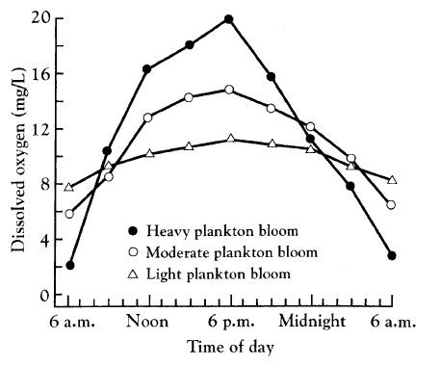
Phytoplankton profoundly affect pH, and concentrations of DO and carbon dioxide during the 24-hour cycle of light and darkness.
In daylight, photosynthesis uses carbon dioxide and releases DO faster than respiration releases carbon dioxide and uses oxygen.
This results in an increase in DO concentration and a decrease in carbon dioxide concentration. The decrease in carbon dioxide will cause pH to increase.
At night, photosynthesis stops but respiration continues. Depletion of DO may occur at night in water bodies with especially dense phytoplankton blooms

Slide 35
EFFECTS OF WATER QUALITY
ON CULTURE SPECIES
The effects of these water quality variables tend to follow three patterns . ‘Performance’ includes factors such as level of feeding, growth, normal behavior, survival, fecundity, and immunity.

Slide 36
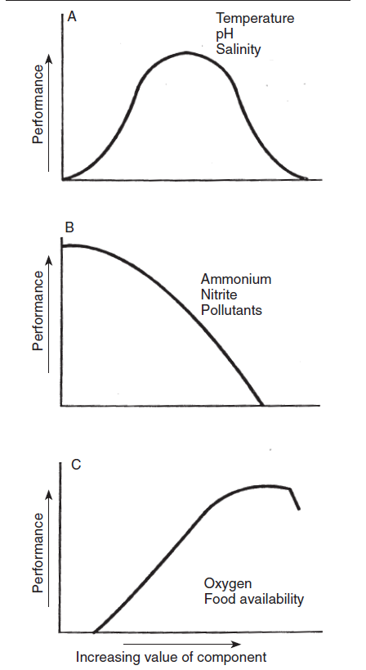
Three curves showing different patterns of the influence of environmental parameters on cultured animals.
A. With a distinct optimum level.
B. Toxic environmental parameters.
C. There is a broad optimum, but an adverse effect of very high levels of the parameter. After Tomasso (1996).

Slide 37
1. pH
The optimum pH for growth and health of most freshwater aquatic animals is in the range of 6.5 to 9.0. Acid and alkaline death points are approximately pH 4 and pH 11.
The gills of aquatic animals are the primary target of elevated, environmental H+ concentration.
Maintaining internal ion balance is the major problem facing animals in low pH environments. Increased mucus production and gill damage at low pH also impair respiratory efficiency.
Respiration is further compromised by blood acidosis, which decreases the affinity of hemoglobin for oxygen. Under mild acid stress, animals expend extra metabolic energy for maintenance of gill function at the expense of growth and immune function.
Under extreme acid stress, the animal is not capable of maintaining homeostasis and dies.
Low pH in aquaculture systems usually can be controlled through liming.

Slide 38
2. Dissolved oxygen
Oxygen is needed to oxidize organic matter from food to provide energy for biological activities.
Low DO concentration may cause chronic problems of poor appetite, slow growth, and increased susceptibility to disease. It also may result in mortality, with sudden severe DO depletion causing massive mortality.
Critical DO concentrations that negatively affect growth are lower than 5–6 mg/L for trout and salmon, and 3–4 mg/L for warmwater fish.
Fish feed best, grow fastest, and are healthiest when DO concentrations are above 5 mg/L. As DO concentrations fall below 5 mg/L, fish compensate for decreased availability of oxygen through behavioral and physiological changes.

Slide 39
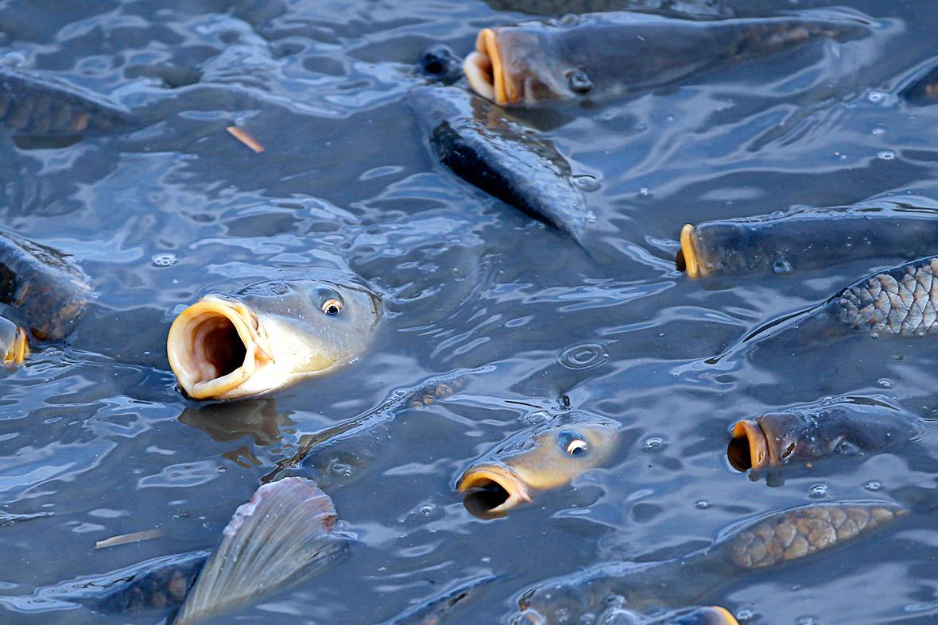
Fish gasping for air

Slide 40
Certain physiological responses to low DO concentrations increase the capability for gas exchange at the gills. These adaptations and responses allow warm water pond fish to survive for days even when DO concentrations are as low as 1–2 mg/L.
At some point, compensatory responses are no longer sufficient and oxygen demand of tissues exceeds the amount that can be supplied. At about that point, fish swim to the surface in an attempt to exploit oxygen in the surface film.
Eventually, the energy requirement for metabolism in the brain is not met and fish die
Adult fish can live for several hours at DO concentrations as low as 0.3–0.5 mg/L and fingerlings may survive short exposure to lower concentrations

Slide 41
3. Carbon dioxide
Carbon dioxide concentrations of more than about 60–80 mg/L have a narcotic effect (Sedation or drowsiness) on aquatic animals and higher concentrations may cause death
Lower concentrations may stress fish by interfering with respiration or by causing the formation of calcareous deposits in the kidney.
High concentrations of dissolved carbon dioxide reduce carbon dioxide excretion at fish gills cause elevated levels of plasma carbon dioxide and uncompensated respiratory acidosis.
These conditions decrease the affinity of hemoglobin for oxygen and reduce oxygen uptake by blood at the gills, even if DO concentrations are high.
In ponds, carbon dioxide concentrations may change by an order of magnitude between night and day. If DO concentrations are above about 5 mg/L, carbon dioxide concentrations of at least 30 mg/L can be tolerated by warmwater species.
Nevertheless, fish can sense small differences in carbon dioxide concentrations and try to avoid areas with high concentrations.

Slide 42

4. Ammonia and nitrite
Ammonia nitrogen exists in two forms, NH3 and NH4+, in a pH- and temperature-dependent equilibrium:
As pH rises, un-ionized ammonia increases relative to ammonium.
Water temperature also causes an increase in the proportion of un-ionized ammonia, but the effect of temperature is less than that of pH.
The common analytical procedures for ammonia nitrogen measure total ammonia nitrogen (TAN) which includes both NH3 and NH4+.

Slide 43
The tolerance of aquatic organisms to ammonia varies with species, physiological condition, and environmental factors.
Lethal concentrations to warmwater fish and crustaceans for 24–96 h exposure are between 0.4 and 2.0 mg/L of un-ionized ammonia.
TAN toxicity to fish and other aquatic creatures is attributed primarily to NH3. As ammonia concentration in water increases, ammonia excretion by aquatic organisms diminishes, and levels of ammonia in blood and other tissues increase.
The result is an elevation in blood pH and adverse effects on enzyme-catalyzed reactions and membrane stability.
Ammonia increases oxygen consumption by tissues, damages gills, and reduces the ability of blood to transport oxygen. Its toxicity is usually expressed by a reduced growth rate instead of mortality
However, disease susceptibility also increases in organisms exposed to sublethal concentrations of ammonia.

Slide 44
Nitrite-nitrogen, NO2-N, may accumulate to concentrations of 1–10 mg/L or more in water of aquaculture systems under certain conditions.
When fish absorb nitrite, it oxidizes ferrous iron in hemoglobin to ferric iron to form methemoglobin that is not capable of combining with oxygen.
Blood containing significant amounts of methemoglobin is brown, so nitrite poisoning is commonly called “brown blood disease.”

Slide 45
5. Total alkalinity and total hardness
Total alkalinity results primarily from bicarbonate in waters for aquaculture, and fish have no direct requirement for bicarbonate.
There is evidence that crustaceans need bicarbonate when moulting, and 75–100 mg/L is considered sufficient for this purpose.
Waters with low total alkalinity are poorly buffered and the availability of carbon dioxide is limited.
Waters containing 50 mg/L or more total alkalinity have more stable water quality and are more productive than waters of lower total alkalinity.
Waters with total alkalinity more than 200–300 mg/L may have high pH and low availability of phosphorus.
Calcium is a major contributor to total hardness in freshwater and low hardness is an indicator of low calcium concentration.

Slide 46
WATER QUALITY MANAGEMENT
1. Pollution and turbidity
High turbidity in surface water is common where agriculture, logging, mining, or other activities have disturbed soils in the catchment area.
Water from agricultural areas may be contaminated with pesticides. Pollution from domestic and municipal sources has high concentrations of nutrients and organic matter. Industrial pollution can be a source of heavy metals, potentially toxic inorganic and organic chemicals, organic matter, and acids and bases.
Limitations from turbidity and acidity can usually be corrected at aquaculture facilities, but little can be done at the farm level to mitigate other types of pollution in source water.
Turbidity from suspended soil particles can best be corrected by eliminating the source of the turbidity on the catchment. If this cannot be done, a settling basin may be constructed to remove suspended soil particles from water before it enters production units

Slide 47
Liming of acidic, low-alkalinity water
Ponds built in areas with acidic-sulfate soils may have waters with pH values so low that culture species will not survive or, if they survive, they will not grow well
However, it is best to avoid using sites with potential acid-sulfate soils for aquaculture.
The more common acidity problem occurs in ponds constructed on soils with a high concentration of exchangeable aluminum. Waters in such ponds have pH of 5.5–6.5 and alkalinity below 20 mg/L.
Liming materials increase the pH of bottom soils and elevate alkalinity and hardness in water.
These changes improve conditions for microbial activity and growth of benthic animals; increase the availability of carbon dioxide, phosphorus, and other nutrients; enhance phytoplankton growth; and improve the survival and growth of the aquacultural crop.

Slide 48
The most common liming materials are agricultural limestone, burnt lime, and hydrated lime.
Agricultural limestone neutralizes acidity with release of calcium to calcium ions, carbon dioxide, and water
Ponds with total alkalinity below 50–60 mg/L must be limed.
The liming rate is to apply agricultural limestone at 1000 kg/ha and check total alkalinity after 3 or 4 weeks. If the alkalinity is still low, more agricultural limestone may be applied.
Acidic ponds usually will need to be limed after every crop if they are drained for harvest

Slide 49
Control of high pH
Several treatments have been used to lower pH. In some cases, water exchange may be used to flush out phytoplankton and this will often lower pH.
Copper sulfate treatment will kill algae, causing a decline in carbon dioxide use in photosynthesis and a resulting drop in pH.
This practice, however, can cause low DO concentration when dead algae decay

Slide 50
Organic amendments such as manure and molasses have been applied because carbon dioxide released when these materials decay will depress pH. This treatment is seldom highly successful and it also can cause DO depletion.
In emergencies, aluminum sulfate may be applied. Aluminum ion hydrolyzes to release hydrogen ions and lower pH.

Slide 51
Manures
A wide variety of organic materials may be used to fertilize ponds.
Application rates must not exceed about 25 kg/ha of dry matter per day in unaerated ponds to avoid dissolved oxygen depression by microbial degradation of the manure.
Fish production in manured ponds can be as high as or higher than that achieved with chemical fertilizers.
Manures have their maximum benefit in developing countries where small-scale farmers may have manure available from farm livestock and cannot afford chemical
fertilizers.

Slide 52
There are, however, several disadvantages to manures:
Manures have a low percentage of nutrients and vary in composition.
Because of low nutrient quality, large application rates are necessary.
Large applications can cause dissolved oxygen depletion and accumulation of partially decomposed manure in pond bottoms.
Manures encourage growth of algal mats.
Manures may contain antibiotics put into animal feeds and they have high concentrations of trace metals.
Many consumers do not prefer aquaculture products from manured ponds.

Slide 53
Chemical fertilizers
two most common fertilizers used worldwide in aquaculture are triple superphosphate and urea.
Nitrogen in fertilizers is present as urea, ammonium or nitrate.
Phosphorus occurs as orthophosphate or polyphosphate, while potassium appears in its ionic form.
Fertilizers dissolve in water to release their nutrients.

Slide 54
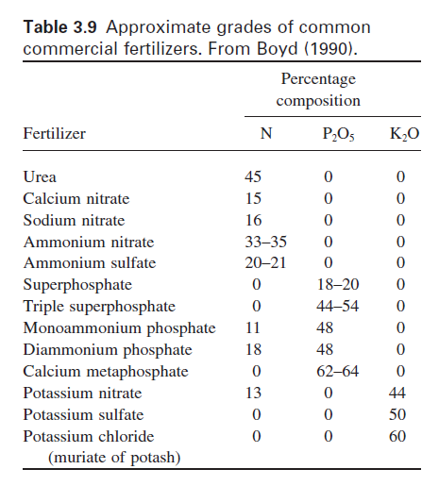
Fertilizer granules or prills are water soluble but settle to the pond bottom before completely dissolving. Much of the phosphorus may be adsorbed by the bottom soil instead of remaining in the water.
This problem can be lessened by using liquid fertilizers. Once blooms have been initiated, fertilizer can be applied according to need as judged from the Secchi disk visibility.
A Secchi disk visibility of 25–40 cm is usually considered adequate.

Slide 55
Feeding and water quality
Only a portion of the feed applied is eaten. Fish quickly ingest feed pellets and, with careful feeding, 90% or more of the feed will be consumed.
Absorbed nutrients are used in metabolism and, to a lesser degree, for growth
Water, carbon dioxide, ammonia, phosphate, and other basic compounds are excreted as metabolic wastes
A relatively small amount of the nutrients in the original feed input is captured in biomass of harvested animals.
Aquacultured fish may contain only 12.2% of the carbon, 25.8% of the nitrogen, and 14.2% of the phosphorus applied in feed.

Slide 56
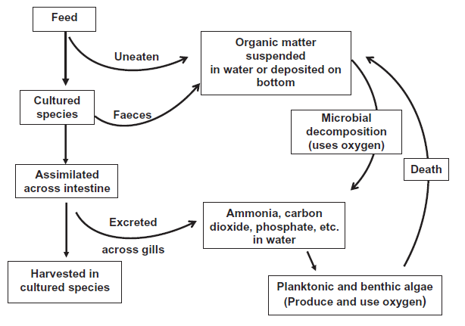
Fate of feed in an aquaculture pond.

Slide 57
Wastes from feeding have a tremendous influence on pond water quality. Micro-organisms readily decompose organic matter in uneaten feed and feces
This decay process removes dissolved oxygen from the water and releases carbon dioxide, ammonia, phosphate, and other mineral nutrients.
The culture species also consumes dissolved oxygen and excretes minerals similar to those generated by decomposition. Ammonia and phosphate stimulate growth of planktonic and benthic algae. Algal abundance in ponds increases as feed inputs increase.
Ponds with dense blooms of planktonic algae typically have high dissolved oxygen concentrations during the day, but lower dissolved oxygen at night can stress or kill the culture species
Low DO stresses culture species, so mechanical aeration is necessary at higher daily feeding rates
Water exchange sometimes is used to flush plankton and nutrients from ponds and improve water quality.

Slide 58
Mechanical aeration
Mechanical aeration is widely used in pond aquaculture to prevent low DO concentrations, especially at night; to improve the efficiency of feed use; and increase production of the cultured species.
Mechanical aerators increase the rate at which oxygen from air enters water by providing a greater surface area between air and water to facilitate diffusion
This can be achieved mechanically by two methods. Water may be splashed into air to increase its surface area and accelerate the rate of diffusion.
Alternatively, bubbles of air may be released into water to create a large surface area between bubbles and water through which oxygen from the bubbles enters the water.

Slide 59
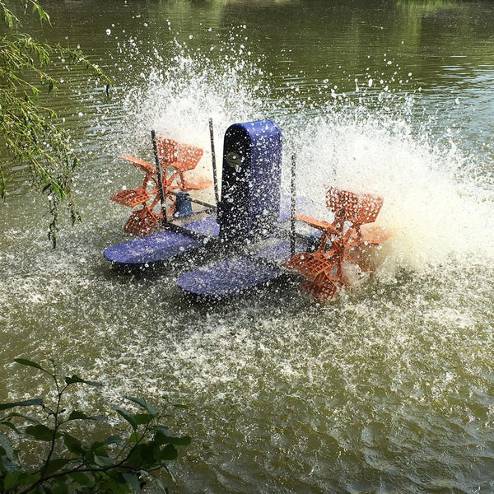
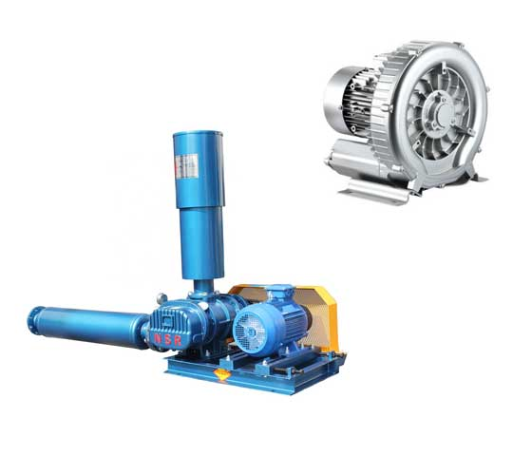
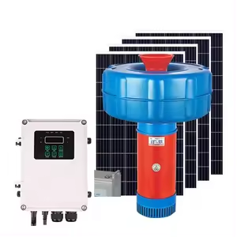
Paddlewheel
Air compressor
Solar aerator
Roots blower

Slide 60
In addition to transferring oxygen to water, aerators circulate pond water. Water circulation is beneficial in moving oxygenated water away from aerators to prevent localized saturation and loss of oxygen-transfer efficiency.
It also prevents ponds from thermally stratifying.

Slide 61
END OF TOPIC
QUIZ 2

