Slide 1
THE UNIVERSITY OF ZAMBIA
SCHOOL OF AGRICULTURAL SCIENCES
DEPARTMENT OF ANIMAL SCIENCE
COURSE:BEEF AND SMALL RUMINANTS PRODUCTION
COURSE CODE:AGA4511
GROUP NUMBER:FIVE (5)
TASK: ASSIGNMENT ONE
QUESTION: GOATS AND SHEEP BREEDS IN ZAMBIA

Slide 2
Introduction
Goats and sheep are ruminant mammals, digesting plant-based foods with their four-chambered stomach.
They regurgitate and re-chew their food to extract nutrients.
Both are hooved, herbivorous,
And often raised for meat, milk, and wool.

Slide 3
GOAT BREEDS IN ZAMBIA
The following are some of the breeds that are reared in Zambia :
1.The Small East-African Goat
The local goats are commonly referred to as a branch of the Small East-African goat. A branch of the Small East-African goatincludes the Gwembe goat that has pricky ears and ishorned

Slide 4
The adult males can attain 25 kg weight. The local goats are prolific breeders, hardy and prefer browsing.
TheSmall East-African goats are multi-purpose animals providing man with meat (chevon), milk, skins and hair for direct or indirect use.
The local goats are poor milk producers, yielding about 0.2 –0.5 litres of milk per day.
As a result of the low milk yields, goat owners do not bother to milk them. Where the local goats are milked it is done by children / shepherds.

Slide 5
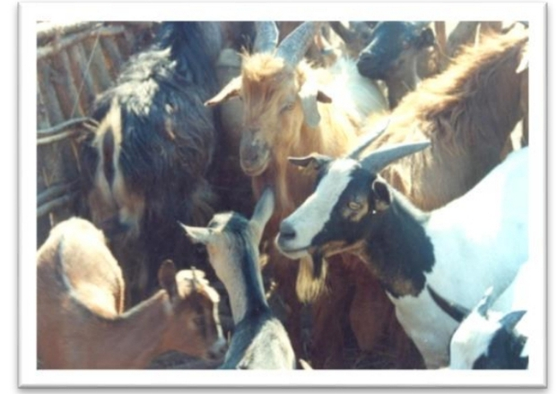

Slide 6
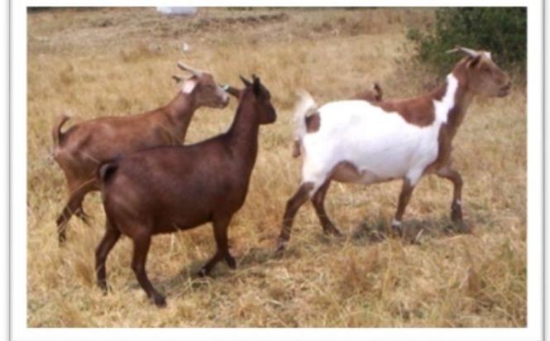

Slide 7
2.THE BOER GOAT
The Boer Goat, imported from South Africa, is a typical meat (chevon) producer with a fairly good milk yield.
The Boer Goat has good carcase characteristics and is far superior to any othermeat goat in Zambia.
Although the Boer Goat is a meat breed it yields 1.2 –2.0 litres of milk per day containing 5 –6% butterfat.As a result of its good characteristics (meat and milk), the Boer Goat is used to up-grade the indigenous breeds through cross breeding

Slide 8
The Boer Goat is also used to replace the indigenous goat.
The Boer goat has a nice colour pattern of white and brown, a white body with a brown head.
The Boer goat has drooping ears and an upturned tail.It is a prolific breeder, a good browsing animal with good mothering ability and adults weigh 30 –80 kg.
Hence, it is larger than the indigenous or local goat.

Slide 9
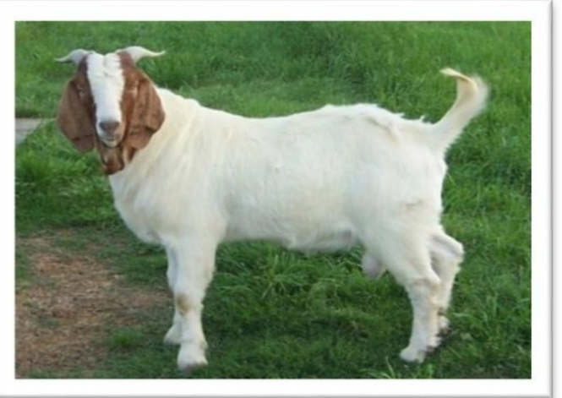

Slide 10
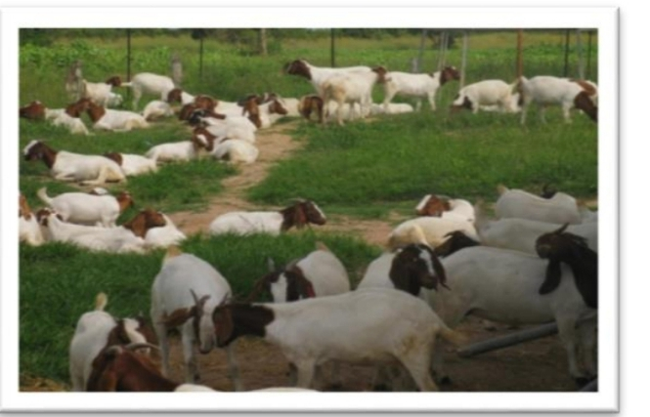

Slide 11
3.THE SAANEN
The Saanen originates from Switzerland. The Saanen is heavy milk producer, yielding 2 –5 litres per day containing 3 –4 percent milk fat.
It is medium to large in size (65 kg) and is generally white or light cream in colour with forward-facing ears; kindand friendly.
The Saanen can be reared as a pure breed or be used to up-grade local goats; and does reasonably well in the tropical countries, including Zambia, when management is good.
The Saanen is not recommended to be reared when good pasture or roughage are not available.

Slide 12
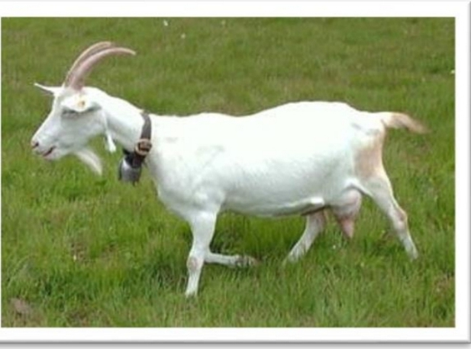

Slide 13
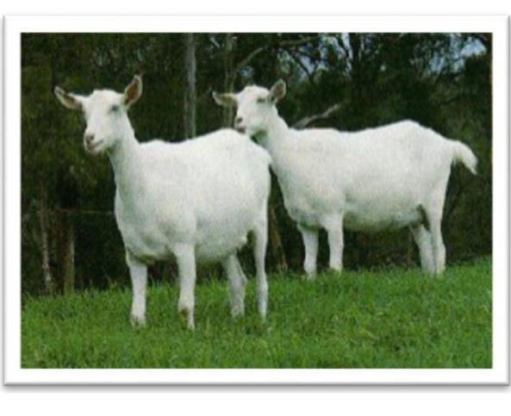

Slide 14
4.THE KALAHARI RED
The Kalahari Red is a breed originates from South Africa. The breed has become increasingly popular in recent years with many neighbouring countries now starting to rear them.
They got their name, Kalahari Red, because of their coat is red and their habitat is located near the Kalahari Desert that spans the borders of Botswana, South Africa and Namibia.

Slide 15
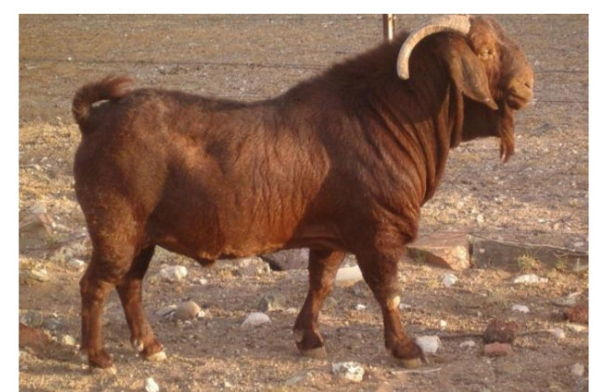

Slide 16
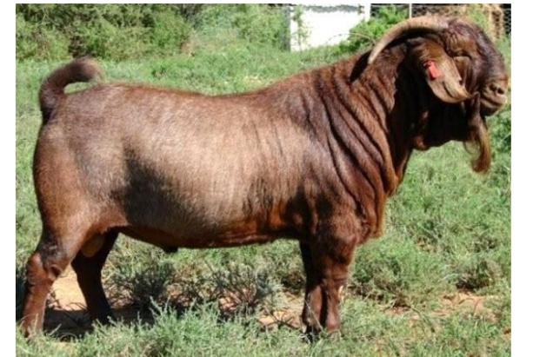

Slide 17
5. ANGORA GOAT
The Angora Goat originated from Asia Minor (Turkey) and is reared for mohair production; since biblical times (Moses).
The Angora goat is now found in most of the Mediterranean countries.
Of all the Angora goats in the world, Turkey has a population of about 45%.
Mohair is very similar to wool in chemical composition but differs from wool in that it is has a much smoother surface and is very thin.
The average goat shears about 5 kg of mohair annually. However, meat and milk (2 kg/day) are good

Slide 18
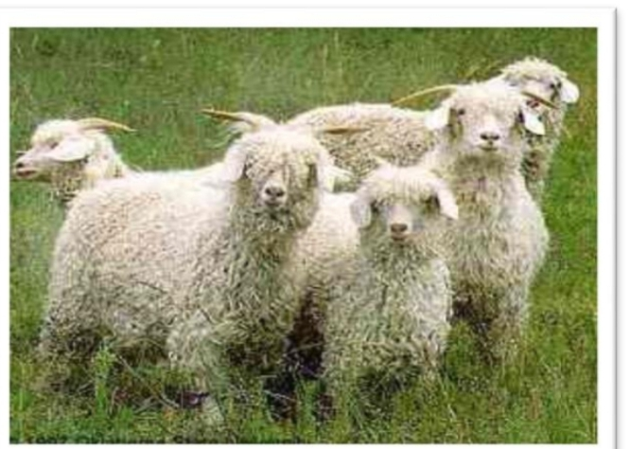

Slide 19
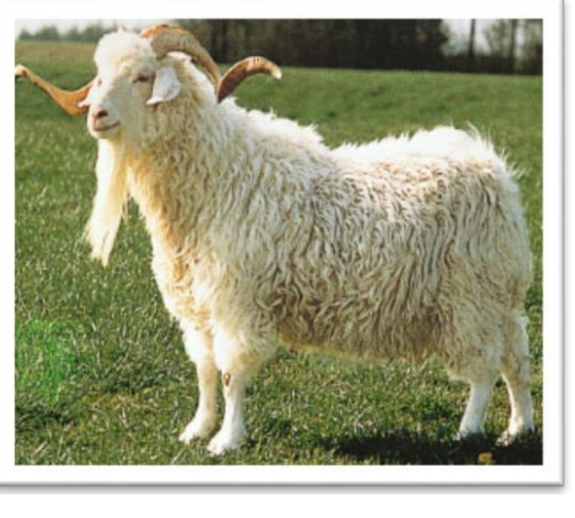

Slide 20
6.THE ALPINE
The Alpine, also referred to as the French Alpine or the Alpine Dairy Goat, originates from the Alps Mountains
They are hardy and adaptable goats that thrive in any climate while maintaining good health and excellent milk production (2 –5 litres per day). The Alpine has large, well-shaped udders with well-placed teats of desirable shape.
The adult females weigh about 65 kg and adult males about 60 kg live-weight. The butterfat content of the milk is 3.6%.

Slide 21
The breed does not have an established colour. The colour ranges from pure white through to shades of fawn, gray, brown, black, red, bluff, piebald, or various shadings or combinations of these colours.
Both sexes are generally short haired but the bucks usually have a roach of long hair along the spine with pronounced beards.
The breed has dished or curved noses and upright ears.

Slide 22
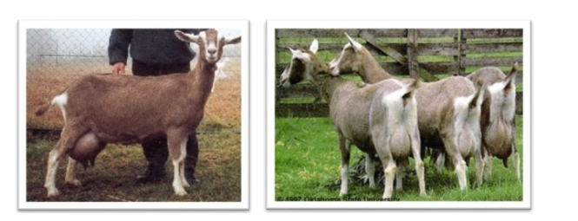

Slide 23
7.THE TOGGENBURG
The Toggenburgalso originated from Switzerland. This is a chocolate coloured goat with white markings on the face, the hindquarters and the legs.
It is a very good milking goat that has been introduced into many tropical countries, including Zambia.
The adult females weigh about 65kg and adult males about 50kg live-weight.Their
milk (2 –5 litres/day) has an average butterfat content of 3.7 p

Slide 24
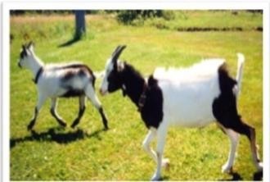

Slide 25
8.THE NUBIAN GOAT
The origin of this breed is the Sudan. However, as a result of its good characteristics, the Nubian goat has now spread all over North-East Africa and the Mediterranean countries.
The breed is also found in Europe and America where it has been further improved by crossing breeding with local milk breeds and resulting into an excellent new breed, the Anglo-Nubian.

Slide 26
This is the most popular tropical milking goat. This breed is large; has long, wide and pendulous ears; and a roman nose.
It is a very good tropical milk breed with various local types that vary in milk yield as well as in appearance. The Anglo-Nubian is a large long-legged goat with long pendulous ears.
In general, it is black or brownish in colour. The adult females weigh about 60kg and adult males about 70kg live-weight.
They produce milk (2 –5 litres per day) with high butterfat content (4.5%) that is good for cheese making.

Slide 27
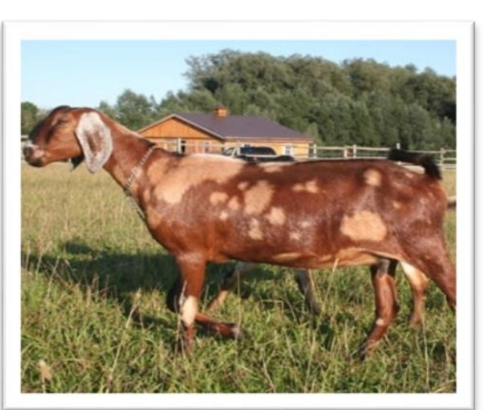

Slide 28
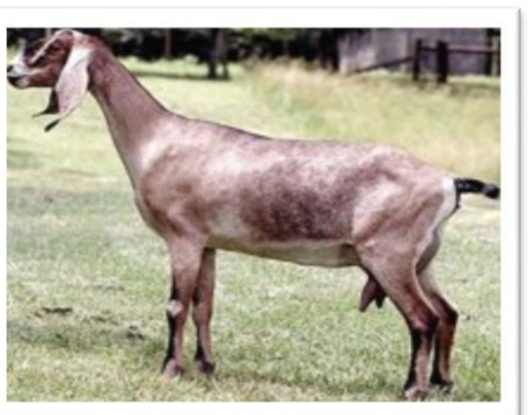

Slide 29
SHEEP BREEEDS IN ZAMBIA
Sheep are reared in the tropics, including Zambia, for meat and as a subsidiary for wool, hair, skins, milk and manure. In India, a bushier breed of sheep is used as pack animals to carry up to 3 kg loads.
Meat (mutton) is an important product of sheep. Just like goats, sheep also survive periods of drought and semi-starvation; and still produce mutton and enough milk.
Milk is produced at commercial level only in a few countries. In most countries, milk is produced for home consumption

Slide 30
1.The East-African fat-tailed Sheep
The East African fat-tailed sheep are the local breed of sheep that are found all over Zambia and kept under traditional conditions
The breed has poor meat conformation (bone and fleshing structure) and stores large amounts of fatover the tail; and hence the name fat-tailed sheep.
The East African fat-tailed sheep are very hardy and resistant to various diseases andhave mixed colours.

Slide 31
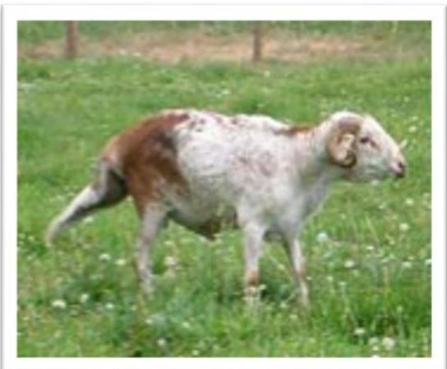

Slide 32
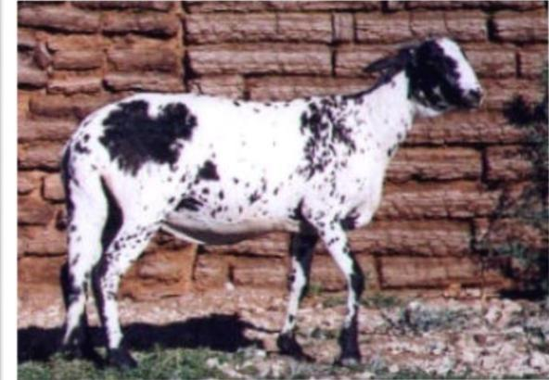

Slide 33
2.The Black Head Persian (BHP)
The BHP crosses well with the indigenous sheep. It is thelargest of the fat-rump sheep and has a hairy coat, white in colour except for a black head and neck.
The haired nature of the coat makes the breed very suitable to seeding, i.e. the penetration of grass seeds of the Heteropogon contortustype into fleece(coarse wool/hair) and eventually into the skin.
The breed is recommended for the average farmer who keeps sheep under an extensive system of management because it is a hardy breed and well able to withstand veldt conditions.

Slide 34
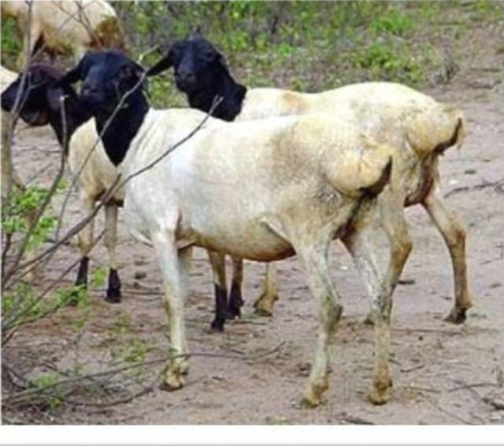

Slide 35
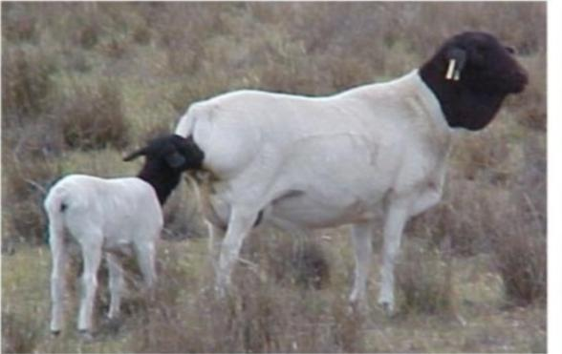

Slide 36
3.The Dorset Horn
The Dorset Horn is known for its good qualities as a meat and wool producer. The breeds’ chief distinction is its horns that are large and curled, in both rams and ewes.
The Dorset Horn is a big sheep (ewes weigh 70 –90 kg and rams 100 –120 kg) that is hardy and very active. The breed has a pink nose and light coloured hooves.
The fleece (coarse wool/hair) is of medium length, fine and very white with the face and legs clear of wool. The fleece average 2.25 –4 kg in the ewes.
The staple length is 6 –10 cm.The fibre diameter ranges from 23.0 to 27.0 microns.
Dorset ewes can breed twice in one year although three lambings in two years is more usual.They are excellent mothers with abundant milk. Multiple births are

Slide 37
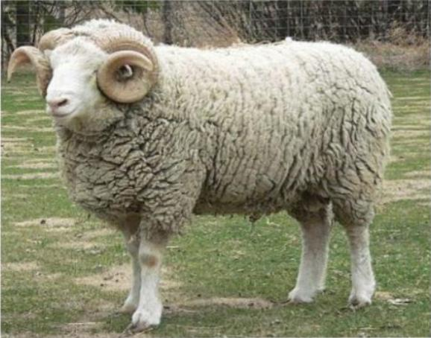

Slide 38
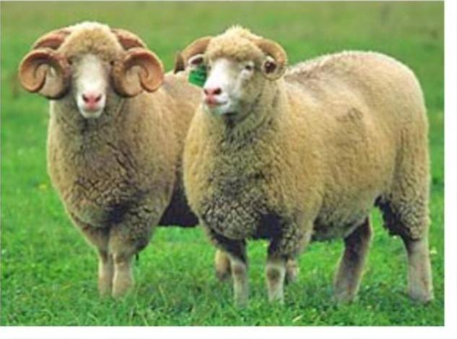

Slide 39
4. The Dorper:
This breed is an established cross between the Dorset Horn and the BHP. The Dorper combines the hardiness and disease resistance of the BHP with good growth and meat productivity of the Dorset Horn.
Therefore, the Dorper can be reared in hardy conditions where few of the improved breeds would survive. Adult weight varies from 30 –80 kg.
The Dorper has a black head and white body. It carries a poor kempy type of fleece (coarse wool/hair) which tends to be naturally shed in the warm season (spring).
The fleece consists of at least 50% pure wool. This breed is, therefore, not suitable to rear in grass veldt (range) containing a high proportion of spear grasses.
The Dorper should be sheared in September to November in order to remove the ‘dead fleece’.

Slide 40
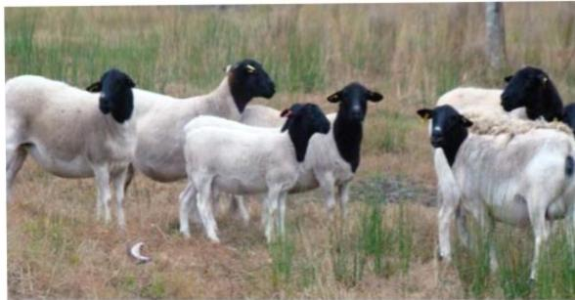

Slide 41
5. THE SUFFOLK
One of the main British breeds of meat producing sheep. The breed has a black face that appears in lambs even when they are crossed with a white faced sheep breed.
It is suited to crossing with Dorper for high quality lamb production. The Suffolk is a pure exogenous mutton and wool breed that is capable of thriving under Zambian conditions.
However, being a woollen breed means that it requires improved pastures (to prevent seeding) and a very high standard of management.
Therefore, the breed should not be recommended to a new sheep farmer who has no experience of sheep rearing. The breed has excellent growth rate and conformation, and the wool is of good quality provided a uniform plane of nutrition is maintained.

Slide 42
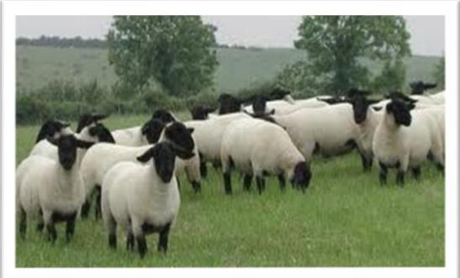

Slide 43
6.THE MERINO
Merinos are primarily grown / reared for wool production but their improved carcass quality makes the breed dual purpose. The Merino sheep are intermediate in body size and produce some of the finest and softest wool available in the world.
The wool is used by the textile industry, in particular, high quality apparel wool. The Merino are large framed and relatively plain bodied.
They produce a heavy fleece (coarse wool/hair) which is soft and of good colour with a fibre diameter of 20 –22 microns.
Staple length is approximately 90mm. A Merino sheep produces 4 –8 kg wool annually.
The Merino are noted for their hardiness and their herding instincts. They are white-faced. The rams are horned but the ewes are hornless.

Slide 44
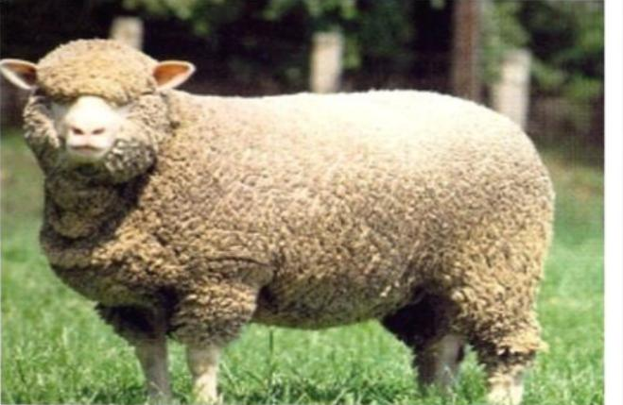

Slide 45
THE END

