Slide 1
CROP PRODUCTION OPERATIONS
Crop Protection
Dr. Mwansa Kaoma
© 2023

Slide 2
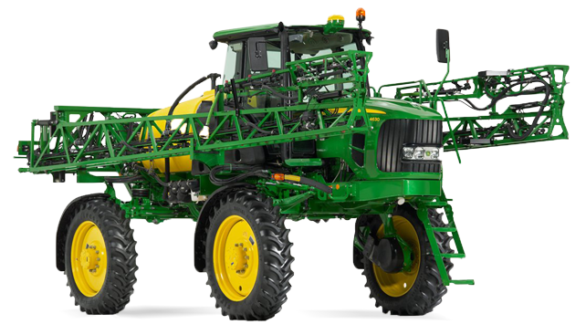

Slide 3
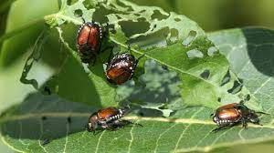
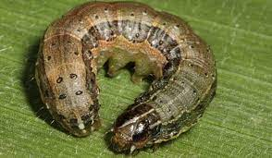
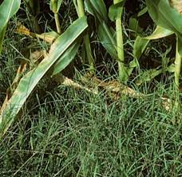
PESTS
Pests are organisms living and growing where they are not wanted and can cause damage to plants
It is estimated that pre- and postharvest pests and diseases destroy at least 30–40% of global agricultural production

Slide 4
PESTS
Pests can be broken into four main categories:
Vertebrate Pests
Have a backbone. Examples: Rodents, birds, reptiles, and other mammals
Invertebrate Pests
No backbone. Examples: Insets, spiders, ticks, army worms
Weeds
Any plant growing out of place.
Diseases
Fungi, bacteria, viruses, and other microorganisms.

Slide 5
Integrated Pest Management (IPM)
A system of crop protection, consisting of a combination of cultural, biological, genetic and chemical control methods that aims at maximum productivity with the least possible adverse consequences for the environment.
The three factors of pest management (the Pest Triangle) are the Hosts, Pest, and Environment.
Only when these three components are present will a pest problem occur.
Apply pesticides only when pests reach economically damaging levels (thresholds).

Slide 6
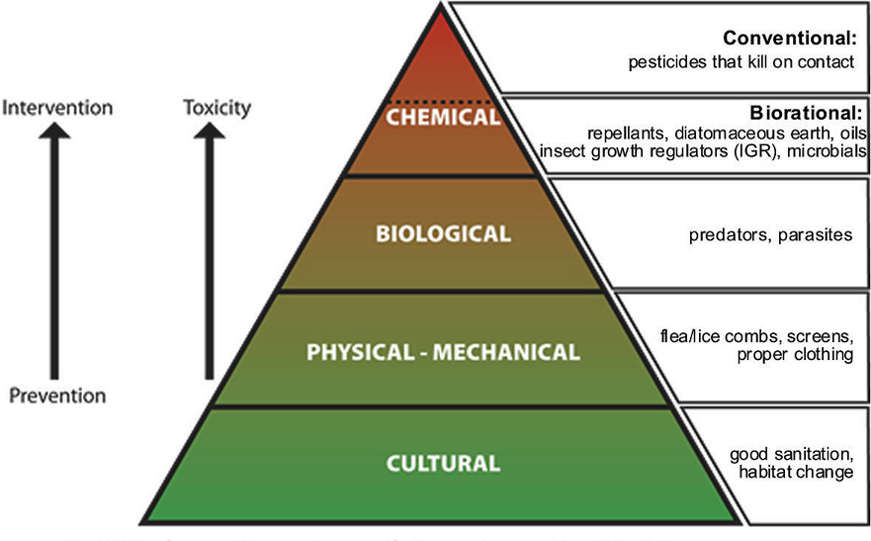
Integrated Pest Management (IPM)

Slide 7
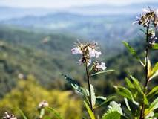
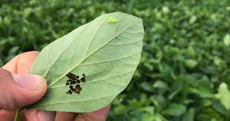
Aim of IPM
Reduce pest populations to levels below those causing economic impact, using multiple & compatible techniques;
Reduce environmental impact of pest management.

Slide 8
Economic Injury Level
the lowest population density of a pest that will cause economic loss (damage).
Economic Threshold / Action Threshold
is the density of a pest at which control measures should be initiated to prevent an increasing pest population from reaching the economic injury level.
Insect density that would justify intervention
Factors that may affect Economic Threshold
  value of the crop
  cost of control
  stresses on the crop

Slide 9
IPM Steps
Pest identification.
It is essential to identify pests and have an understanding of pest biology.
Many organisms are essential in one environment but unwanted in another, e.g.,:
  Termites are essential decomposers and recyclers of wood and other cellulose-based materials in nature.
  In a building, termites become a pest.

Slide 10
IPM Steps Cont’d
Monitoring and use of threshold levels.
Many organisms do not achieve pest status unless significant numbers are apparent.
When agricultural pests exceed “threshold” values, the result is lost profit due to a reduction in crop quality or yield.
If necessary, take action.
When the organism has been identified and is present in numbers determined to be a problem, ecologically sound management methods should be used to reduce the population levels below threshold levels.

Slide 11
Pest Control Methods
Pest control focuses on eliminating infestations that already occurred.
Pest Control Categories:
  Nonchemical
  Cultural
  Biological
  Preventive control methods
  Chemical

Slide 12
COMPONENTS OF IPM
Cultural Pest Control
Methods of pest control by means of skilful combination of agronomic practises such as tillage, planting, irrigation, sanitation and crop rotation so that the environment is less favourable for the spread of certain pests.
Phyto-sanitation: measures requiring removal or destruction of infected or infested plant material likely to be a source of pathogens or pests.
Pest Free Propagation material: refers to the use of planting material that is free of any infestation

Slide 13
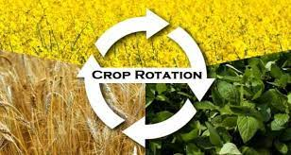
Cultural Pest Control Cont’d
Crop Rotation: growing in the same field various crops alternately over successive years.
  This interrupts specific relationship between pests and host plants.

Slide 14
BIOLOGICAL CONTROL
The use of any methods that entirely depends on biological interaction to control pests or diseases.
Resistant Varieties: The ability of an organism to withstand or retard the activity of a pest.
  This is achieved by using insect-resistant crop varieties developed through plant breeding.

Slide 15
BIOLOGICAL CONTROL
Sterile Male Method: involves large scale release of artificially sterilised male insects that belong to the same species as the target pest.
  The sterile male compete with fertile ones in mating with the female.
  If the releases are repeated over a long period of time, the pest species may be suppressed or even eradicated owing to the absence of fertilised females.
  This technique is really effective if females mate only once before laying eggs.

Slide 16
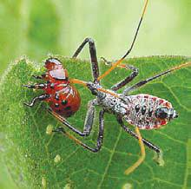
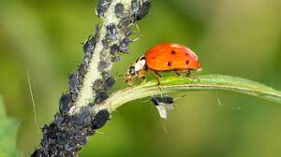
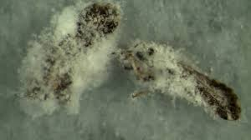
BIOLOGICAL CONTROL
Natural Enemies: Use of insects, animals or plants that kill or injure other insects, animals or plant
  e.g., predators and parasites (insects or diseases) that attack pests.

Slide 17
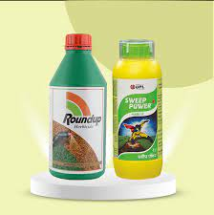
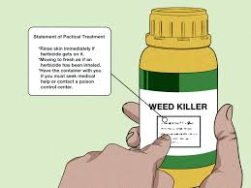
CHEMICAL PEST CONTROL
Chemical pest control methods consists of application of botanical or inorganic and organic synthetic compounds that have a killing, inhibiting or repulsive effect on injurious organisms threatening plants.
The active ingredient(s) causing such effects is contained in a formulation, the form of which enables efficient application and safe handling.

Slide 18
CHEMICAL PEST CONTROL CONT’D
Factors that may cause a pesticide to be ineffective:
Wrong type or wrong dosage
Application when pest is less susceptible
  Pest is hibernating – not very active
Treating in wrong area of plant or animal
  Foliage spray for root problem
Pesticide resistant pest

Slide 19
Advantages of Chemical Control
It is an effective and reliable means for controlling pests and diseases.
Most pesticides demonstrate a fast activity, by which serious infections and outbreaks can be limited or possibly even controlled.
Chemical control is effective under diverse ecological conditions, and it is less dependent on the scale of operation than the various forms of cultural and biological control.

Slide 20
Advantages of Chemical Control Cont’d
Pesticides are almost widely available, and usually at affordable prices.
Application of pesticides, if measured in terms of the harvested produce, have successfully prevented plant damage by pests.

Slide 21
Disadvantages of Chemical Control
Many pesticides cause the development of resistance in populations of organisms:
  many species of insects, mites, micro-organisms and weeds have acquired a degree of resistance against one or several types or chemical group of pesticides.
Pesticides, particularly broad-spectrum and non-selective pesticides have a persistent activity, may destroy the natural enemy complex.
  Pose high risks to beneficial natural enemies that usually regulate pest populations under natural conditions

Slide 22
Disadvantages of Chemical Control Cont’d
Improper application of pesticides may injure humans and animals.
Inherent toxicity of pesticides and their often-long persistence can cause accidents involving mankind and non-target animals, and they are a grave source of environmental contamination.

Slide 23
CLASSIFICATION OF INSECTICIDES
The term insecticides refer to chemicals that are capable of destroying, mitigating or repelling insects
Classification By Chemical Nature:
  Inorganic Compounds: are derived from naturally occurring elements and do not contain carbon. They are stable, non-volatile chemicals frequently soluble in water.
  Organic Compounds: are man-made or extracted pesticides consisting of carbon, hydrogen and one or more other elements such as chlorine, oxygen, sulphur, phosphorus and nitrogen.
  Botanicals (natural insecticides): are pesticides that have been derived from plant materials.

Slide 24
CLASSIFICATION OF INSECTICIDES BY MODE OF ACTION:
The ways pesticides come in contact with or enter the target are called modes of entry
TYPE OF PESTICIDE | DESCRIPTION
Systemic | Pesticides that are absorbed by plants or animals and transferred to untreated tissue
Contact | The pesticides act on target pests when they come in contact
Stomach | The pesticide enters the pest’s body through their mouth and digestive system
Fumigants | Pesticides that kill the target pests by producing vapour that enters the pests through the respiratory system
Repellents | Pesticides that do not kill but distasteful enough to keep pests away from treated areas.

Slide 25
CLASSIFICATION OF HERBICIDES BY MODE OF ACTION
Herbicides may also be classified according to the various ways they are being used or in which they act.
Selective action: chemicals that kill weeds without harming crops
Non-selective: indiscriminately kills all vegetation.

Slide 26
CLASSIFICATION OF HERBICIDES BASED ON WHEN THEY ARE APPLIED
Pre-plant herbicides: These are applied to soil before seedling or transplanting.
Pre-emergent herbicides- These are applied to soil after planting but before emergence of crop or weed.
Post-emergent herbicides- These are applied after crop or weed has emerged.

Slide 27
Pesticide Formulation
Once a decision has been made to use chemicals to control a particular pest, a user is often faced with several choices of formulations (mixture of chemicals).
The active ingredient of pesticides are usually mixed with inert (inactive) ingredients such as solvents, wetting agents, inert solids, and other materials to dilute the active ingredient.
They make pesticides safer and easier to handle and apply and more effective.

Slide 28
Pesticide Formulation
Pesticide formulation is defined as the way the technical pesticide material is prepared for practical use.
Factors to consider in choosing pesticide formulation
Type of application equipment required
Cost of the pesticide
Danger of drift of runoff
The crop to be treated
Ease of handling
The formulation is usually listed on the label.

Slide 29
Formulations and their abbreviations
Suspension Concentration (Flowable Concetration) (SC): is a stable suspension of active ingredient in a fluid intended for dilution with water prior to its use.
Emulsifiable Concentrates (EC or E): is a solution of active ingredient in non-water miscible solvents.
Advantages of using a liquid formulation:
  easier to handle e.g. can be poured.
  easy to measure.
  they give no dust problems

Slide 30
Wettable Powder (WP) [Water Dispersible Powder]
  is a dry, finely ground formulation that looks like dust.
  the active ingredient is combined with a finely ground, dry carrier, usually mineral clay, along with other ingredients
  Mixed with water for application as a spray.
Granules (G) are free flowing, ready-to-use, solid product of a defined granule size.
Most often used for soil applications.

Slide 31
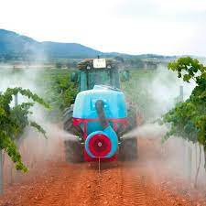
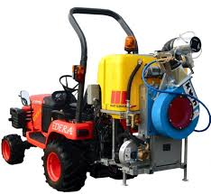
Dustable Powder (dust) (DP) is a ready-to-use, free-flowing powder, generally with a low concentration of active ingredient, and suitable for dusting.
Solutions (S): is a type of formulation in which a chemical completely dissolves in a liquid.

Slide 32
EQUIPMENT FOR CHEMICAL CONTROL
A chemical application machine requires some form of carrier for applying the chemical.
For dry powder chemicals, air is commonly used as the carrier and the machine employing this principle is called a duster.
When the chemical to be applied is in liquid form, water or oil is most used as the carrier, and such a machine is broadly termed as a sprayer.
Sometimes both air and a liquid are used as carriers and such equipment is generally called a mist blower.

Slide 33
Duster
A duster will usually have the following components:
hopper for storing the chemical in dust form;
agitator which is usually provided within the hopper to keep the dust moving freely and prevent it caking;
metering mechanism to vary the rate of discharge
delivery blower which creates an air stream that is used to carry the powder to the target.

Slide 34
Sprayer
Sprayers rely on some form of liquid, usually water, to act as the carrier for the chemical.
The chemical as such may be in the form of powder or granules that can be mixed in water, or the chemical may already be in the form of a liquid and may or may not be diluted with water.
Generally, the chemical, when mixed, can form one of the following:
a solution, in which the chemical (whether originally powder or fluid) is completely dissolved when mixed with the water;

Slide 35
a suspension, in which the chemical (in powder form) remains floating in water and needs constant agitation to prevent it settling out;
an emulsion, in which the chemical (in liquid form) disperses in the water but does not actually dissolve.

Slide 36
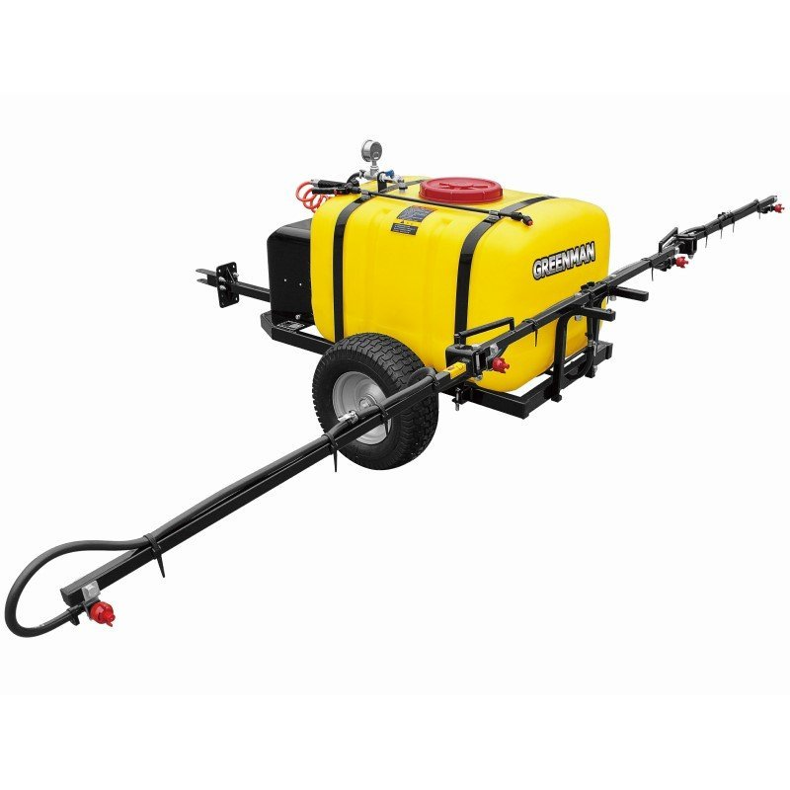
SPRAYER COMPONENTS

Slide 37
The sprayer has the following essential components:
Tank: stores and carries the chemical. It is usually made of non-corrosive material (plastic, fibre glass or stainless steel);
Nozzle: breaks up the liquid chemical into small droplets of a given size distribution. It also controls the rate of discharge of the liquid chemical.
Pump: creates flow of the liquid chemical and, with the appropriate nozzle, it delivers the liquid chemical at the required rate.

Slide 38
Sprayer Components Cont’d
Pressure gauge: monitors sprayer pressure. It is located on the delivery side of the pump.
boom or lance: a tubular frame that holds nozzles.
control valve or cut-off device: regulates the flow of the liquid chemical.
Filters: ensures free flow of liquid chemical by trapping solid material. They are usually located at the tank (filling hole), before the pump, and in the nozzle.

Slide 39
NOZZLES
Controls flow rate and convert the spray liquid into droplets (via atomisation) that are of a suitable size for depositing on the intended target.
The size of the spray particle is important because it affects both efficacy and spray drift of the application of a herbicide, insecticide, or fungicide.
There are many types of nozzles available, each providing different:
  Flow rate
  Spray angle
  Droplet size
  Droplet patterns

Slide 40
Types of Nozzles
Flat Fan Nozzle
The most common type of nozzle used in agriculture.
A fan nozzle is widely used for spraying pesticides — both banding (over and between rows) and broadcast applications.
These nozzles produce a tapered-edge, flat-fan spray pattern.
On boom sprayers for broadcast applications, nozzles are positioned so their output overlaps.

Slide 41
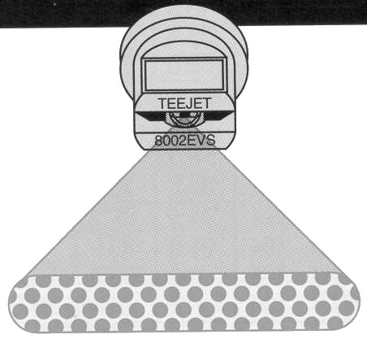
Types of Nozzles
Flat Fan Nozzle Cont’d

Slide 42
TYPICAL APPLICATIONS OF NOZZLES
Hollow Cone Nozzles
Hollow cone nozzles produce small-sized drops forming a hollow cone pattern with a ring-shaped impact area (great surface area coverage).
These are used primarily where plant leaf penetration is essential for effective insect and disease control, and where drift is not a major consideration.
And where drift is not a major consideration.
Generally, this type of nozzle should not be used to apply herbicides.

Slide 43
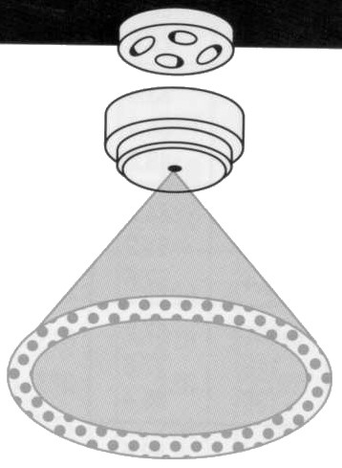
TYPICAL APPLICATIONS OF NOZZLES
Hollow Cone Nozzles

Slide 44
TYPICAL APPLICATIONS OF NOZZLES
Solid Cone Nozzles
Full cone nozzles produce medium- to large-size drops forming a solid cone-shaped spray pattern with a round impact area.
The wide-angle, full-cone nozzles are a good choice if drift is a concern because they produce relatively large droplets
Recommended for soil-incorporated herbicides.
Generally used when the objective is to distribute the fluid evenly over an area, rather than over a concentrated line or a hollow-ring shaped area

Slide 45
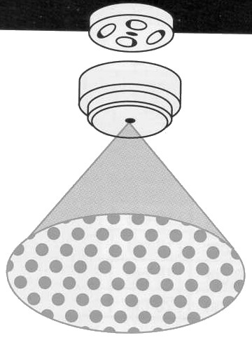
TYPICAL APPLICATIONS OF NOZZLES
Solid Cone Nozzles

Slide 46
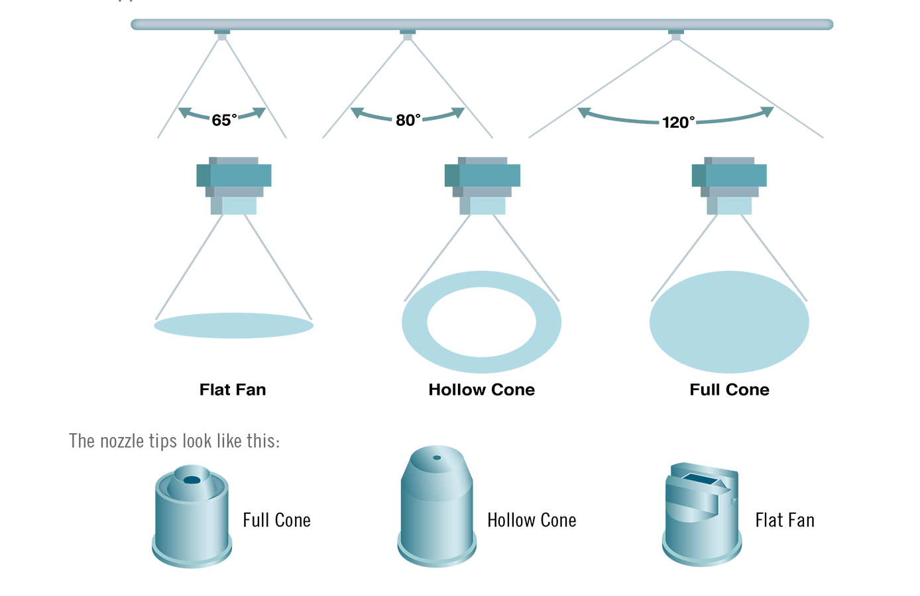
TYPICAL APPLICATIONS OF NOZZLES

Slide 47
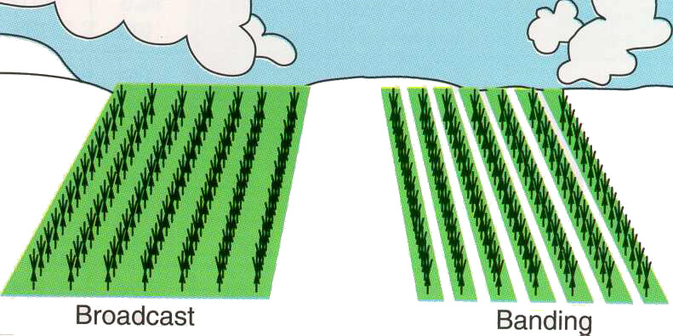
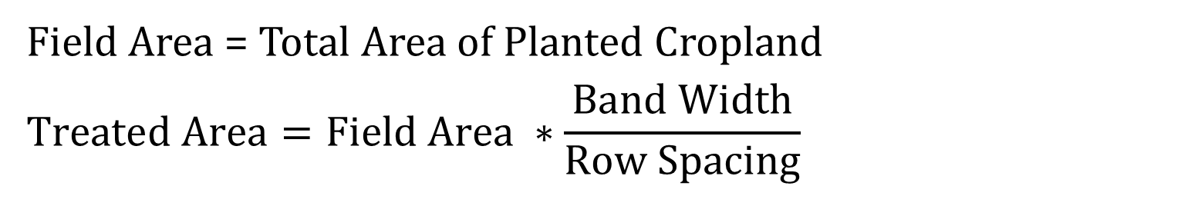
SPRAYING PATTERNS
Field Area = Total Area of Planted Cropland
$$Treated Area=Field Area ∗\frac{Band Width}{Row Spacing}$$

Slide 48
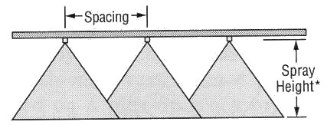
Adjust spray height in the field to overlap approximately 30% of each edge of pattern
Broadcast Spraying

Slide 49
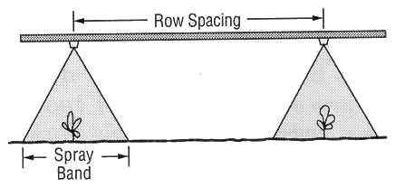
Banded Spraying

Slide 50
SPRAYER PERFORMANCE
Factors directly affecting the performance of a sprayer
Operating pressure
Nozzle size
Operating speed
Parameters affected by the above factors:
Application rate
Droplet size
Droplet distribution
Swath width

Slide 51
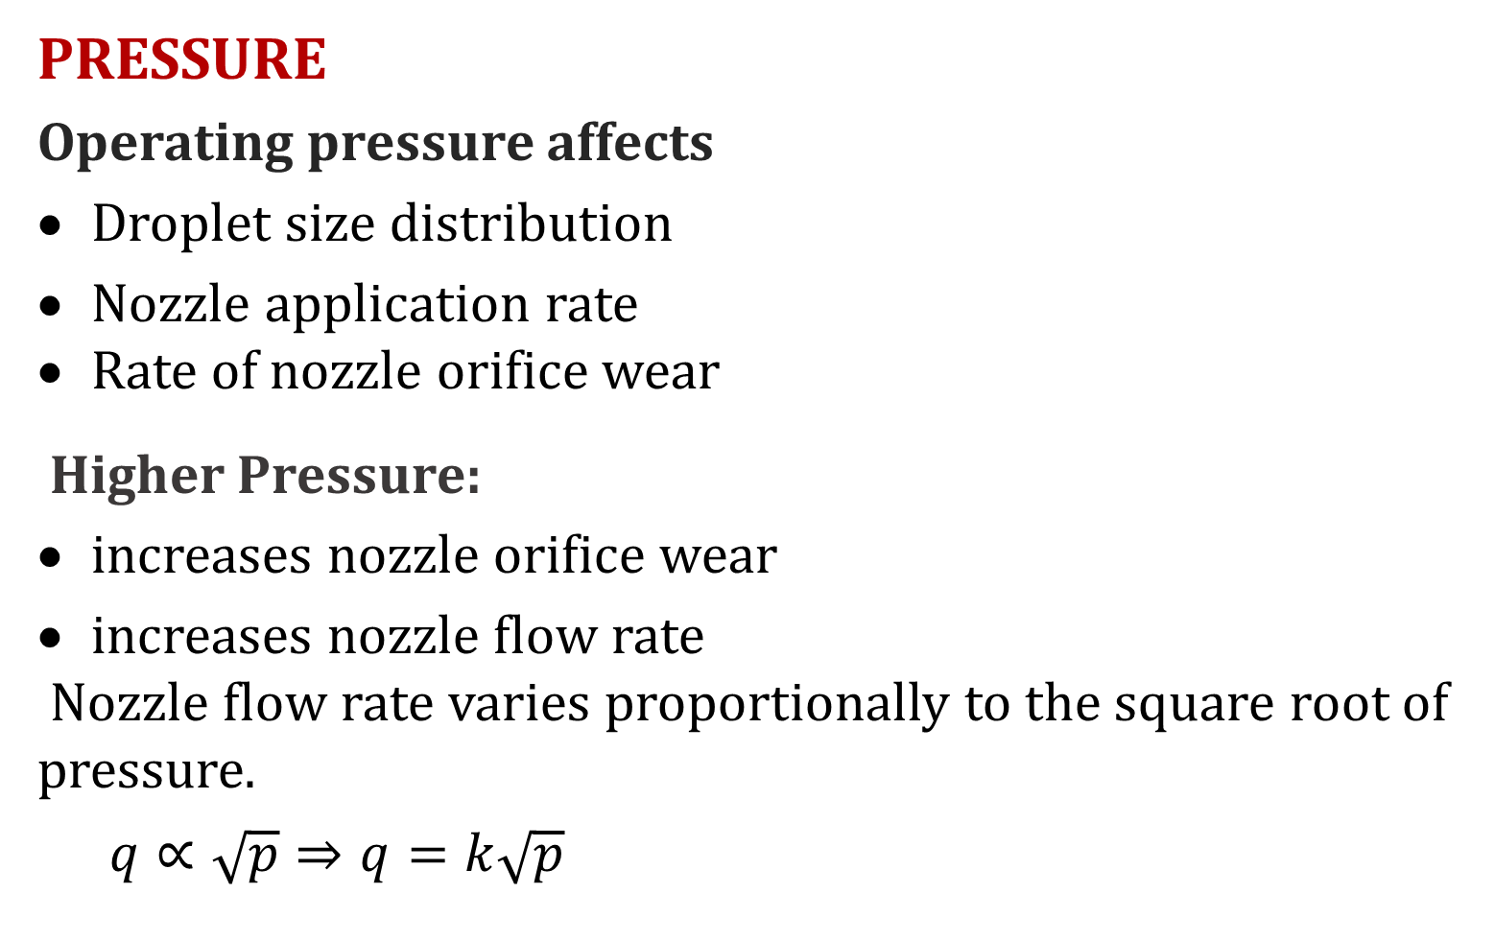
PRESSURE
Operating pressure affects
Droplet size distribution
Nozzle application rate
Rate of nozzle orifice wear
Higher Pressure:
increases nozzle orifice wear
increases nozzle flow rate
Nozzle flow rate varies proportionally to the square root of pressure.
  $$q∝\sqrt{p}⇒q=k\sqrt{p}$$

Slide 52
Simply stated, in order to double the nozzle flow rate, the pressure must be increased four times.
Drift is the blowing away of fine particles of spray or dust by wind to areas outside their intended target.
SPEED
Increasing the sprayer ground speed reduces the liquid chemical application rate (litres/ha) and vice versa.

Slide 53
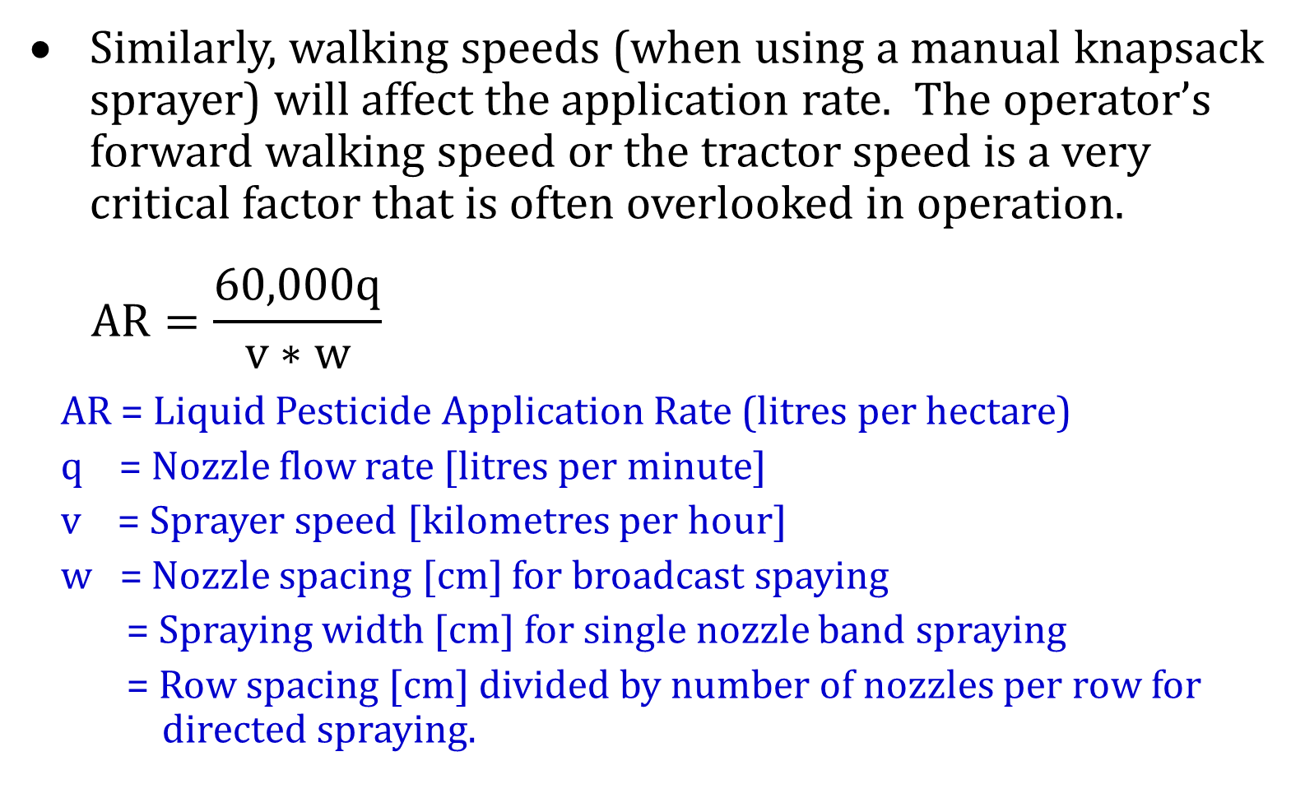
Similarly, walking speeds (when using a manual knapsack sprayer) will affect the application rate. The operator’s forward walking speed or the tractor speed is a very critical factor that is often overlooked in operation.
  $$AR=\frac{60,000q}{v∗w}$$
AR = Liquid Pesticide Application Rate (litres per hectare)
q = Nozzle flow rate [litres per minute]
v = Sprayer speed [kilometres per hour]
w = Nozzle spacing [cm] for broadcast spaying
= Spraying width [cm] for single nozzle band spraying
= Row spacing [cm] divided by number of nozzles per row for directed spraying.

