Slide 1
The t-test

Slide 2
Concerns??
What is the main use of the t-test?
How is the distribution of t related to the unit normal?
When would we use a t-test instead of a z-test?
What are the types?

Slide 3
Main Use?
The t-test is used to test hypotheses about means
when the population variance is unknown (the usual case).
Usually when n< 30 (some literature may differ)
Closely related to z

Slide 4
Types of t-test?
Single sample
Two sample (Independent samples or Dependent samples).

Slide 5
Single sample t – we have only 1 group; want to test against a hypothetical mean.
Independent samples t – we have 2 means, 2 groups; no relation between groups, e.g., people randomly assigned to a single group.
Dependent t – we have two means. Either same people in both groups, or of some relation.

Slide 6
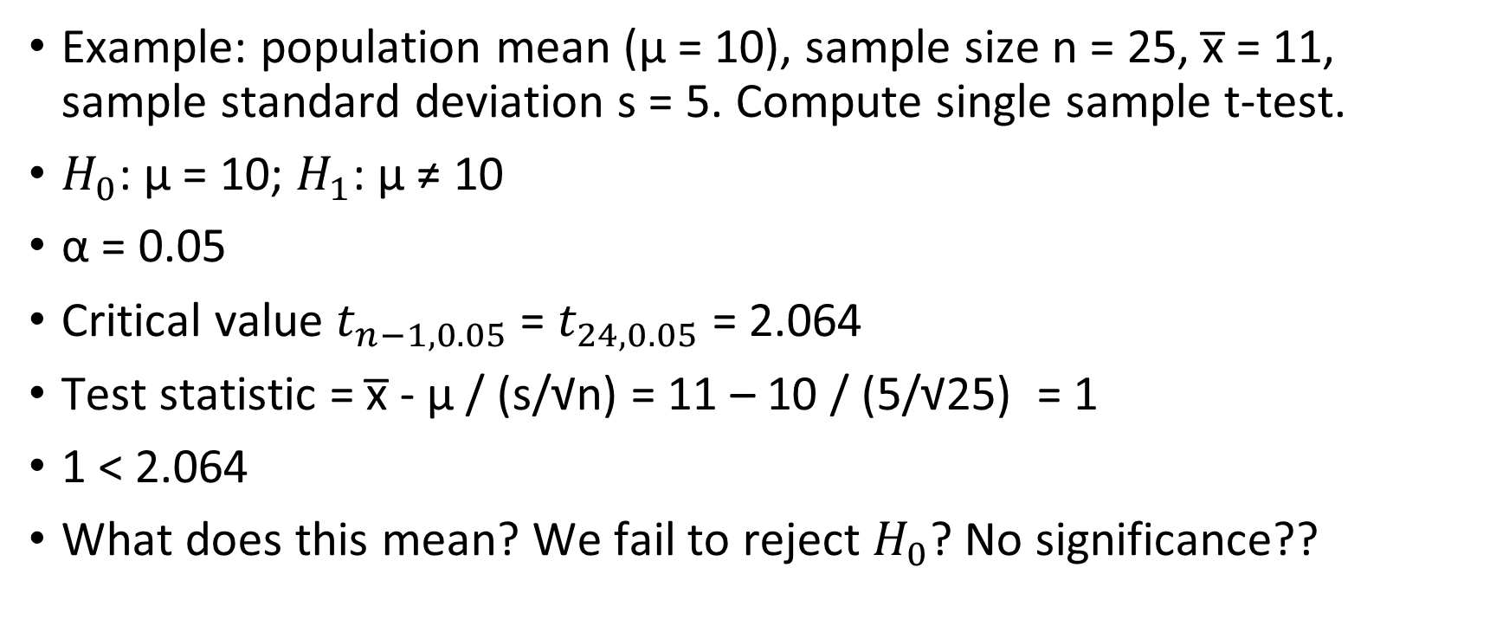
Single sample t-test
Example: population mean (µ = 10), sample size n = 25, x̅ = 11, sample standard deviation s = 5. Compute single sample t-test.
$H_{0}$: µ = 10; $H_{1}$: µ ≠ 10
α = 0.05
Critical value $t_{n−1,0.05}$ = $t_{24,0.05}$ = 2.064
Test statistic = x̅ - µ / (s/√n) = 11 – 10 / (5/√25) = 1
1 < 2.064
What does this mean? We fail to reject $H_{0}$? No significance??

Slide 7
Two-sample t-test
Most studies have at least 2 groups (Experimental treatment vs. Control)
If we want to know diff in population means, best guess is diff in sample means. Is this enough?
Imagine you have 2 fields of maize that you want to compare. You get samples from each and want to determine if there is a difference in yield.
Statistical significance will depend not only on the means of each sample but also the variance (distribution) of samples

Slide 8
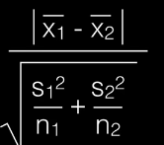

To get the t-value test statistic, we look for:
T value = $\frac{difference between group means}{variability of groups}$
T value =
An increase in the variance reduces the t value

Slide 9
Back to our example:
Is there a statistical difference between the two groups?
15.2 | 15.3 | 16 | 15.8 | 15.6 | 14.9 | 15 | 15.4 | 15.6 | 15.7 | 15.5 | 15.7 | 15.5 | 15.1 | 15.3 | 15
15.9 | 15.9 | 15.2 | 16.6 | 15.2 | 15.8 | 15.8 | 16.2 | 15.6 | 15.6 | 15.8 | 15.5 | 15.5 | 15.5 | 14.9 | 15.9

Slide 10

$H_{0}$: $µ_{1}$ = $µ_{2}$ ; $H_{1}$: $µ_{1}$ ≠ $µ_{2}$
α = 0.05
Critical value $t_{n1+n2−2, 0.05}$ = $t_{16+16−2, 0.05}$ =2.042
T test statistic:

Slide 11
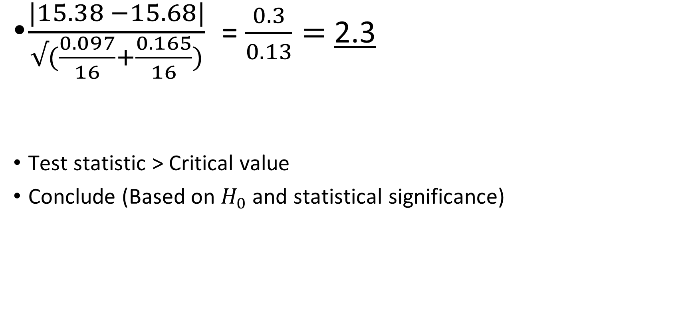
$\frac{|15.38 −15.68|}{√(\frac{0.097}{16}+\frac{0.165}{16})}$= $\frac{0.3}{0.13}=$2.3
Test statistic > Critical value
Conclude (Based on $H_{0}$ and statistical significance)

Slide 12
Assumptions of the t-test
Normal distribution
Similar variance in samples
Same sample size
Generally n<30

