Slide 1
The Concept of Development

Slide 2
Definitions of Development
For almost every writer a different definition of development exists.
Its important to first distinguish between:
Development as a state or condition-static
Development as a process or course of change- dynamic

Slide 3
Meaning of Development-Todaro
Development is not purely an economic phenomenon but rather a multi-dimensional process involving reorganization and reorientation of entire economic AND social system
Development is process of improving the quality of all human lives with three equally important aspects.
These are:

Slide 4
1. Raising peoples’ living levels, i.e. incomes and consumption, levels of food, medical services, education through relevant growth processes
2. Creating conditions conducive to the growth of peoples’ self-esteem through the establishment of social, political and economic systems and institutions which promote human dignity and respect
3. Increasing peoples’ freedom to choose by enlarging the range of their choice variables, e.g. varieties of goods and services

Slide 5
Alternative Interpretations of Development
1. Development as Economic Growth- too often commodity output as opposed to people is emphasized-measures of growth in GNP.
It is the CAPACITY of the national economy, whose initial economic condition has been more or less static for a long time, to GENERATE and SUSTAIN an annual increase in its GROSS NATIONAL PRODUCT at the rates of 5% to 7%

Slide 6
2. Development as Modernization- Emphasizes the process of social change which is required to produce economic advancement.
It examines changes in social, psychological and political processes.
How to develop wealth oriented behavior and values in individuals; profit seeking rather than subsistence and self sufficiency
Shift from commodity to human approach with investment in education and skill training

Slide 7
3. Development as Distributive Justice- view development as improving basic needs.
Interest in social justice which has raised three issues:
Nature of goods and services provided by governments
Matter of access of these public goods to different social classes
How burden of development can be shared among these classes
*the target groups include small farmers, landless, urban under-employed and unemployed

Slide 8
Sustainable Development
Defined as development that is likely to achieve lasting satisfaction of human needs and improvement of the quality of life and encompasses:
Help for the very poorest who are left with no option but to destroy their environment to survive
Idea of self-reliant development with natural resource constraints
Cost effective development using different economic criteria to the traditional –i.e. development should not degrade environment
Important issues of health control, appropriate technologies, food self-reliance, clean water and shelter for all
People centered activities are necessary- human beings are the resources in the concept

Slide 9
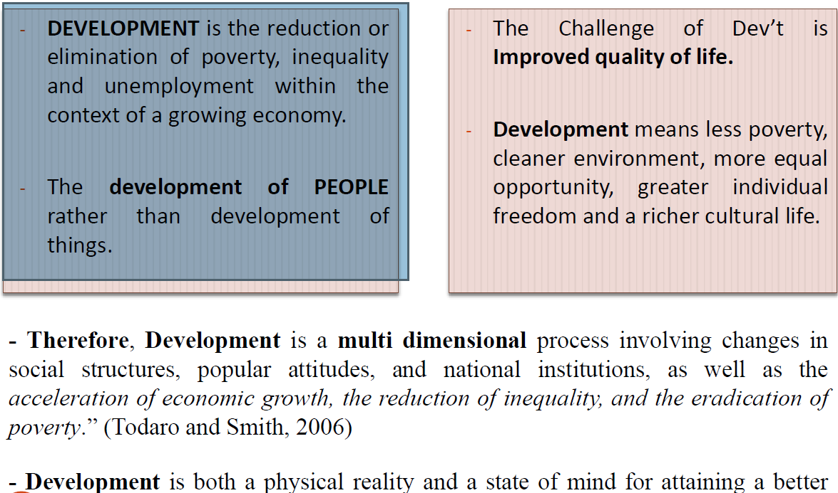

Slide 10
THE END
ANY QUESTIONS, CONTRIBUTIONS OR CONCERNS?

