Slide 1
THEORETICAL BASE OF PARTICIPATORY APPROACHES
Freirianism -Paulo R.N Freire
Hegemony - Antonio Gramsci
Knowledge Production Process

Slide 2
PAULO FREIRE
Paulo Freire (1921-1997) is considered to be one of the greatest thinkers of education of the 20th Century.
Freire was born in Recife, Brazil an impoverished area of Brazil.
Perhaps the most influential thinker of education in the late twentieth century;
Paulo Freire has been particularly popular with informal educators with his emphasis on dialogue and his concern for the oppressed, and educational programs for adult education and literacy.
He is a true educationist and philosopher of the contemporary era.
His innovative ideas and theories created and are creating sound discussions in the education scenario of democratic states of third world.
He strongly believed that the societies of the third world countries can reach on their own destiny by efforts and true education, which is progressive education for 'conscientization’.
Paulo Freire had a faith that “The future isn't something hidden in a corner. The future is something we build in the present”

Slide 3
1. The starting point
Freire starts by arguing that oppressed human beings need to be re-humanized
– that they need to be freed from all constraints to their personal and societal development;
and that they need to be transformed from the current state of powerlessness to enable them act on their conditions of the world that are dehumanizing them.
To understand Freire’s concept of dehumanization we need to start where Freire started and that is Karl Marx’s concepts of the human potential and Marx’s concept of consciousness.
Freire borrowed the concepts of consciousness and human potential from Karl Marx.

Slide 4
2. Human Potential
Human being is a separate identity, differ from other species.
Marx argued that human beings have two sets of powers:
  natural powers and needs which are shared with other animals and
  species powers that are uniquely human.
Marx was not interested in the natural powers which are common to all animals but in species powers
According to Marx, people are distinguished from other animals by their consciousness.
The following mental capacities set apart human from other animals:

Slide 5
While animals just do people can set themselves off mentally from whatever their doing.
Since they have a distinctive form of consciousness, human actors are able to choose to act or not to act. Furthermore, they are capable of choosing what kind of action to undertake.
The minds of human beings enable them to plan before hand what their action is going to be.
Human beings possess both physical and mental flexibility.
Human beings are capable of giving close attention to what they are doing over a long time
The nature of the human mind leads people to be highly social.
The ability of humans to plan and shape the world for their future needs is what separates man from animals.

Slide 6
The ability of humans to plan and shape the world for their future needs is what separates man from animals.
But these ‘planning and shaping’ is done by the oppressors, though all of the human beings have these abilities.
The oppressed majority must be taught to imagine a better way so that they can shape their future and thereby become more human.
There is difference in the concept of human nature between the elite and others.
The elite (oppressors) naturally believe that they are better and anything else is naturally inferior.

Slide 7
3. Other Marxist Ideas borrowed by Freire
Exploitation- Marx argued that the stages prior to capitalism were too harsh to enable people realize their full potential.
People were too busy trying to get enough food, shelter and protection to permit realization of full potential.
Similarly, capitalism is too oppressive to allow people to get their full potential. Oppression manifests itself in
  Alienation
    Alienation from productive activity: Workers do not work for themselves in order to satisfy their own ends
    Alienation from the product: The product of their labor does not belong to them but to capitalists.
    Alienation from fellow workers: Strangers are forced to work side by side for capitalists.

Slide 8
Fetishism
  There is also fetishism of commodities under capitalism which accompanies the development of commodities.
  Fetishism of commodities is a process by which actors fail to recognize that it is their labor that gives the commodities their value, rather they fetishize those commodities.
Reification
  Reification or thingfication is the process of coming to believe that humanly created social forms are natural, universal and absolute things and as a result those social forms do acquire those characteristics.
  The concept of reification implies that people believe that social structures are beyond their control and unchangeable. Due to this social structures actually do acquire the character people endow them with.
Emancipation-
  In order to restore the human potential from the oppressive structures Marx proposed the process of emancipation.
  According to Marx, human emancipation will only be complete when each individual man has become a species being;
  and emancipation is brought about through concrete action informed by theory or praxis.

Slide 9
PAULO FREIRE’S MAIN IDEAS
Techniques of Oppression:
Friere identified four techniques set in motion to oppress the people as the part of the oppressors’ frame work; they are
Conquest;
Divide and rule;
Manipulation; and
Cultural invasion
The alternative frame works of the oppressed those are to be achieved by education are
co-operation against conquest,
unity for liberation against divide and rule
organization against manipulation
cultural synthesis against cultural invasion

Slide 10
2. Theory of Value:
Education should raise the awareness of the students so that they become subjects, rather than objects, of the world.
This is done by teaching students to think democratically and to continually question and make meaning from (critically view) everything they learn.
This he says cannot be achieved with the kind of education that we undergo which is dehumanizing
Dehumazation is the process of ensuring that a person or group of people are deprived of the positive human qualities.
He criticizes the education system as likens it to a Bank and argues that our education system promotes a culture of silence.

Slide 11
Banking Education
Freire attacks the concept that the education system likes a bank,
A large repository where students come to withdraw the knowledge they need for life.
He agues that knowledge is not a set commodity that is passed from the teachers to the students.
Students must construct knowledge from knowledge they already possess.
Teachers must learn how the students understand the world so that the teacher understands how the student can learn.
Alternative- Problem Posing
A method of teaching that emphasizes on critical thinking for the purpose of LIBERATION.
A teacher and/or students poses a problem and the class collaborates to find answers.
This kills a culture of silence and promotes DIALOGUE
True education is that which is progressive, democratic and denies the banking method.

Slide 12
Problem-posing education does not and cannot serve the interests of the oppressor.
“In problem--posing education, people develop their power to perceive critically the way they exist in the world with which and in which they find themselves;
they come to see the world not as a static reality, but as a reality in process, in transformation”.
Teachers-students and students-teachers are continually reflecting on themselves and the world, establishing ‘an authentic form of thought and action’

Slide 13
3. Theory of knowledge
Theory of Knowledge: Knowledge is a social construct.
According to Freire teaching is a political process.
It must be a democratic process.
The teacher must learn about the student so that knowledge can be constructed in ways that are meaningful to the student.
The teachers must become learners and teaching and learning become knowing and ‘re-knowing’.
He discusses two types of knowledge:
Unconscious, sometimes practical knowledge and
Critical, reflective or theory knowledge. Beliefs are shaped into knowledge by discussion and critical reflection
Education should raise the awareness of the students so that they become subjects, rather than objects, of the teaching learning process.
THIS TAKES US TO HIS IDES ON CRITICAL CONSCIOUSNESS

Slide 14
EDUCATION FOR CRITICAL COUNSCIOUNESS

Slide 15
INTRODUCTION
Critical consciousness is a popular education and social concept developed by Brazilian pedagogue and educational theorist Paulo Freire,
Grounded in post-Marxist critical theory.
Critical theory aims at explaining and transforming the circumstances that enslave human being.
The may include: Poverty, illiteracy, stereotypes, etc.

Slide 16
Critical consciousness focuses on achieving an in-depth understanding of the world, allowing for the perception and exposure of social and political contradictions.
Critical consciousness also includes taking action against the oppressive elements in one's life that are illuminated by that understanding.
It dimply means-AWARENESS RAISING

Slide 17
LEVELS OF CONSCIOUSNESS
According to Paulo Freire

Slide 18
Definitions
  Conscientization
  This refers to the process in which individuals and communities develop a critical understanding of their social reality through a combination of reflection and action, know as praxis

Slide 19
  The process by which one develops the ability to think critically about issues of power in relation to privilege and oppression in different spheres of influence

Slide 20
  Praxis
  What is praxis?
  Concrete action that is formed by
  theory
  Reflection and
  action
  of men and women upon their world in order to transform it.

Slide 21
Level 1: In-transitive consciousness
This is also known as magical consciousness
The intransitive consciousness is the lowest level of consciousness
this state of consciousness denies the power of human beings to change their lives or their society
Matters are taken the way they are
No questioning
Unable to change their situation or life
Believe in magic, luck (no effort into changing things)

Slide 22
Due to these explanations of everyday life and events an intransitive person is disempowered
and believes that human beings cannot control, understand or change life or society.
Consequently, an intransitive person tends to be magical, superstitious, mystical, non-historical and pre-scientific.
An intransitive person tends to accept and celebrate the status quo and to live in a state of political disempowerment.
Examples:
Drought (Parts of Lusaka, Eastern & Western)

Slide 23
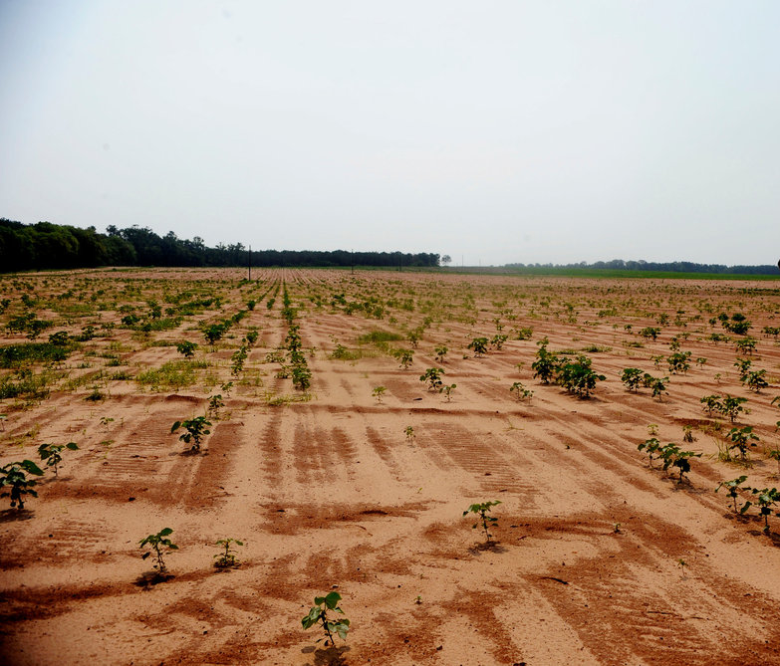

Slide 24

Cholera

Slide 25
  b) Semi-transitive
This is also known as Naïve consciousness
Second level of consciousness
Slightly empowered
Human agency
Becomes aware of oppressor and oppressed
Fails to challenge oppression

Slide 26
  According to Shor (1992), the semi-intransitive thought is partially empowered because it accepts human agency in the making of personal and social change.
  The problem with this kind of thinking is that it can take forms that lead to partial or contradictory changes.
  For example policy makers can demand for cost-sharing at public health centers without dealing with the poverty that led to a deterioration of quality of health care in such institutions to start with - NHIMA
  A non-governmental organization can provide food relief in a rural area without asking why so many people are unable to grow sufficient food.
  Policy-makers can formulate and implement Free Basic Education Policy without dealing with the infrastructure in schools which limit the number of pupils that can enroll in school.

Slide 27
The semi-intransitive consciousness in one-dimensional short-term thinking
that leads to acting on an isolated problem,
ignoring the root causes and long-term solutions
and often creating other problems because the social system underlying the problem is not addressed
They have the mind to change things but they are pessimistic and deal with problems that arise one at a time
They also naively follow strong leaders who they hope to make the change so that they do not have to- BOMA ILANGANEPO

Slide 28
C. CRITICAL CONSCIOUNESS-HIGHEST LEVEL
The final stage of consciousness is the critical consciousness stage or the critical transitive state.
Critical consciousness allows people to make broad connection between
  individual experience and social issues,
  between single problems and the larger social system.
According to Shor (1992) students in a class of critical consciousness explores the historical context out of which knowledge has emerged and its relation to the current social context.
Critically conscious people perceive society as a human creation, which we can know and transform.
Although elite groups wield dominant power and wealth, the non-elite sectors can organize to change power relations.
Knowing who the elite is, how it got there, how it operates in the economic system and how its power can be democratized requires critical consciousness.

Slide 29
Critical reflection
Make broad connections
Authentic dialogue + Action = Liberation
Ability to change things
They believe that they themselves can make changes

Slide 30
For Freire, the aim of Liberatory education should be development of the critical consciousness of learners.

Slide 31
Goals of critical consciousness
  Power awareness
  Critical Literacy
  Permanent Desocialization
  Self- education

Slide 32
Goals of critical consciousness
  Power awareness
  Knowing that society and history can be made and remade by human action and organized groups
  Power structures in society
  Who has power in society
  Investigate origin and formation of power structures (political, education, economic status etc.)
  Locate oneself in power structure (oppressor & oppressed relationship)
  Understand what power individuals have (power over, to, within, with; visible, visible, hidden)

Slide 33
  Critical literacy
Having an analytical style of speaking, writing, thinking, reading and discussing and gaining deeper meaning
This analysis goes beyond surface impression, traditional myths and mere opinions
Reading beyond what is written, portrayed or stated (between lines)
Ability to question official knowledge, existing authority and ways of speaking in order to discover and understand the root causes of our social context

Slide 34
  Permanent de-socialization
  Challenging what is learnt in Mass Culture… bell hooks
  Critically challenging regressive values operating in our society which are internalized into our consciousness – ie racism, tribalism, regionalism, sexism, class bias, homophobia, hero-worshiping etc
Socialization = enculturation = intransitive consciousness
Permanent from Permanente meaning continuous process
De-socialization meaning to unlearn
Permanent de-socialization is the process of unlearning what individuals have been encultured (socialized) into, to enable them understand and challenge artificial political limits on human development, question power and inequality and reject stereotypes.

Slide 35
  Self-education
Taking initiative to make the changes needed in an undemocratic society
What is learnt is dependent on life circumstances
Self-study and organize learning in groups
Importance: one discovers limitations and how others can assists
Self-education and organizing go hand-in-hand to form corporative action

Slide 36
A SET OF POLITICAL PRINCIPLES
The principal goal of education for critical is to change the power relationships in our society.
The objective is to create mechanisms of collective power over all the structures of society
This means of attaining this goal cannot be in contradiction with the final objective—to construct a really democratic society you cannot use authoritarian methods- The projects, strategies and tactics used in the political process should be participatory, democratic and dialogical

Slide 37
A SET OF PEDAGOGIC PRINCIPLES :
the learners are the SUBJECTS, not the objects of the learning process; through this approach they can become the SUBJECTS of society.
The educator and the learners are equal participants in the learning process; all are the producers of knowledge
The learning process is developed by a continuous dialogue between the educator and the learners
The objective of the learning process is to liberate the participants from their external and internal oppression; to make them capable of changing their reality, their lives and the society they live in.

Slide 38
Summary
  Conscientization is the process by which one develops the ability to think critically about issues of power in relation to privilege and oppression in different spheres of influence
  Levels of consciousness: in-transitive is where individuals belief that they do not have the power to change anything while semi-transitive individuals believe they can bring about changes in their lives and society at large but they fail to find root causes to problems. On the other hand, transitive or critically conscious individuals recognize and fight oppression by being power aware, critically literate, permanently de-socialized, and self-educated and organized.

Slide 39
Questions and Contributions

Slide 40
Antonio Gramsci

Slide 41
INTRODUCTION
Antonio Gramsci (1891 – 1937) was a leading Italian Marxist, an intellectual, a journalist and a major theorist who spent his last eleven years in Mussolini’s prisons.
During this time, he completed 32 notebooks containing almost 3,000 pages.
These notebooks were smuggled out from his prison and published in Italian after the war but did not find an English-language publisher until the 1970s.
The central and guiding theme of the Notebooks was the development of a new Marxist theory applicable to the conditions of advanced capitalism.
Prison Notes carry much of his legacy
What Gramsci was to develop, however, was not just an ability to propagandise or to organise political activity.
He became the first Marxist theorist to work with the problems of revolutionary change in 20th-century Western European society and the first to identify the importance of the struggle against bourgeois values ie an ideological-cultural struggle.

Slide 42
GRAMSCI’S MAIN IDEAS
1. HEGEMONY- Leadership or dominance, especially by one state or social group over others.
Antonio Gramsci shares with Marx and the Marxists as a whole the belief that the struggle between the ruling class and the subordinate working class is what enables society to move forward.
However, when it comes to the way the ruling class dominates and rules, Gramsci distances himself a lot from Marxism.
In Other words, whereas the Marxists focus on the coercive practices of the ruling class and its tendency to exploit the proletariat by means of force,
Gramsci emphasizes the role of ideology.
In his opinion, before the ruling class resorts to direct force and coercion, it seeks to make its rule acceptable by all classes.
This is what Gramsci calls “hegemony

Slide 43
Marx’s basic division of society into a base represented by the economic structure and a superstructure represented by the institutions and beliefs prevalent in society was accepted by most Marxists familiar with the concepts.
Gramsci took this a step further when he divided the superstructure into those institutions that were overtly coercive and those that were not.
The coercive ones, which were basically the public institutions such as the government, police, armed forces and the legal system he regarded as the state or political society
and the non-coercive ones were the others such as the churches, the schools, trade unions, political parties, cultural associations, clubs, the family etc. which he regarded as civil society.
To some extent, schools could fit into both categories. Parts of school life are quite clearly coercive (compulsory education, the national curriculum, national standards and qualifications) whilst others are not (the hidden curriculum).

Slide 44
So for Gramsci, society was made up of the relations of production (capital v labour); the state or political society (coercive institutions) and civil society (all other non-coercive institutions).
Gramsci rejects the Marxist claim that the power of the ruling class is limited to the economic base.
For him, a social class becomes hegemonic not only by controlling the means of production and coercing other classes but rather by establishing their consent.
In fact, consent is so important to Gramsci’s theory of hegemony
The main point to get hold of here is that the consent of the people is what makes the rule of the dominant class secure.
This is why the latter relies more on manipulative and ideological means than direct force and oppressive power.
Put differently, when the subaltern people believe that it is in their interests to accept the leadership of the ruling class, they do so willingly

Slide 45
2. Counter-Hegemony- The Role of Intellectuals
Now, if Gramsci was correct that the ruling class maintained its domination by the consent of the mass of the people, what were the consequences for Marxists who wished to see the overthrow of that same ruling class?
If the hegemony of the ruling capitalist class resulted from an ideological bond between the rulers and the ruled, what strategy needed to be employed?
The answer to those questions was that those who wished to break that ideological bond had to build up a ‘counter-hegemony’ to that of the ruling class.
They had to see structural change and ideological change as part of the same struggle.
The labour process was at the core of the class struggle but it was the ideological struggle that had to be addressed if the mass of the people were to come to a consciousness that allowed them to question their political and economic masters right to rule.
It was a popular consensus in civil society that had to be challenged and in this, we can see a role for informal education.
Overcoming popular consensus, however, is not easy.
Ideological hegemony meant that the majority of the population accepted what was happening in society as ‘common sense’ or as ‘the only way of running society’
This brings me to my second theme. Gramsci saw the role of the intellectual as a crucial one in the context of creating a counter-hegemony

Slide 46
He was clear that the transformation from capitalism to socialism required mass participation.
There was no question that socialism could be brought about by an elite group of dedicated revolutionaries acting for the working class.
It had to be the work of the majority of the population conscious of what they were doing and not an organised party leadership
For Gramsci, mass consciousness was essential and the role of the intellectual was crucial.
It is important at this juncture to note that when Gramsci wrote about intellectuals, he was not referring solely to the boffins and academics that sat in ivory towers or wrote erudite pieces for academic journals only read by others of the same ilk.
His definition went much further and he spread his net much wider
Gramsci’s notebooks are quite clear on the matter.
He writes that “all men are intellectuals” [and presumably women] “but not all men have in society the function of intellectuals”.
What he meant by that was that everyone has an intellect and uses it but not all are intellectuals by social function.
He explains this by stating that “everyone at some time fries a couple of eggs or sews up a tear in a jacket, we do not necessarily say that everyone is a cook or a tailor”.

Slide 47
Each social group that comes into existence creates within itself one or more strata of intellectuals that gives it meaning, that helps to bind it together and helps it function.
They can take the form of managers, civil servants, the clergy, professors and teachers, technicians and scientists, lawyers, doctors etc.
Essentially, they have developed organically alongside the ruling class and function for the benefit of the ruling class.
Gramsci maintained that the notion of intellectuals as being a distinct social category independent of class was a myth.
He identified two types of intellectuals – traditional and organic.
Traditional intellectuals are those who do regard themselves as autonomous and independent of the dominant social group and are regarded as such by the population at large.
They seem autonomous and independent.

Slide 48
TRADITIONAL INTELLECTUALS:
Traditional intellectuals are those who do regard themselves as autonomous and independent of the dominant social group and are regarded as such by the population at large.
They seem autonomous and independent.
They give themselves an aura of historical continuity despite all the social upheavals that they might go through.
The clergy are an example of that as are the men of letters, the philosophers and professors.
These are what we tend to think of when we think of intellectuals.
Although they like to think of themselves as independent of ruling groups, this is usually a myth and an illusion. They are essentially conservative allied to and assisting the ruling group in society.
In other words, Traditional intellectuals are those intellectuals linked to tradition and to past intellectuals;
those who are not so directly linked to the economic structure of their particular society and, in fact, conceive of themselves as having no basis in any social class and adhering to no particular class discourse or political discourse

Slide 49
ORGANIC INTELLECTUALS:
The second type is the organic intellectual.
This is the group mentioned earlier that grows organically with the dominant social group, the ruling class, and is their thinking and organising element.
In other words, Organic intellectuals, are more directly related to the economic structure of their society simply because of the fact that “every social group that originates in the fulfillment of an essential task of economic production” creates its own organic intellectual.
Thus, the organic intellectual “gives his class homogeneity and awareness of its own function, in the economic field and on the social and political level
For Gramsci, it was important to see them for what they were.
They were produced by the educational system to perform a function for the dominant social group in society.
It is through this group that the ruling class maintains its hegemony over the rest of society.
MOOT POINT-Having said that what was required for those who wished to overthrow the present system was a counter-hegemony, a method of upsetting the consensus, of countering the ‘common sense’ view of society, how could this be done?
DISCUSS

Slide 50
Gramsci, in his Notebooks, maintained that what was required was that not only should a significant number of ‘traditional’ intellectuals come over to the revolutionary cause (Marx, Lenin and Gramsci were examples of this)
but also the working-class movement should produce its own organic intellectuals.
Remember that Gramsci said that all men were intellectuals but not all men have the function of intellectuals in society.
He went on to point out that “there is no human activity from which every form of intellectual participation can be excluded”
… and that everyone, outside their particular professional activity, “carries on some form of intellectual activity
…participates in a particular conception of the world,
… has a conscious line of moral conduct\
… and therefore contributes to sustain a conception of the world or to modify it, that is, to bring into being new modes of thought”.
This sounds as if he was exaggerating the possibilities but what he was really trying to convey is that people have the capability and the capacity to think.
The problem was how to harness those capabilities and capacities

Slide 51
Gramsci saw one of his roles as assisting in the creation of organic intellectuals from the working class and the winning over of as many traditional intellectuals to the revolutionary cause as possible.
Gramsci’s insistence on the fundamental importance of the ideological struggle to social change meant that this struggle was not limited to consciousness-raising
…but must aim at consciousness transformation – the creation of socialist consciousness.
It was not something that could be imposed on people but must arise from their actual working lives.
The intellectual realm, therefore, was not to be seen as something confined to an elite
. . . but to be seen as something grounded in everyday life.
Gramsci wrote that:
“. . . the mode of being of the new intellectual can no longer consist in eloquence …
but in active participation in practical life, as a constructor, organiser, “permanent persuader” and not just a simple orator…” [Gramsci 1971 p10]
The creation of working-class intellectuals actively participating in practical life, helping to create a counter-hegemony that would undermine existing social relations was Gramsci’s contribution to the development of a philosophy that would link theory with practice.
His philosophy was a direct counter to those elitist and authoritarian philosophies associated with fascism and Stalinism.

Slide 52
3. DEBATES ON THE KNOWLEDGE PRODUCTION PROCESS

Slide 53
EPISTEMOLOGY- Davies
a. POSITIVISM; b. INTEPRETIVISM
a. PRAGMATIVSM; b. CRITIAC REALISM
Friday class

Slide 54
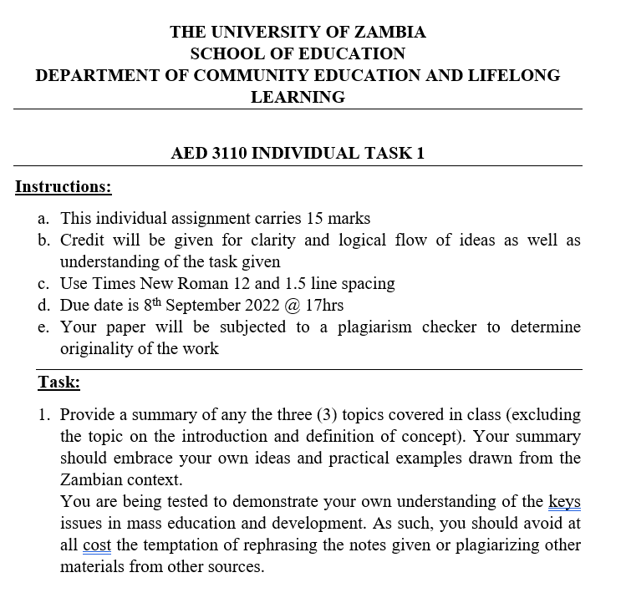
Introduction

Slide 55
GROUP TASK : THEMATIC AREAS
Participatory Learning and Action (Rapid Rural Appraisal)- Davies
Development Education Leadership Teams (DELTA) focus on Training for Transformation (TfT)
Participatory Extension Education (PAE)- Zimbabwe case
Visualization In Participatory Programmes (VIPP)
Participatory Technology Development (PTD)

