Slide 1
Insurance & Pension Law
Lecture One
Ms P Kayuma

Slide 2
Nature and Definition of Insurance
Insurance contracts are mainly governed by rules and principles which form the general law of contract.
Ordinary, businesses seek to minimise risks by using appropriate terms in their contracts with trading partners to allocate particular risks between the contracting parties. (i.e. exclusion clauses)
An insured is the party who will seek to obtain an insurance policy while the insurer is the party that shares the risk for a paid price called an insurance premium.

Slide 3
Nature and Definition of Insurance
Definition
Section 2 of the Insurance Act has defined contract of insurance as an agreement under which a person pays a premium to an insurer who undertakes to indemnify the person against risk or loss, damage or liability arising from the occurrence of some specified contingency.
A contract of insurance is an agreement whereby one party, called the insurer, undertakes, in return for an agreed consideration, called the premium, to pay the other party, namely the insured, a sum of money or its equivalent in kind, upon the occurrence of a specified event resulting in a loss to him. The policy is a document which is an evidence of the contract of insurance.

Slide 4
Nature and Definition of Insurance
In CALLAGHAN v DOMINION INSURANCE CO [1997] 2 LLOYD’S REP 541 insurance was defined as:
“an agreement to confer upon the insured a contractual right which, prima facie, comes into existence immediately when loss is suffered by the happening of an event insured against, to be put by the insurer into the same position in which the insured would have been had the event not occurred, but in no better position”.
Assurance - the term assurance is applied to contracts, where the risk insured against is certain to happen, but the time of happening is uncertain.

Slide 5
What is Risk?
Risk is part of every human endeavour. From the moment we get up in the morning, drive or take public transportation to get to school or to work until we get back into our beds (and perhaps even afterwards), we are exposed to risks of different degrees.
Insurance is a more commonly known concept that describes the act of guarding against risk.
Risk is the potential of loss (an undesirable outcome, however not necessarily so) resulting from a given action, activity and/or inaction.

Slide 6
Classification of Risk
Risk is a chance or possibility that something might occur:
The risk in the insurance contract is an unknown event in terms of its occurrence and non-occurrence, or at least in terms of the date of its occurrence. Thus an event that has already occurred or was known at the time of its occurrence is almost not a risk in the insurance sense and cannot be insured.

Slide 7
Reinsurance
Reinsurance is when an insurance company will guard themselves against the risk of loss.
Reinsurance in simpler terms is the insurance that is taken out by an insurance company. Since insurance companies provide protection against the risk of loss, insurance is a very risky business, and it is important that an insurance company has its own protection in place to avoid bankruptcy. See; Section 74 to 78 of Insurance Act.

Slide 8
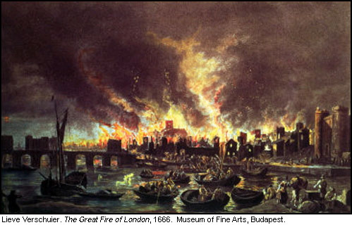
Historical Development of Insurance
The origins of the modern insurance contract are to be found in the practices adopted by Italian merchants from the 14th century and in maritime commerce in Europe.
Following the Great fire of London in 1666, fire insurance came into being.

Slide 9
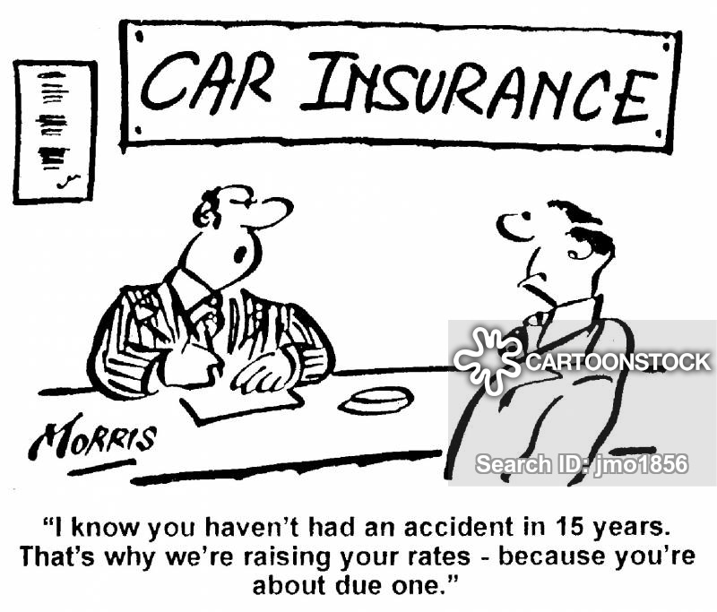
Historical Development of Insurance
After the first world war, a number of motor vehicles increased which also lead to an increment in the number of accident. The British Parliament enacted the Road Traffic Act 1930.

Slide 10
Development of Insurance Law in Zambia
History of insurance in Zambia dates back to the colonial rule when Zambia was known as Northern Rhodesia.
Most of the private insurance companies were largely controlled from Salisbury in Southern Rhodesia – after independence the Zambian Government sought to acquire control over insurance business in the country.
Parliament passed the Insurance Companies (Cessation and Transfer of Business) Act in 1970 and saw the formation of the state owned monopoly, the Zambia State Insurance Corporation.

Slide 11
Characteristics of Insurance
Legal entitlement – there must be a binding a contract, and the insurer must be legally bound to compensate the other party. See; Prudential Insurance Co v IRC (1904) 2KB 658
Medical Defence Union v Department of Trade [1979] 2 All ER 421
Uncertainty – is a necessary feature of insurance, to amount to an insurance contract the agreement must relate to a risk which may or may not happen or an event which is certain to happen but at a time that cannot be predicted. It must be noted that in terms of a Life Insurance it is possible to take up such a policy even though death is certain because time of death is unknown. See Gould v Curtis [1913] 3 L.B 84

Slide 12
Characteristics of Insurance
Insurable interest – an insurable interest is an essential requirement of all contracts of insurance; party to the insurance contract who is the insured or policyholder must have a particular relationship with the subject matter of the insurance, whether that is life or property or a liability to which he might be exposed. See; Castellain v Preston (1883) 2 QB 380
Benefit - the consideration supplied by the insurer is the promise to provide a benefit in exchange for the premium.
The essential features of benefits are:-
1. Insured must have a legal right to the benefit
2. Benefit must have value

Slide 13
Characteristics of Insurance
Premium- amount paid to an insurer for accepting a risk. The insured pays a premium to the insurer as consideration for the insurer’s promise to provide a benefit in the event of the insured suffering a loss i.e. A (insured) pays a premium to B (insurer) under a fire policy and in the event of a fire causing damage to A’s property, B would meet the arising damage. The Premium is set by the insurer and may either be a single payment or paid by agreed instalments.
Section 26 of the Insurance Act provides that a contract of general insurance ceases to operate if a premium is not paid within 30 days after the due date of the premium or within such period as the contract may stipulate.

Slide 14
Characteristics of Insurance
See; Mornach Steel Ltd V Jessons Insurance Agency Ltd SCZ JUDGMENT NO 6 OF 2013(UNREPORTED) (However take note that the Court made reference to 60 days which has since been amended to 30 days)
See; Sections 23-48
It is a requirement that the premium is in the currency of Zambia or in any foreign currency acceptable to banks and financial services licensed under the Banking and Financial Services Act. S27

Slide 15
Contracts of Guarantee
Insurance is a contract of indemnity whereby Insurer agrees to indemnify, or pay, the insured for certain types of loss while in a contract of guarantee, one party agrees to act on behalf of another should that second party default. In plain terms, this means that if an individual fails to pay her guaranteed debt or to perform some other duty or obligation, the guarantor -- the party who has agreed to act on behalf of another - - will step in to pay or perform the obligation.

Slide 16
Contracts of Guarantee
Seaton V Heath [1899] 1 QB 782 gives the following distinction between a contract of guarantee and a contract of insurance:
“The insured generally puts the risk before the insurer as a business transaction, and the insurer on the risk stated fixes a proper price to remunerate him for the risk to be undertaken and the insurer engages to pay the loss incurred by the insured in the event of certain specified contingencies occurring. On the other hand...[where contracts of guarantee are concerned] the creditor does not himself go to the surety, or represent, or explain the surety, the risk to be run. The surety often takes the position from motives of friendship, and generally not as a result of any direct bargaining between him and the creditor, or in consideration of any remuneration passing to him from the creditor.”

Slide 17
Contracts of Indemnity
The principle of indemnity is central to insurance. This means that following a loss the insured should be restored to the same financial position as s/he had immediately prior to the occurrence of the event i.e. the insured is entitled to no more than the previous financial position and should not profit from the claim. See;
Leppard V Excess Insurance Co Ltd [1979] 1 WLR 512
Mr Leppard owned a country cottage surrounded by fields. Mr Leppard decided to sell the cottage but a local farmer who owned all the land surrounding the property opposed the sale. Consequently the market value of the house fell from £ 8694 to £3000. There was afire and the cottage was completely destroyed. The insurers paid £3000. The Judge stated as follows:

Slide 18
Contracts of Indemnity
Held; “This is an indemnity policy. It entitles Mr Leppard to the amount of his loss and no more. Accordingly, it seems to me that the amount to which he is entitled in respect of this fire is £3000 which is the agreed value of the cottage as it was immediately before the fire. That is all he is entitled to recover”
Indemnity means security, protection and compensation given against damage, loss or injury. According to the principle of indemnity, an insurance contract is signed only for getting protection against unpredicted financial losses arising due to future uncertainties. Insurance contract is not made for making profit else its sole purpose is to give compensation in case of any damage or loss.

Slide 19
Contracts of Indemnity
For example, a person insured a car for K2.5m against damage on an accident case. Due to accident he suffered a loss of K1.5m, then the insurance company will compensate him K1.5m only not the policy amount i.e., K2.5m as the purpose behind it is to compensate not to make profit.
However, in case of life insurance, the principle of indemnity does not apply because the value of human life cannot be measured in terms of money.

