Slide 2
Question1

Slide 3
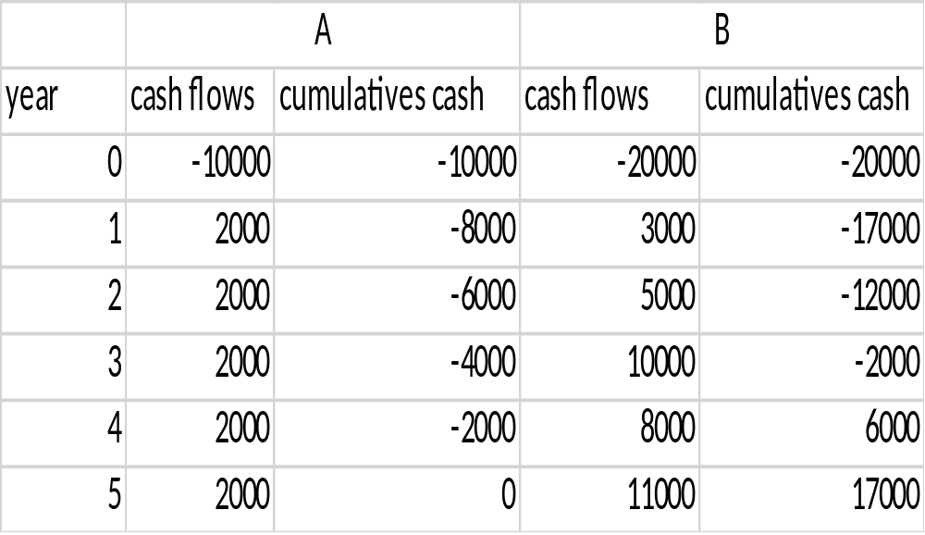
solution

Slide 4
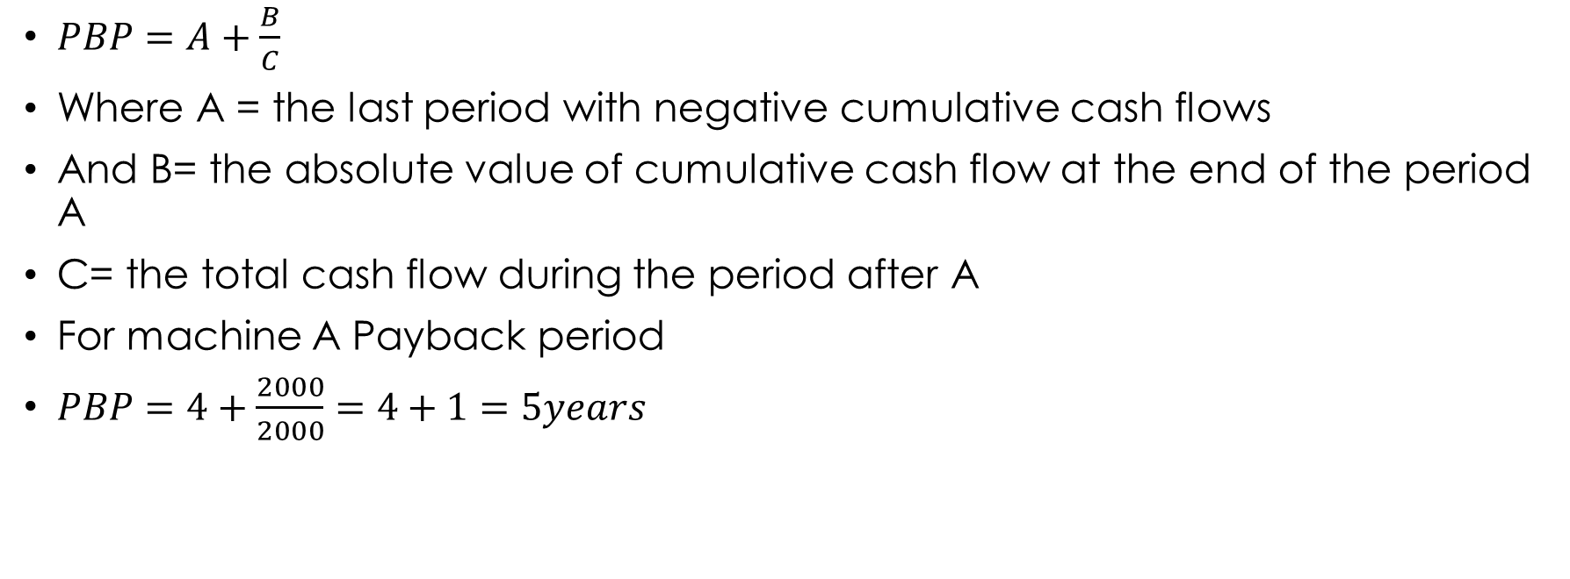
$PBP=A+\frac{B}{C}$
Where A = the last period with negative cumulative cash flows
And B= the absolute value of cumulative cash flow at the end of the period A
C= the total cash flow during the period after A
For machine A Payback period
$PBP=4+\frac{2000}{2000}=4+1=5years$

Slide 5
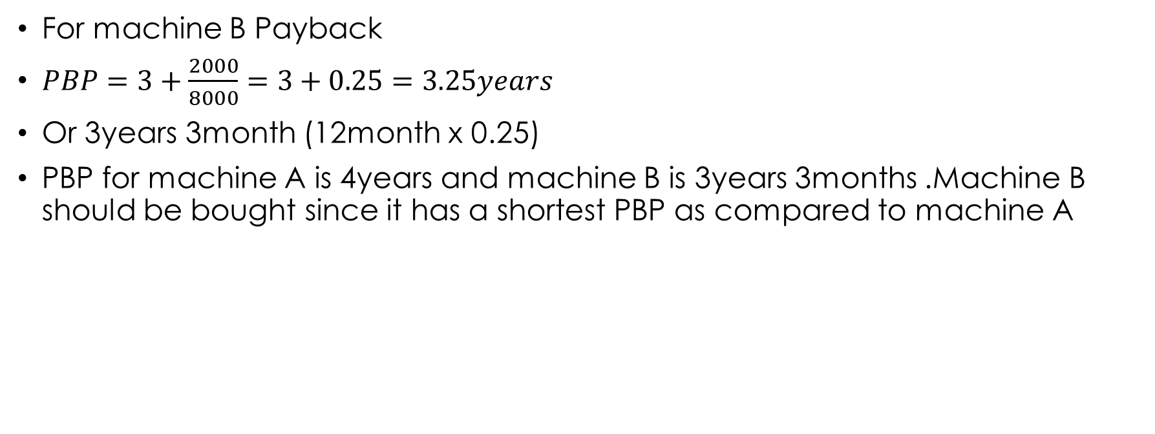
For machine B Payback
$PBP=3+\frac{2000}{8000}=3+0.25=3.25years$
Or 3years 3month (12month x 0.25)
PBP for machine A is 4years and machine B is 3years 3months .Machine B should be bought since it has a shortest PBP as compared to machine A

Slide 6
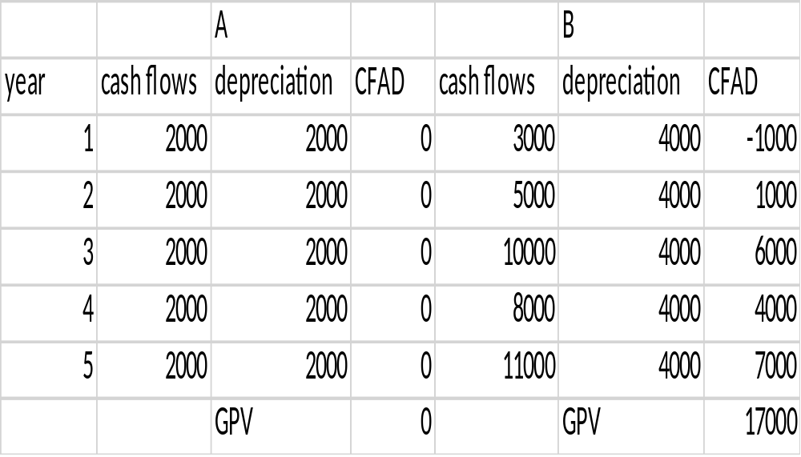
Accounting rate of return (ARR)

Slide 7
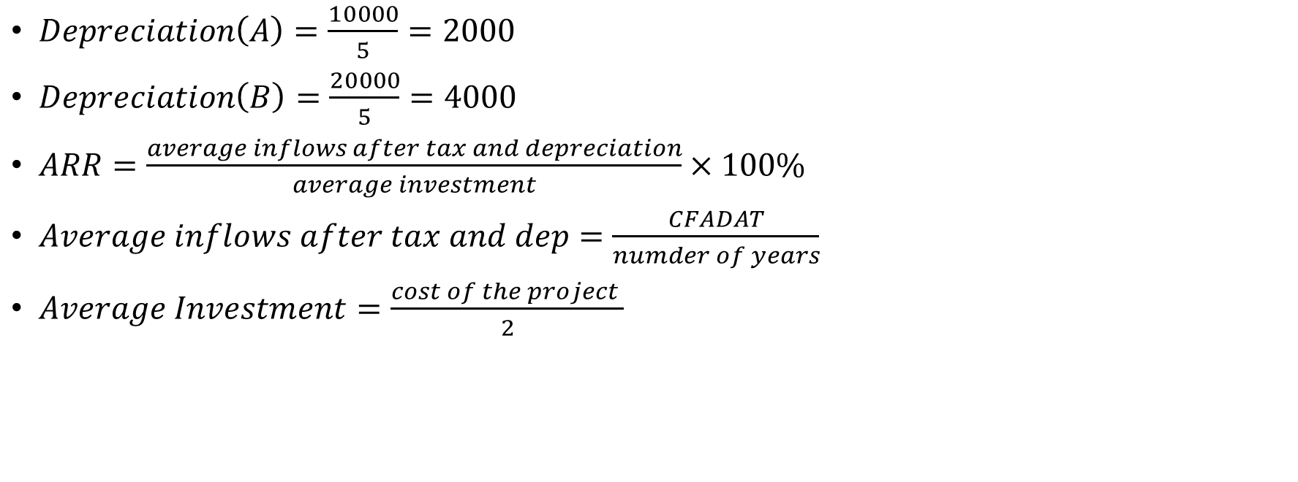
$Depreciation\left(A\right)=\frac{10000}{5}=2000$
$Depreciation\left(B\right)=\frac{20000}{5}=4000$
$ARR=\frac{average inflows after tax and depreciation}{average investment}×100\%$
$Average inflows after tax and dep=\frac{CFADAT}{numder of years}$
$Average Investment=\frac{cost of the project }{2}$

Slide 8
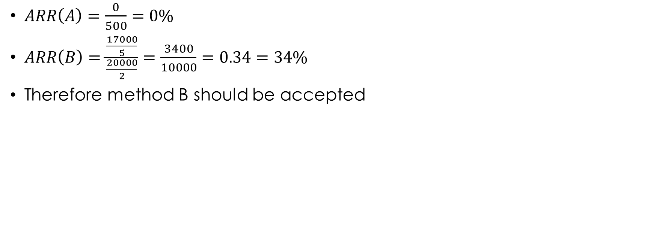
$ARR\left(A\right)=\frac{0}{500}=0\%$
$ARR\left(B\right)=\frac{\frac{17000}{5}}{\frac{20000}{2}}=\frac{3400}{10000}=0.34=34\%$
Therefore method B should be accepted

Slide 9
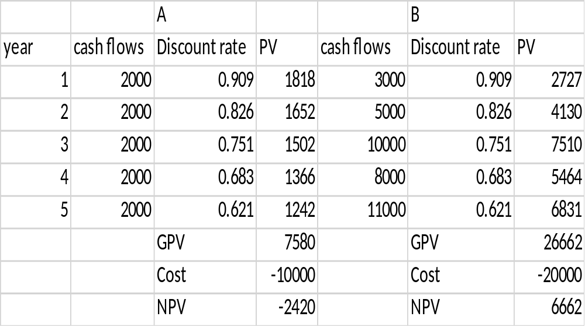
Net present value (NPV)

Slide 10
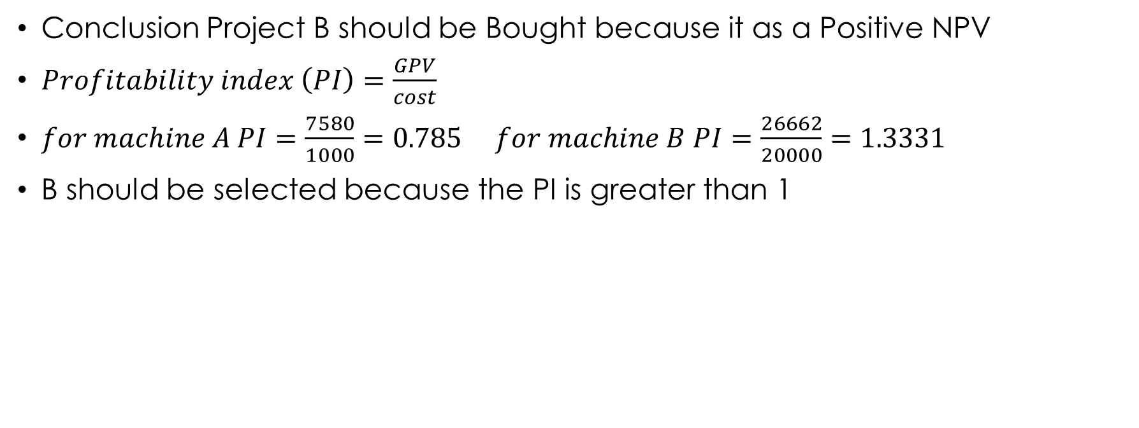
Conclusion Project B should be Bought because it as a Positive NPV
$Profitability index \left(PI\right)=\frac{GPV}{cost}$
$for machine A PI=\frac{7580}{1000}=0.785 for machine B PI=\frac{26662}{20000}=1.3331$
B should be selected because the PI is greater than 1

Slide 11

Internal rate of return

Slide 12
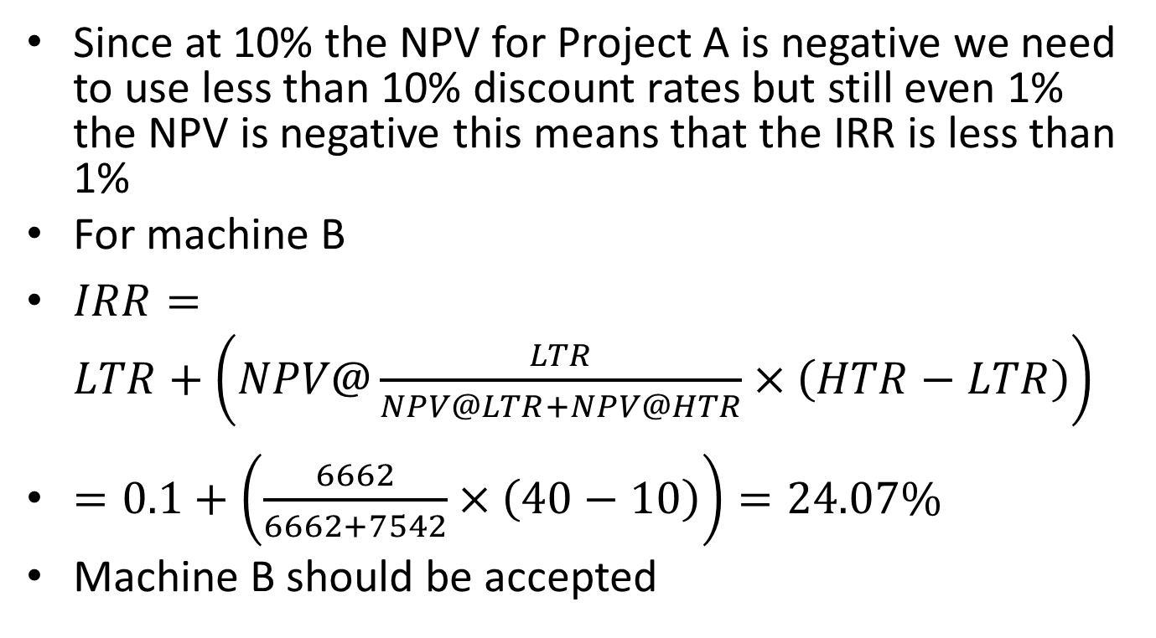
Since at 10% the NPV for Project A is negative we need to use less than 10% discount rates but still even 1% the NPV is negative this means that the IRR is less than 1%
For machine B
$IRR=LTR+\left(NPV@\frac{LTR}{NPV@LTR+NPV@HTR}×\left(HTR−LTR\right)\right)$
$=0.1+\left(\frac{6662}{6662+7542}×\left(40−10\right)\right)=24.07\%$
Machine B should be accepted

